Slide 1
HUMAN INDUCED DISASTER:
INDUSTRIAL ACCIDENT HAZARD
BY
DR RANJITA ROY SARKAR
ASSISTANT PROFESSOR
DEPARTMENT OF GEOGRAPHY
KGTM, BAGDOGRA

Slide 2
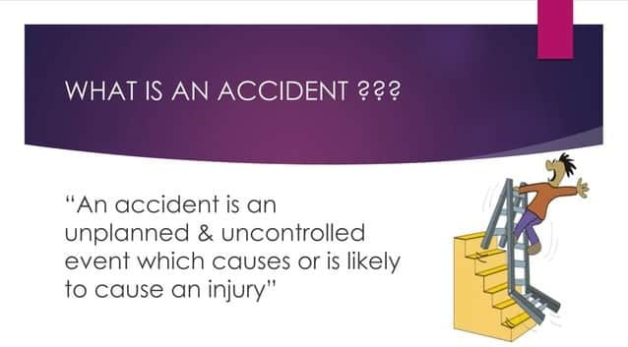

Slide 3
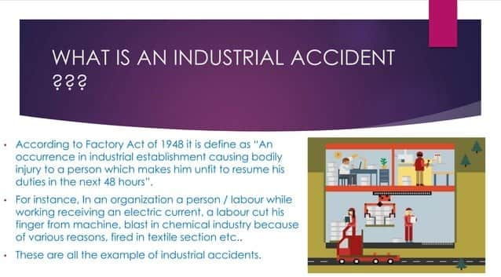

Slide 4
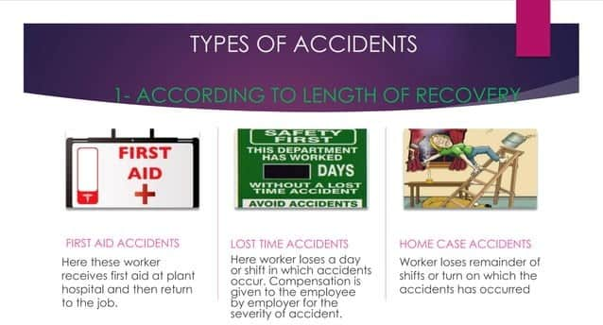

Slide 5
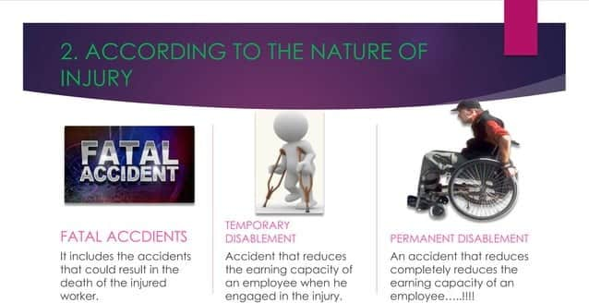

Slide 6
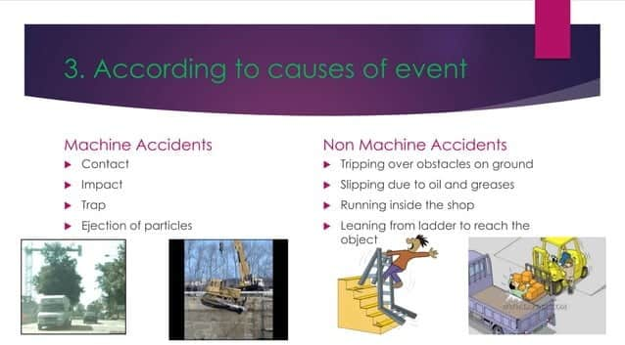

Slide 7
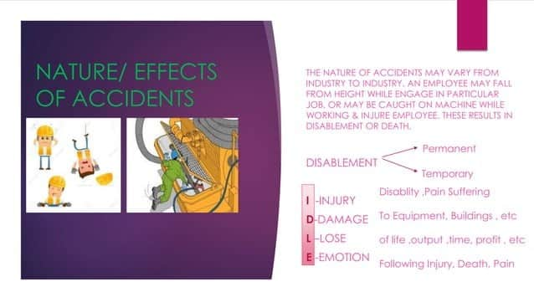

Slide 8
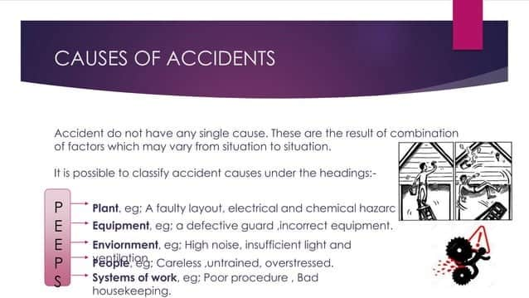

Slide 9
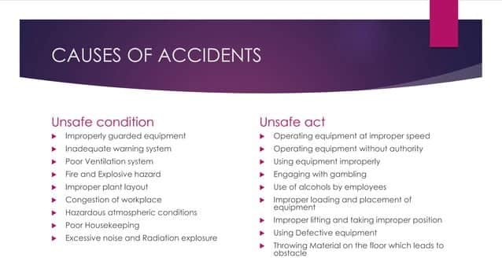

Slide 10
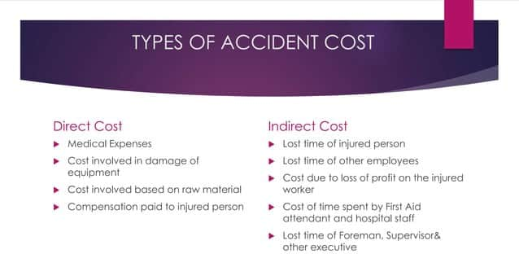

Slide 11
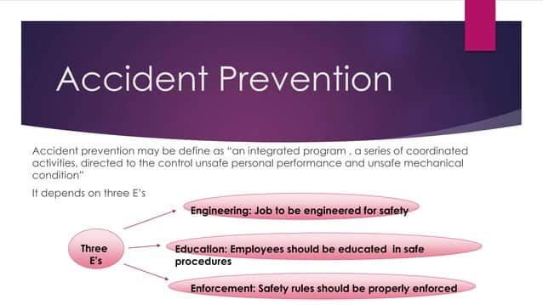

Slide 12


Slide 13


Slide 14


Slide 15


Slide 16
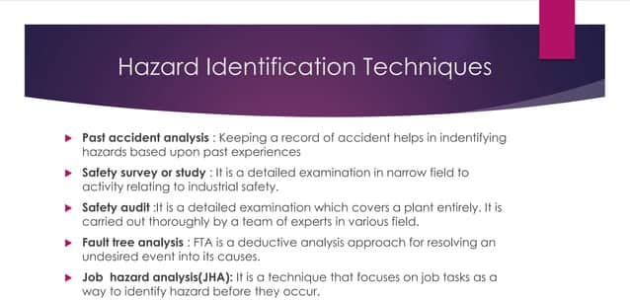

Slide 17


Slide 18


Slide 19


Slide 20


