Slide 1
Importance of Biodiversity in Ecosystem Services

Slide 2
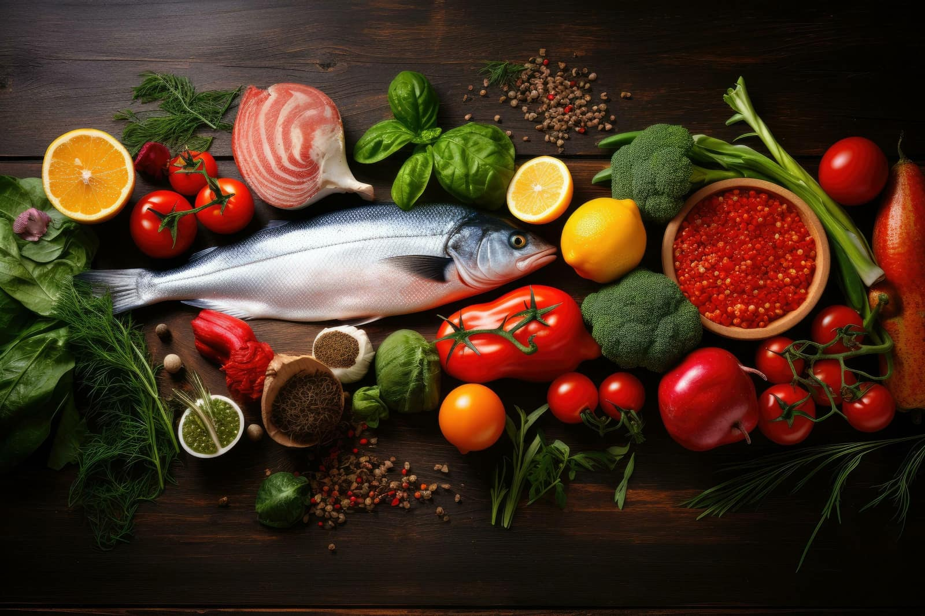
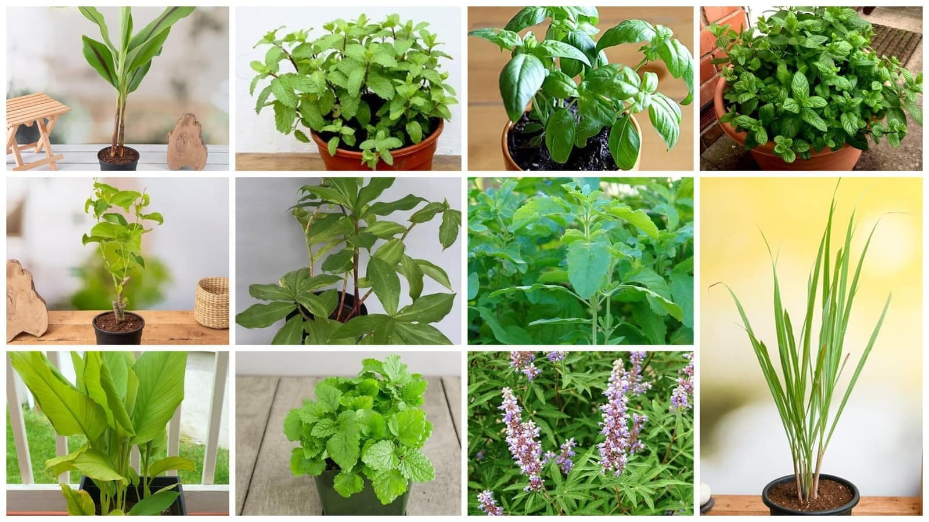
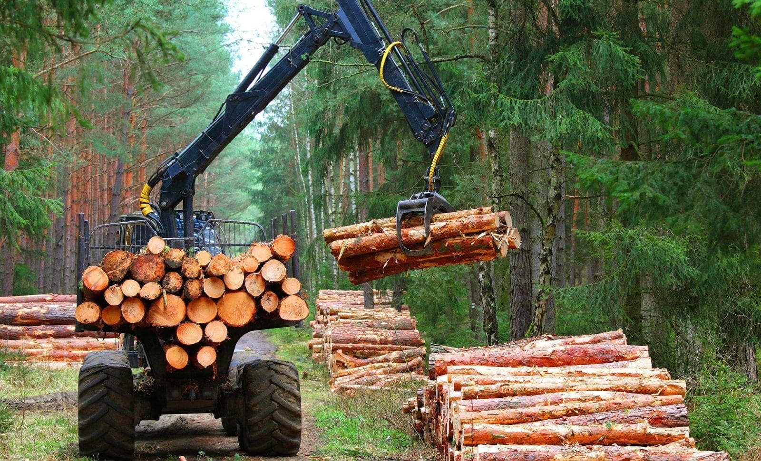
Provisioning Services
Food (crops, fish, fruits)
Medicines (from plants like neem, turmeric)
Raw materials (timber, fiber)

Slide 3

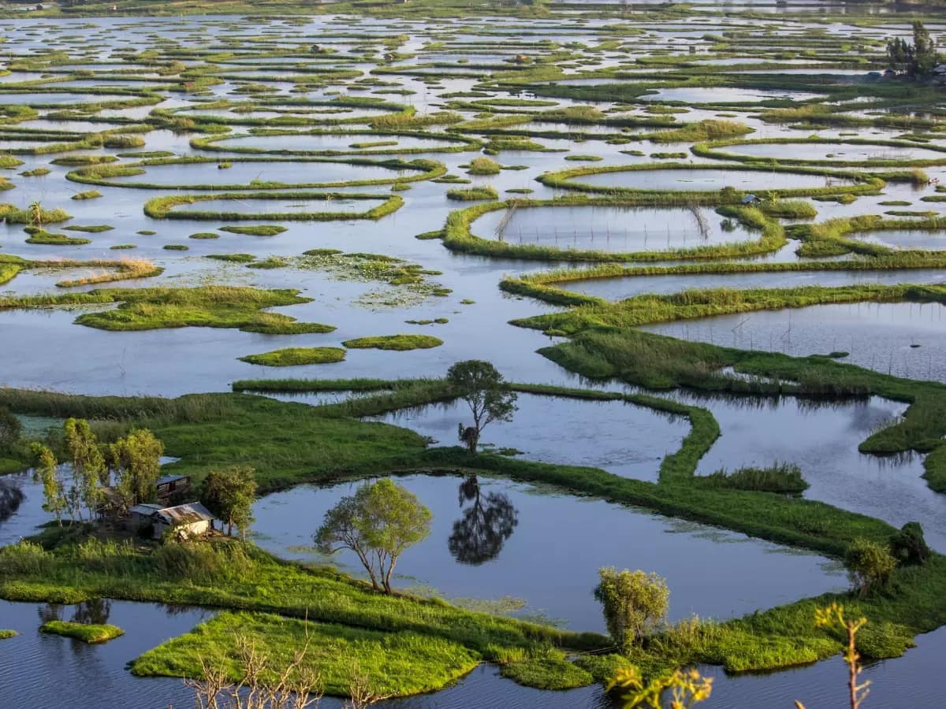
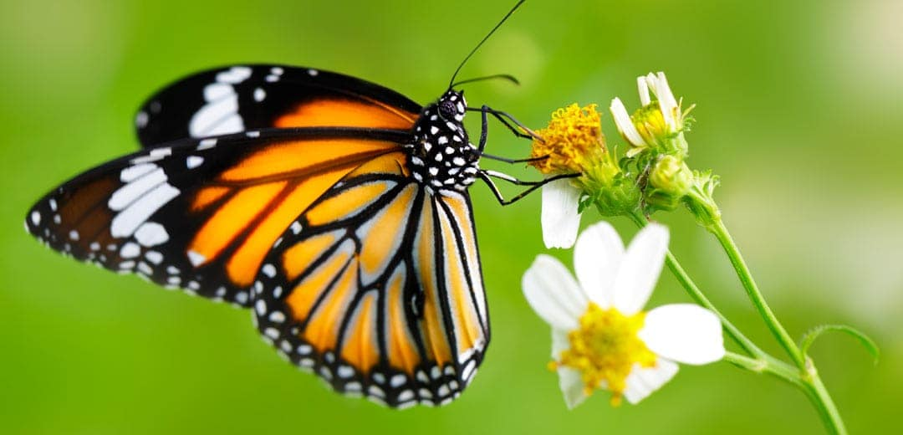
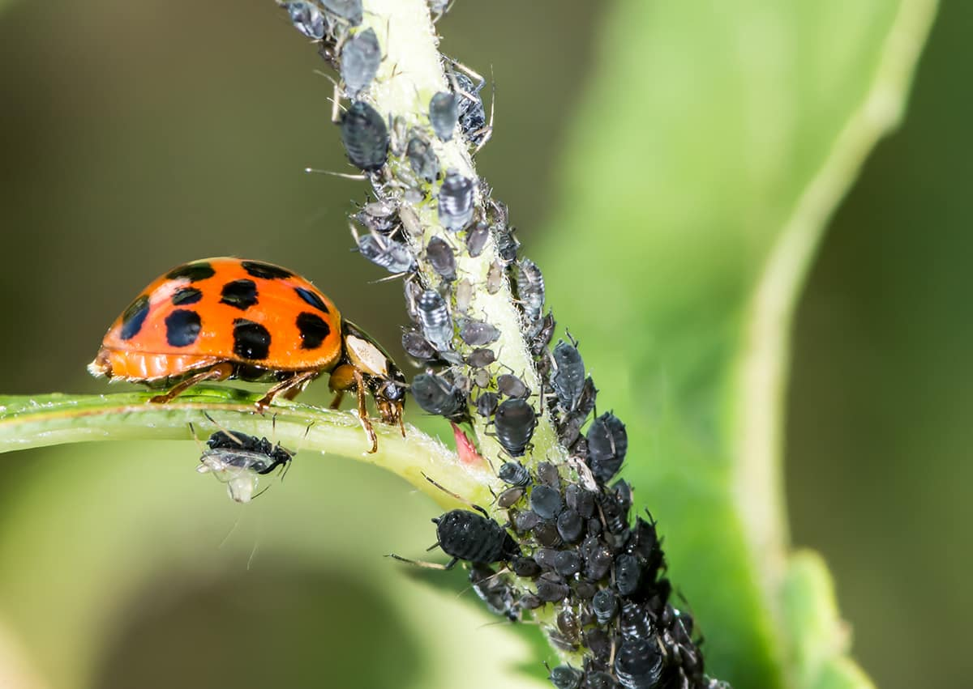
Regulating Services
Climate regulation (carbon absorption by forests)
Water purification (wetlands)
Pollination (bees, butterflies)
Pest control (natural predators)

Slide 4
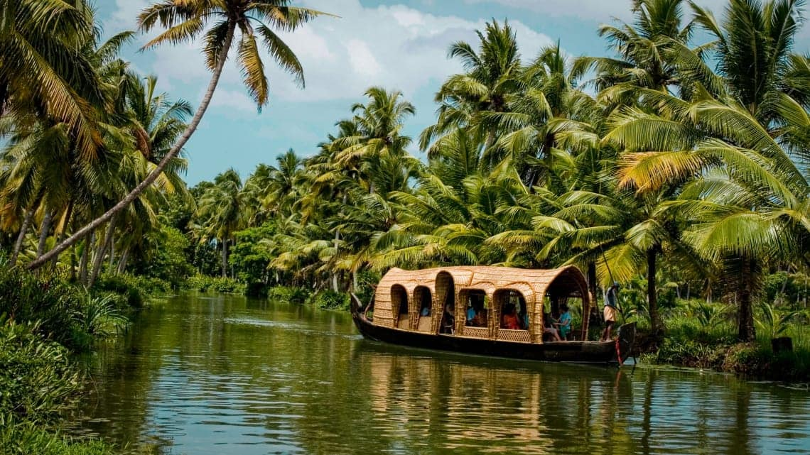
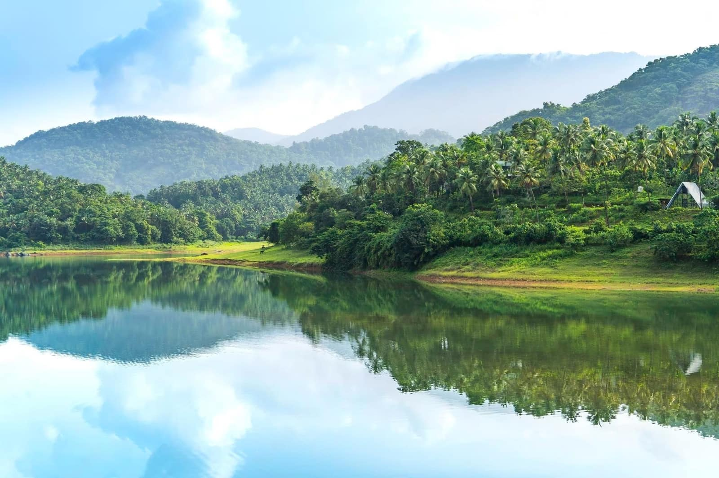
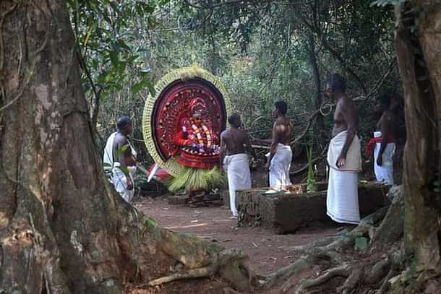
Cultural Services
Tourism and recreation (ecotourism)
Spiritual value (sacred groves, species)
Aesthetic appreciation (landscapes, art)

Slide 5
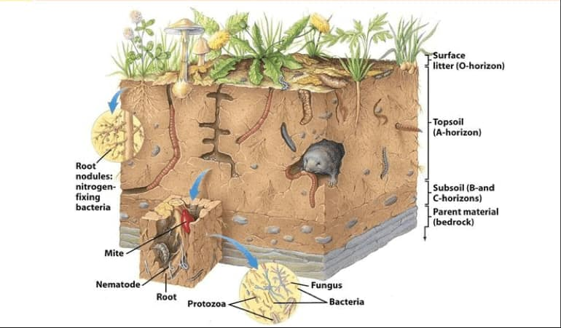
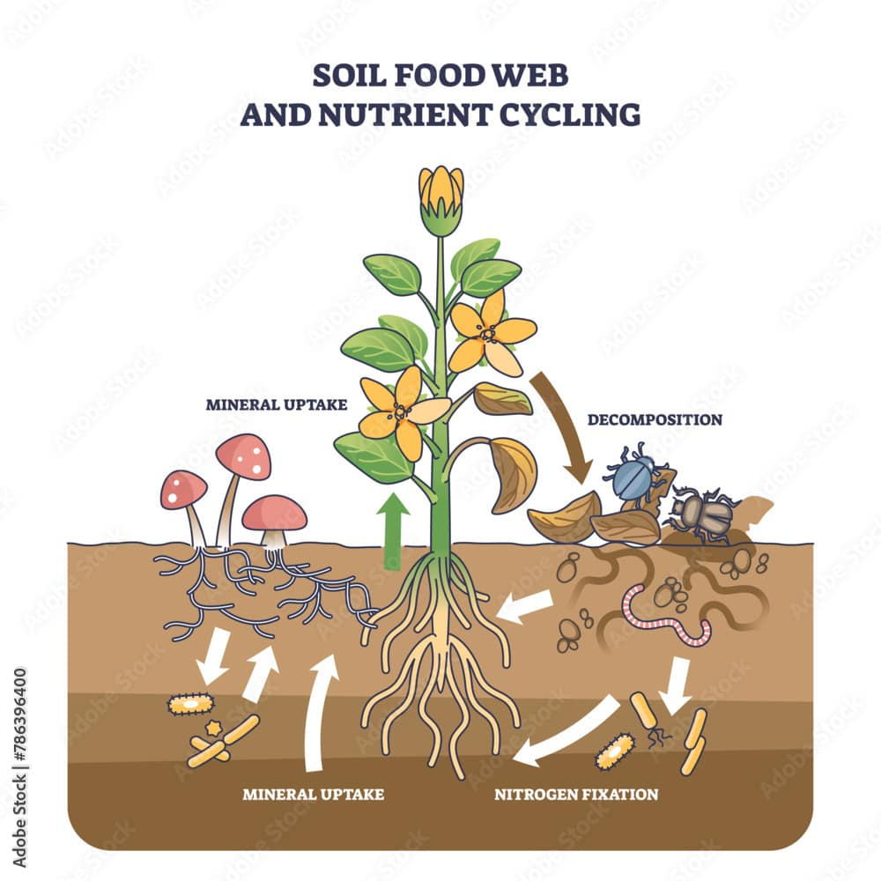
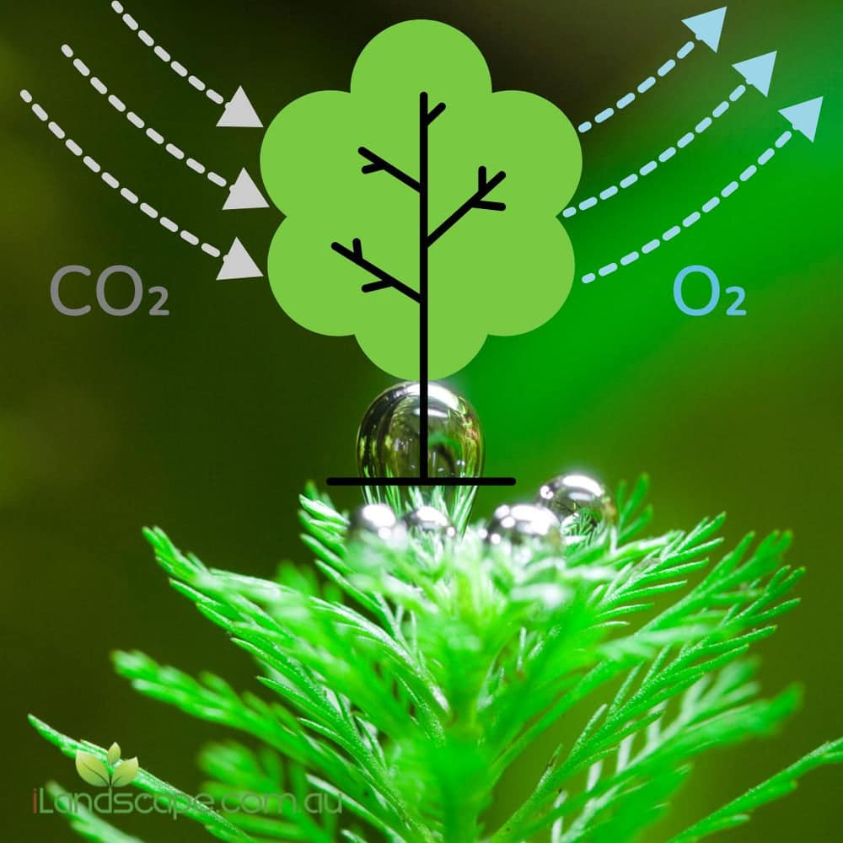
Supporting Services
Soil formation (decomposers)
Nutrient cycling (bacteria, fungi)
Photosynthesis (plants producing oxygen)

