Slide 1
Threats to biodiversity

Slide 2
Threats to biodiversity
Habitat loss and degradation
Habitat fragmentation
Poaching of wildlife
Introduction of exotic or alien species
Over-exploitation of bio-resources
Pollution and disturbances

Slide 3
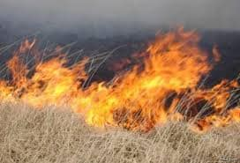
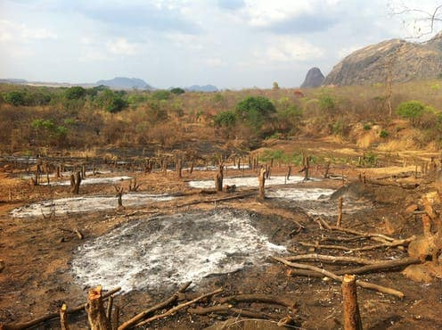
Habitat loss and degradation
Destruction of habitat is the primary cause for the loss of biodiversity. When people cut down trees, fill a wetland, plough grassland or burn a forest, the natural habitat of a species gets changed or destroyed resulting in killing many plants, animals and micro-organisms.
The main causes of habitat loss are agricultural activities, harvesting or extraction, mining, logging, deforestation, rapid rate of urbanization, industrial development. The ever increasing human settlements have been causing destruction of natural ecosystems to meet their requirements of food shelter and other needs.

Slide 4
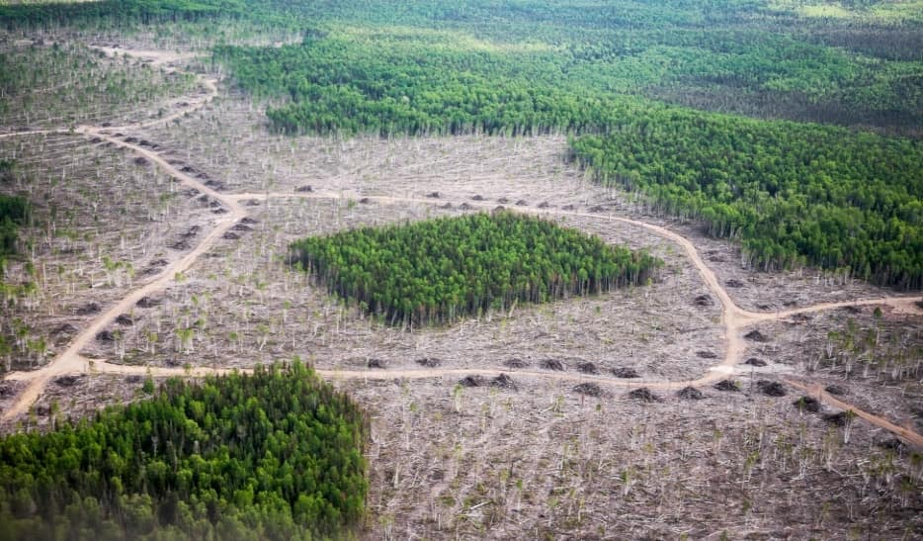
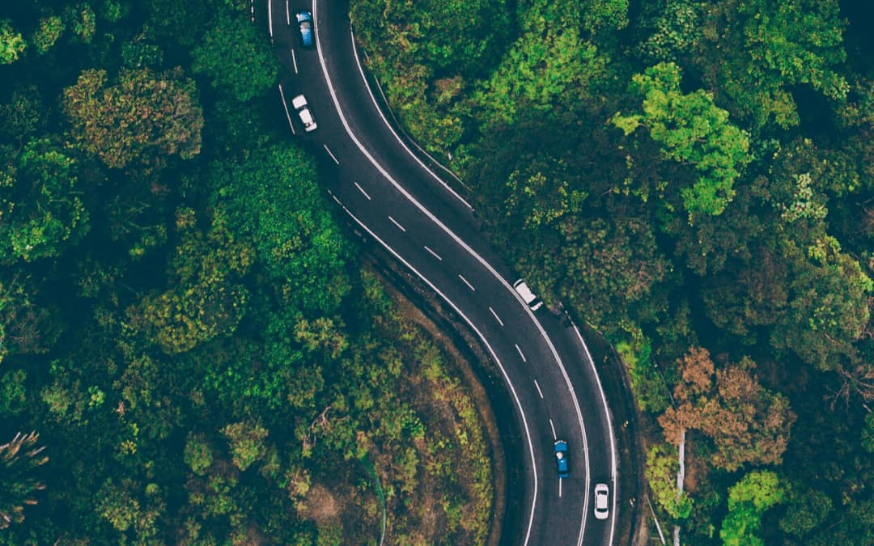
Habitat fragmentation
Fragmented habitats are such as a forest patch surrounded by croplands, orchards, plantations or urban areas i.e. large continuous habitat is divided into small and scattered patches. Sometimes, the habitats, that formerly occupied wide areas, are often divided into pieces by roads, fields, towns, canals, industries, power line etc. The fragments thus formed are often isolated from one another. As a result, the population of a species gets separated into isolated groups. These isolated, small and scattered populations are increasingly vulnerable to inbreeding depressions, high infant mortality and susceptibility to environmental stresses and finally lead to extinction.

Slide 5
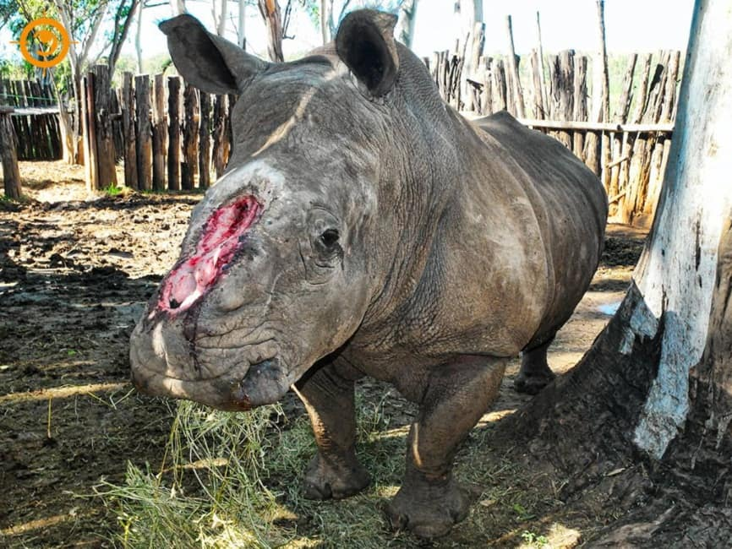
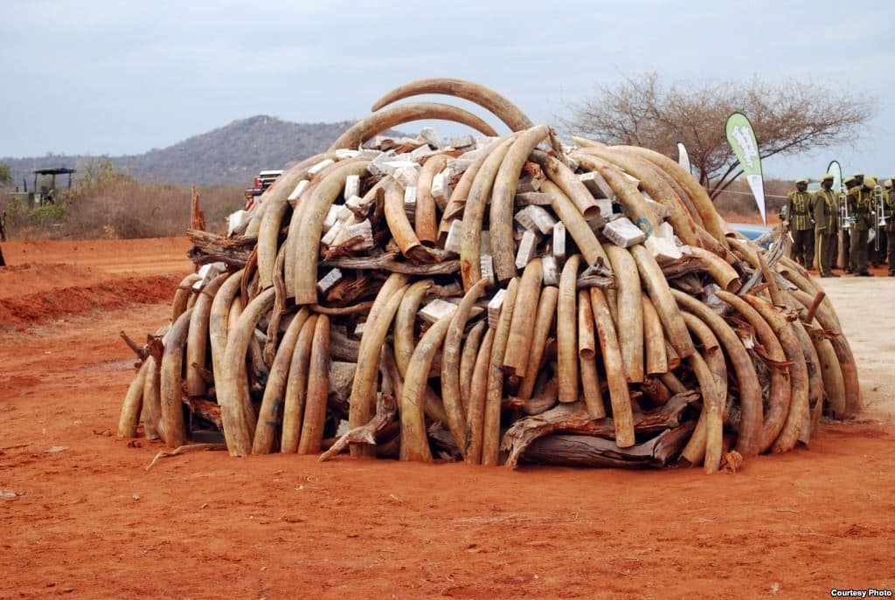
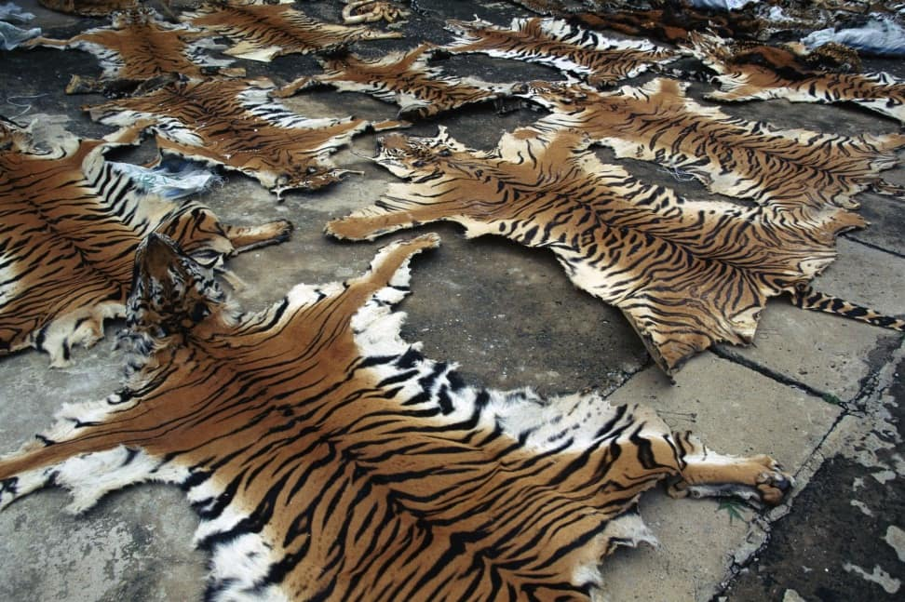
Poaching of wildlife (Commercial hunting)
Poaching refers to illegal trade of endangered and rare species of animals and plants and their products. In India, rhino is hunted for its horn, tigers for its bones and skin, musk deer for musk, elephant for ivory, gharial and crocodile for their skin, whale for combs, and spiny tailed lizard for ‘sanda’ oil.

Slide 6
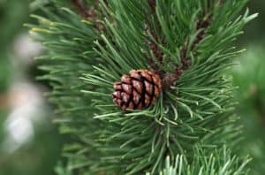
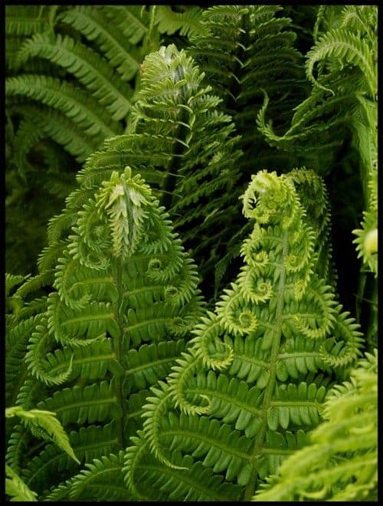
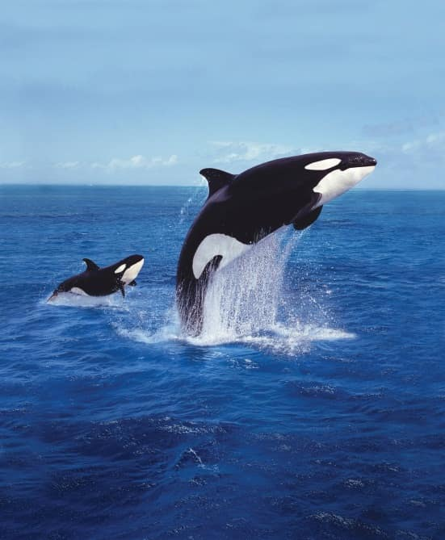
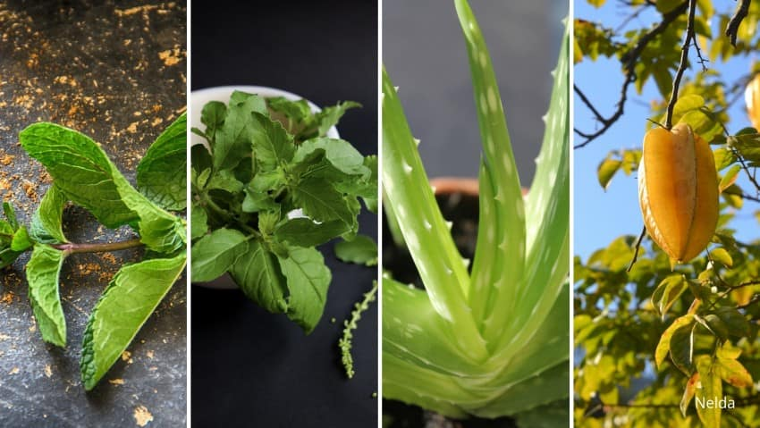
Over-exploitation of bio-resources
A particular species, if over-exploited, reduces the size of its population to an extent that it becomes vulnerable to extinct. Many fern species and gymnosperms and animal species such as frogs, earthworms, cockroaches etc. needed for laboratory teaching work are overused for study purposes. Overuse of such bio-wealth coupled with commercial over-exploitation caused their destruction.

Slide 7
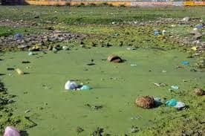
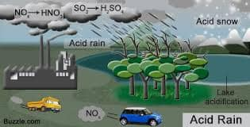
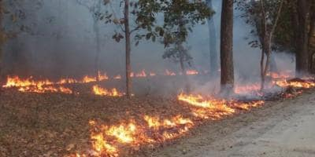
Pollution and disturbances
Pollution may alter natural habitats and cause reduction and elimination of population of sensitive species. Excessive use of pesticides in crop fields is causing decline in the population of birds and falcons. Toxic wastes entering the water in fresh water bodies bring about changes in the food chain.
Water pollution, due to excessive organic loading of water bodies, results eutrophication which drastically reduces biodiversity. Acid rain, global warming and ozone layer depletion affect adversely plant and animal species.
EUTROPHICATION
FORST FIRE

Slide 8

Thankyou

