Slide 1
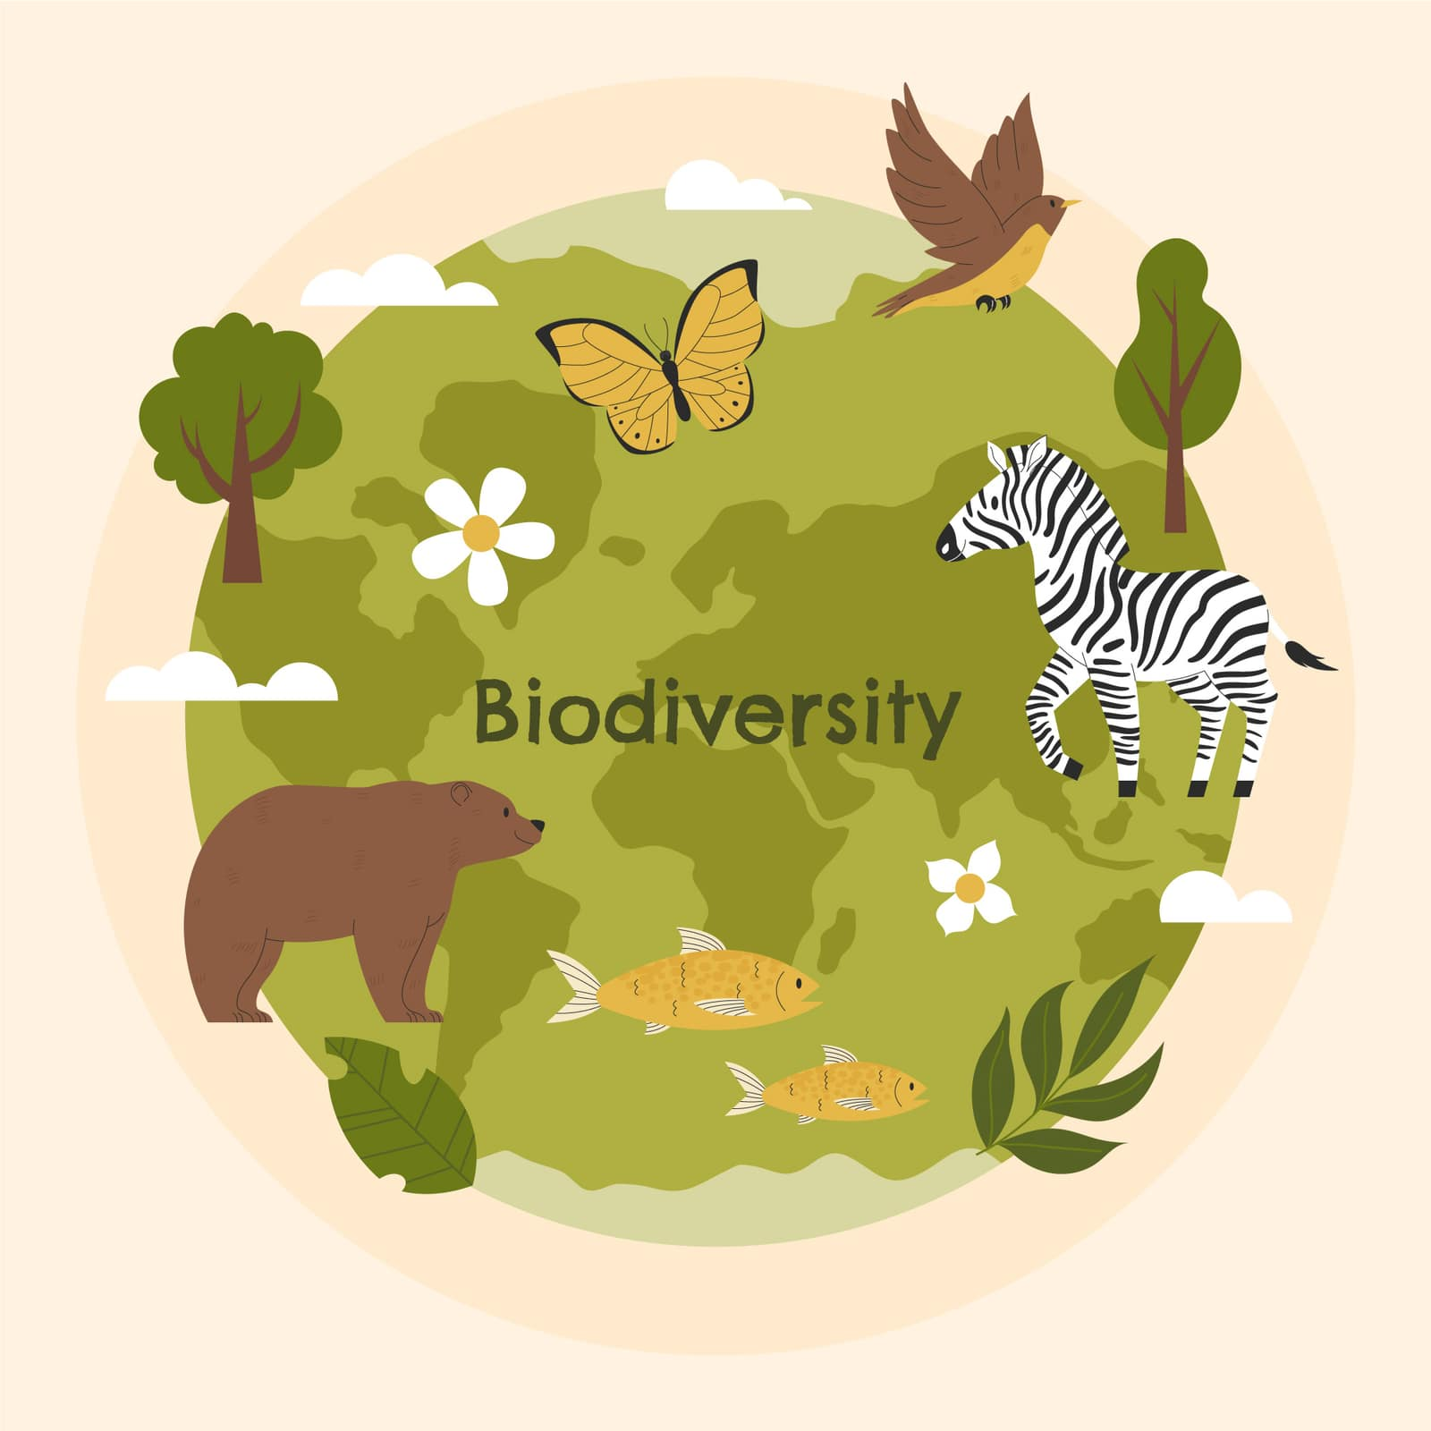
Importance of Biodiversity

Slide 2
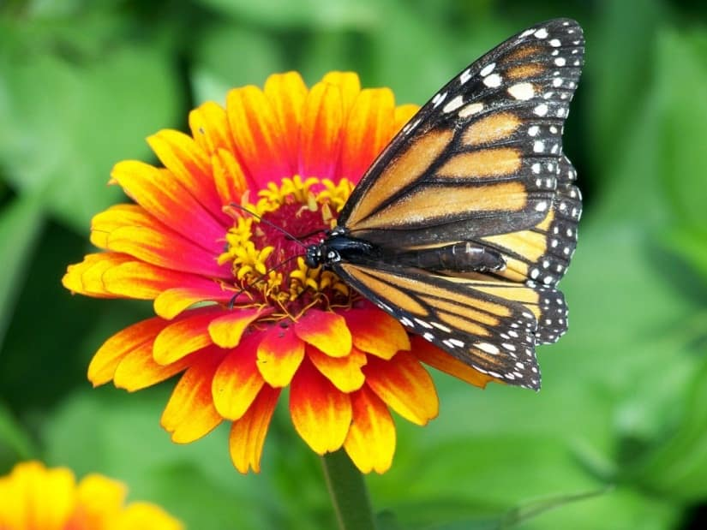

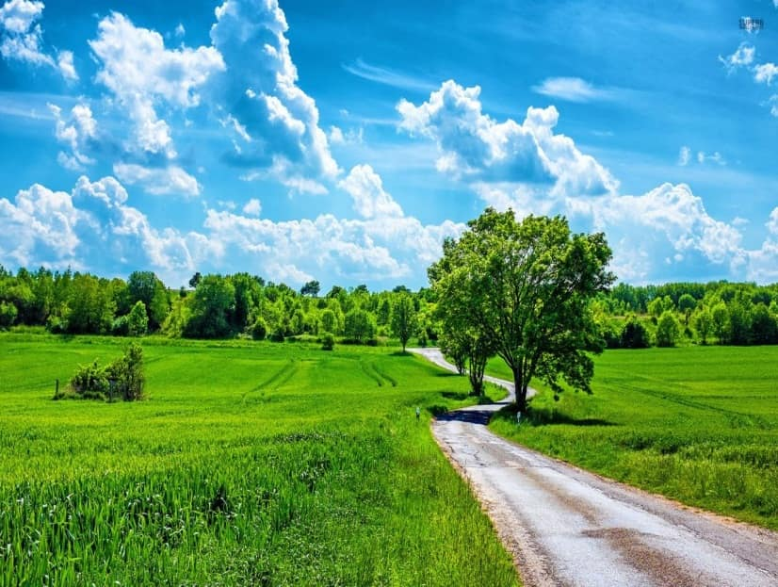
Ecosystem and Biodiversity Service
Ecosystem service value: ecosystem service value of biodiversity refers to the service provided by the ecosystem such as prevention of soil erosion, soil formation, cycling of nutrients, fixation, waste disposal, role as carbon sink, and pollination of plants by insects and birds, climate regulation, prevention from flood and drought etc.

Slide 3
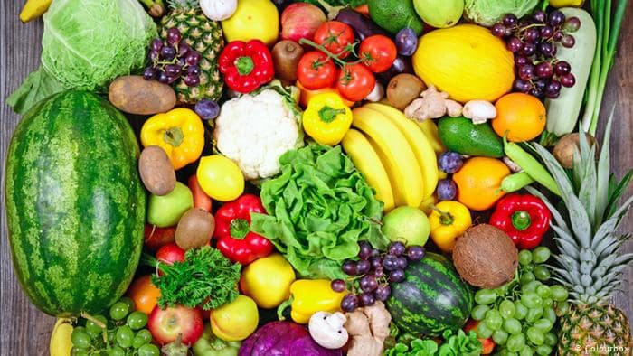
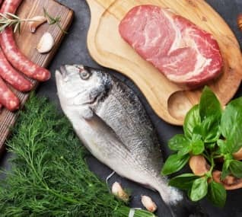
Ecosystem and Biodiversity Service
Food value: Human consumes a number of wild and semi-wild species of plant as food. Many species of marine algae and mushroom also form the source of the food. Wheat, rice and corn, the three major carbohydrate crops. Livestock and wild fauna also contribute greatly to feeding humans. Staple crops, meat and fish form bulk of our diet while vegetables and fruits add variety to our diet and are indispensable source of vitamins and minerals.

Slide 4
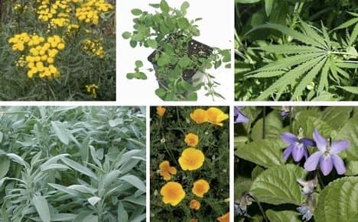
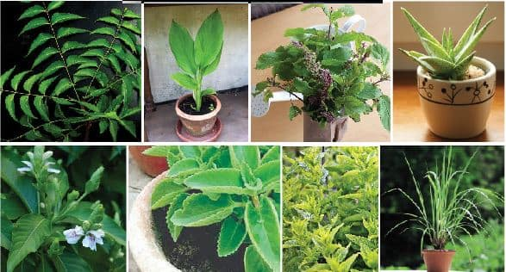
Ecosystem and Biodiversity Service
Medicinal value: Many of the chemicals are derived from plants that had been used in the traditional medicines. Currently 25% of all prescription drugs are derived from mere 120 species of plants. Some of the plant species native to India, such as Neem and Tulsi etc. has potential medicinal applications. In India, 3,000 plant species are still used as medicinal plants by more than 75% rural population.

Slide 5
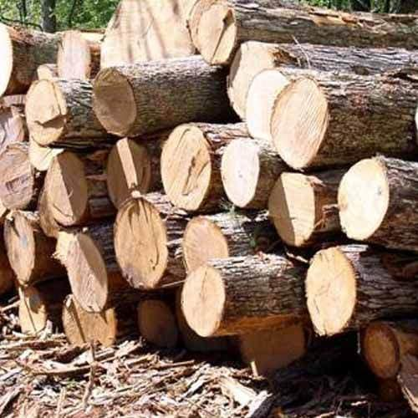
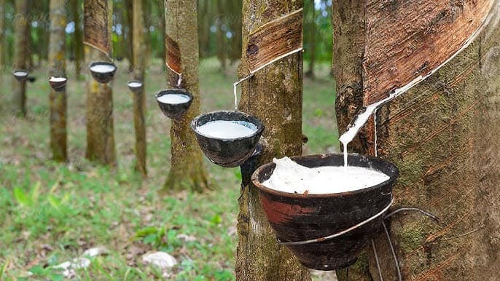
Ecosystem and Biodiversity Service
Timber value: wood harvested from wild species, timber is a source of income generation. Many industries such as pulp and paper industry, saw milling, plywood, construction poles, railway sleepers thrive on wood resources.
Many non-wood products of economic value produced by wild species include medicinal herbs, gum and resin, honey beeswax, fibers, essential oils etc. form important sources of income.

Slide 6
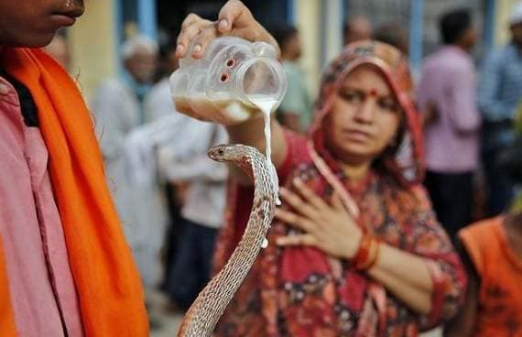
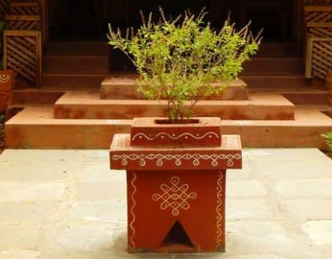
Ecosystem and Biodiversity Service
Social, Cultural and Religious Service Value: Social service value of biodiversity is associated with social life, customs, religious, and psycho-spiritual aspects of the people in different societies. Human history reveals that people have through cultural religious beliefs. In, India leaves, flowers and fruits or other parts of plants of Tulsi, Pipal, Bargad, Neem, Mango, Khejri, Bel are used variously and their trees are planted which are considered sacred and worshiped by the people. Many animals such as birds, cow, snake, bull, peacock, owl etc. have been considered sacred and find a significant place in our psycho-spiritual arena.

Slide 7

Thankyou

