Slide 1
Biodiversity conservation

Slide 2
Biodiversity conservation
In-situ conservation
Ex-situ conservation
National Parks
Botanical Gardens
Wildlife Sanctuary
Zoological Parks
Biosphere Reserve
Aquaria
Project Tiger
NBPGR
Sacred forest
NBAGR

Slide 3
In situ v/s Ex situ conservation
In situ conservation
Ex situ conservation
Advantage
It is a cheap and convenient method.
In natural environment, organisms not only live and multiply but also evolve and continue to maintain their ability to resist environmental stress.
Disadvantages
It requires larger areas and minimizes the space for inhabiting human population which is increasing tremendously.
Advantage
The organisms is assured of food, shelter and security and hence can have longer lifespan and breeding activity.
Captive breeding and use of genetic practices provide possible reintroduction of animals to the wild at later stage.
Disadvantages
It can be adopted only for new selected species because of limited space, facilities and finances in the centers.
Since it is done under a set of favorable environmental conditions, it deprives organisms the opportunity to adapt to the ever-changing natural environment.

Slide 4
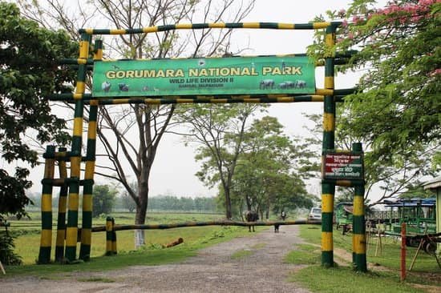
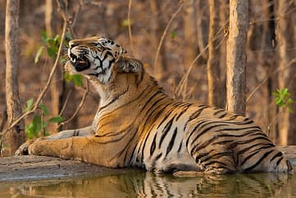
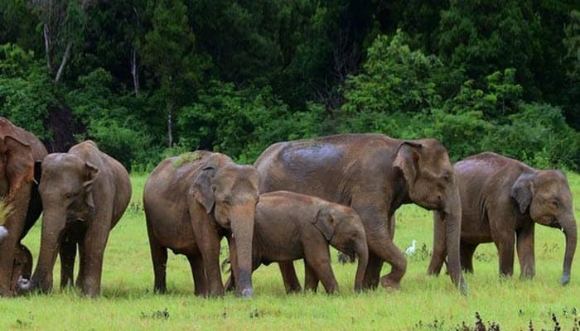
In-situ conservation
National Parks
These are strictly reserved for the betterment of the wildlife and declared as places where activities such as forestry, grazing, hunting, cultivation etc. are not permitted either.
No private ownership is allowed. Usually they are hitched to the habitat for specific wild animal with their boundaries circumscribed by legislation.
No biotic interference is allowed except for the buffer zone where limited human activity for enjoyment through eco-tourism is allowed.
For example Gorumara National Park. Common fauna found are tiger, leopard, elephant, clouded leopard, Sāmbhar etc.

Slide 5
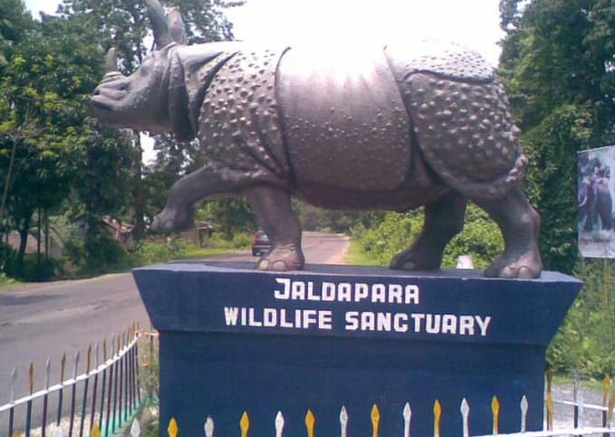
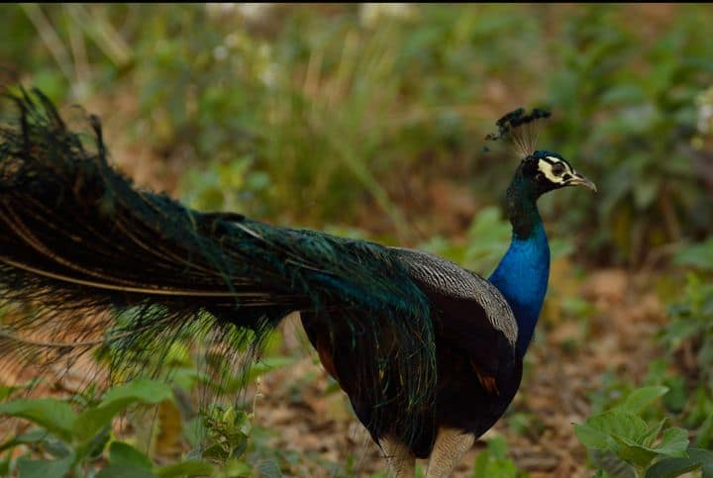
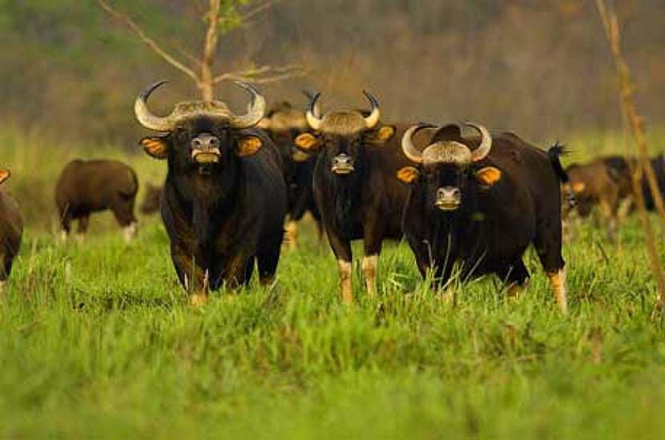
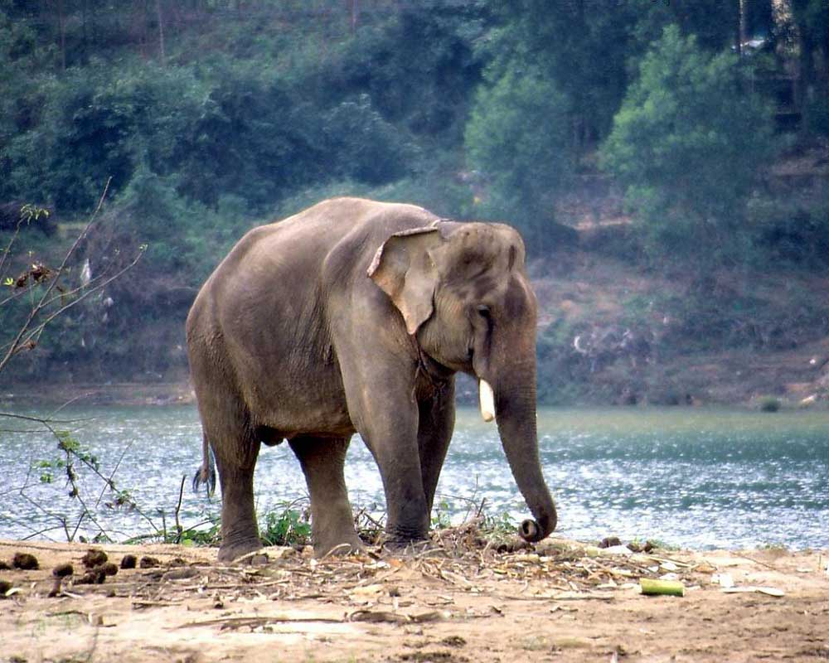
In-situ conservation
Wildlife sanctuaries
Wildlife sanctuaries are also protected areas dedicated to protect wildlife, but they aimed at conversing animal species only.
Also the boundary of a sanctuary is not limited by state legislation.
Limited biotic interference is allowed in them.
Private ownership rights and forestry operations are permissible to an extent that they do not affect the wildlife adversely.
Visitors are not allowed to carry weapons without permission, set fire, leave any fire burning or its remnant, feed animals and use the chemicals or explosives injurious to any wildlife
e.g. Jaldapara Sanctuary. Important fauna found are Rhino, Elephant, Bison, Deer, Sāmbhar, Tiger, Leopard, Different kinds of birds.

Slide 6
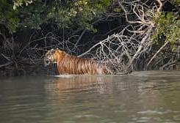
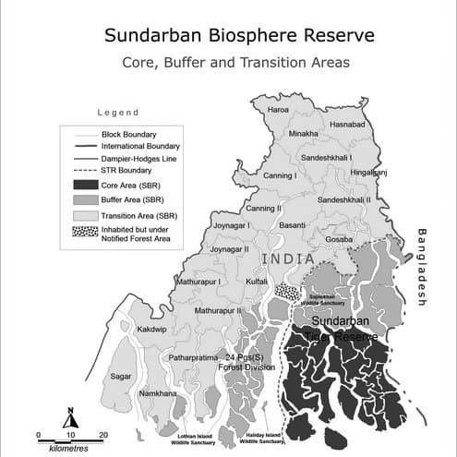

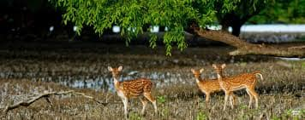
In-situ conservation
Biosphere reserves: are special categories of protected areas of land representing natural ecosystems with unique biological communities selected for long term in-situ conservation of species of plants and animals.
In Biosphere reserve, multiple land use is permitted.
A biosphere is not hitched to any one, two or three species but to the ecosystem as a whole i.e. totally of all life forms that live in it.
In a biosphere reserves wild population as well as traditional life styles of tribals and various domesticated plants and animals are also protected.
There are three distinct zones viz. core, buffer and transition in a biosphere reserve e.g. Sunderbans Biosphere Reserve.

Slide 7
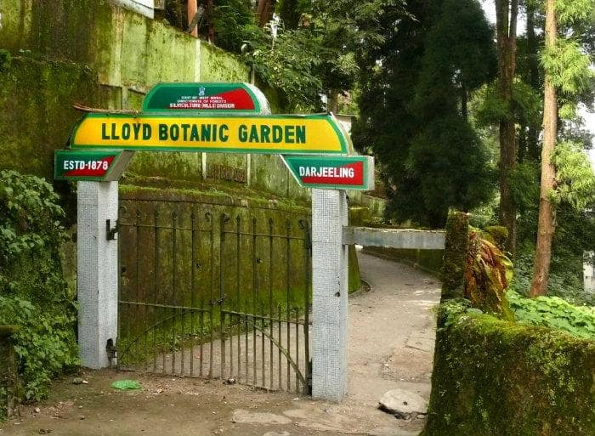
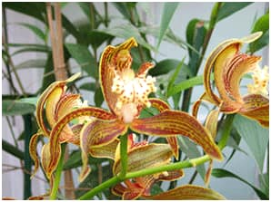
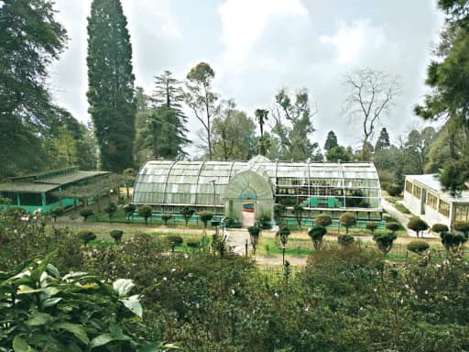
In-situ conservation
Botanical gardens plays a significant role in conservation of plant species beyond preservation in the wild and in supply for research and education, thereby taking pressure off of wild population of species. These botanical gardens are the living repository of thousands of trees and shrubs. These are aimed at conservation of rare and the multiplication of selected endangered plant species. Many of the botanical gardens now have seed banks, tissue culture facilities and other ex-situ technologies e.g. Lloyd Botanical Garden, Darjeeling

Slide 8
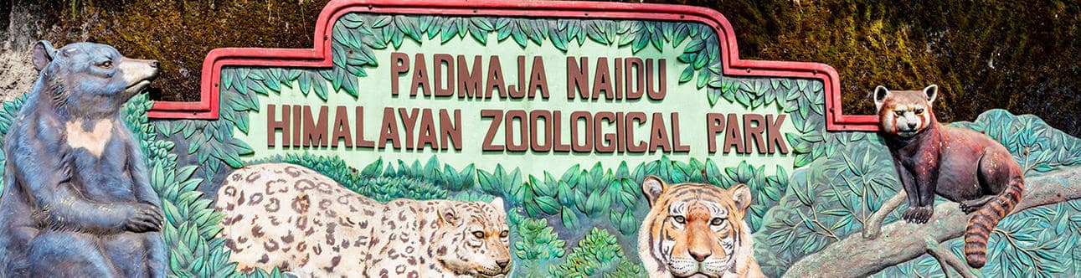
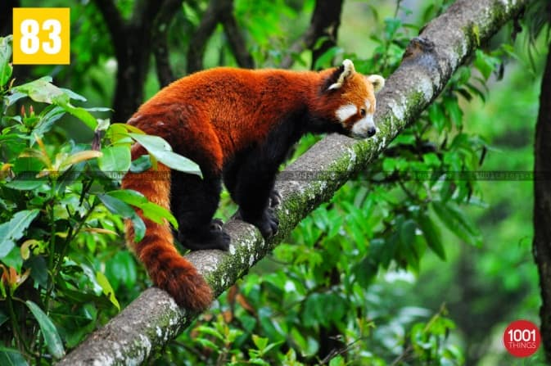
In-situ conservation
Zoos or Zoological parks: Contribute to the conservation of animal diversity by propagating and reintroducing endangered species, they also act as centers for research to improve management of captive and wild population. Many of them have well developed captive breeding programs for restoring those species of animals whose number of surviving species is so small that there is no realistic chance of in-situ survival. As the number of individual increases in the captive breeding, they are selectively released in the wild. Apart from conservation, zoos are also aimed to inspire among visitors sympathy for wild animals and understanding and awareness about the orphaned wild animals. E.g. Padmaja Naidu Himalayan Zoological Park, Darjeeling is a center for captive breeding of snow leopards and red pandas.

Slide 9

Thankyou

