Slide 1
Kalipada Ghosh Tarai Mahavidyalaya
Bagdogra
Department of Environmental Science

Slide 2
Unit 5: Environmental Pollution
Environmental pollution: types, causes, effects and controls
Air, water, soil and noise pollution
Nuclear hazards and human health risks
Solid waste management

Slide 3
Unit-5 Environmental Pollution
Pollution is an undesirable change in the physical, chemical and biological characteristics of air, water and soil which affects human life.
Types of Pollution
Air pollution
Water pollution
Soil pollution
Noise pollution
Thermal pollution
Radiation pollution

Slide 4
Air Pollution
Air pollution may be defined as that quantity of pollutants which is sufficient to cause injury to human beings and their living creatures .
Sources of Air Pollution
Natural sources
Anthropogenic sources
Combustion Sources
Other Sources

Slide 5
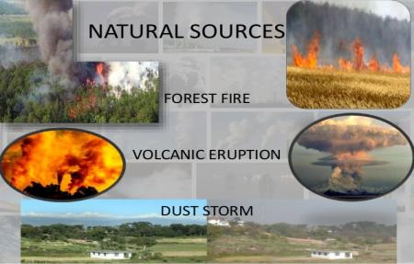
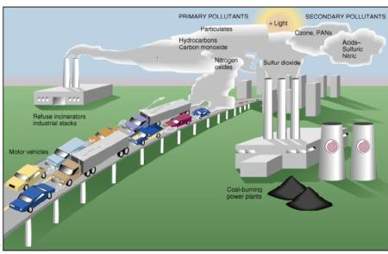
Sources of Air Pollution
Natural sources are those which are originated from natural processes like volcanic eruptions, windblown dust, sea-salt spray and emissions of volatile organic compounds from plants.
Anthropogenic sources are those which are originated from burning of fossil fuels in electricity generation, transport, industry and households; Industrial processes and solvent use, agriculture, waste treatment.
ANTHROPOGENIC SOURCES

Slide 6
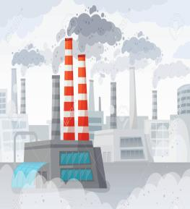
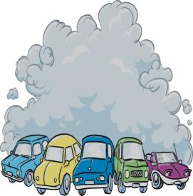
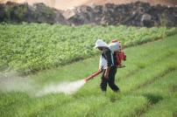

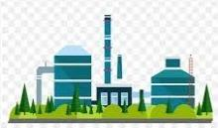
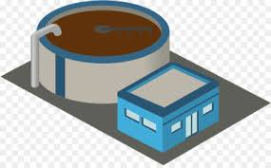
Anthropogenic Sources of air pollution
Stationary Combustion Sources e.g. Burning of coal and petroleum in industries and factories.
Mobile Combustion Sources e.g. automobiles, locomotives, aircrafts etc.
Industrial Processing and other Sources e.g. chemical industries, sewage treatment plant, agricultural activities etc.
Industrial Emission
Automobile emission
Agricultural practices
Chemical processes in factories
Sewage treatment plant

Slide 7
Air Pollutants
Based on their nature
Based on their formation
Gaseous Pollutants
Particulate Pollutants
Primary Pollutants
Secondary Pollutants

Slide 8
Types of Air Pollutants
Gaseous Pollutants such as oxides of sulphur(SO₂, SO₃), oxides of nitrogen( NO₃, NO₂), oxides of Carbon( CO_{2,} CO), H₂S, NH₃, O_{3,} fluorine, hydrocarbons, aldehydes, etc.
Particulate Pollutants such as Dust, Fly ash, smoke, soot, aerosol droplets, mist, fog, pollen grains etc.

Slide 9
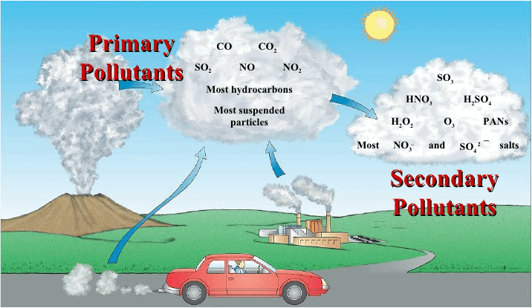
Air Pollution
Types of air pollutants
Based on their formation:
Primary Pollutants-these enter into the air directly e.g. SO₂, SO₃, NO₃, NO₂, CO_{2,} CO etc.
Secondary Pollutants-they are created in the air from the primary pollutants e.g. Peroxy acetyl nitrate(PAN), O₃ etc.

Slide 10
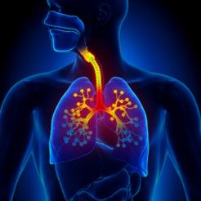
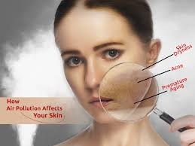

Effects of Air Pollution
The effects of air pollution on human health:
Pollutants like SO₂ and nitrogen oxide affects the respiratory system due to their inhalation.
SO₃, NO_{X}, and CO diffuses into the blood, combine with haemoglobin and impede oxygen transport.
Radioactive elements emitted in the atmosphere cause severe skin diseases and deformities.
Silicon particles, asbestos fiber and cotton fibers cause silicosis, fibrosis and byssinosis respectively.
Air borne spores, pollen grains, bacteria, fungi, fur, hair, etc. cause various allergic reactions.

Slide 11
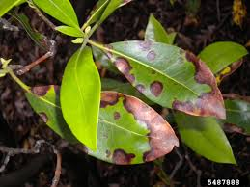
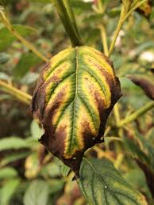
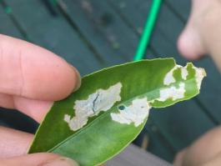
Effects of Air Pollution
Effect of air pollution on plants:
SO₂ pollution develops symptoms like bleached spots on leaves, chlorosis, early abscission, reduced yield etc.
Oxides of nitrogen produce brown spots on leaves and suppression of growth.
Fluoride reduces the crop yield and damage leaf tissues.
Chlorine induces bleaching, leaf tip and margin browning, dropping of leaves etc.
Photochemical smog bleaches and blazes leaves of important foliage crops.
Ozone causes trees to lose their leaves prematurely

Slide 12
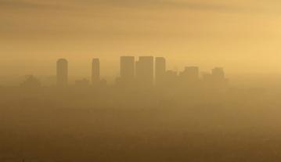
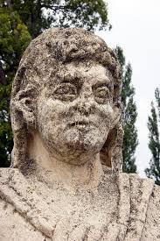
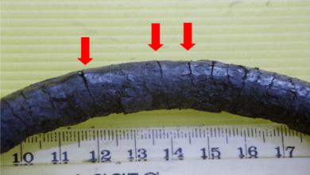
Effects of Air Pollution
Effects of air pollution on materials:
The acid rain and the products of photochemical smog cause disintegration of textiles, paper and marbles.
Air pollutants (acid rain) damage historical monuments.
Hydrogen sulfide (H₂S) decolorizes silver and lead paints.
O₃ oxidizes rubber goods and causes damaging effects on fabrics and dyes.
Photochemical Smog
Ozone Cracking

Slide 13
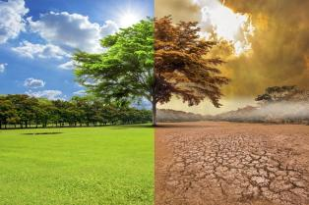
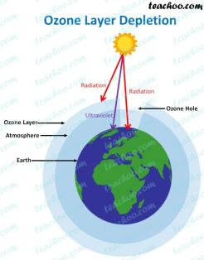
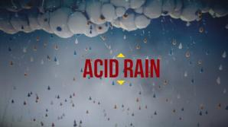
Effects of Air Pollution
Effects of air pollution on climate:
Air pollution causes changes in atmospheric conditions; the release of greenhouse gases from various sources are causing rise in global temperature.
An increase of global temperature may lead to melting of glaciers and polar ice caps, flooding of low lying coastal, increase in the flow of rivers and change in the rainfall pattern and possible submersion of some islands.
Freon gas and nitrogen oxide in the atmosphere deplete ozone layer.
Warmth of earth surface, depletion of ozone layer, rising of sea level and acids rains are major effects of air pollution at global level.
Global Warming

Slide 14
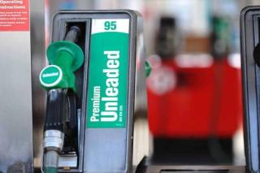
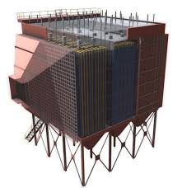
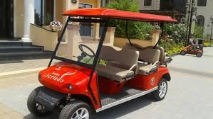
Control air pollution
Some important measures to reduce or minimize the air pollution:
Use of purified unleaded and good quality of petrol reduces the level of sulphur and lead oxides in automobile exhaust.
Modernization of industries: The industrial machines and vehicle engines should be made energy efficient to use fuels at maximum level to reduce the release of pollutants.
Installation of air treatment plants: Large number of treatment plants for air purification must be installed and run throughout the clock.
Use of alternative energy sources: The common alternative sources of energy are wind, water and sun. Automobile industry should manufacture battery operated and solar operated vehicles to reduce the use of fossil fuel run vehicles.
Treatment of emissions: The emissions from factories and industries should be treated by various techniques like settling chambers, cyclone separator, wet and gas scrubbers,etc. before being released into the atmosphere.

Slide 15

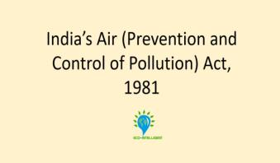
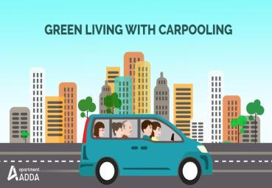
Control air pollution
Plantation of trees green plants absorb CO₂ for photosynthesis and reduce CO₂ pollution from the air. Forest trees trap large amount of gases and dust on their leaves and twigs.
Change in lifestyle may have considerable effect on the reduction of air pollution.
Use of energy more efficiently
Use of alternative source of energy such as solar and wind energy.
Industries to install away from cities
Plantation of trees as green belts
Ideal traffic planning removal of unnecessary speed breakers and check posts
Checking of undesirable burning of vegetation
carpooling
Enforcement of Air (Prevention and Control) Pollution Act, 1981, as recommended by CPCB (Central Pollution Control Board).
Environmental education: The most important and fundamental programme for dealing with environmental problems is to impart environmental education.

Slide 16

Thankyou

