Slide 1
Kalipada Ghosh Tarai Mahavidyalaya
Bagdogra
Department of Environmental Science

Slide 2
Solid Waste Management
All discarded and thrown away solid and semi-solid wastes arising human and animal activities are called solid waste.
Three general categories of solid wastes are –
Municipal wastes
Industrial wastes
Hazardous wastes
Municipal wastes arise from domestic activities, restaurants, institutions, public places etc. and typically rubbish, garbage, ashes, building materials, treatment wastes, dead animals etc. sources of such wastes are residential, commercial and open areas.
Industrial wastes arise from industrial activities and typically include ashes, rubbish, building material wastes, toxic wastes, metal containers, plastic containers, paints etc.
Hazardous wastes are substantially dangerous and hazardous to plants, animals and human beings. Substances which have characteristic ignitability or corrosivity or reactivity or toxicity are called hazardous. Radioactive substances, chemicals, biological wastes, flammable wastes and explosives are common hazardous wastes

Slide 3
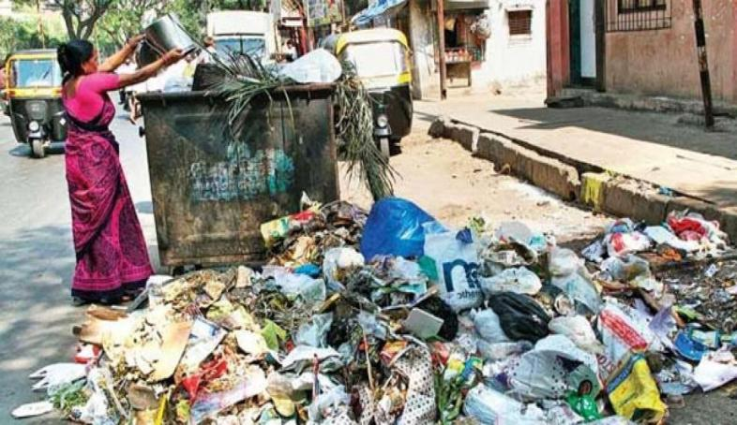

Slide 4
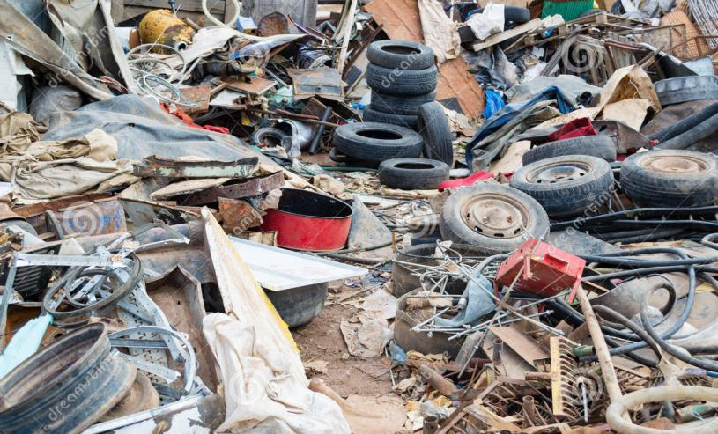

Slide 5
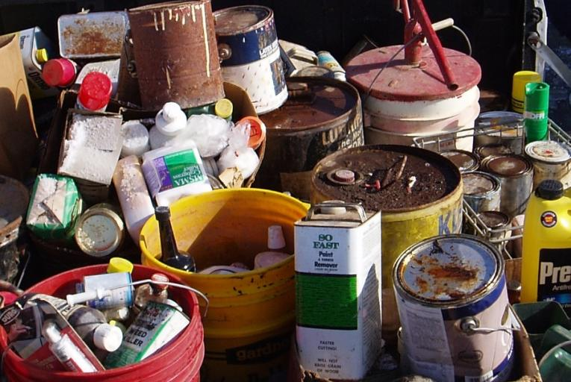

Slide 6
Causes of solid wastes generation
Over population: Population increase is causing a rapid growth of all kinds including solid wastes. Advanced countries have adopted a culture of use and throw which is further aggravating the problem.
Urbanization: Solid waste is primarily an urban problem where people the habit of using a variety of items and discarding them afterwards. These comprise almost all kinds of solid wastes.
Affluence: In an affluent society, the per capita consumption is very high and there is a general tendency to declare items as obsolete. Such discarded items increase solid wastes regularly. Removal of such wastes develops a serious problem.
Technology: There is a shift in technology from the returnable packaging to non-returnable packaging. Since packaging material like made from plastic are non-biodegradable they are largely responsible for causing for solid waste pollution.

Slide 7
Adverse effects of solid waste pollution
Improper handling and transportation of solid wastes further aggravate the adverse effects. Some of the effects are as follows are:
Health hazards
During handling and transfer of hospital and clinic wastes, disease transmission may take place. Several diseases are possible through their pilferage.
Vectors like rats and insects invade refuse dumps and can spread various diseases.
Diseases like bacillary dysentery, diarrhea and amoebic dysentery may result in humans from food and water contamination through flies.
Rats dwelling with infectious solid wastes may spread diseases like plague (Black Death), salmonellosis, trichinosis, endemic typhus etc.
Water supply, if gets contaminated with pathogens present in solid wastes, may result in cholera, jaundice, hepatitis, gastro-enteric disease etc.
Choking of drains and gully pits by the solid wastes results in water logging which facilitates breeding of mosquitoes and results in the spread of diseases like malaria and plague.

Slide 8
Adverse effects of solid waste pollution
Environmental impacts
Organic solid wastes emit obnoxious odor on their decomposition and make the environment polluted.
Burning of waste products like plastic rubber pollutes the atmosphere with noxious fumes.
Scavengers and stray animals invade the roadside garbage and litter the waste over large area causing much aesthetic damage to the atmosphere damage to the atmosphere.
Leachates from such refuge dumps percolate into the soil and contaminate underground water.

Slide 9
Solid waste management
Solid waste management has three basic functional elements. They are:
Collection
Disposal
Reutilization or recycling
Collection of solid waste is to be made from various places such as residential, commercial, institutional, and industrial areas. There are three basic methods,
a)Community storage points
b)Kerbside collection
c)Block collection
In advanced countries and in some of Indian metropolitan cities, biodegradable and non-biodegradable refuses are collected and are disposed separately.

Slide 10
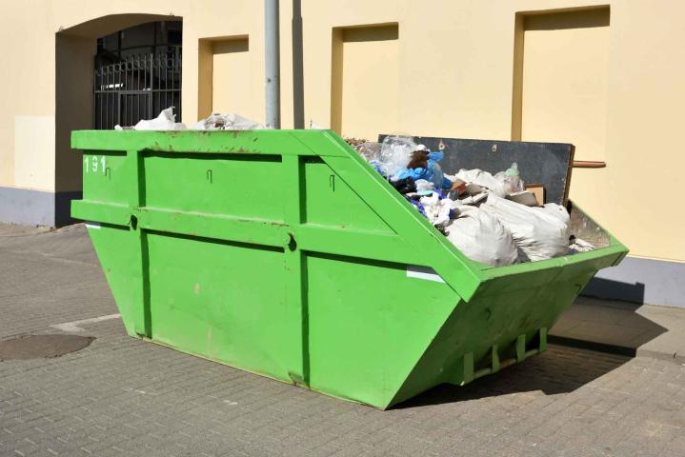

Slide 11
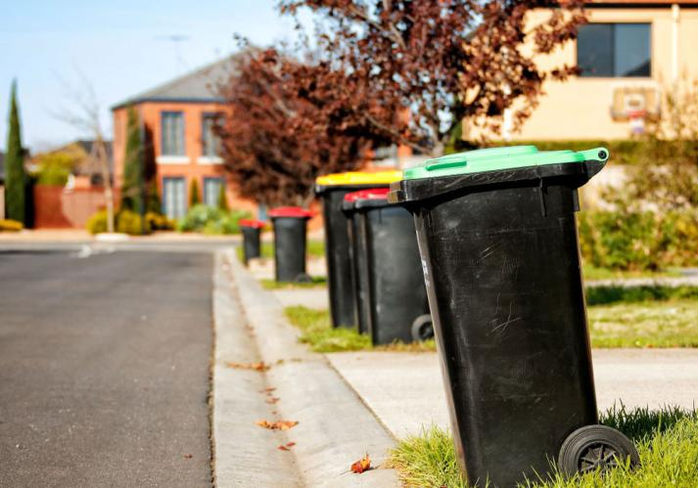

Slide 12
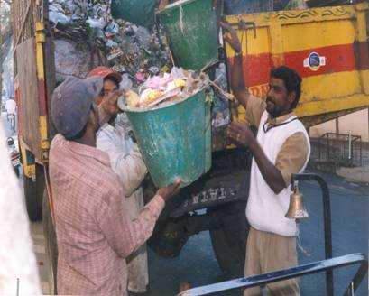

Slide 13
Solid waste management
Disposal: common methods adopted in solid waste disposal –
Manual component separation: Reusable articles such as cardboards, paper, newspaper, glass, metals, and wood, aluminum cans etc. are manually separated for recycling or for resale.
Compaction: After separation volume of waste is mechanically reduced by compactors to form large solid bales. Such process facilitates transportation.
Incineration: The combustible wastes are subjected to incineration i.e. burning at a very high temperature (above 670ºC). Plastics, cardboards, rubbers, wood, scrap, floor sweepings etc. are incinerated for volume reduction.
Open dumping: Solid wastes are directly dumped in low lying area of the earth. Since this method is cheaper, it is extensively adopted. Such dumping have certain disadvantages –
Causes health hazards due to breeding of flies, mosquitoes, rats and other pests in open dump.
Causes wastage and shortage of lands.
Causes air pollution on burning.

Slide 14
Solid waste management
Sanitary landfilling: In this process, solid wastes are compacted and spread in thin layers. The final layer is covered by one meters thick earth layer to prevent burrowing by rodents. It has advantages like – it does not cause environmental damages and health hazards and prevents breeding of pests and diseases vectors.
Pyrolysis: It is a kind of destructive distillation in which the solid wastes are heated in pyrolysis reactor at 650-1000ºC in oxygen depleted environment.
Composting: Bacterial decomposition of the organic components of the municipal wastes results in the formation of humus or compost and the process is known as composting. Composting may be called biodegradation.

Slide 15
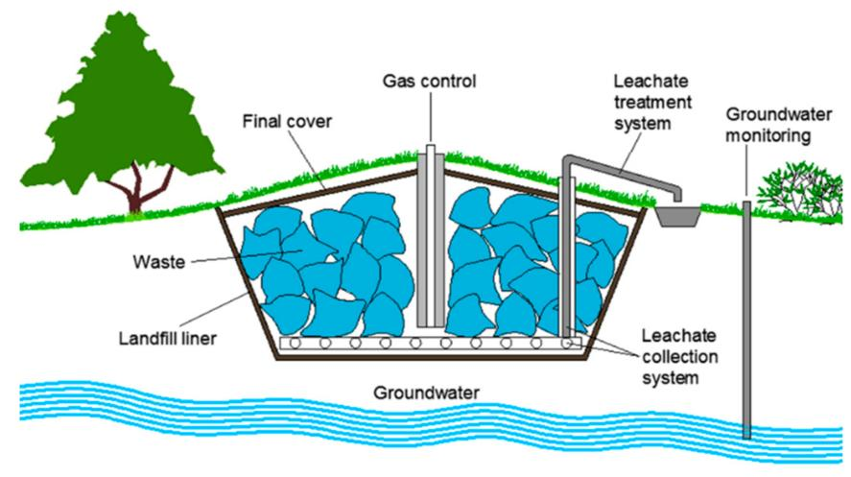
Solid waste management

Slide 16
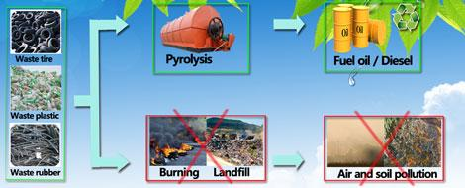

Slide 17
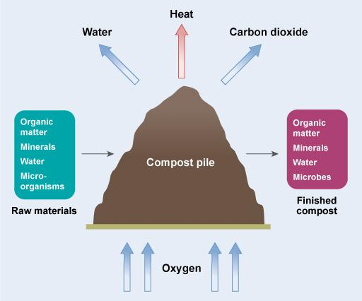

Slide 18
Recycling of solid wastes
The recovery of solid waste components for possible use as raw materials is called recycling.
Examples of recycling and waste utilization
Construction materials from waste: construction material can be produced from wastes such as silt from water works, red mud from aluminum industry, agricultural wastes, fly ash etc.
Utilizing agricultural wastes: agricultural wastes can be used for the manufacture of paper and black boards. Sugarcane bagasse is used as chief sources of cellulose. Attempts are being made to produce or recover protein from such wastes etc. such wastes are also utilized for the production of energy.
Medicines from agricultural wastes: Furfural, the basic material used for the synthesis of nitrofurans, a germicide used for treating cattle diseases. This is produced commercially by the reaction of corn cobs.
Utilizing slaughter house wastes: wastes from slaughter house can also be utilized, e.g. blood is used in pharmaceutical industries and hides and skin are used leather production.

Slide 19
Recycling of solid wastes
Recovery of heavy metal ions: Presence of toxic heavy metal ions in industrial wastes can be recovered by chemical treatments or by bio-extraction technology.
Liquid fuels from agricultural wastes: techniques are being developed for the production of ethanol by fermentation of agricultural wastes for use as a fuel. This will reduce the use of petroleum.
Energy from wastes: industrial and urban wastes can be utilized as an enormous source of potential energy.
Rubber from old tyres: used tyre casings are used in the manufacture of synthetic rubber.
Proteins from cellulose wastes: cellulose wastes can be converted into digestible form of protein with the help of cellulomonas bacteria.

Slide 20
Recycling of solid wastes
Utilizing aquatic weeds: Common aquatic weed water hyacinth can be utilized by conversion into fertilizers, biogas production and in the manufacture of papers.
Oil from plastic wastes: Plastic bags, yogurt cartons, computer casing etc. are used to produce synthetic oil which is used to produce high quality oil based products.
Plastic for heat and electricity generation: Great amount of heat can be produced by burning plastics wastes which can be used for generating electricity.
Recycling of plastics: Plastic is easily recycled to make new packs, soft boxes, greases and adhesives.
Recycling of metals: Various metal pieces collected from the wastes are reintroduced into the production cycle for the production of the same products.
Cooking gas and electricity from organic wastes: Cattle dung is frequently used in biogas plants for generating cooking gas and generating electricity.

Slide 21

Thankyou

