Slide 1
Kalipada Ghosh Tarai Mahavidyalaya
Bagdogra
Department of Environmental Science

Slide 2
Noise Pollution
Noise pollution may be defined as unwanted sound released into the atmosphere without any concern to the adverse effects it may have or the unwanted noise, released into the environment and affecting our lives adversely.
Sources of Noise Pollution
Industrial Noise
Non-Industrial Noise
Indoor Noise
Outdoor Noise

Slide 3

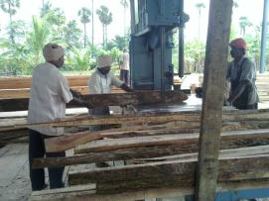
Sources of noise pollution
Industrial sources: Noise generated from steam reducers, exhaust, gas compressor, blast furnace, pump etc. are responsible for noise pollution.
Power plants, fertilizer industry, heavy engineering industry, hydel power plants, saw mills, automobile plants, sugar industry, leather industry are the industrial sources of noise.
Thus, people working in factories, mills, etc. are exposed to noise pollution due to their occupations.

Slide 4





Sources of noise pollution
Non-industrial sources: these are mainly due to loud speakers, automobiles, aeroplanes, trains, construction works, radios, microphones, loudspeakers etc.
Indoor noise – are from different gadgets like televisions, music systems, water pumps, washing machines, vacuum cleaners etc.
Outdoor noise – are from nearby streets and the automobile traffic, railways, aeroplanes, loudspeakers, machines etc.
Indoor noise source
Outdoor noise source

Slide 5
Effects of noise pollution
Noise exposure is an additional stress to man which affects according to its intensity, frequency and periodicity. Some illustrations are as follows
Effect of high intensity sound (80-100 dB): it can cause emotional and behavioral changes by producing nervous tension and cardio-vascular problems like heart diseases and blood pressure. It also affects the central nervous system (CNS). It adversely affects the efficiency of work.
Effect of explosive sounds (above 110 dB): cause acoustic trauma leading to severe damage to internal ear, vomiting and even deafness.
Effect of loud and sudden noise: A sonic boom can damage brain. It can also cause physical damages to property such as window breaks.
Effect of intermittent noise: such sound is very disturbing and may be a cause of psychiatric illness as found in areas having regular sounds of aeroplanes.
Effects of low noise: such noise is responsible for the increased consumption of drugs, tranquilizers and sleeping pills. Emotional breakdown and insomnia may arise due to too much noise.

Slide 6



Control of noise pollution
To reduce noise produced by industries: Noise in industries can be reduced by replacing old machineries with new ones having modern methods of reverting and chipping in place of nut and bolts.
The noisy generators should be located far away from the place of work.
Factory workers must wear ear-muffs (for sounds above 90 dB) or ear plugs (below 90 dB)
To reduce community noise: use of loud speakers during marriages or other festive occasions should be banned.
Measures should be taken to prohibit the manufacture, sale and use of crackers of high sound intensities.
Public should be made aware of their damages.
Ear Muff

Slide 7
Control of noise pollution
To reduce traffic noise: old and sound producing vehicles should be denied to operate on road.
Hooting and blowing of horns needless should be restricted legally.
All along highways 50 feet wide plantation strips should be developed.
To reduce aeroplane and jet noise: aerodromes should be located far away from the residential areas. Heavy and thick green belts around functions as noise absorbers as well as air purifiers
Planning of cities and housing system: cities should be developed in a way that they can escape from noise of industries and highways. Newly constructed buildings should have sound proofing mechanisms. There should be sufficient number of green belts in between residential areas.

Slide 8
Control of noise pollution
Legal control of noise pollution: recently Central and State Pollution Control Boards have been given power to frame certain rules and regulations to control noise pollution. Certain rules and regulations are –
Silence zones should be created near hospitals and educational institutions.
Use of sound amplifiers should be strictly restricted.
All vehicles must have effective silencers and uncontrolled blowing of horns should be declared illegal. Double sirens in and around residential area should be prohibited.
Mid-night air craft flights should be minimized.
Restriction on factory noises should be handled legally. Government should encourage use of new soundless machines.
Development authorities should find legal provisions to establish sufficient green belts in and around cities.

Slide 9
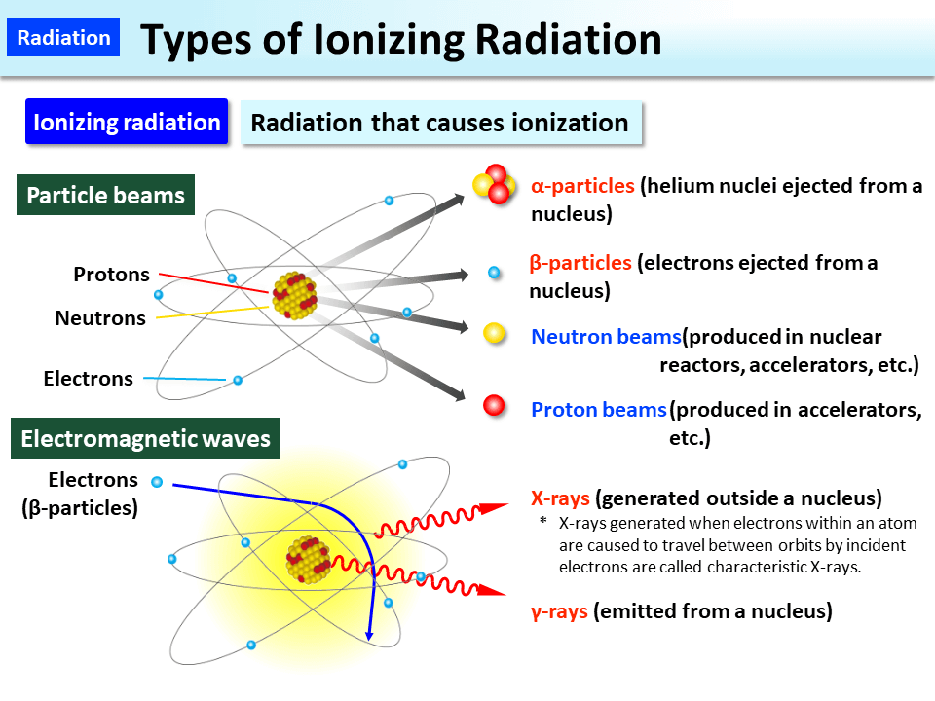
Nuclear hazards(Radiation pollution)
Radiation is the emission of rays and particles from a source, and the source of ionizing radiations is the group of radioactive elements.
The radiations are of two types:
Corpuscular radiations (particulate in nature, e.g.α and β radiations)
Electromagnetic radiations (waves of shorter wavelengths, e.g. X- rays, UV rays, ϒ-rays, infra-red rays etc.)
High energy radiations which have ionizing property are emitted by radioactive elements and are called ionizing radiations.

Slide 10
Sources of radioactive pollution
Three main sources of radioactive pollution are as follows –
1. Radioactive fallout from atomic weapon testing: after atomic explosion (after testing of the atomic weapons), the radioactive dusts containing radioactive isotopes fall on the earth. These materials mix and interact with the natural particulate matter and the matter released by the man-made industries etc. in the atmosphere and then continues to fall out gradually over broad geographic areas for a very long time. They produce ionizing radiation and pollute the air. The radioactive dust that falls to the earth after atomic explosion is called radioactive fallout.
2. Radioactive fallout from small atomic weapons: the nuclear weapons used for peaceful purposes e.g. excavation of harbors and canals, in surface mining etc. these also pollute the environment.
3. Atomic waste materials: in nuclear power plants, the radioactive isotopes are used as fuel. Liquid effluents with dissolved and suspended materials enter water bodies and contaminate them. These enter the food chain and harm the organisms at all trophic levels including man.

Slide 11
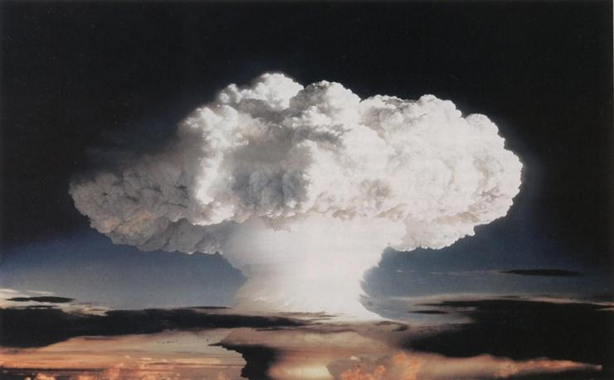
Nuclear Explosion

Slide 12
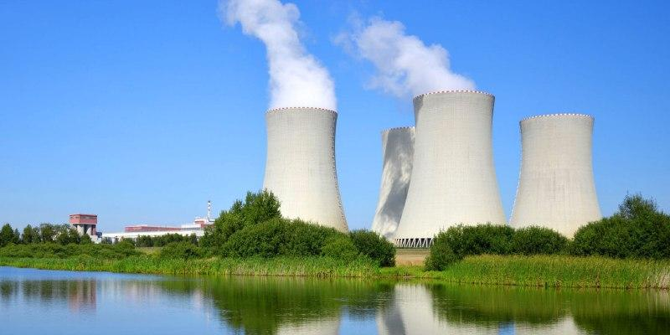
Waste water discharge from Nuclear Power Plant

Slide 13
Adverse effects of radiation pollution
The biological effects of ionizing radiation may be –
Short range effects, or
Long range effects
The short range effects are acute and expressed within few days or weeks after the exposure to radiation. The effects may be –
Physical crippling or
Immediate death

Slide 14
Adverse effects of radiation pollution
The long range effects take longer time to express. The effects may be –
a) Genetic changes
b) Point mutations and chromosomal aberrations
c) Increased incidence of tumors and cancers
d) Shortening of life span
e) Loss of vitality
f) Anemia
g) Hemorrhages etc.

Slide 15
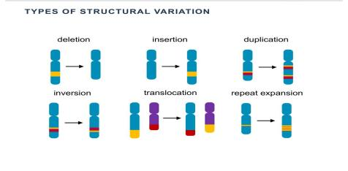
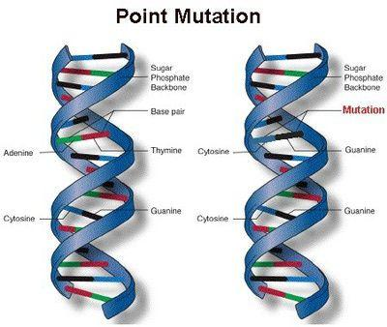
Adverse effects of radiation pollution

Slide 16
Control radiation pollution
Following are a few important measures to protect from damage done by radio-active substances –
While handling UV lamps, dark glass spectacles or goggles must be worn. Ultra violet rays cannot penetrate dark glasses.
High level wastes are long-lived and must be contained –
  In underground tanks without treatment
  Liquids should be converted into inert solids like ceramics and then buried in deep underground.
  Stored in deep salt mines.
Low level wastes must be dispersed into the environment in such a way that these cannot enter food chain.
The radioactive wastes should be stored in places where these gradually decay to their final stable products.
These should be used in minimum and subjected to natural disintegration.

Slide 17
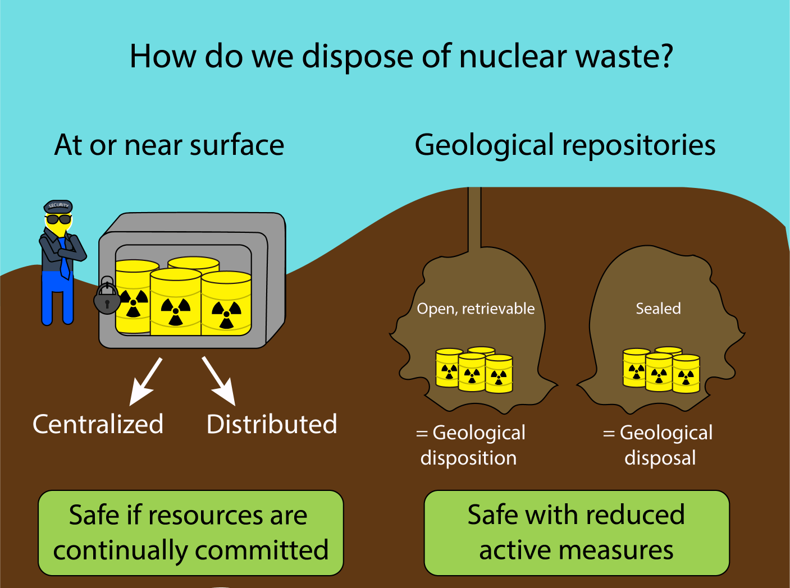
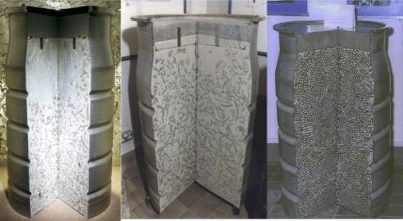
Control radiation pollution

Slide 18

Thankyou

