Slide 1
Kalipada Ghosh Tarai Mahavidyalaya
Bagdogra
Department of Environmental Science

Slide 2
Unit 6: Environmental Policies & Practices
Climate change, global warming, ozone layer depletion, acid rain and impacts on human communities and agriculture
Environment Laws: Environment Protection Act;
Air (Prevention & Control of Pollution) Act;
Water (Prevention and control of Pollution) Act;
Wildlife Protection Act;
Forest Conservation Act.
International agreements: Montreal and Kyoto protocols and Convention on Biological Diversity (CBD).

Slide 3
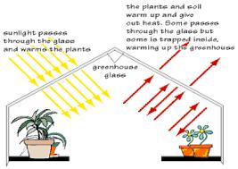
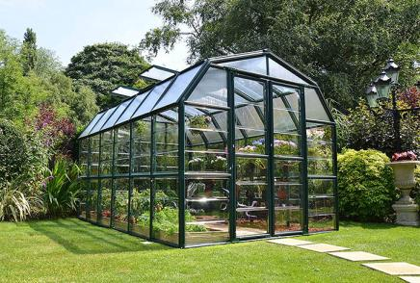
Greenhouse effect (global warming)

Slide 4
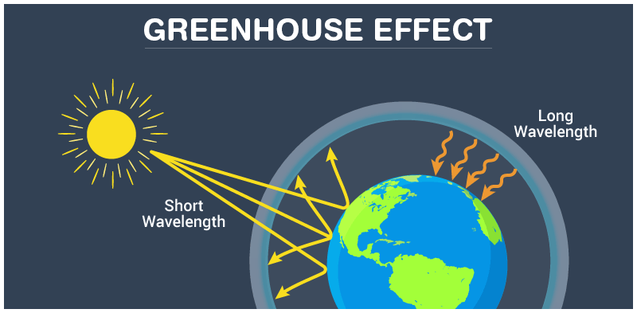

Slide 5
Greenhouse effect (global warming)
Global warming refers to gradual rise in atmosphere and ground surface air temperature and consequent change in global radiation balance caused mainly by anthropogenic progress leading to climate change at different levels.
The atmosphere allows most of the visible light from the Sun to pass through and reach Earth’s surface. As Earth’s surface is heated by sunlight, it radiates part of this energy back toward space as infrared radiation. This radiation, unlike visible light, tends to be absorbed by the greenhouse gases in the atmosphere, raising its temperature. The heated atmosphere in turn radiates infrared radiation back toward Earth’s surface. Without the heating caused by the greenhouse effect, Earth’s average surface temperature would be only about −18 °C (0 °F).
The global warming causing common greenhouse gases are carbon dioxide (CO₂), methane (CH₄), Chlorofluorocarbons (CFCs), nitrous oxide (N₂O), ozone (O₃).

Slide 6
Effects/Consequences of global warming
Global warming and climate change:
It is predicted that by 2030, CO₂concentration will reach about 600 ppm and global temperature will rise by 1.5 to 4.5⁰ C.
Global warming will affect rainfall pattern.
The level of sea water would rise, causing flooding of coastal region of the country.
Ice and snow caps on mountains will melt exposing dark surfaces which will cause a further rise in temperature and reduce the snow fall periods.
Irregular rains and melting of snow on mountain caps will increase the flood incidences world over.
The glaciers melt will adversely alter fresh water balance and dramatic alteration of climatic patterns.
Global warming and human diseases
Rise in temperature and rainfall changes affect the distribution of mosquitoes carry diseases like malaria, encephalitis, filariasis, chikunguinia etc.

Slide 7
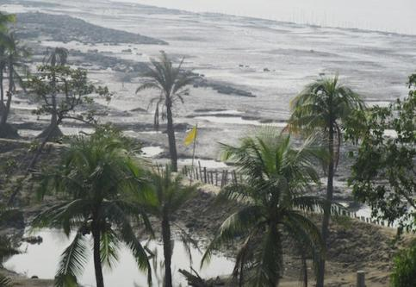
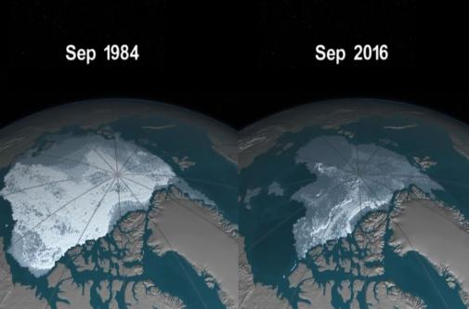
Effects/Consequences of global warming
Coastal Flooding
Glacier melt

Slide 8
Effects/Consequences of global warming
Global warming and agricultural and forestry
Evaporation will increase.
Temperature of soil and water will rise.
Snowing period will be reduced.
Incidence of pests and diseases will become higher.
Growth of wild plants will increase.
Quick deterioration of soil fertility will take place.
Microbial activities will be enhanced.
Irregular rainfall, flood and water problems will increase.
Probabilities of occurrence of cyclones and hurricanes due to global warming will increase adversities.

Slide 9
Remedial measures to reduce Global Warming
The Toronto World Conference held at Toronto, Canada in June, 1988, called for 80% voluntary reduction in the emission of CO₂ by the year 2005.
Discover and develop alternative sources of energy and power and improve better technologies.
Technologies should be advanced and made more efficient to derive maximum energy from fossil fuels to reduce CO₂ and N₂O emissions.
Solar energy may be developed as alternative to the conventional fossil fuel energy. Biogas may be considered as another alternative source of energy for the domestic sector.
Large scale afforestation and reforestation should be taken up, as forest are big natural sink of carbon dioxide.

Slide 10
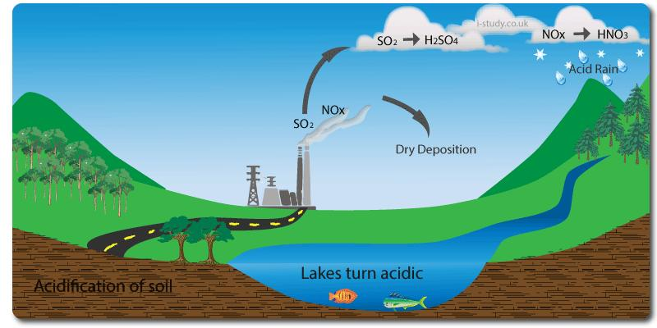
Acid rain

Slide 11
Acid rain
Acid rain simply means fall out of acids caused by sulphur dioxide and nitrogen oxides with rainfall.
Formation of acid rain
The main sources of acid rains are oxides of sulphur and nitrogen which are emitted from industrial establishments and different types of automobiles. In the process, oxides of sulphur and nitrogen released from fossil fuel burning, stay long time in the atmosphere and are oxidized into sulphuric acid (H₂SO₄) and nitric acid (HNO₃). The process of acid formation can be summarized as follows:
SO₂ + H₂O→H₂SO₃ +O→ H₂SO₄
NO + O₂→ NO₂ + H₂O → HNO₃ + H₂O
Water of rains is not neutral because of presence of CO₂ in the atmosphere, which dissolves and makes it slightly acidic. When sulphuric acids and nitric acids are dissolved in rainwater, it becomes more acidic and pH of water falls. The water becomes more injurious when the pH falls below 4.0

Slide 12
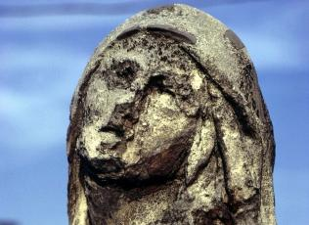
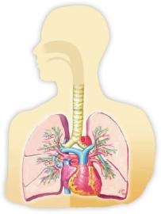
Effects or consequences of Acid Rain
Impact on building and monuments: Acid rain is corrosive. It has a corroding effect on buildings, monuments, other metal and rock structures. In this corrosion, sulphur dioxide plays the main role. Acid causes particles in statues, monuments and buildings to chemically weather. Particularly structures containing limestone or marble – rocks are easily corroded by acids.
Impact on human health: Acid rain is related to several human hazards.
There is irritation in eyes and skin, reduced visibility and disorders in respiratory system.
Respiratory disorders include pulmonary emphysema and bronchitis. It sometimes leads to lung cancer.
Food poisoning is also caused if the drinking water contains acid rain.
Acids in lakes and streams dissolve metals and form toxic chemicals which have a detrimental effect on the human.

Slide 13
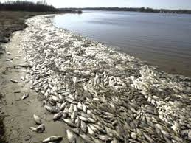
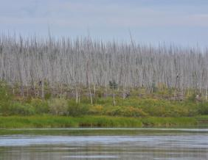
Effects or consequences of Acid Rain
Impact on wildlife: Several direct and indirect effects of acid rain on wildlife can be recognized. Acidic build-up in lakes disrupts the reproductive processes of some aquatic animals. Though the effects of acid rain are mostly seen in aquatic organisms, wildlife is also being affected through food chains. Other indirect effects of acid rain on wildlife are loss and alteration of food and habitat.
Impact on trees: Acids in soil can undergo chemical changes and release toxic metals in forms that can be absorbed by plants. The plants may be damaged or destroyed. Acid rain also causes deficiency in vital nutrients (like potassium and calcium) of soil, making it less fertile. Degradation of plant communities by acid rain can include damage to leaves, loss of productivity and sometimes loss of sensitive plants.

Slide 14
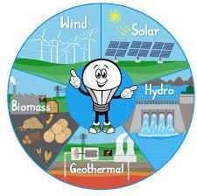
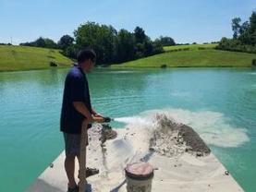
Control of Acid Rain
Acid rain can be controlled by following ways:
Low pollutant producing fuels should be used.
During combustion, methods should be adopted to reduce the formation of pollutants.
Vehicular pollution should be minimized.
Instead of fossil fuels, use of alternative energy sources should be adopted.
Liming of lakes, streams and streams by using lime stones and dolomites should be carried out in acid rain prone areas.
Liming of lake

Slide 15
Ozone layer depletion
Ozone (O₃) occurs naturally between 10 to 50 km above sea level and is most strongly concentrated at an altitude of 20-25 km which is called stratosphere zone of atmosphere or ozonosphere. Ozone is considered as a protective shield and earth’s umbrella because it prevents ultra violet solar radiation from reaching the earth surface. In absence of this ozone layer, the temperature of lower atmosphere might have risen.
Formation of the ozonosphere
Ozone gas is unstable and the creation and destruction of ozone gas is a gradual and continuous process. The oxygen molecules in the atmosphere between 80 km to 1000 km are broken down by ultra violet solar radiation or by an electric discharge during thunderstorm. The atomic oxygen can then either recombine with an oxygen molecule (O₂) to form ozone once again, or combine with other substances.
The quantity of ozone is measured in DU (Dobson Unit)

Slide 16
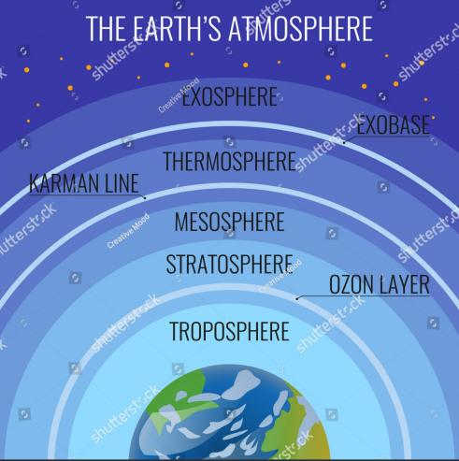
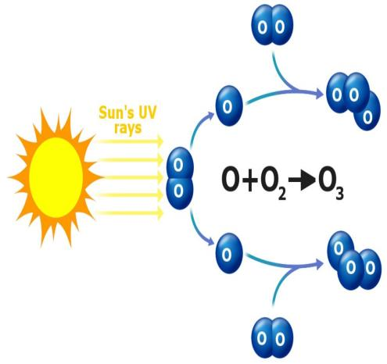
Ozone layer depletion
Formation of Ozone

Slide 17
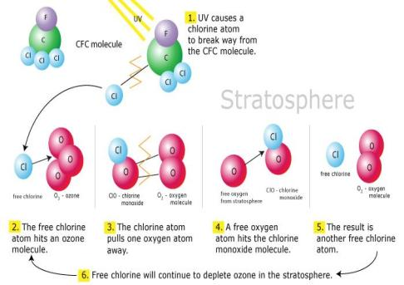
Ozone layer depletion
In 1974, scientists discovered that ChloroFluoro Carbon (CFC), trade name Freon, used in refrigerator, air conditioners, and aerosol and as cleaning agents, are continuously destroying the ozone layer. Apart from that, natural gases like water vapour, methane, hydrogen gas and nitrogen oxides are effective destroyers of ozone layer.
When CFCs rise into the stratosphere, the solar U-V radiations decompose them releasing free chlorine radicals. Each of these chlorine atoms reacts with one molecules of ozone and converts ozone into oxygen molecule, leading to a chain reaction.

Slide 18

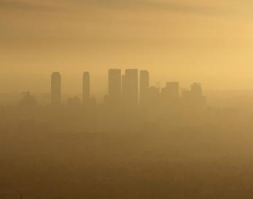
Consequences/adverse effects of ozone layer depletion
Effects on climate: with the depletion of ozone layer in the stratosphere, the uv-rays solar radiation will directly reach the earth’s surface making it too hot. The substantial increase in the surface temperature on the earth would cause global warming.
Effects on human beings:
Higher incidence of UV-rays on earth’s surface due to ozone layer depletion will increase skin cancer.
Increased exposure to UV-rays will decrease immunity system making more prone to the infectious disease.
Increased of UV-rays promote formations of smog, responsible for causing lung cancer and damage to respiratory system.

Slide 19
Consequences/adverse effects of ozone layer depletion
Effects on biotic communities
Death of microbes and planktons, loss in photosynthesis of green plants, fish mortality and unfavorable climate conditions will be the major effects.
Plant responses to UV- radiation include reduced leaf size, stunted growth, poor seed quality and increased susceptibility to weeds, diseases and pests.
Ecological significance of ozone layer depletion
Spectral composition of solar electromagnetic radiation reaching the earth surface will be changed.
Due to the increased surface temperature of earth, the global energy and radiation balance will be changed.
Increase in temperature may change climate at local, regional and global level.
Change will induce imbalance in hydrological cycle and increase in incidence of flood and drought.

Slide 20
Remedial measures to control ozone layer depletion
The international efforts towards remedial measures to control ozone depletion are being taken up at two levels:
To promote reduction in the production and consumption of emission of ozone depleting chemicals - The first substantial step in this regard was the agreement signed by 35 countries in Montreal Protocol on Substances that Deplete the Ozone.
To make serious efforts to produce and propagate the use of alternative chemicals which do not deplete ozone – some chlorine free chemicals, as substitute to CFCs, are under consideration e.g. Bioact- EC-7, a biodegradable, non-toxic and non-corrosive chemical. With trade name HFC-134 which can be used in place of Freon-12 in air conditioners and refrigerators.

Slide 21

Thankyou

