Slide 1
Kalipada Ghosh Tarai Mahavidyalaya
Bagdogra
Department of Environmental Science

Slide 2
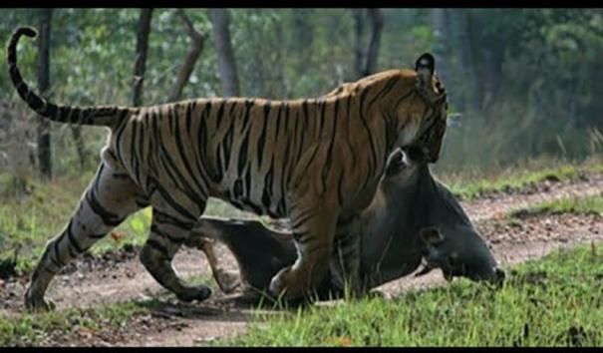
Human-Wildlife Conflict
Predation on livestock or domestic animals by wildlife

Slide 3
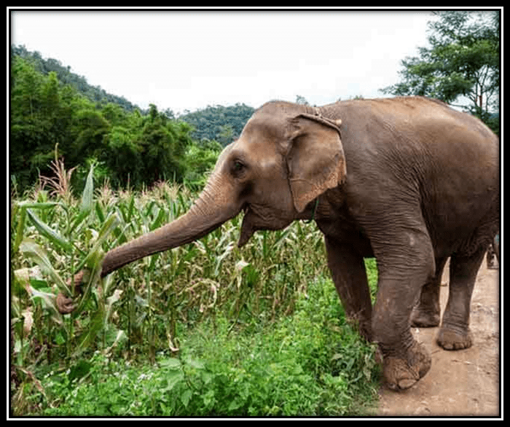
Crop damages by wildlife

Slide 4
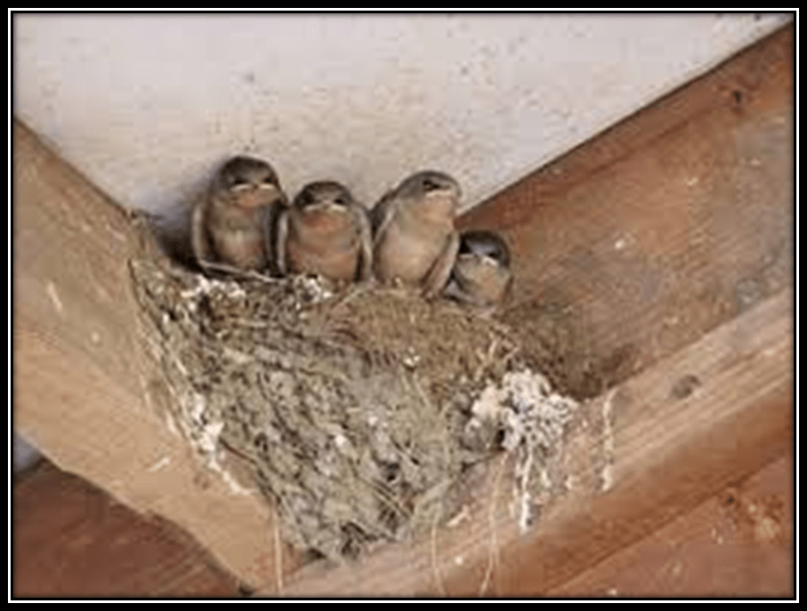
Birds nesting in undesirable residential locations

Slide 5

Vehicle/wildlife collisions

Slide 6
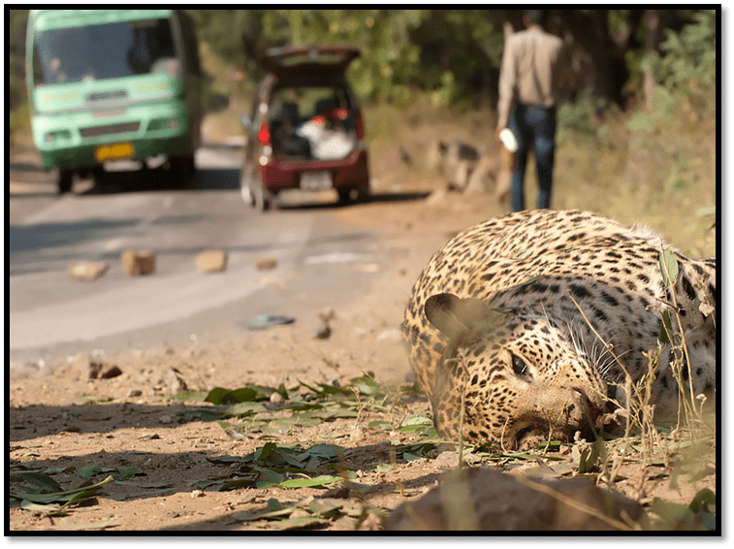
Road Kills
Reasons for Human Animal Conflict

Slide 7
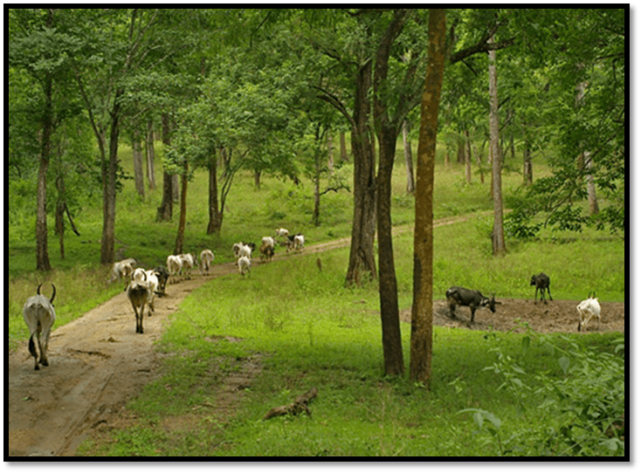
Livestock grazing

Slide 8

Increase in Human population

Slide 9
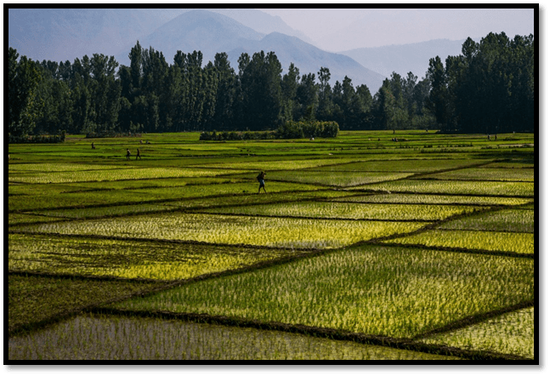
Land use transformations

Slide 10

Installation of barriers
Anti Depredation Squads
Kunki Elephants
Repellent methods
Deterrent Methods
Disguise
Corridors

Slide 11
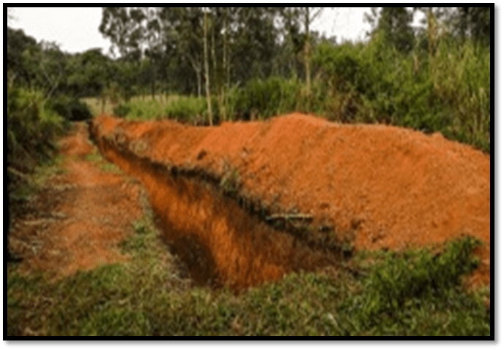
Installation of barriers
Deep trenches

Slide 12
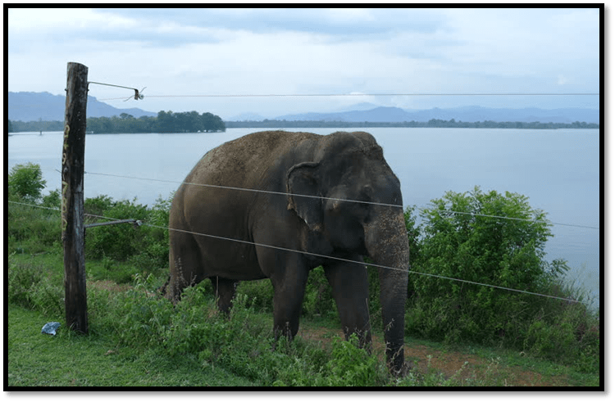
Solar Powered High voltage electric fences

Slide 13
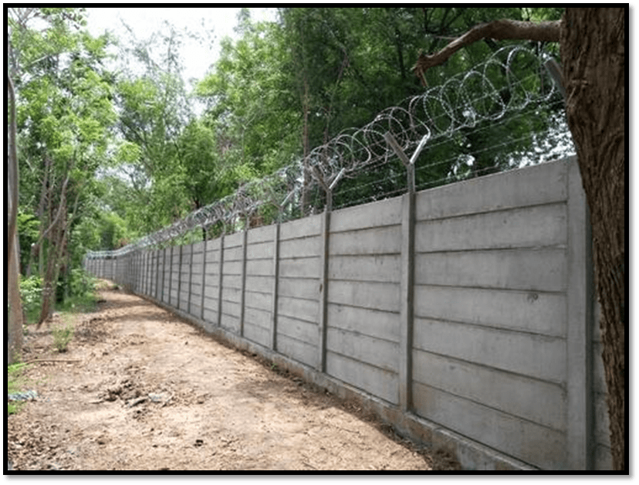
Concrete wall with spikes

Slide 14
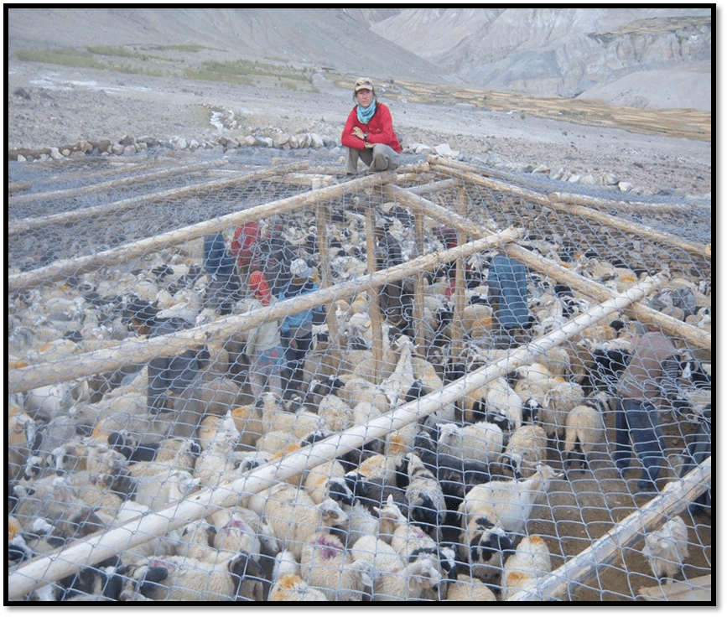
Predator proof corrals

Slide 15
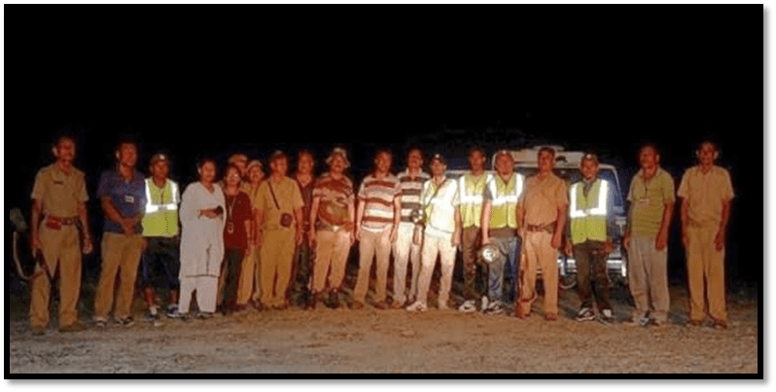
Anti Depredation Squads
ADS are equipped with a vehicle, torch, siren, fire crackers even double barrel guns

Slide 16
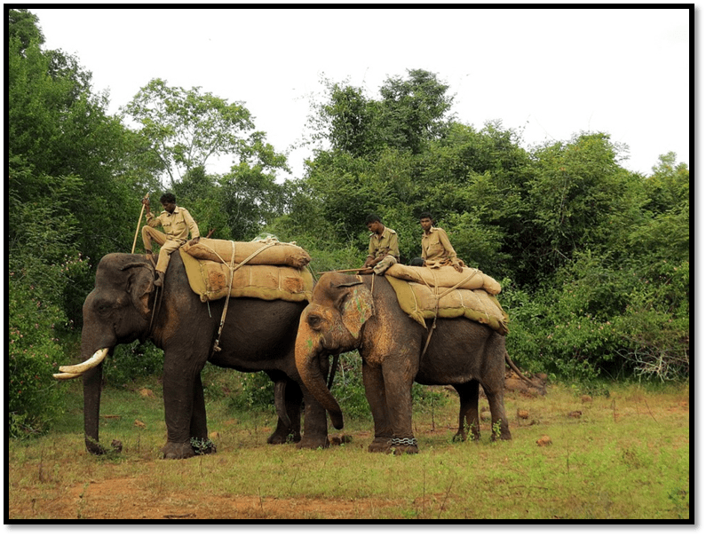
Kunki Elephants
Effective in driving elephants from villages, for monitoring/capturing/ tranquilizing/translocating/ hunting of problems

Slide 17
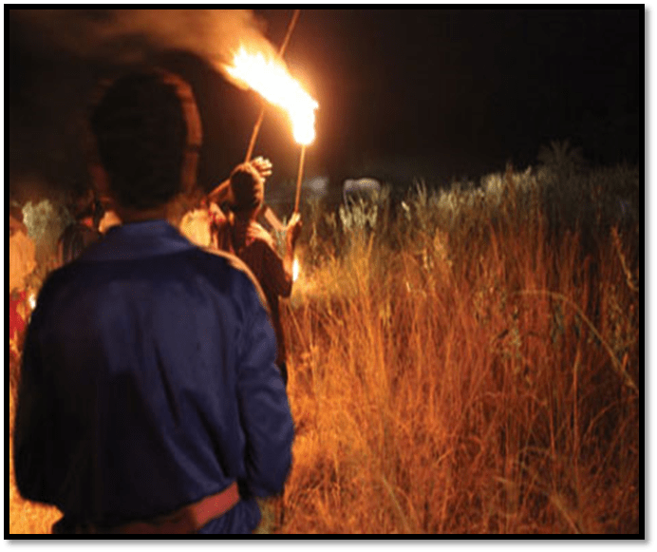
Repellent methods
Drum beating, shouting and bursting crackers

Slide 18
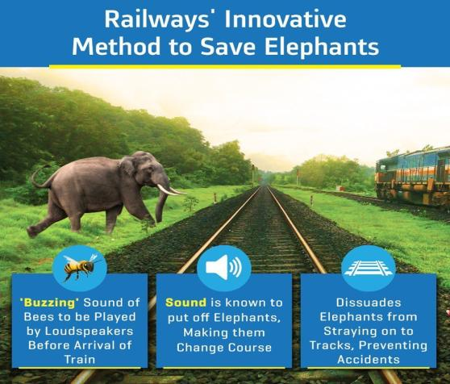
Repellent methods
Elephants are terrified of bees.
Bee fences or bee sounds are very effective.
Carnivore sounds evokes negative response.

Slide 19
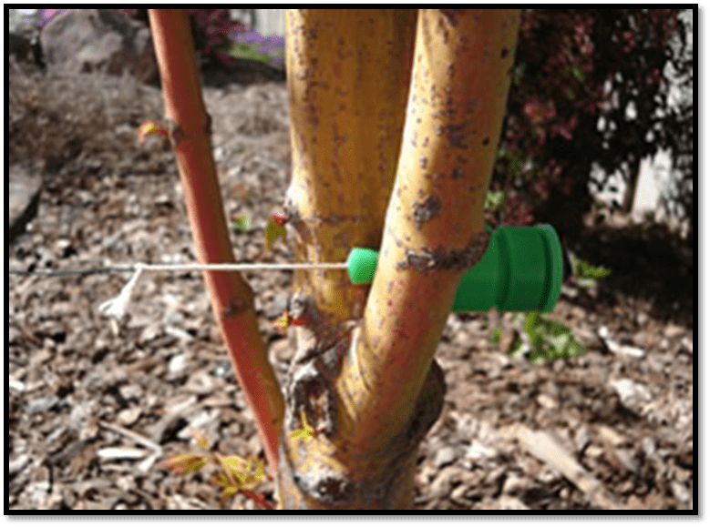
Deterrent Methods
A string stretched across entry points of elephants, connected to a switch of a battery-operated electric bell.

Slide 20
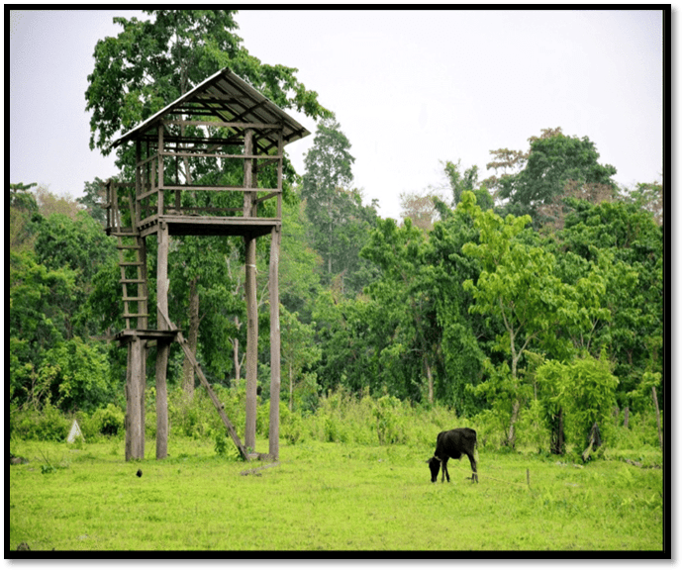
Deterrent Methods
Night guarding at watch towers.
Traditional way of protecting against wild animals.

Slide 21
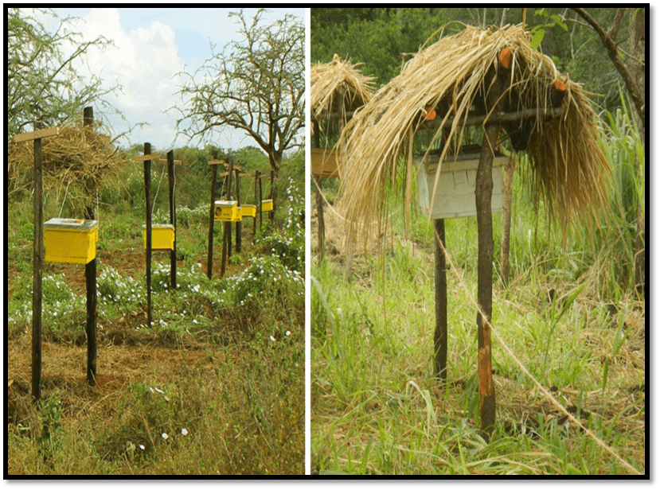
Deterrent Methods
A series of bee hives is created at short intervals along fences at the boundary of the enclave.
Hives are connected to the fence.

Slide 22
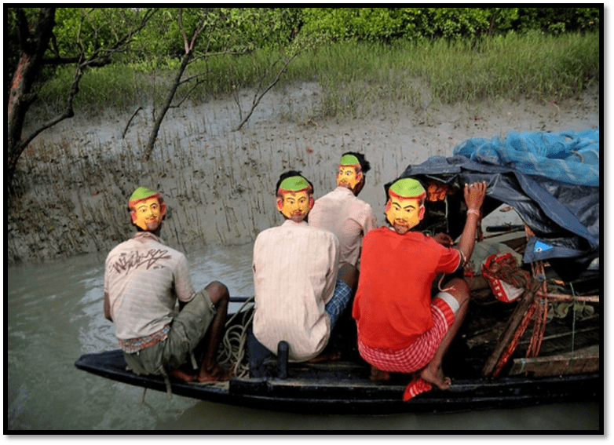
Disguise
Knowledge of big cat behavior is exploited, tiger stalk their prey and attack from behind
Forest worker wear human face mask on the back of their heads to prevent sneak attacks.
Effectiveness of masks decreases over time as tigers become habituated to the disguise.
Honey collectors in disguise

Slide 23
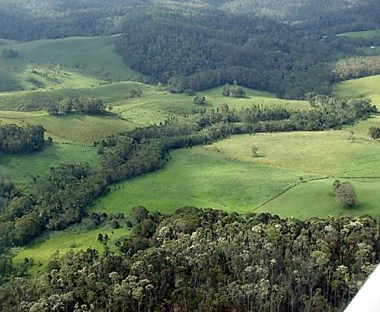
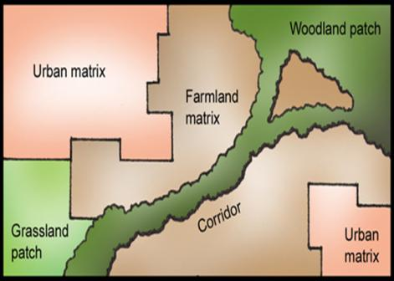
Corridors
Areas of preserved native habitat in human dominated regions.
Safer pathway between larger areas of intact habitat
Reduces conflicts by guiding their movements

Slide 24

Ex-gratia Payment
Paid in cases of crop and property damages, human injuries and human deaths
Ex-gratia rates are insufficient
Process too lengthy
Payment is disbursed too late
Rates for human deaths varies from State to State

Slide 25
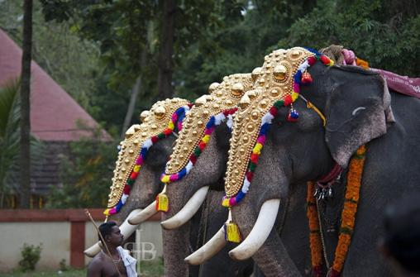
Managing Private and Temple Elephants
Should kept away from congested places and large crowd
Should be manned only by trained and experienced mahouts.
Temple Elephants go out of control during processions due to loud music, crackers, and presence of large crowd

Slide 26
Biodiversity conservation
In-situ conservation
Ex-situ conservation
National Parks
Botanical Gardens
Wildlife Sanctuary
Zoological Parks
Biosphere Reserve
Aquaria
Project Tiger
NBPGR
Sacred forest
NBAGR

Slide 27
In situ v/s Ex situ conservation
In situ conservation
Ex situ conservation
Advantage
It is a cheap and convenient method.
In natural environment, organisms not only live and multiply but also evolve and continue to maintain their ability to resist environmental stress.
Disadvantages
It requires larger areas and minimizes the space for inhabiting human population which is increasing tremendously.
Advantage
The organisms is assured of food, shelter and security and hence can have longer lifespan and breeding activity.
Captive breeding and use of genetic practices provide possible reintroduction of animals to the wild at later stage.
Disadvantages
It can be adopted only for new selected species because of limited space, facilities and finances in the centers.
Since it is done under a set of favorable environmental conditions, it deprives organisms the opportunity to adapt to the ever-changing natural environment.

Slide 28
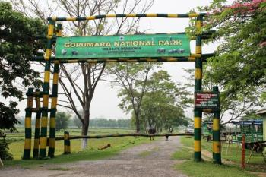
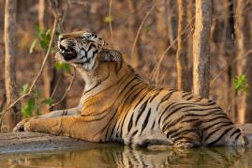
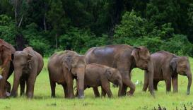
In-situ conservation
National Parks
These are strictly reserved for the betterment of the wildlife and declared as places where activities such as forestry, grazing, hunting, cultivation etc. are not permitted either.
No private ownership is allowed. Usually they are hitched to the habitat for specific wild animal with their boundaries circumscribed by legislation.
No biotic interference is allowed except for the buffer zone where limited human activity for enjoyment through eco-tourism is allowed.
For example Gorumara National Park. Common fauna found are tiger, leopard, elephant, clouded leopard, Sāmbhar etc.

Slide 29
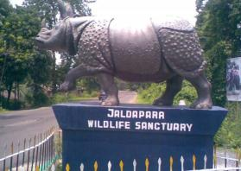
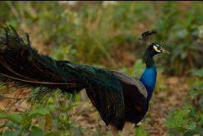
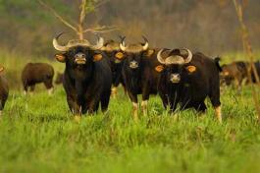
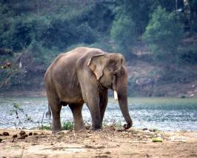
In-situ conservation
Wildlife sanctuaries
Wildlife sanctuaries are also protected areas dedicated to protect wildlife, but they aimed at conversing animal species only.
Also the boundary of a sanctuary is not limited by state legislation.
Limited biotic interference is allowed in them.
Private ownership rights and forestry operations are permissible to an extent that they do not affect the wildlife adversely.
Visitors are not allowed to carry weapons without permission, set fire, leave any fire burning or its remnant, feed animals and use the chemicals or explosives injurious to any wildlife
e.g. Jaldapara Sanctuary. Important fauna found are Rhino, Elephant, Bison, Deer, Sāmbhar, Tiger, Leopard, Different kinds of birds.

Slide 30
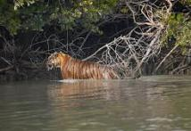
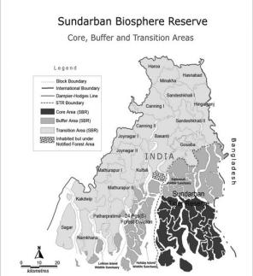
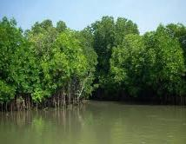
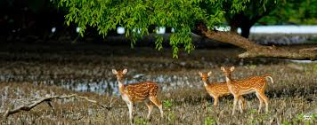
In-situ conservation
Biosphere reserves: are special categories of protected areas of land representing natural ecosystems with unique biological communities selected for long term in-situ conservation of species of plants and animals.
In Biosphere reserve, multiple land use is permitted.
A biosphere is not hitched to any one, two or three species but to the ecosystem as a whole i.e. totally of all life forms that live in it.
In a biosphere reserves wild population as well as traditional life styles of tribals and various domesticated plants and animals are also protected.
There are three distinct zones viz. core, buffer and transition in a biosphere reserve e.g. Sunderbans Biosphere Reserve.

Slide 31
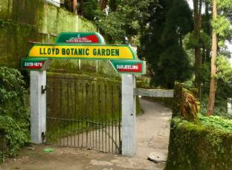
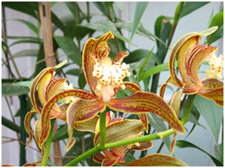
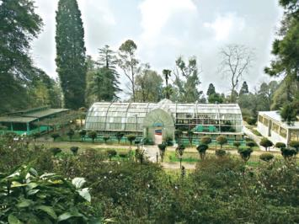
Ex-situ conservation
Botanical gardens plays a significant role in conservation of plant species beyond preservation in the wild and in supply for research and education, thereby taking pressure off of wild population of species. These botanical gardens are the living repository of thousands of trees and shrubs. These are aimed at conservation of rare and the multiplication of selected endangered plant species. Many of the botanical gardens now have seed banks, tissue culture facilities and other ex-situ technologies e.g. Lloyd Botanical Garden, Darjeeling

Slide 32
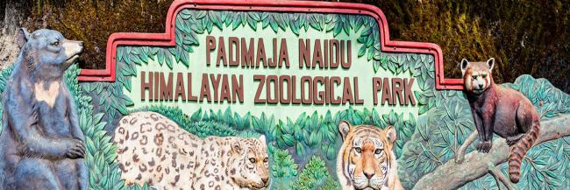
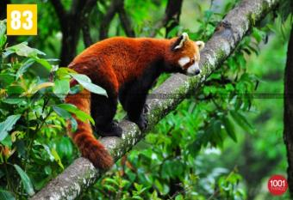
Ex-situ conservation
Zoos or Zoological parks: Contribute to the conservation of animal diversity by propagating and reintroducing endangered species, they also act as centers for research to improve management of captive and wild population. Many of them have well developed captive breeding programs for restoring those species of animals whose number of surviving species is so small that there is no realistic chance of in-situ survival. As the number of individual increases in the captive breeding, they are selectively released in the wild. Apart from conservation, zoos are also aimed to inspire among visitors sympathy for wild animals and understanding and awareness about the orphaned wild animals. E.g. Padmaja Naidu Himalayan Zoological Park, Darjeeling is a center for captive breeding of snow leopards and red pandas.

Slide 34
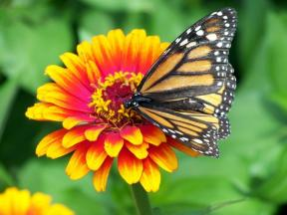
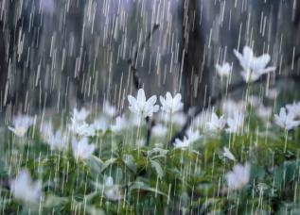
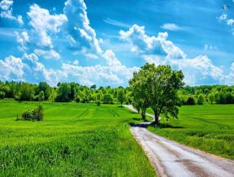
Ecosystem and Biodiversity Service
Ecosystem service value: ecosystem service value of biodiversity refers to the service provided by the ecosystem such as prevention of soil erosion, soil formation, cycling of nutrients, fixation, waste disposal, role as carbon sink, and pollination of plants by insects and birds, climate regulation, prevention from flood and drought etc.

Slide 35
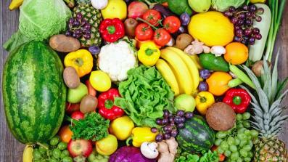
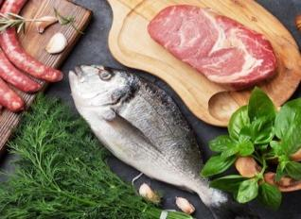
Ecosystem and Biodiversity Service
Food value: Human consumes a number of wild and semi-wild species of plant as food. Many species of marine algae and mushroom also form the source of the food. Wheat, rice and corn, the three major carbohydrate crops. Livestock and wild fauna also contribute greatly to feeding humans. Staple crops, meat and fish form bulk of our diet while vegetables and fruits add variety to our diet and are indispensable source of vitamins and minerals.

Slide 36
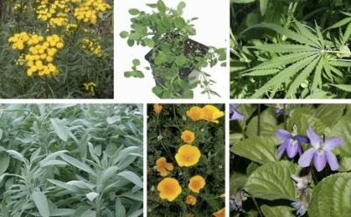
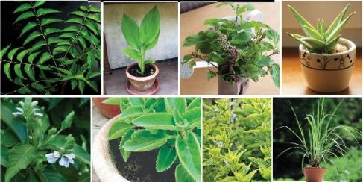
Ecosystem and Biodiversity Service
Medicinal value: Many of the chemicals are derived from plants that had been used in the traditional medicines. Currently 25% of all prescription drugs are derived from mere 120 species of plants. Some of the plant species native to India, such as Neem and Tulsi etc. has potential medicinal applications. In India, 3,000 plant species are still used as medicinal plants by more than 75% rural population.

Slide 37
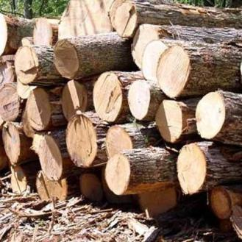

Ecosystem and Biodiversity Service
Timber value: wood harvested from wild species, timber is a source of income generation. Many industries such as pulp and paper industry, saw milling, plywood, construction poles, railway sleepers thrive on wood resources.
Many non-wood products of economic value produced by wild species include medicinal herbs, gum and resin, honey beeswax, fibers, essential oils etc. form important sources of income.

Slide 38
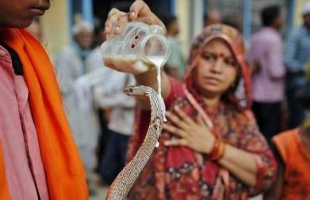
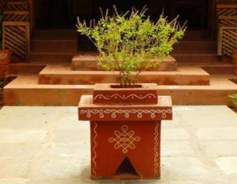
Ecosystem and Biodiversity Service
Social, Cultural and Religious Service Value: Social service value of biodiversity is associated with social life, customs, religious, and psycho-spiritual aspects of the people in different societies. Human history reveals that people have through cultural religious beliefs. In, India leaves, flowers and fruits or other parts of plants of Tulsi, Pipal, Bargad, Neem, Mango, Khejri, Bel are used variously and their trees are planted which are considered sacred and worshiped by the people. Many animals such as birds, cow, snake, bull, peacock, owl etc. have been considered sacred and find a significant place in our psycho-spiritual arena.

Slide 39

END OF UNIT –4
Thankyou

