Slide 1
Kalipada Ghosh Tarai Mahavidyalaya
Bagdogra
Department of Environmental Science

Slide 2
Unit 4: Biodiversity and Conservation
Levels of biological diversity : genetic, species and ecosystem diversity; biodiversity hotspots
India as a mega---biodiversity nation; Endangered and endemic species of India
Threats to biodiversity: Habitat loss, poaching of wildlife, man---wildlife conflicts.
Conservation of biodiversity: In-situ and ex-situ conservation of biodiversity.
Ecosystem and biodiversity services: Ecological, economic, social, ethical, aesthetic and Informational value.

Slide 3
BIODIVERSITY AND ITS CONSERVATION
Biodiversity is the shortened form of two words "biological" and "diversity". It refers to all the variety of life that can be found on Earth (plants, animals, fungi and micro-organisms) as well as to the communities that they form and the habitats in which they live.
Biodiversity hot spots are the geographical regions of the world exhibiting species richness and species diversity with flora and fauna under constant threat due to over-exploitation by humans. Currently, 36 biodiversity hotspots have been identified, most of which occur in tropical forests.

Slide 4
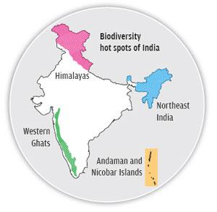
Biodiversity hot spots
India hosts 4 biodiversity hotspots:
the Himalayas,
the Western Ghats,
the Indo-Burma region and
the Sundaland (Includes Nicobar group of Islands).
These hotspots have numerous endemic species.

Slide 5
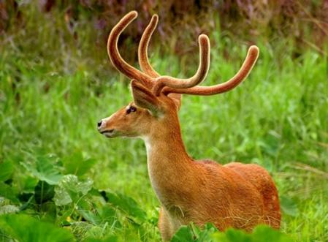
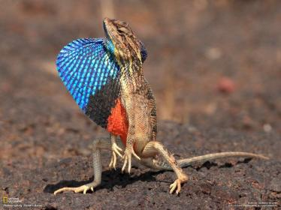
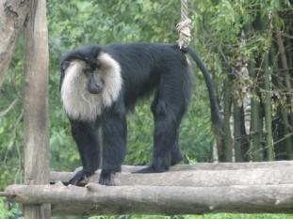
BIODIVERSITY AND ITS CONSERVATION
Endemic species are those species which remain confined only to a particular locality. Such species are very important from the point of view of conservation strategy because their disappearance means extinction of these species as they are not found elsewhere. Isolated mountain tops, valleys and large oceanic islands are usually areas of endemism.
Fan throated Lizard-Eastern Ghat
Sangai deer-Eastern Himalaya
Lion Tailed Macaque-Western Ghat

Slide 6
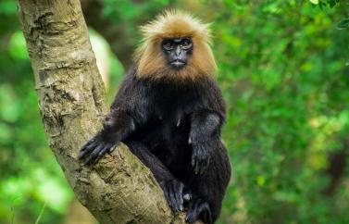
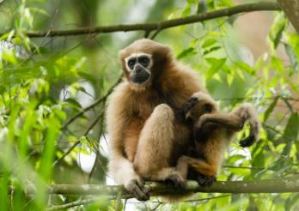
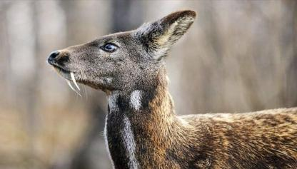
BIODIVERSITY AND ITS CONSERVATION
Endangered species are those species which have very low population and are in considerable danger of extinction and whose survival is unlikely if the causal factors continue operating, fall under this category. Endangered species included those species whose number has been reduced to a critical level or whose habitats have been so drastically reduced that they are deemed to be in immediate danger of extinction.
Nilgiri Langur
Hoolock Gibbon
Musk deer

Slide 7

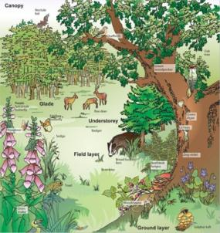
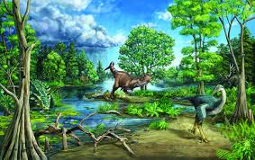
Types of Biodiversity
Genetic Diversity
It is basically the variety of species expressed at the genetic level by each individual in a species. No two individuals belonging to the same species are exactly similar.
Species Diversity
It is the biodiversity observed within a community. It stands for the number and distribution of species. The number of species in a region varies widely depending upon the varied environmental conditions.
Ecological diversity
It defines the diversity observed among the ecosystems in a particular region. Different ecosystems like mangroves, rainforests, deserts, etc., show a great variety of life forms residing in them.

Slide 8
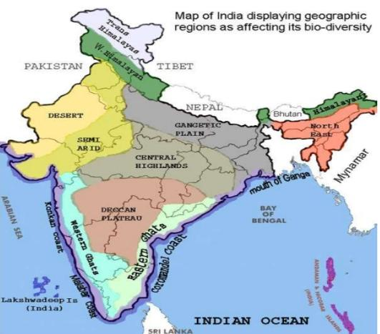
Biogeographical regions of India

Slide 9
Biogeographical regions of India
India represents almost all biogeographical regions of the world. These are:
Trans-Himalayan Zone (upper region): It is an extension of Tibetan plateau including the high-altitude cold desert in Ladakh and Lahul Spiti with sparse mountain vegetation and possesses the richest wild sheep and goat community in the world. The snow-leopard and migratory black necked crane are found here.
Himalayan Zone: It comprises diverse biotic provinces and biomes. Based on altitude, there are three zones of vegetation in Himalayan range which correspond to three climatic belts: first the sub-montane or lower region (tropical and subtropical), that extends from plain to foot of hills up to 5000-6000 ft. altitude. Second the temperate or montane zone, ranging between 5,500-12,000 ft altitudes, has vegetation dominated by Pinus, chir, deodar etc. Third the alpine zone, where shrubby growth of junipers and rhododendron is found in grassy areas. At about 15000 ft. altitude and snow-line, plant growth is almost nil.
Desert Zone: This arid area, west of the Aravali hill range, comprises three biotic provinces, viz. Kutch (salt desert of Gujarat), Thar sand desert of Rajasthan and Ladakh. Kutch and Thar incorporates parts of Gujarat, Rajasthan, Haryana, and Delhi with climate which is very and dry (in summer) and very cold (in winters) and rainfall less than 700 mm. The Ladakh region, the cold desert region, on the other, hand has sparse vegetation.
Semi-arid Zone: This are, between the desert and the Deccan plateau including Aravali range, comprises Madhya Pradesh, Chhattisgarh, parts of Orissa and Gujarat. On the basis of the amount of rainfall, the forests in this region have developed into thorny, mixed deciduous and ‘Sal’ type.

Slide 10
Biogeographical regions of India
Western Ghat Zone: This area of hill ranges and plains, running along western coastline, comprising the Malabar Coast and Western Ghat mountains of India, extends from Gujarat in the north to the Cape of Camorin in the south. This region receives heavy rainfall and has rich vegetation. The tropical moist evergreen forests are luxuriant and multistoried and have tall trees.
Deccan Peninsula Zone: This area of south and south-central plateau, south of the river Tapi. The zone is semi-arid region and lies in the rain shadow of Western Ghats. The precipitation hardly exceeds 100 mm.
The Gangetic Plain: Gangetic plain, along Ganga river system, lies in the north extending up to Himalayan foothills. This region, comprising Uttarkhand, Uttar Pradesh, Bihar and West Bengal, is the most fertile region due to alluvial soil. The major climatic factors, for the temperature and precipitation together, are responsible for the distinctive type vegetation in the region. The vegetation is chiefly of tropical moist and dry deciduous forest type.
The North-East India: It comprises non-Himalayan hill ranges and is one of the richest florist regions in the country. This region receives the heaviest precipitation. The temperature and wetness are also very high, resulting in the dense tropical evergreen forests.
The Islands: The islands of Lakshadweep in the Arabian Sea and Andaman and Nicobar in the Bay of Bengal, have a wide range of spreading coastal vegetation like mangroves, beach forests etc.
The Coast: India has a coastline of about 7516.6 km. Mangrove vegetation is the characteristic of the estuarine tracts along the coast.

Slide 11
Threats to biodiversity
Habitat loss and degradation
Habitat fragmentation
Poaching of wildlife
Introduction of exotic or alien species
Over-exploitation of bio-resources
Pollution and disturbances

Slide 12
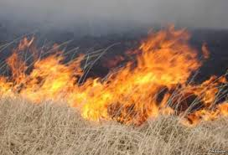
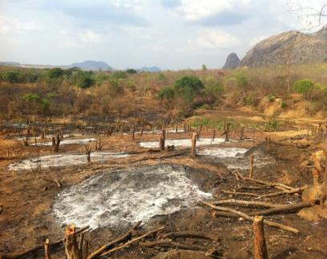
Habitat loss and degradation
Destruction of habitat is the primary cause for the loss of biodiversity. When people cut down trees, fill a wetland, plough grassland or burn a forest, the natural habitat of a species gets changed or destroyed resulting in killing many plants, animals and micro-organisms.
The main causes of habitat loss are agricultural activities, harvesting or extraction, mining, logging, deforestation, rapid rate of urbanization, industrial development. The ever increasing human settlements have been causing destruction of natural ecosystems to meet their requirements of food shelter and other needs.

Slide 13
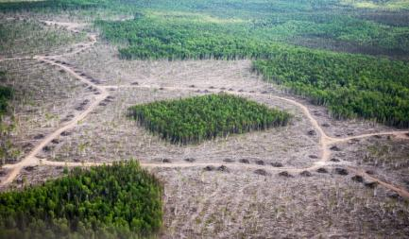
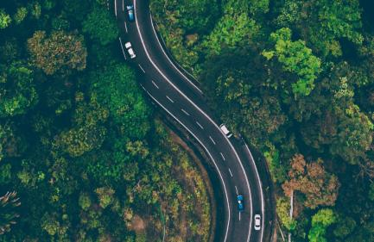
Habitat fragmentation
Fragmented habitats are such as a forest patch surrounded by croplands, orchards, plantations or urban areas i.e. large continuous habitat is divided into small and scattered patches. Sometimes, the habitats, that formerly occupied wide areas, are often divided into pieces by roads, fields, towns, canals, industries, power line etc. The fragments thus formed are often isolated from one another. As a result, the population of a species gets separated into isolated groups. These isolated, small and scattered populations are increasingly vulnerable to inbreeding depressions, high infant mortality and susceptibility to environmental stresses and finally lead to extinction.

Slide 14
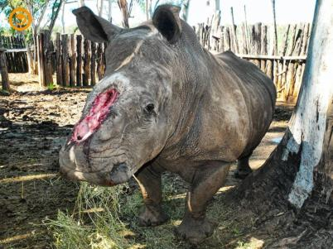
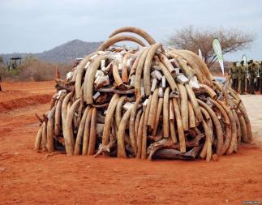
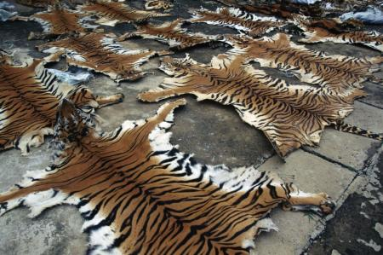
Poaching of wildlife (Commercial hunting)
Poaching refers to illegal trade of endangered and rare species of animals and plants and their products. In India, rhino is hunted for its horn, tigers for its bones and skin, musk deer for musk, elephant for ivory, gharial and crocodile for their skin, whale for combs, and spiny tailed lizard for ‘sanda’ oil.

Slide 15

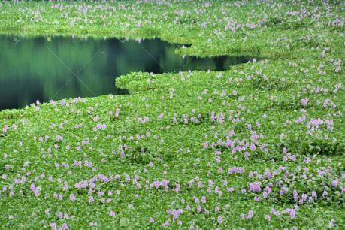
Introduction of exotic or alien species
Exotic or alien species are the non-native newly entering species in a geographical region where they have never been. Exotic species, often called ecological cancer, have no predators, competitors, parasites or pathogens and flourish well if established in the new geographical regions. They wipe out many local species. Introduction of water hyacinth (jalkumbhi), a water weed in several tropical countries clogs rivers and lakes and lakes and threatens the survival of many aquatic species in lake and flood plain.

Slide 16
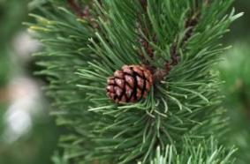
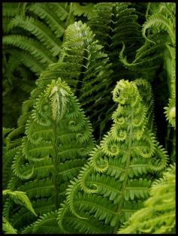
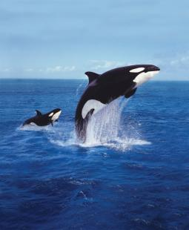

Over-exploitation of bio-resources
A particular species, if over-exploited, reduces the size of its population to an extent that it becomes vulnerable to extinct. Many fern species and gymnosperms and animal species such as frogs, earthworms, cockroaches etc. needed for laboratory teaching work are overused for study purposes. Overuse of such bio-wealth coupled with commercial over-exploitation caused their destruction.

Slide 17
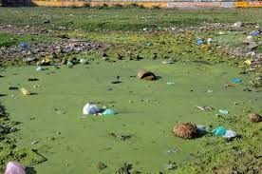
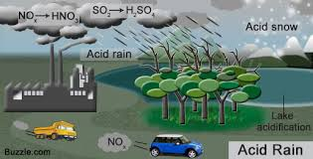
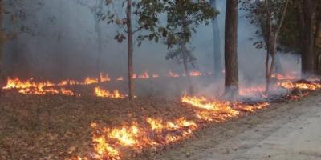
Pollution and disturbances
Pollution may alter natural habitats and cause reduction and elimination of population of sensitive species. Excessive use of pesticides in crop fields is causing decline in the population of birds and falcons. Toxic wastes entering the water in fresh water bodies bring about changes in the food chain.
Water pollution, due to excessive organic loading of water bodies, results eutrophication which drastically reduces biodiversity. Acid rain, global warming and ozone layer depletion affect adversely plant and animal species.
EUTROPHICATION
FORST FIRE

Slide 18

Thankyou

