Slide 1
Kalipada Ghosh Tarai Mahavidyalaya
Bagdogra
Department of Environmental Science

Slide 2
Unit 3: Natural Resources: Renewable and Non – renewable Resources
Topics to be covered
Water: Use and over exploitation of surface and ground water, floods, droughts, Dams benefits and problems.
Food resources: effects of modern agriculture, fertilizer-pesticide problems

Slide 3
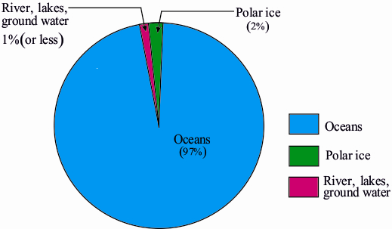
Water Resource
Of the total volume of water available on this earth, 97% is in the vast oceans, 2 % is locked in the form of ice-sheets and only less than 1% is available as fresh water for which all people, animals and plants compete.

Slide 4
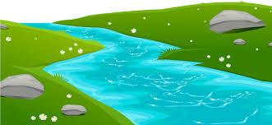
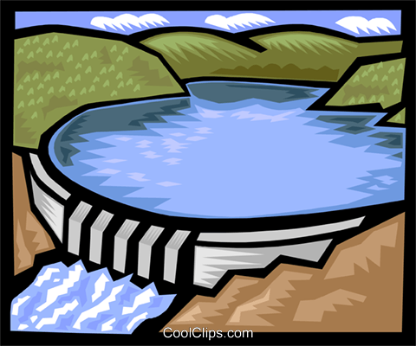
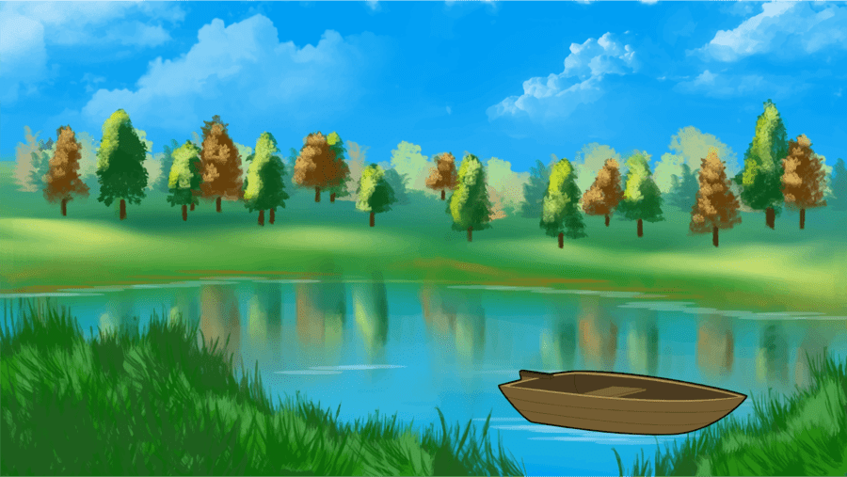
Water on the land surface
Rivers and streams: The precipitation, that does not evaporates or infiltrates, run off over the ground surface in the form of streams and rivers which flow towards the sea. Rivers and streams are the major sources of water supply.
Natural lakes and ponds: Natural lakes are the inland depression that holds fresh water for long periods. Ponds are generally small and permanent or temporary fresh water bodies. They are the important sources of water supply in limited quantities.
Artificial impounding reservoirs: Artificial impounding reservoirs are formed by constructing hydraulic structures such as dams across river valleys. Deeper and narrower valley is most suitable for construction of dams. They provide enough water for irrigation and domestic use and generating hydro-power.
River
Reservoir
pond

Slide 5
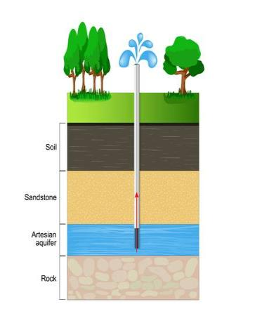
Groundwater
The rain water and water from melted ice that neither runs off along the surface nor evaporates but reaches under the surface of the land through pores and cracks, is called ground or underground water.
The layer of sediment or rock that is highly permeable and contains water is, called aquifer.

Slide 6
Uses of water
Water can be used for direct and indirect purposes.
Direct purposes include bathing, drinking, and cooking,
indirect purposes are the use of water in processing wood to make paper and in producing steel for automobiles.
The bulk of the world’s water use is for agriculture, industry, and electricity.
The most common water uses include:
Drinking and Household Needs
Recreation
Industry and Commerce
Agriculture
Thermoelectricity/Energy

Slide 7
Effects of over-utilisation of surface and ground water
Most of us waste water during a bath by using a shower or during washing of clothes.
Many agriculturists use more water than necessary to grow crops. There are many ways in which farmers can use less water without reducing yields such as the use of drip irrigation systems.
Agriculture also pollutes surface water and under groundwater stores by the excessive use of chemical fertilizers and pesticides.
Excessive extraction of groundwater, especially in arid and semi-arid areas, causes a sharp decline in the level of water table.
Excessive irrigation with brackish water gradually raises water table and causes water logging and salinity problems.
When groundwater withdrawal rate exceeds its recharge rate, the sediments in the aquifer get compacted, a phenomenon known as ‘ground subsidence’. It may cause huge economic losses because it results in the sinking of overlying land surface associated with structural damage to building and sewage and pipelines.
Excessive pumping of groundwater results in porous formation and makes the shallow well to become dry.
Overuse of groundwater and fresh water reservoir along coastlines often allows saltwater to intrude into aquifers that are used for agricultural domestic purposes.

Slide 8
Impacts of big dam
The enormous weight of Water behind the dam could trigger seismic activity that might crack the dam and cause floods.
The dam expansion themselves submerge large fertile land area, forest and human settlements.
Submergence of forests may result habitat destruction of tribal and wildlife.
Rehabilitation and resettlement problem for local inhabitants may be created for displaced persons.
A number of water related diseases, such as malaria may occur, particularly where water impoundments provide breeding sites for the vectors such as mosquitoes
Catchment areas may suffer water logging and siltation.
Loss of free flowing river currents, decrease in their breadths and volume of water.
Salts left behind evaporation of water of reservoirs, increase the salinity of rivers and make their water unusable when it reaches downstream cities.

Slide 9
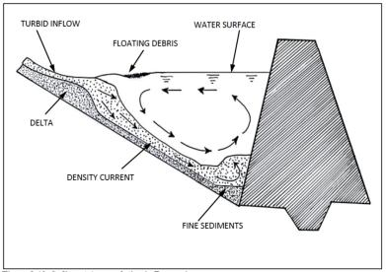
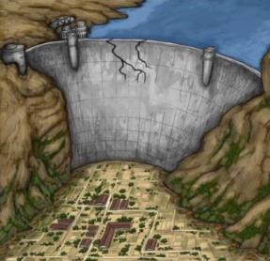
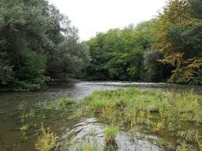
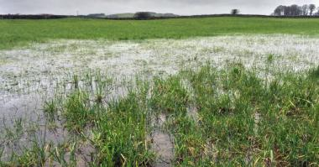
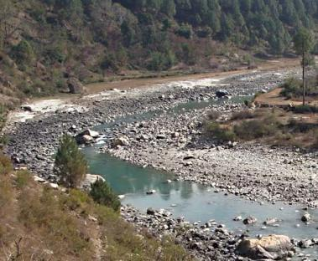
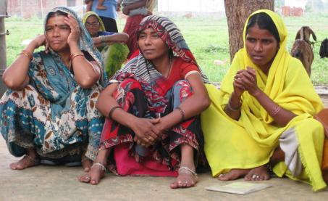
Impacts of big dam
Submerged forest
Silt deposition
Resettlement of displaced people
Waterlogged fields
Drying river at downstream

Slide 10
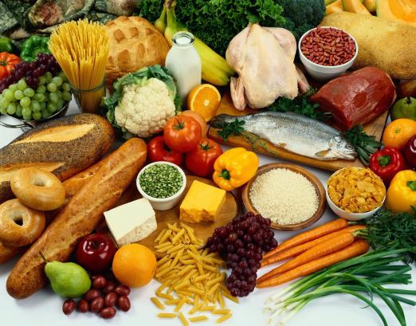
FOOD RESOURCES
Plants and animals are the main source of food for all the organisms on earth. Food obtained from animals is the main source of protein and include fish, milk, meat, poultry, and cheese.
Whereas plants provide us with fruits and vegetables, which are an important source of fibres, proteins and carbohydrates.

Slide 11
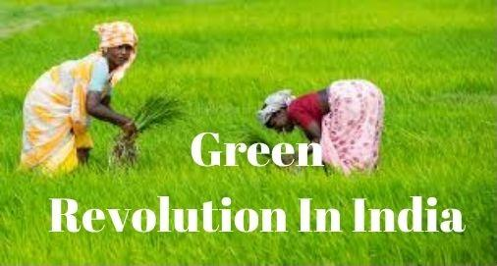
Green Revolution
Green revolution refers to the rapid increase in the world food production, especially in developing countries, in the second half of the twentieth century, primarily through the use of lab-engineered High Yielding Varieties (HYV’s) of seeds.

Slide 12
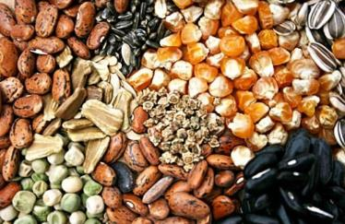
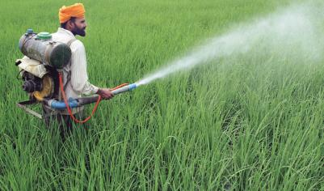
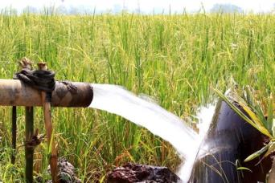
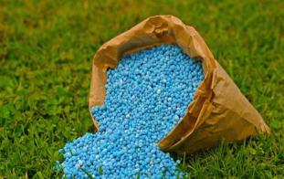
Green Revolution
It came in as a package of high yielding varieties along with inputs of inorganic fertilizers, water, pesticides and agricultural machinery such as tractors and water lifting pumps.
High Yielding variety seeds
Chemical Pesticides
Irrigation
Chemical Fertilizer

Slide 13
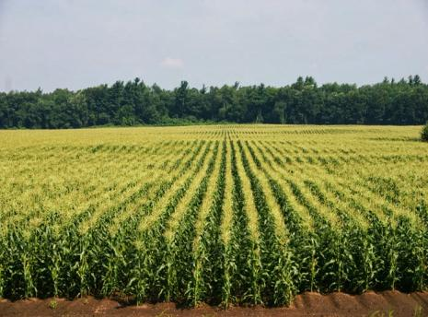
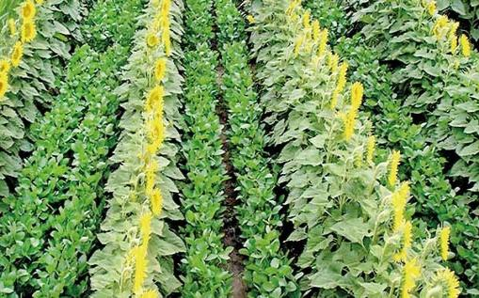
Impact of Green Revolution
The use of high yielding varieties (HYVs) has encouraged monoculture, i.e. the same type is grown over vast areas and in case of attack by some pathogen, and there is a total devastation of the crop by the disease in the whole lot. Moreover, the disease spreads rapidly as the condition are exactly uniform all over growing areas. There has been a great reduction in the genetic diversity both in crop and livestock.
Monoculture
Mixed cropping

Slide 14
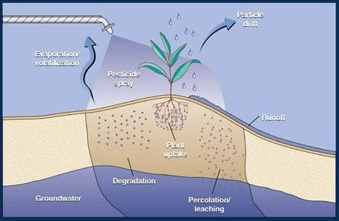
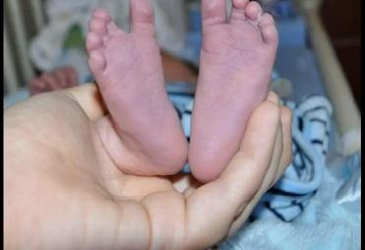
Impact of Green Revolution
Problems caused due to use to fertilisers
Nitrate pollution: nitrogen fertilizers such as urea, applied in the field often leach deep into the soil and invariably contaminate ground water resource. Nitrate consumed through potable water can cause fatal methaemoglobinemea sickness or blue-baby syndrome in which haemoglobin forms methaemoglobin which retards the oxygen transporting capacity of the blood and skin develops bluish colour and in young babies even to death.
Nitrate Leaching
Blue-baby Syndrome

Slide 15
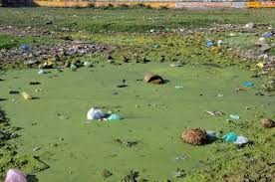
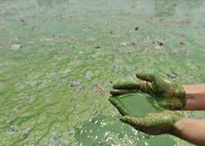
Impact of Green Revolution
Impact of phosphates/ Eutrophication: Excessive use of fertilizers, particularly rich in phosphorus in agricultural fields affects water bodies like lake, reservoirs, ponds etc.
Nutrients such as phosphorus, and nitrogen get washed off from the fields along with runoff water reach the water bodies causing them to become over nourished and give way to the growth of desirable aquatic plants, this is called Eutrophication.

Slide 16
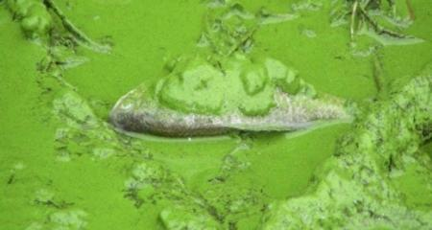
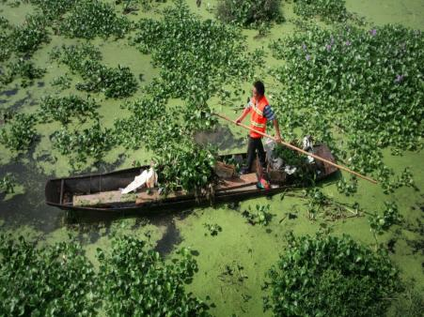
Effects of eutrophication
Effects of Eutrophication:
Abundance of Unwanted Substances
Threatens the Survival of Fish and other Aquatic Life Forms
Deterioration of Water Quality and Limited Access to Safe Drinking Water
Poisoning and Impact on Human Health
Endangers Fishing
Degradation of Recreational Opportunities

Slide 17
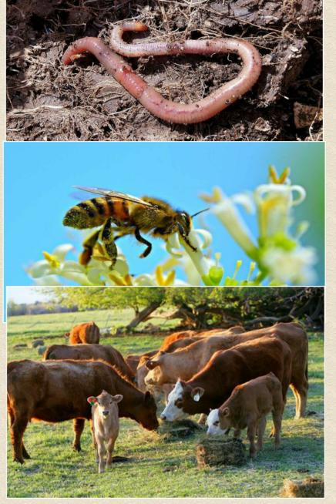
Impact of Green Revolution
Problems associated with the use of pesticides:
Creating resistance in pests and producing new pests
Death of non-target organisms
Biological magnification
Impact on human health

Slide 18
Impact of Green Revolution
Problems due to insecticides can be reduced/controlled by:
Banning dangerous compounds.
Developing alternatives –biological pest control.
Restricting trade of pesticide—contaminated produce.
Controlling pesticide usage.
Developing less dangerous and safer pesticides.
Rotation of crops to upset pest breeding and access to food.
Weeding or non-chemical weeding.

Slide 19

Thankyou

