Slide 1
Kalipada Ghosh Tarai Mahavidyalaya
Bagdogra
Department of Environmental Science

Slide 2
UNIT 2- ECOSYSTEM
LECTURE-2
Topics to be covered
Function of an ecosystem
Energy flow in an ecosystem
Food Chain and Food Web
Ecological Pyramid

Slide 3
Function of an ecosystem
The functional aspect of an ecosystem can be explained as follows:
Fixation of energy
Production of food
Transfer of food
Nutrient cycling and Energy flow

Slide 4
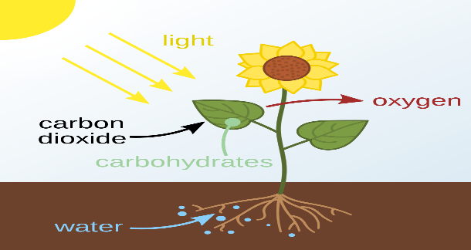
1. Fixation of Energy
In the initial stage, green plants also called producers, fix radiant energy (solar energy) in the presence of chlorophyll (green pigments), carbon dioxide and water through the process called photosynthesis. Carbohydrates thus synthesized in the plants comprise chemical energy, is utilised by the plants for their own metabolic activities as well as by herbivores.

Slide 5
2. Production of food
The food that comprises energy bound organic matter in the organisms is the productivity of an ecosystem and constitutes the biomass. The rate of biomass production is called productivity.
The autotrophs determine the available energy whereas the heterotrophs affect the turnover and cycling of matter within an ecosystem.

Slide 6
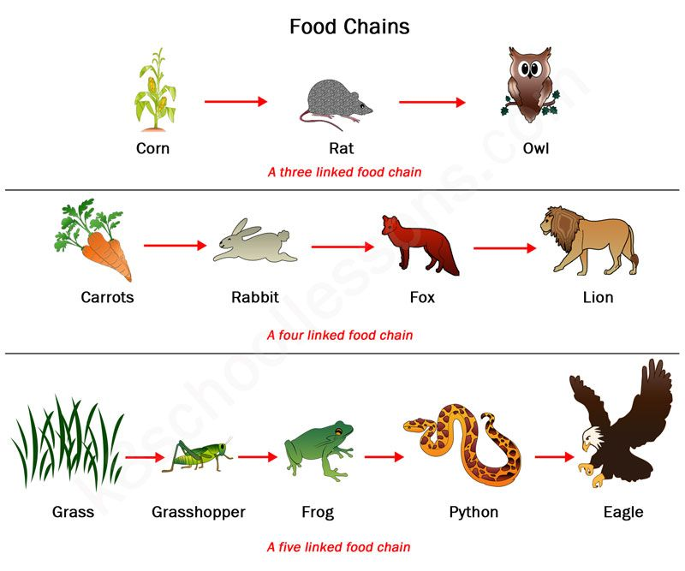
3. Transfer of food
The food synthesized (productivity) by green plants is either taken away by herbivorous organisms by eating them or is lost by the death and decay of plants or plant parts. The herbivorous organisms are eaten by carnivorous animals. The transfer of food energy from the producers through a series (herbivores to carnivores to decomposers) with repeated eating and being eaten is known as a food chain and each constitutes the trophic level.

Slide 7
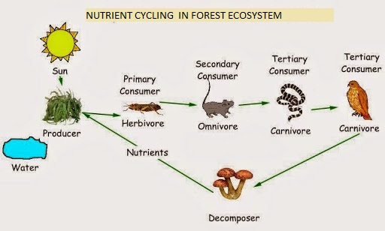
4. Nutrient cycling and Energy flow
Organisms of all trophic levels are subjected to death and decay. So either through a food chain or due to death and decay, the productivity is ultimately decomposed step by step releasing minerals in the soil and energy in the atmosphere.
Since these minerals are again absorbed by the plants and utilized again and again, their movement in the ecosystem is called cyclic
Since energy is ultimately lost in the atmosphere and not utilized again, its movement is unidirectional.

Slide 8
Biogeochemical cycle
Gaseous cycle
Reservoir is in the atmosphere or hydrosphere
Sedimentary cycle
Reservoir is in the lithosphere
Imperfect cycle, very slow
Nitrogen cycle
Oxygen cycle
Carbon cycle
Hydrological (water) cycle
Phosphorus cycle
Sulphur cycle

Slide 9
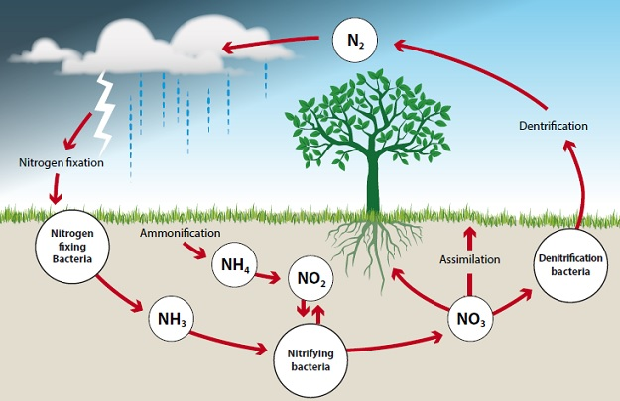
NITROGEN CYCLE
Nitrogen enters into the living beings
Nitrogen fixation: conversion of free atmospheric nitrogen into ammonia.
Ammonification: Plants incorporate fixed nitrogen into the protoplasm by amino acid and protein synthesis.
Nitrification: Conversion of ammonia into nitrates.
II. Nitrogen gets back into the atmosphere
Denitrification

Slide 10
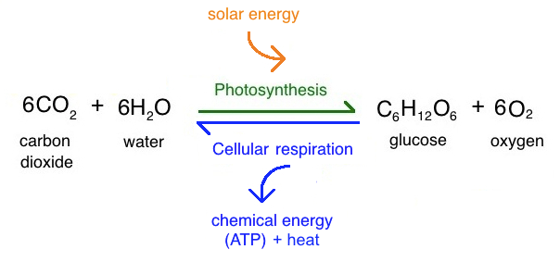
ENERGY FLOW IN ECOSYSTEM

Slide 11
ENERGY FLOW IN ECOSYSTEM
The behavior of energy flow follows two laws of thermodynamics:
First law of thermodynamics: Energy may be converted from one form to another i.e. from light energy to chemical energy, but is neither created nor destroyed, and
Second law thermodynamics: No process involving an energy transformation will occur spontaneously unless there is a loss of energy.

Slide 12
ENERGY FLOW IN ECOSYSTEM
Lost as heat during respiration
Producers
(Autotrophs)
Primary Consumer
(Herbivores)
Secondary Consumer
(Carnivores)
Tertiary Consumers
(Top Carnivores)
Decomposers
(Death and decay)
Lost as heat during respiration

Slide 13
ENERGY FLOW IN ECOSYSTEM (arrows)
Solar Energy
Decomposition
Decomposition
Decomposition
AUTOTROPHS
HERBIVORES
CARNIVORES
Not utilised
Not utilised
Not utilised
Respiration
Respiration
Respiration

Slide 14
ENERGY FLOW IN ECOSYSTEM
Thus there is a progressive loss of energy via respiration from autotrophs to herbivore to carnivore level. The energy captured by the producers does not revert back to the solar input and whichever passes to the herbivores does not pass back to the autotrophs, so is true from herbivores to carnivores. Thus, the passage of energy through different trophic levels is characterised by two attributes:
The flow of energy is always unidirectional.
Some energy is lost at every successive step.
Lindeman’s 10 per cent law: According to this law, during the transfer of organic food energy from one trophic level to the next higher level, only about ten percent of the transferred energy is stored as flesh.

Slide 15
Food chain and Food web
Top Carnivores/ Tertiary Consumer
Forth Trophic Level
Snake
Carnivores/ Secondary Consumer
Frog
Third Trophic Level
Herbivores/ Primary consumer
Grasshopper
Second Trophic Level
Producer
Green Grass
First Trophic Level
Simple food chain in a grassland ecosystem

Slide 16
Food Chain
The transfer of food energy from the source in plants through a series of organisms with repeated eating and being eaten is referred to as food chain.
The successive levels of energy flow constituting the links of the food chain are called trophic levels.
Types of food chains
Grazing food chain, and
Detritus food chain
Grazing food chain: it starts from green plants and operates from herbivores to primary carnivores and so on. Examples of some common grazing food chain are-
Detritus food chain: it starts from dead organic matter to micro-organisms and then to detritus feeding organisms (detrivores) and their predators. The dead organic matter is decomposed into detritus by micro-organisms like bacteria and fungi. A detritus food chain based on forest floor leaves as follows :
Phytoplankton
Aquatic insects
Small Fishes
Big Fishes
Grass
Deer
Tiger
Dead leaves, twigs, fruit
Detrivores
Insects
Birds
Snake

Slide 17
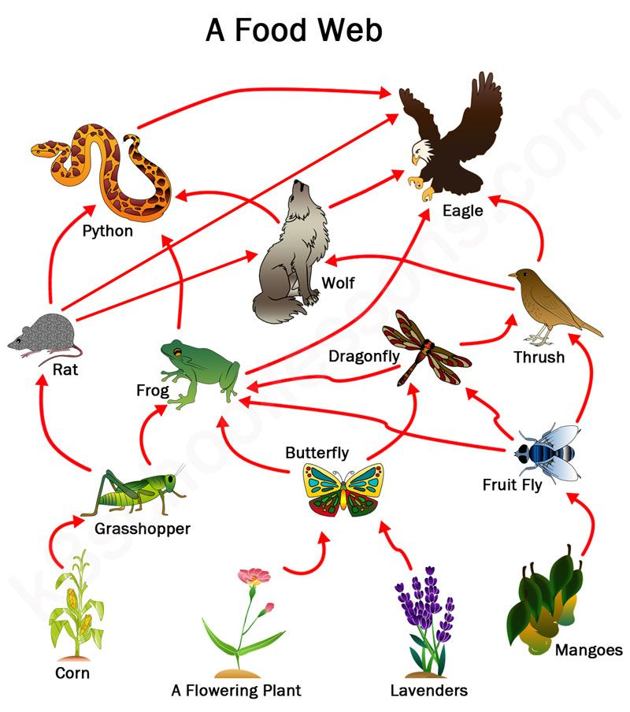
Food Web
In nature, a net work of food chains is found and these interconnected food chains form a structure called food web.
Importance of food webs:
Food webs are quite important in maintaining the ecosystem stability. Food webs with alternative food chains do not let the imbalance occur and in this way play a vital role in the maintenance of the stability of the ecosystem.

Slide 18
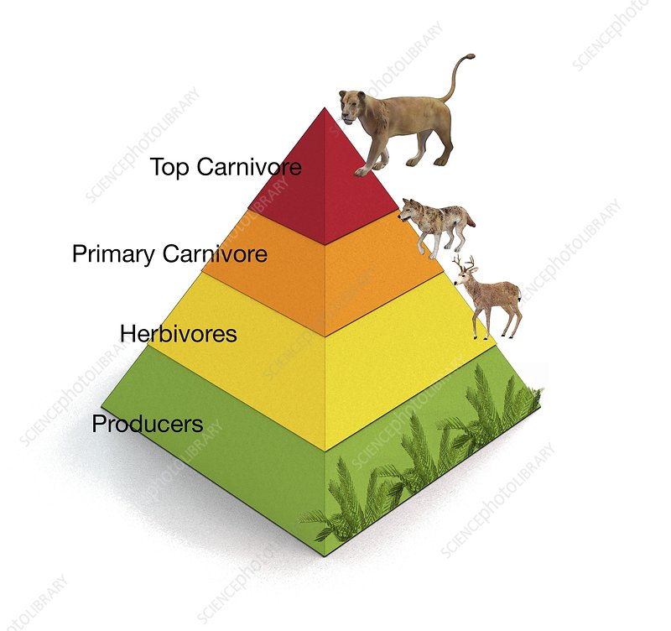
Ecological Pyramid
The graphic representation of relationship between the various trophic levels of a food chain is called ecological pyramids.
Basically three types of pyramids are recognised –
Pyramids of number
Pyramids of biomass
Pyramids of energy

Slide 19
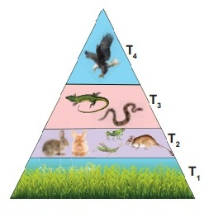
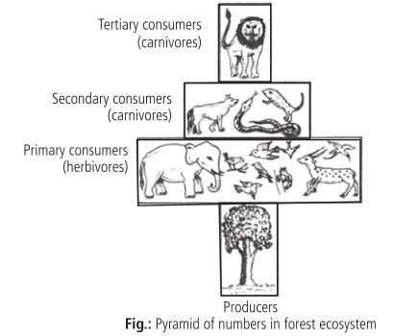
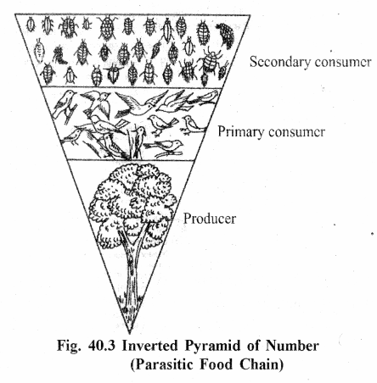
Pyramid of Numbers
Pyramid of numbers: In this, the total number of organisms at each trophic level is counted and accordingly a respective volume to each trophic level in the pyramid is allotted. In majority, the pyramid is upright i.e. broad at the base and narrowest at the top, as in Grassland ecosystem
Grassland Ecosystem
spindle-shaped (broad in the middle) in the forest ecosystem
Forest Ecosystem
Inverted i.e. (narrow at the base and broad at the top) as in a Parasitic Food Chain
Parasitic Food Chain

Slide 20
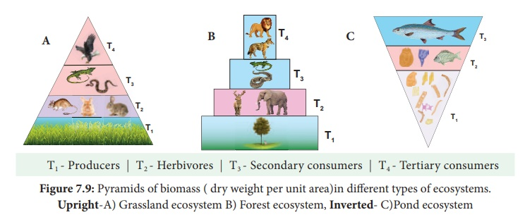
Pyramid of Biomass
Biomass is the total weight of dry matter (dry weight) present in the ecosystem at any one time.
The pyramid shows the total mass of organisms at each trophic level and provides a rough picture of the overall effect of the food chain relationships for the ecological group as a whole. In this dry weight of the organisms at each trophic level is accounted.
It is upright in terrestrial ecosystem but inverted in pond ecosystem.

Slide 21
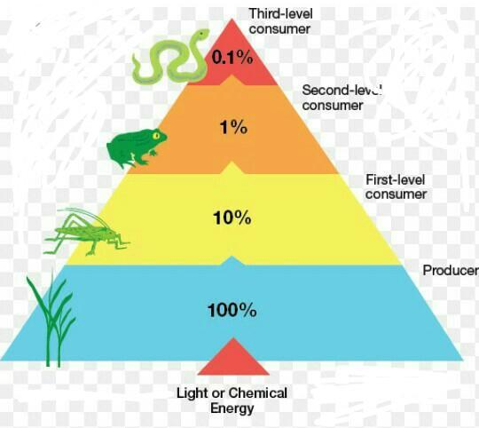
Pyramid of Energy
In this, the amount of total energy at each trophic level is determined.
The amount of energy and matter transferred through food to successive higher levels become less and less.
The deficiency of transfer of energy from one trophic level to another trophic is more or less about 10 %, and as such the general pattern of pyramids of energy remains upright in all different ecosystems.

Slide 22

END OF UNIT – 2
Thankyou

