Slide 1
Kalipada Ghosh Tarai Mahavidyalaya
Bagdogra
Department of Environmental Science

Slide 2
Unit 2: Ecosystems
Syllabus
What is an ecosystem?
Structure and function of ecosystem
Energy flow in an ecosystem
Food chains and food webs
Ecological Pyramids

Slide 3
Unit 2: Ecosystems
Lecture-1
Topics to be covered
Definition
Types of ecosystem
Aspects of ecosystem
Structure of ecosystem
Inter-relationship between biotic and abiotic components
Concept of Homeostasis

Slide 4
ECOSYSTEM
Sir Arthur G Tansley coined the term Ecosystem
Definition: ‘the system resulting from the integration of all living and non-living factors of the environment’
Ecosystem is not a synonym of Habitat

Slide 5
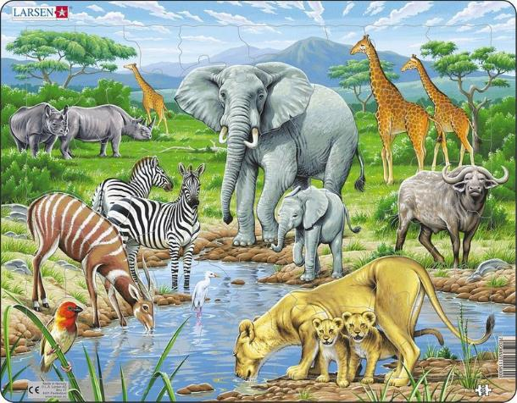
A typical ecosystem

Slide 6
Types of Ecosystems (natural)
Terrestrial Ecosystem
Aquatic Ecosystem
Grassland ecosystem
Forest Ecosystem
Desert Ecosystem
Marine Ecosystem
Freshwater Ecosystem
Pond
Lake
River
Stream

Slide 7
Types of Ecosystems (artificial)
Terrestrial Ecosystem
Aquatic Ecosystem
Crop field Ecosystem
Garden Ecosystem
Aquarium Ecosystem

Slide 8
Aspects of Ecosystem
Structure
Function
Biotic Components
Producers
Consumers
Decomposers
Abiotic Components
Temperature
Water
Light
Humidity
Mineral elements
Topography
Fixation of radiant energy
Production of food
Transfer of food
Nutrient cycling and Energy flow

Slide 9
Structure of an Ecosystem
Biotic Components
Abiotic Components
Producers (Plants)
Consumers (Animals)
Primary consumer
Secondary consumer
Tertiary consumer
Decomposers (Micro-organisms)
Temperature
Water
Light
Humidity
Mineral elements
Topography

Slide 10
Producers (Plants)
Producers are the green plants that manufacture carbohydrates by the process called photosynthesis.
Photosynthesis is the first and the single most process in which solar energy (radiant energy) is converted into chemical energy (potential energy) and since it is carried out only by the green plants, the green plants in an ecosystem are called producers.
Producers are autotrophic, i.e. self nourishing.

Slide 11
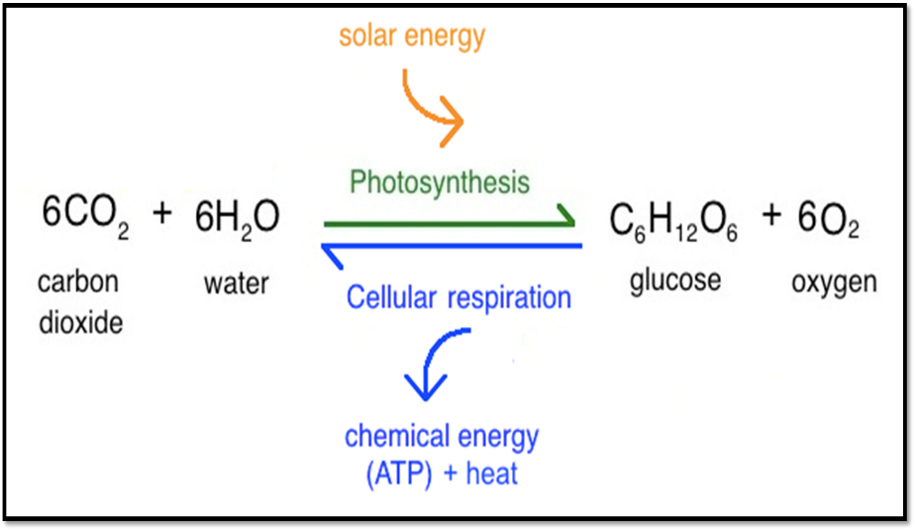
Photosynthesis and Respiration

Slide 12
Consumers (Animals)
The animals that consume directly or indirectly the energy of the food found in the plants are called consumers.
Also known as Phagotrophs as they generally ingest or swallow the food.
They are also called heterotrophs because they depend on plants for their food.
Categories of consumers:
Primary consumers
Secondary consumers
Tertiary consumers

Slide 13
Consumers (Animals)
Primary consumers: These organisms are herbivores which depend upon green plants for their food e.g. cow, goat, rabbit, grasshopper.
Secondary consumers: These organisms are carnivores and are flesh eating animals that are adapted to consume herbivorous animals, e.g. fox, wolves, cats, snakes etc.
Tertiary consumers: They are popularly called top carnivores which prey upon other carnivores and herbivores, e.g. lion, tiger, hawk, vulture etc.

Slide 14
Decomposers
Decomposers are micro-organisms, like fungi and some bacteria, which are incapable of manufacturing their food and live on dead and decaying plants or animals parts. they are also called saprotrophs or detrivores.
These decompose complex organic substances of the dead parts into simpler forms to make them available to other organisms, the producers. By releasing enzymes, they carry out extracellular digestion of the dead remains and convert them into simpler inorganic substances.

Slide 15
Abiotic Components
Climatic factors
Edaphic factors
Temperature
Water
Light
Humidity
Topography
Background
Soil pH
Soil moisture
Soil minerals
Soil porosity

Slide 16
Inter-relationship between Biotic and Abiotic components
Light Energy
Biotic components
Primary consumers
(Herbivores)
Photosynthesis
Biotic components
Secondary consumers
(Carnivores)
Biotic components
(producers)
death
excreta
excreta
death
Decomposers
(saprophytes)
death
Mineralisation
Abiotic Components
N, Ca, Mg, S, CO₂, H₂O, P
Abiotic Components
Physical Decomposition

Slide 17
Concept of Homeostasis
Natural ecosystem are capable of self-regulation and self-maintenance as they are able to maintain a stable steady state.
Odum defined homeostasis as the tendency of natural ecosystem to resist change and to remain in a state of equlibrium.

Slide 18

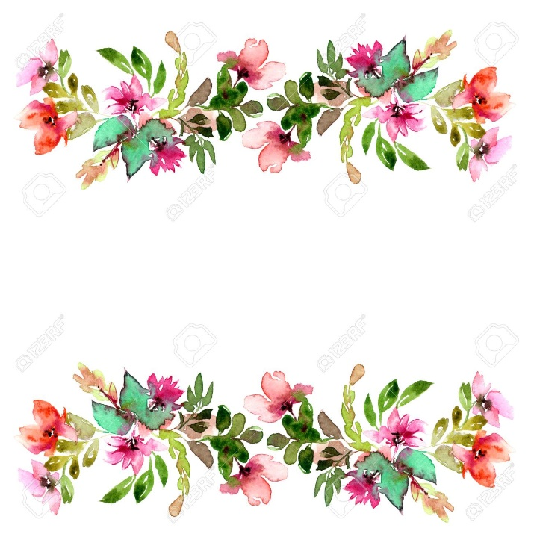
Thankyou

