Slide 1
Understanding the Growth Pole Model of Perroux
DR RANJITA ROY SARKAR
ASSISTANT PROFESSOR, DEPARTMENT OF GEOGRAPHY, KGTM

Slide 2




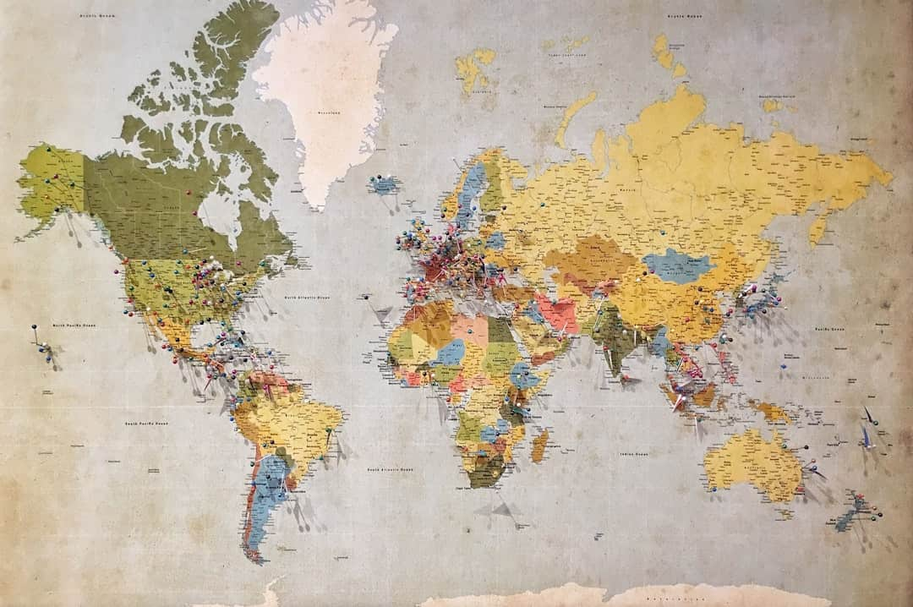

Understanding the Growth Pole Model of Perroux
This presentation explores the Growth Pole Model developed by François Perroux, which emphasizes the role of specific industries in regional economic development. By identifying key growth poles, we can understand how certain areas can stimulate broader economic growth. This model has significant implications for urban planning and regional policy-making, providing insights into how to foster sustainable economic development in various contexts.

Slide 3








Introduction to the Model
Origin of the Model
Regional Focus
Developed by François Perroux in the 1950s to analyze regional growth.
Concentrates economic development in specific regions to enhance productivity.
Key Industries
Economic Linkages
Identifies specific industries as growth poles to drive local economies.
Aims to stimulate surrounding areas through strategic economic connections.
Photo by Leandro Barreto

Slide 4




Key Concepts
Concentrated Economic Activity
Growth poles are regions with high levels of economic concentration and activity.
Regional Development Driver
They stimulate regional growth through industrialization and job creation.
Agglomeration Economies
Perroux emphasized the benefits of agglomeration for enhancing productivity and innovation.
Photo by Jan Kopřiva

Slide 5


Economic Impact of Growth Poles

Slide 6
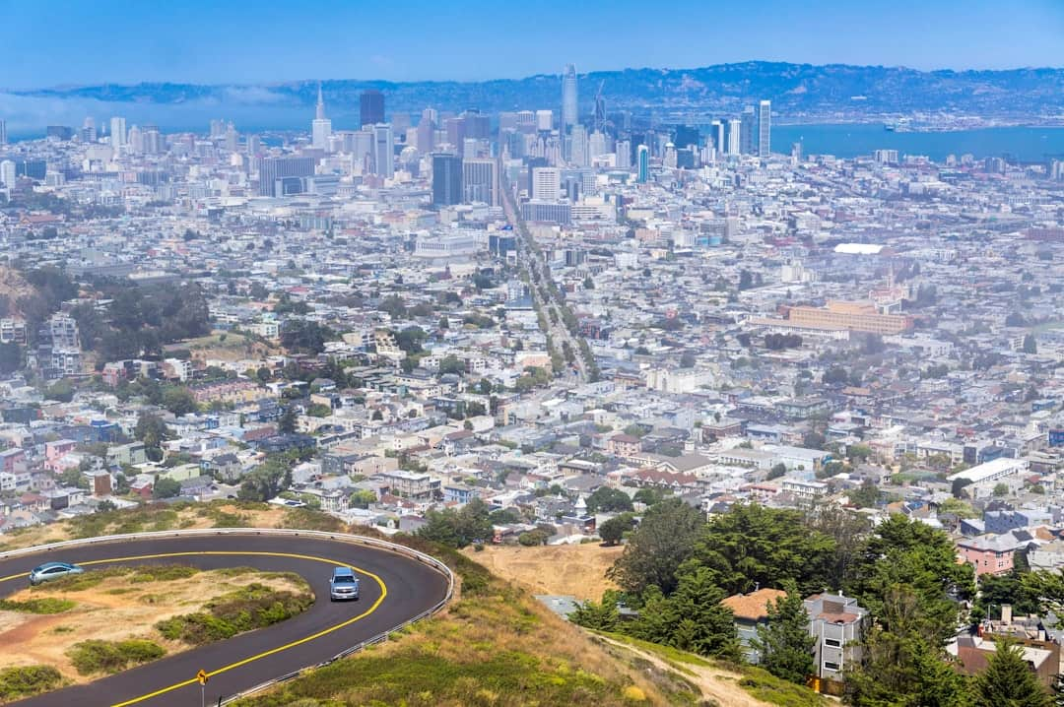





Examples of Growth Poles
Silicon Valley's Tech Hub
Silicon Valley generates over $300 billion in annual revenue, driving global tech innovation.
Detroit's Auto Industry
Detroit was the birthplace of the automobile, producing 75% of U.S. cars in the 1950s.
Asia's Emerging Markets
Countries like Vietnam and India are rapidly developing as new growth poles in technology.
Regional Success Case Studies
Case studies reveal diverse regional strategies leading to successful growth pole dynamics.
Impact on Local Economies
Growth poles significantly boost local economies, creating jobs and attracting investments.
Photo by Piotr Musioł

Slide 7


Growth Poles vs. Growth Centers
Growth Poles
Growth Centers
Focus on specific industries that drive local economies.
Involves broader economic activities across multiple sectors.
Localized impact on employment and income generation.
Wider influence on regional development and infrastructure.
Encourages investment in targeted sectors for rapid growth.
Promotes diversification of the economy to reduce risks.
Can lead to regional disparities if not managed properly.
Encourages balanced regional development and equity.
Policy implications include targeted incentives for specific industries.
Policy implications include comprehensive planning for diverse sectors.

Slide 8



Critiques of the Model
Neglect of Rural Areas
Regional Disparities
Perroux's model often overlooks rural development, focusing excessively on industrial growth.
The model can exacerbate regional inequalities, favoring urban over rural regions significantly.
Environmental Oversights
Need for Inclusivity
Environmental impacts are frequently ignored, leading to unsustainable growth practices.
Critics argue for more inclusive development strategies that address diverse community needs.
Photo by Sveta Fedarava

Slide 9




Growth Pole Dynamics Illustration
This visual represents the Growth Pole Model, highlighting key areas of economic development and their interconnections. It illustrates how growth poles stimulate surrounding regions through infrastructure and investment.

Slide 10
Frequently Asked Questions
?
What are the main drivers of growth poles?
The main drivers of growth poles include innovation, investment in infrastructure, and the concentration of skilled labor, which together stimulate economic activity and attract further investment.
?
How can policymakers leverage this model?
Policymakers can leverage the Growth Pole Model by identifying and supporting key industries and sectors that have the potential to drive regional development and create jobs.
?
What industries are typically identified as growth poles?
Industries such as technology, manufacturing, and services are often identified as growth poles due to their capacity for innovation and job creation.
?
Are there successful examples outside of traditional sectors?
Yes, successful examples include growth poles in renewable energy and creative industries, which have demonstrated significant economic impact and job creation in various regions.

Slide 11



Future of Growth Poles
Adapting to Digital Economies
Sustainability in Strategies
Growth poles must integrate digital technologies to enhance economic resilience and innovation.
Incorporating sustainable practices can lead to long-term viability and community support.
Social Equity Considerations
Emerging Market Potential
Development plans should prioritize social equity to ensure inclusive growth and opportunity.
New growth poles are likely to emerge in developing regions, driven by local entrepreneurship.
Photo by Conny Schneider

Slide 12

Conclusion
Significance of Growth Poles
Regional Dynamics Importance
Perroux's model emphasizes growth poles as engines of regional economic development.
Understanding regional dynamics is essential for crafting effective economic policies.
Future Considerations
Sustainability and equity must be prioritized in future growth pole strategies.
Photo by CHUTTERSNAP

Slide 13






Final Thoughts
In conclusion, the Growth Pole Model of Perroux highlights the significance of strategic economic hubs. Key takeaways include the role of innovation, infrastructure, and regional collaboration. Moving forward, stakeholders should focus on fostering these growth poles to enhance regional development and economic resilience. Embracing this model can lead to sustainable growth and improved quality of life for communities.

