Slide 1




Understanding Geographic Information Systems
DR RANJITA ROY SARKAR , ASSISTANT PROFESSOR, DEPARTMENT OF GEOGRAPHY, KGTM

Slide 2

Understanding Geographic Information Systems
This presentation explores the essential components of Geographic Information Systems (GIS) and the principles behind the Global Positioning System (GPS). GIS integrates hardware, software, and data for capturing, managing, and analyzing spatial information. GPS, on the other hand, provides location data through satellite signals, enabling various applications from navigation to environmental monitoring. Together, these technologies revolutionize how we understand and interact with our world.

Slide 3




What is GIS?
GIS Definition
Core Components
Geographical Information System (GIS) integrates hardware, software, and data to analyze spatial information, enabling informed decision-making across various sectors.
Key components of GIS include data input, data management, spatial analysis, and output, which collectively facilitate effective geographic data utilization.
Applications of GIS
GIS is widely used in urban planning, resource management, and environmental monitoring, such as mapping flood zones for effective disaster management strategies.
Photo by Ståle Grut

Slide 4

GIS Data Types
Vector Data Representation
Vector data represents discrete geographic features like points, lines, and polygons, essential for mapping roads, boundaries, and landmarks in GIS applications.
Raster Data Characteristics
Raster data consists of grid cells representing continuous variables, such as temperature or elevation, allowing for detailed spatial analysis and modeling in GIS.
Geospatial Data Analysis
Geospatial data enables comprehensive analysis of geographic patterns, facilitating decision-making in urban planning, environmental monitoring, and resource management.
Aerial Imagery Example
Aerial imagery is crucial for land cover classification, providing high-resolution visuals that help in assessing land use changes and environmental impacts.

Slide 5
GIS Applications Overview

Slide 6
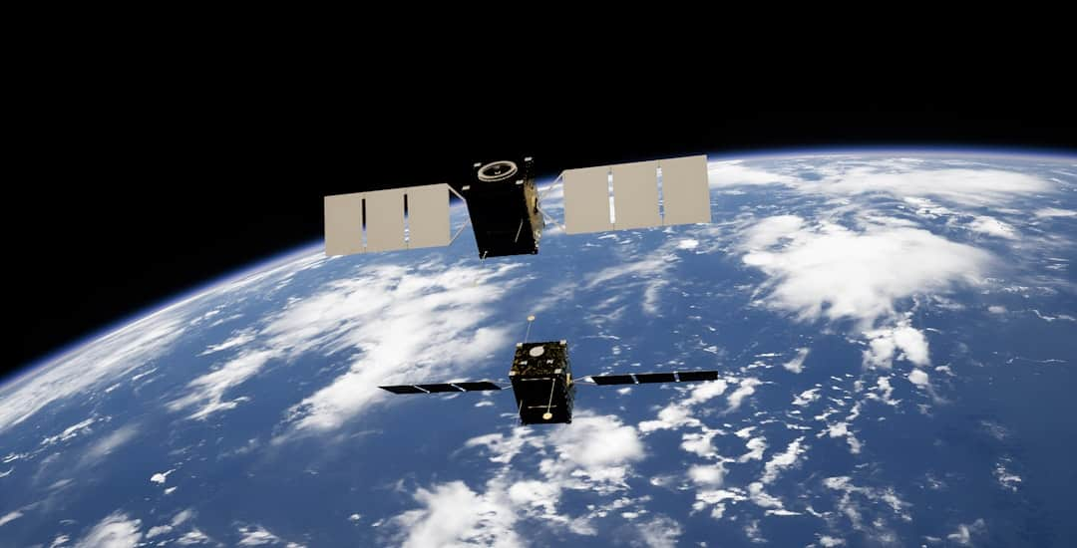




What is GPS?
GPS Overview
GPS is a satellite-based navigation system that provides precise location data to users worldwide, enabling accurate positioning and navigation.
Operational Principles
GPS operates by receiving signals from a network of at least 24 satellites, allowing devices to triangulate their position within meters.
Applications in Navigation
Used extensively in land, sea, and air transport, GPS enhances navigation efficiency, safety, and real-time tracking capabilities in various vehicles.
Smartphone Integration
Modern smartphones utilize GPS technology for real-time location tracking, enabling applications like maps, ride-sharing, and fitness tracking.
Photo by Kevin Stadnyk

Slide 7
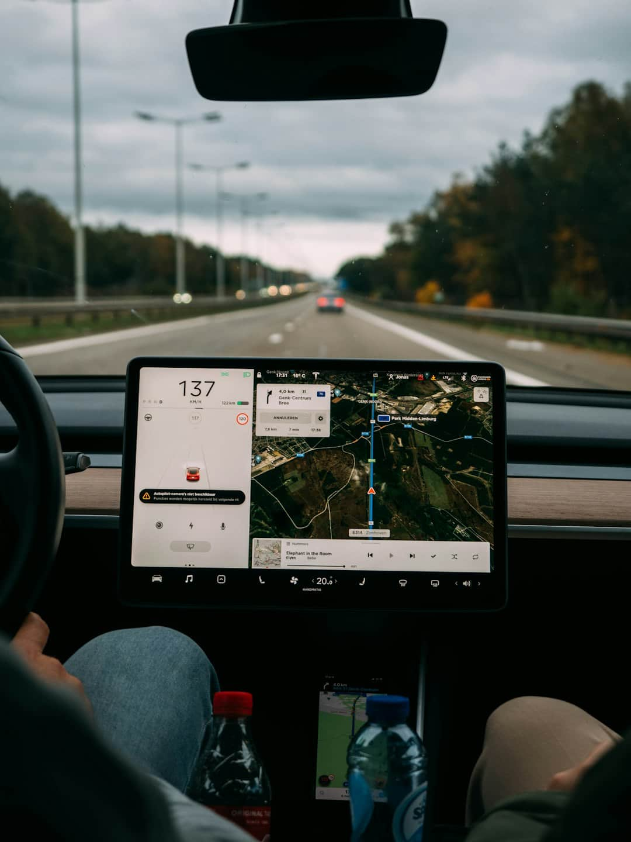




How GPS Works
Trilateration Mechanics
GPS utilizes trilateration, calculating distances from multiple satellites to pinpoint exact locations on Earth with remarkable accuracy, often within a few meters.
Satellite Distance Calculation
Receivers determine their position by calculating distances from at least four satellites, ensuring precise location data through triangulation and signal timing.
Signal Delay Factors
Signal delays and satellite positions are critical in calculations, as they account for atmospheric conditions, enhancing the overall accuracy of GPS technology.
Improved Accuracy
GPS accuracy significantly improves with additional satellite signals, allowing for better navigation and location tracking, especially in urban environments with obstructions.
Photo by Brecht Denil

Slide 8
Comparison of GIS and GPS Technologies
Geographical Information System (GIS)
Global Positioning System (GPS)
Offers precise location data for navigation and tracking.
Provides spatial analysis for informed decision-making.
Focuses primarily on real-time navigation and route guidance.
Handles data management and visualization of geographic data.
Widely used in transportation, logistics, and outdoor activities.
Applications span multiple sectors including urban planning, environmental management, and disaster response.

Slide 9

GIS Applications in Real World
This visual showcases various GIS applications, including urban planning, environmental monitoring, and disaster management. Key takeaway: GIS enhances decision-making through spatial analysis and data visualization.

Slide 10
Transformative Impact of GIS Technology
90%
30%
Organizations Utilizing GIS
Cost Savings in Planning
Over 90% of organizations leverage GIS for informed decision-making.
GIS technology can save cities up to 30% on urban planning costs.
40%
$14B
Improved Emergency Response
Projected Global Market
GIS enhances response times in emergency management by 40%.
The global GIS market is expected to reach $14 billion by 2026.

Slide 11
Frequently Asked Questions
?
What is the main difference between GIS and GPS?
GIS is a system for capturing, storing, analyzing, and managing spatial data, while GPS is a satellite-based navigation system that provides location information.
?
How accurate is GPS technology?
GPS technology typically offers accuracy within 5 to 10 meters for civilian use, but with advanced techniques like Differential GPS, accuracy can improve to within centimeters.
?
Can GIS and GPS be integrated?
Yes, GIS and GPS can be integrated to enhance spatial data collection and analysis, allowing for real-time mapping and location tracking.

Slide 12
Future of GIS and GPS
Advancements in GIS
Advancements in GPS
Enhanced AI-driven analytics for predictive modeling.
Improved accuracy with new satellite systems.
Integration of GPS with mobile technology for real-time tracking.
Integration of GIS with IoT for smart city development.
Development of multi-frequency GPS for enhanced reliability.
Utilization of GIS for climate change adaptation strategies.
Use of GPS in autonomous vehicles for navigation.
Improved data visualization techniques for better decision-making.
Expansion of GPS applications in agriculture and logistics.
Increased accessibility through cloud-based GIS solutions.

Slide 13
Key Takeaways
In summary, GIS and GPS are integral tools for spatial analysis and navigation, respectively. Understanding their components enhances decision-making in various fields, from urban planning to environmental management. As we move forward, integrating these technologies can lead to innovative solutions for complex geographical challenges. Embracing advancements in GIS and GPS will empower professionals to harness data effectively, driving progress in their respective domains.

