Slide 1
Understanding GPS: Principles and Applications
DR RANJITA ROY SARKAR
ASSISTANT PROFESSOR, DEPARTMENT OF GEOGRAPHY, KGTM

Slide 2




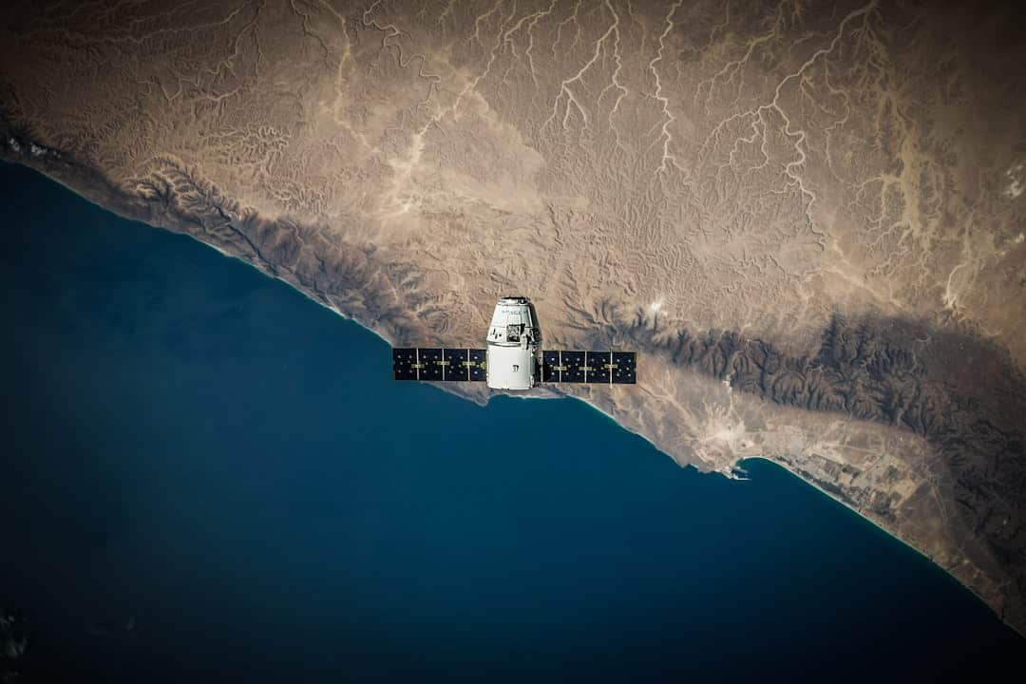

Understanding GPS: Principles and Applications
Global Positioning System (GPS) is a satellite-based navigation system that provides accurate location data. This presentation explores the fundamental principles of GPS technology, its various applications in everyday life, and its impact on sectors like transportation, agriculture, and emergency services. Join us as we delve into how GPS has revolutionized navigation and location-based services.

Slide 3

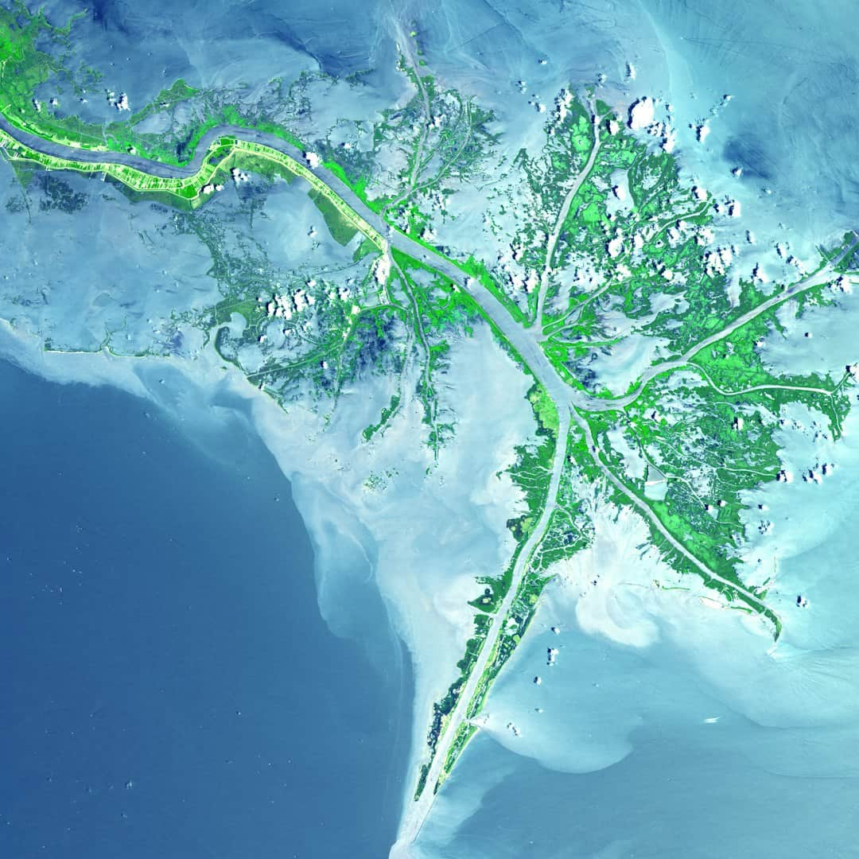






What is GPS?
Definition of GPS
Satellite Navigation
GPS stands for Global Positioning System, a satellite-based navigation tool.
It utilizes a network of satellites to provide precise location data globally.
Time Information
Military Origins
GPS delivers accurate time information, essential for various applications.
Originally developed for military use, GPS has expanded to civilian applications.
Photo by USGS

Slide 4
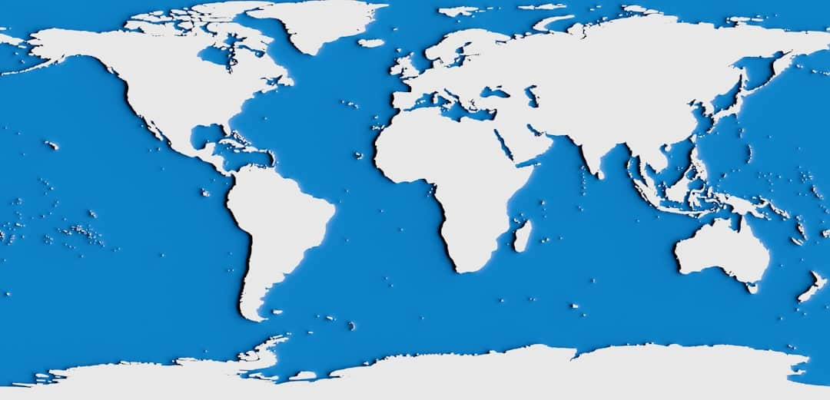



How GPS Works
Satellite Constellation
GPS relies on 31 satellites orbiting Earth to provide accurate positioning data.
Receiver Calculations
GPS receivers determine locations by analyzing signals from multiple satellites simultaneously.
Triangulation Method
Triangulation from satellite signals ensures precise location accuracy within meters.
Photo by Insaanu Studio

Slide 5


GPS Satellite Constellation Overview

Slide 6
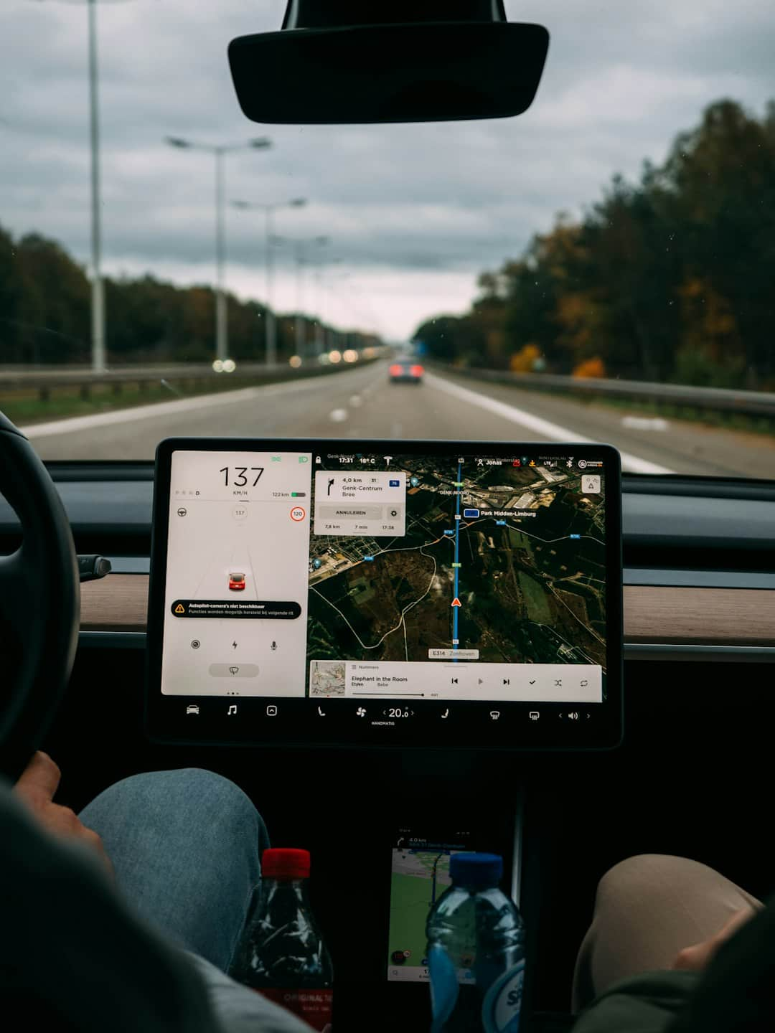





Applications of GPS
Vehicle Navigation Systems
GPS technology enables real-time navigation for over 1.5 billion vehicles globally.
Marine and Aviation Navigation
Ships and aircraft utilize GPS for precise route planning and safety enhancements.
Smartphone Integration
Over 90% of smartphones now incorporate GPS for location-based services and apps.
Precision Agriculture
Farmers use GPS for accurate planting, reducing costs by up to 20% in crop management.
Surveying and Mapping
GPS technology improves mapping accuracy, reducing survey time by approximately 50%.
Photo by Brecht Denil

Slide 7
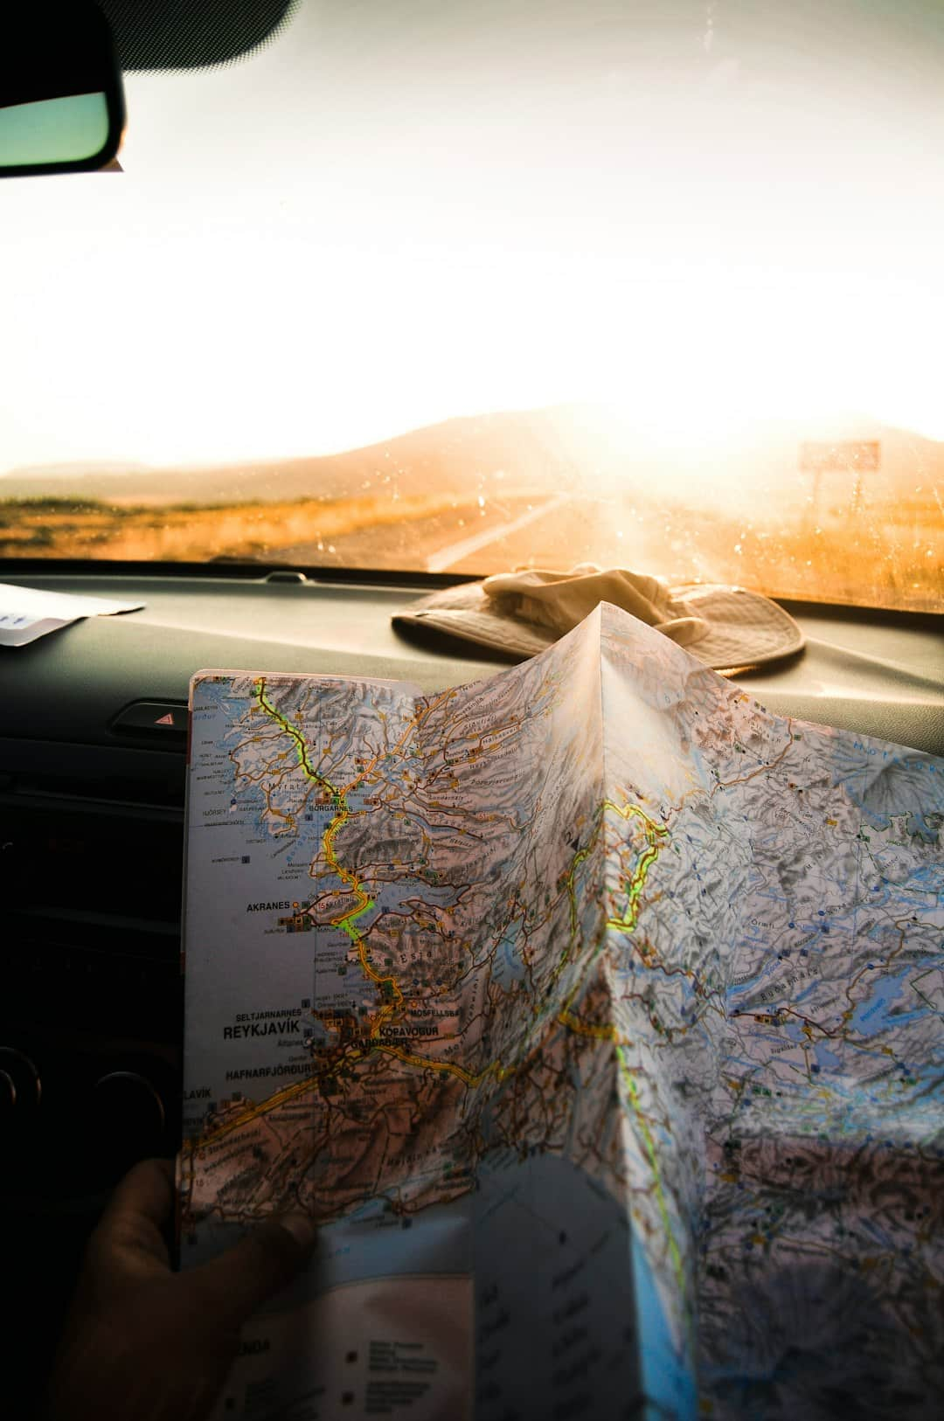
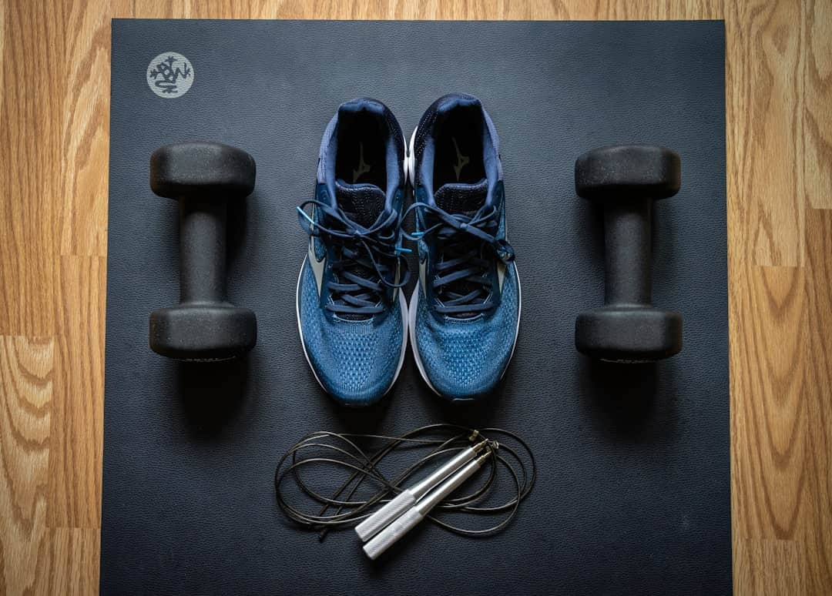





GPS in Everyday Life
Navigation Apps Usage
Fitness Trackers
Google Maps processes over 1 billion requests daily for navigation assistance.
GPS-enabled devices track running distances, improving fitness accuracy by 20%.
Photo by Julentto Photography
Photo by Alexandra Tran
Fleet Tracking Systems
Emergency Services
Logistics companies use GPS to optimize routes, reducing fuel costs by 15%.
GPS technology enables rapid location tracking, improving response times by 30%.
Photo by CHUTTERSNAP

Slide 8


GPS vs. Other Navigation Systems
GPS (Global Positioning System)
GLONASS & Galileo
Developed and maintained by the United States.
GLONASS is operated by Russia, providing global coverage.
Most widely used navigation system globally.
Galileo is Europe's alternative, focusing on civilian applications.
Offers high accuracy and reliability for civilian and military use.
GLONASS has a slightly lower accuracy compared to GPS.
Consists of a constellation of at least 24 satellites.
Galileo aims for high precision and is interoperable with GPS.
Provides real-time positioning, navigation, and timing services.
Both systems enhance global navigation capabilities and redundancy.

Slide 9
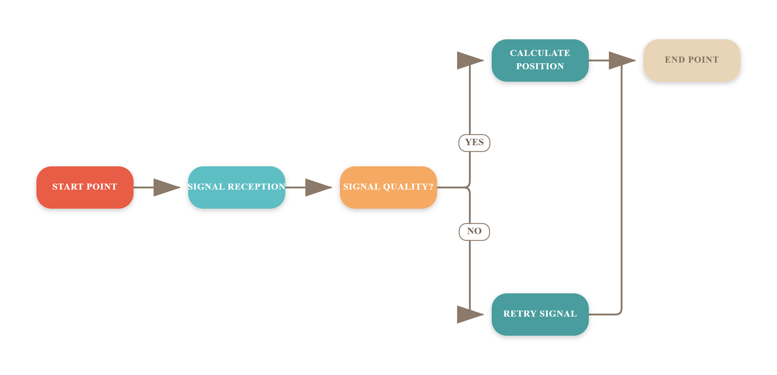
GPS Positioning Process

Slide 10
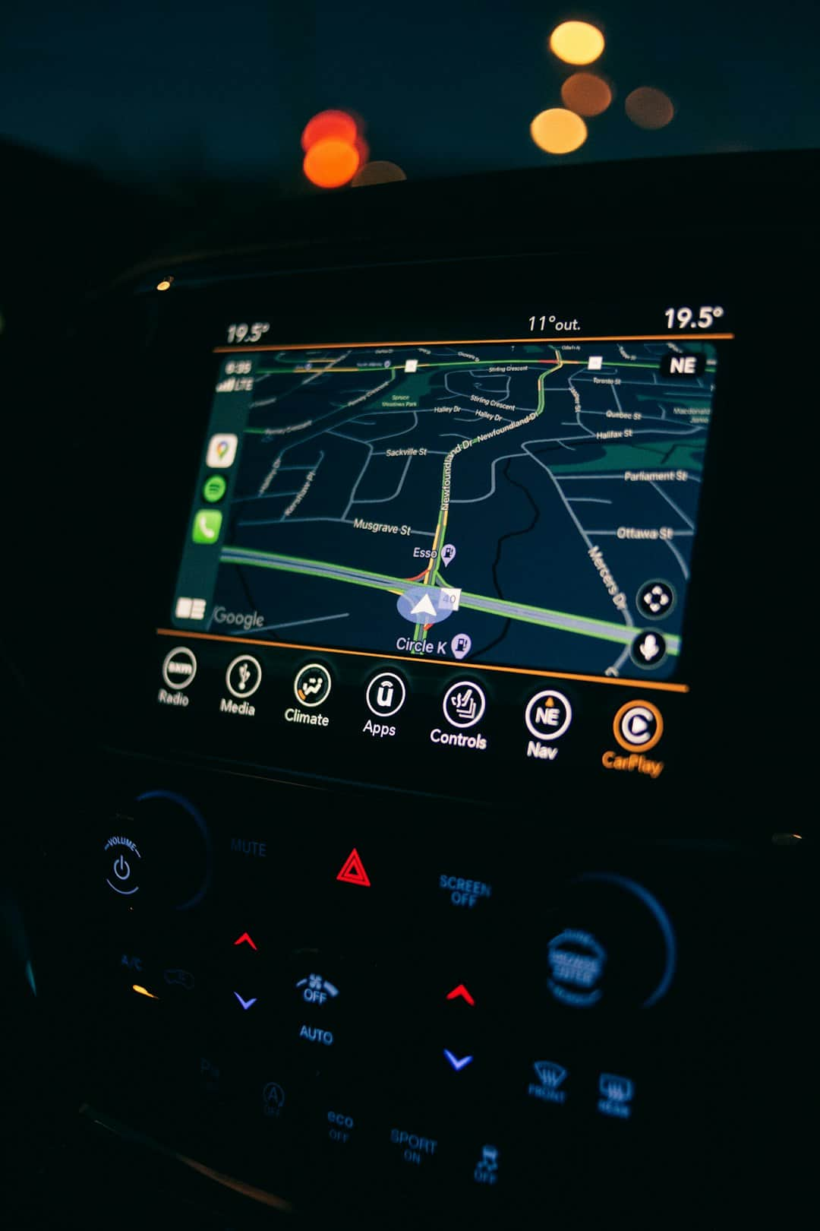



Challenges of GPS
Signal Interference Issues
Weather Impact on Accuracy
Urban structures and terrain can significantly disrupt GPS signal accuracy.
Heavy rain or storms can reduce GPS precision by up to 50%.
Privacy Concerns
Location tracking raises significant privacy issues for users and organizations.
Photo by Erik Mclean

Slide 11



Transformative Impact of GPS Technology
90%
4B+
$100B+
Smartphone Integration
GPS Devices
Savings in Logistics
In use globally, revolutionizing navigation
Annual savings attributed to GPS efficiency
GPS technology embedded in nearly all smartphones

Slide 12
Frequently Asked Questions
?
How accurate is GPS?
GPS can provide location accuracy within 5 to 10 meters under open sky conditions, but accuracy can vary based on environmental factors.
?
What happens if satellites fail?
If a satellite fails, GPS receivers can still function using signals from other operational satellites, but overall accuracy and reliability may decrease.
?
Can GPS work indoors?
GPS signals are weak indoors due to obstructions, making it difficult for devices to determine precise locations; alternative technologies like Wi-Fi positioning may be used instead.
?
How is GPS data secured?
GPS data is transmitted using encrypted signals for military applications, while civilian use relies on open signals that are less secure but still monitored for accuracy.

Slide 13






Key Takeaways
In summary, GPS technology has revolutionized navigation, enhanced precision in various fields, and improved safety. Key applications include transportation, agriculture, and disaster management. As GPS continues to evolve, embracing advancements like augmented reality and integration with IoT will further enhance its utility. The future of GPS promises even greater innovations that will shape our world.

