Slide 1
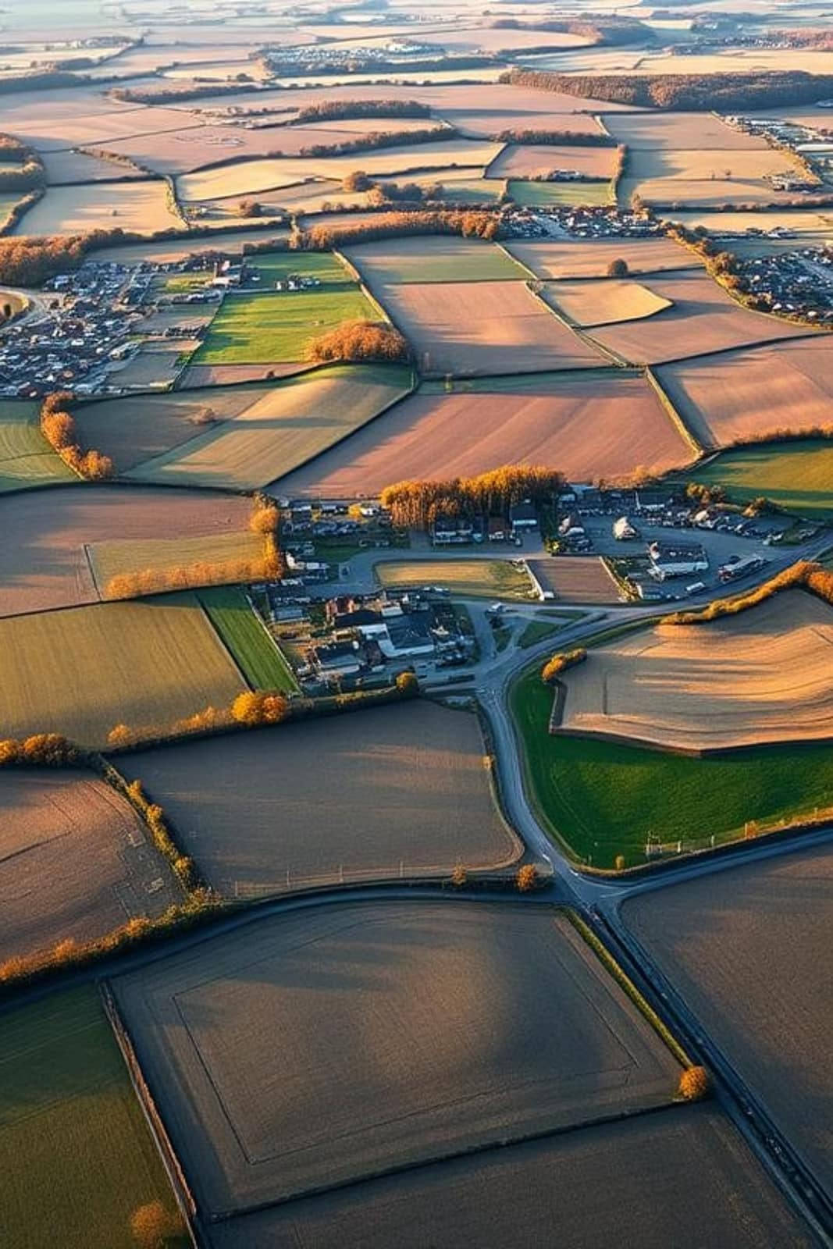
Types and Patterns of Rural Settlement
Presented by Dr. Suraj Tamang

Slide 2
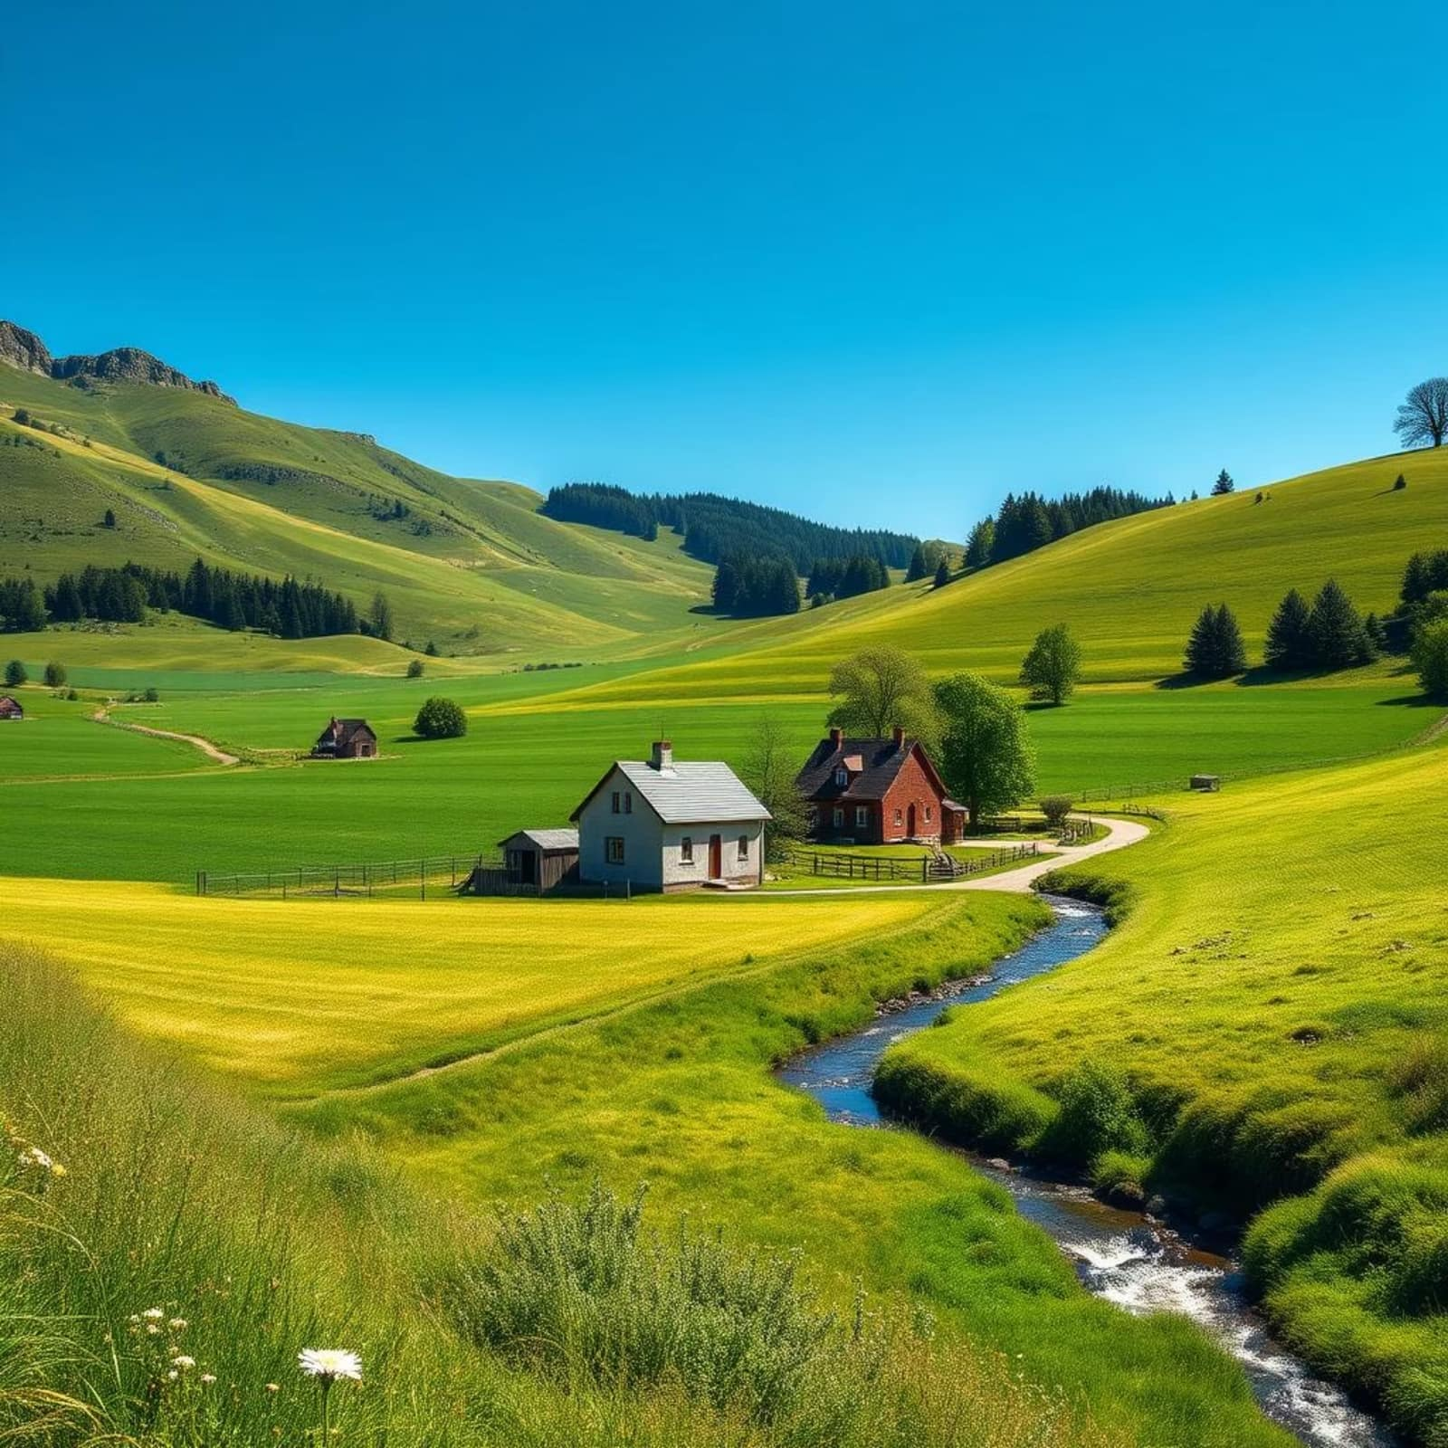
What is a Rural Settlement?
A rural settlement is a community where people live in non-urban areas, typically involved in primary economic activities like farming, fishing, forestry, or mining. These settlements are characterized by:
Small population size
Limited infrastructure
Diverse range from single farms to small villages

Slide 3




Main Types of Rural Settlements
Clustered
Dispersed
Houses grouped closely around a central feature, fostering community and shared resources.
Houses spread widely over large areas, common in regions with extensive agriculture.
Linear
Nucleated
Buildings arranged along transport routes like roads, rivers, or coastlines.
Buildings densely clustered, often for historical reasons of defense or social interaction.

Slide 4
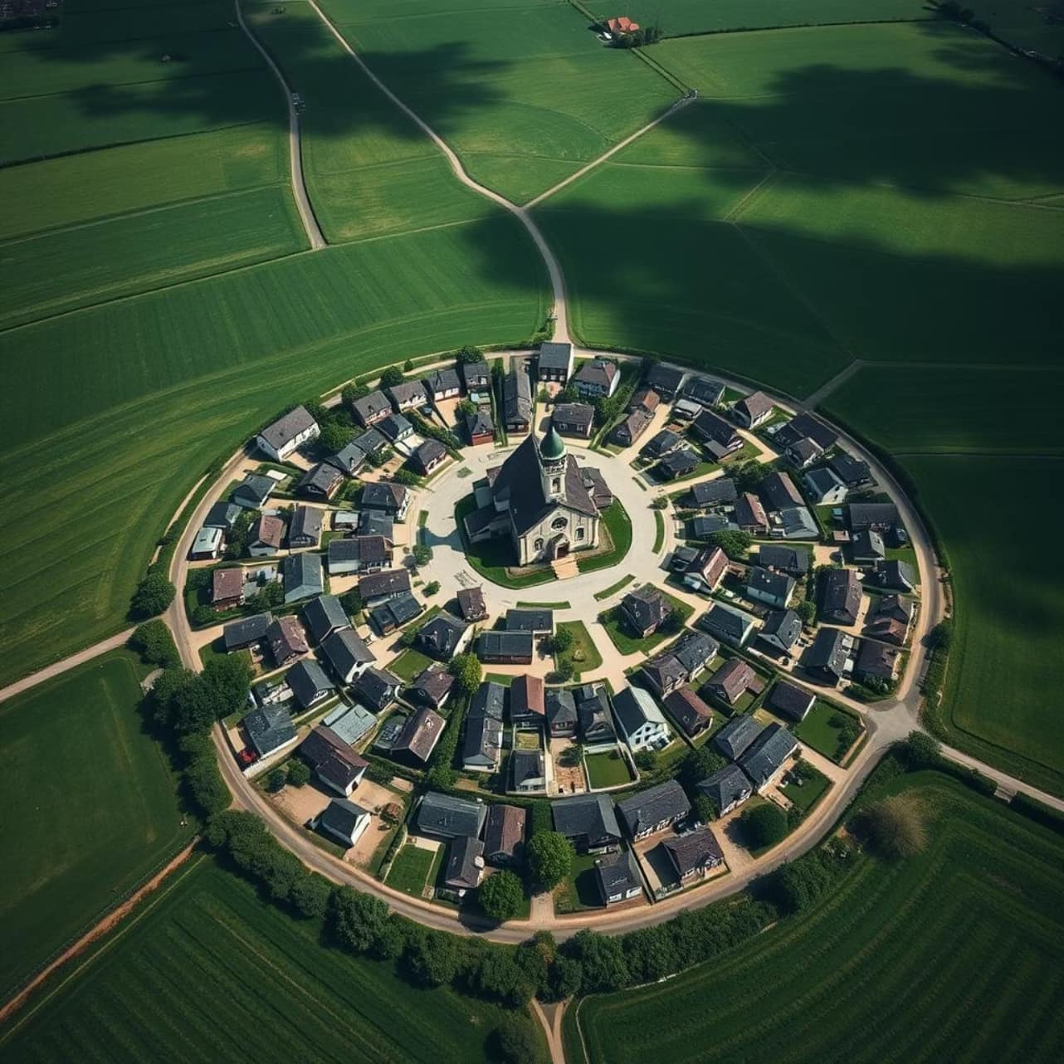
Clustered Settlement Pattern
This pattern features a dense grouping of homes around a central focal point, such as a church, market, or well. This layout offers several advantages:
Enhanced social interaction and community ties
Improved collective defense against threats
Easier access to shared resources and services
Often found in fertile plains and areas with reliable water sources, like Little Thetford, England.

Slide 5
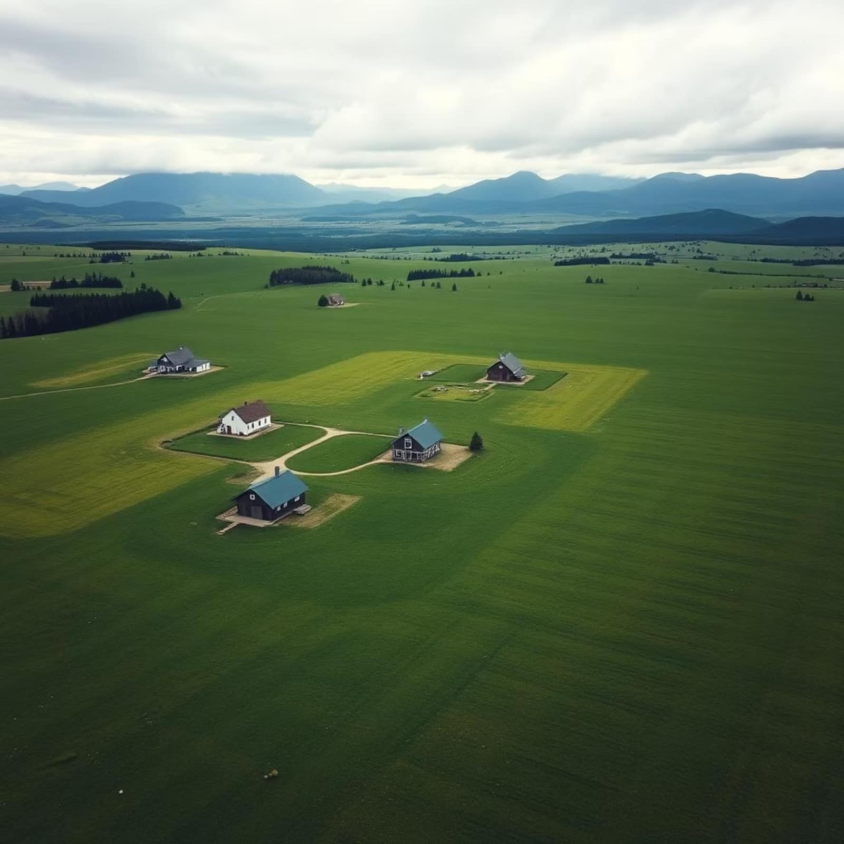
Dispersed Settlement Pattern
Characterized by individual farms or houses spread far apart across the landscape. This pattern is prevalent in:
Areas with large-scale agricultural practices
Regions with challenging terrain or harsh climates
Places with limited transport infrastructure
Examples include vast ranch lands or isolated mountain communities, such as Brülisau, Switzerland.

Slide 6


Linear and Nucleated Patterns
Linear Settlements
Nuclaeated Settlements
Buildings aligned along a natural or man-made linear feature. This layout optimizes access to transportation routes and facilitates communication within the community.
A tightly clustered core of buildings often surrounded by agricultuaral land. These settlements frequently have historical roots, having formed for defensive purposes or as centers of trade and social life.

Slide 7
Factors Influencing Rural Settlement Patterns
Physical
Economic
Terrain, water availability, and climate dictate where and how settlements can form and persist.
The type of farming, access to markets, transport networks, and resource locations shape settlement distribution.
Social
Historical
Defense needs, cultural traditions, community ties, and historical migration patterns influence grouping or dispersal.
Past land ownership systems, colonization, and historical events leave lasting imprints on settlement patterns.

Slide 8
Summary and Importance
Rural settlements are a tangible reflection of the intricate relationship between the environment and human needs.
Studying diverse global examples enhances our comprehension of their formation and ongoing evolution.
Distinct patterns profoundly impact social life, economic activities, and land use efficiency.
Understanding these patterns is crucial for informed rural planning and sustainable development initiatives.

Slide 9
Thank you

