Slide 1
The Role, Value, and Ethics of Fieldwork
DR RANJITA ROY SARKAR
ASSISTANT PROFESSOR, DEPARTMENT OF GEOGRAPHY, KGTM

Slide 2




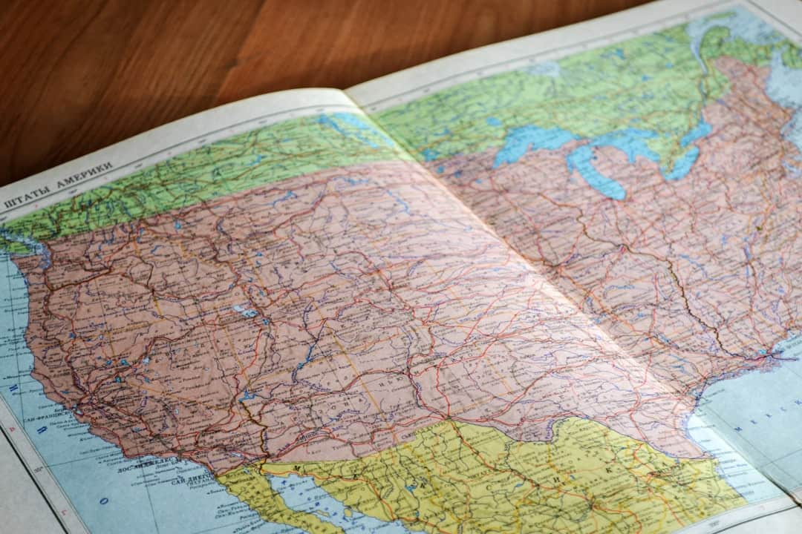

The Role, Value, and Ethics of Fieldwork
Fieldwork is essential in geography, providing firsthand data and insights. It enhances understanding of spatial patterns and human-environment interactions. This presentation explores the significance of fieldwork, its ethical considerations, and its impact on research quality. By examining real-world examples, we will highlight how fieldwork contributes to academic and practical applications in geography and related fields.

Slide 3








Introduction to Field Work
Hands-On Research Experience
Bridging Theory and Practice
Field work involves practical research in natural environments, enhancing learning outcomes.
It connects theoretical knowledge with real-world applications, enriching academic understanding.
Fostering Critical Skills
Interdisciplinary Relevance
Conducting field work develops critical thinking and problem-solving abilities in students.
Field work is essential in geography, biology, and anthropology, among other disciplines.
Photo by Nik

Slide 4




Role of Field Work
Firsthand Data Collection
Field work provides firsthand data, enhancing the validity of research findings.
Direct Observation
Researchers observe phenomena directly, gaining insights into natural contexts and behaviors.
Community Engagement
Field work fosters collaboration, strengthening ties between researchers and local communities.
Photo by Jan Kopřiva

Slide 5



Overall challenge being addressed
The Problem
Our Solution
Field work is often undervalued in academic and decision-making processes, leading to a disconnect between theory and practice.
Implementing comprehensive field work programs can bridge the gap between theory and practice, enhancing both academic and community outcomes.
Lack of empirical data to support decision-making.
Contributes to evidence-based decision-making with real-world data.
Limited understanding of local contexts and issues.
Enriches academic knowledge by providing practical insights.
Insufficient integration of practical insights into academic curricula.
Fosters innovative solutions tailored to local issues.
Challenges in addressing environmental and social changes effectively.
Enhances understanding of environmental and social changes through direct engagement.

Slide 6






Ethics in Field Work
Informed Consent Importance
Informed consent respects participants' rights and promotes ethical research practices.
Confidentiality Assurance
Research must ensure confidentiality to protect subjects' identities and personal information.
Avoiding Exploitation
Field work should not exploit or harm communities or their environments during research.
Integrity in Research
Adhering to ethical guidelines maintains integrity and transparency throughout the research process.
Community Engagement
Engaging communities ethically fosters trust and enhances the quality of research outcomes.
Photo by Kyle Glenn

Slide 7


Field Work Impact Statistics

Slide 8


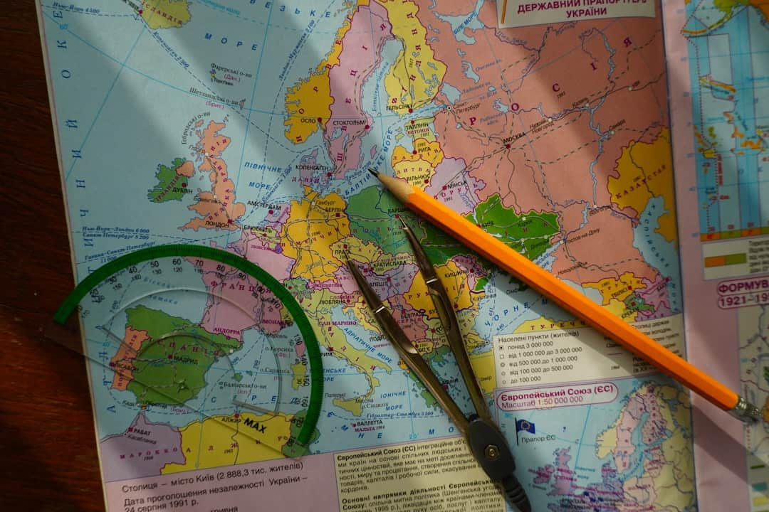

Field Work in Action
This slide showcases various field work activities, emphasizing hands-on learning and real-world applications. Key takeaway: Field work enhances understanding of geographical concepts through direct engagement.

Slide 9


Field Work vs. Laboratory Research
Field Work
Laboratory Research
Offers real-world insights and practical applications.
Provides controlled conditions for precise measurements.
Captures complex variables and interactions in natural settings.
Minimizes external variables to isolate specific factors.
Emphasizes context and environmental factors influencing results.
Facilitates repeatability and verification of experiments.

Slide 10
How to Conduct Ethical Field Work
1
Obtain Informed Consent
Ensure that all participants are fully aware of the purpose of the research, what their involvement entails, and any potential risks. Obtain their explicit consent before proceeding.
2
Ensure Confidentiality
Implement measures to protect the identity and data of participants. Use anonymization techniques and secure data storage to maintain confidentiality.
3
Minimize Environmental Impact
Plan fieldwork activities to reduce disruption to the local environment and communities. Follow guidelines for sustainable practices and respect local ecosystems.
4
Report Findings Transparently
Share research results honestly and responsibly, acknowledging any limitations and the context of the findings. Ensure that the reporting does not misrepresent the data or the participants.

Slide 11
Frequently Asked Questions
?
What types of research benefit from field work?
Field work is particularly beneficial for qualitative research, environmental studies, and social sciences, where direct observation and interaction with subjects provide deeper insights.
?
How can one ensure ethical practices in field studies?
Researchers can ensure ethical practices by obtaining informed consent, respecting participants' privacy, and adhering to institutional review board guidelines.
?
What challenges do researchers face in the field?
Common challenges include logistical issues, unpredictable weather, cultural differences, and potential safety risks, which can impact data collection and participant engagement.
?
How do findings from field work influence policy-making?
Field work findings provide empirical evidence that can inform policy decisions, highlight community needs, and support advocacy efforts for social change.

Slide 12





Future of Field Work
Tech Integration in Research
Sustainability Focus
Drones and GIS enhance data collection efficiency by 40% in field studies.
Research now prioritizes sustainable practices, reducing environmental impact significantly.
Community Collaboration
Remote Sensing Growth
Engaging local communities improves research relevance and data accuracy by 25%.
Remote sensing technologies are revolutionizing data collection in inaccessible areas.
Virtual Field Work Trends
Virtual field work is increasing accessibility, allowing global participation in research.
Photo by Alessio Soggetti

Slide 13






Conclusion
Fieldwork is essential for practical understanding and application of theoretical concepts in geography. It fosters critical thinking, enhances observational skills, and promotes ethical considerations in research. By engaging directly with environments and communities, researchers can gather invaluable data that informs policy and practice. Emphasizing fieldwork's role will ensure future generations are equipped to address complex geographical challenges effectively.

