Slide 1
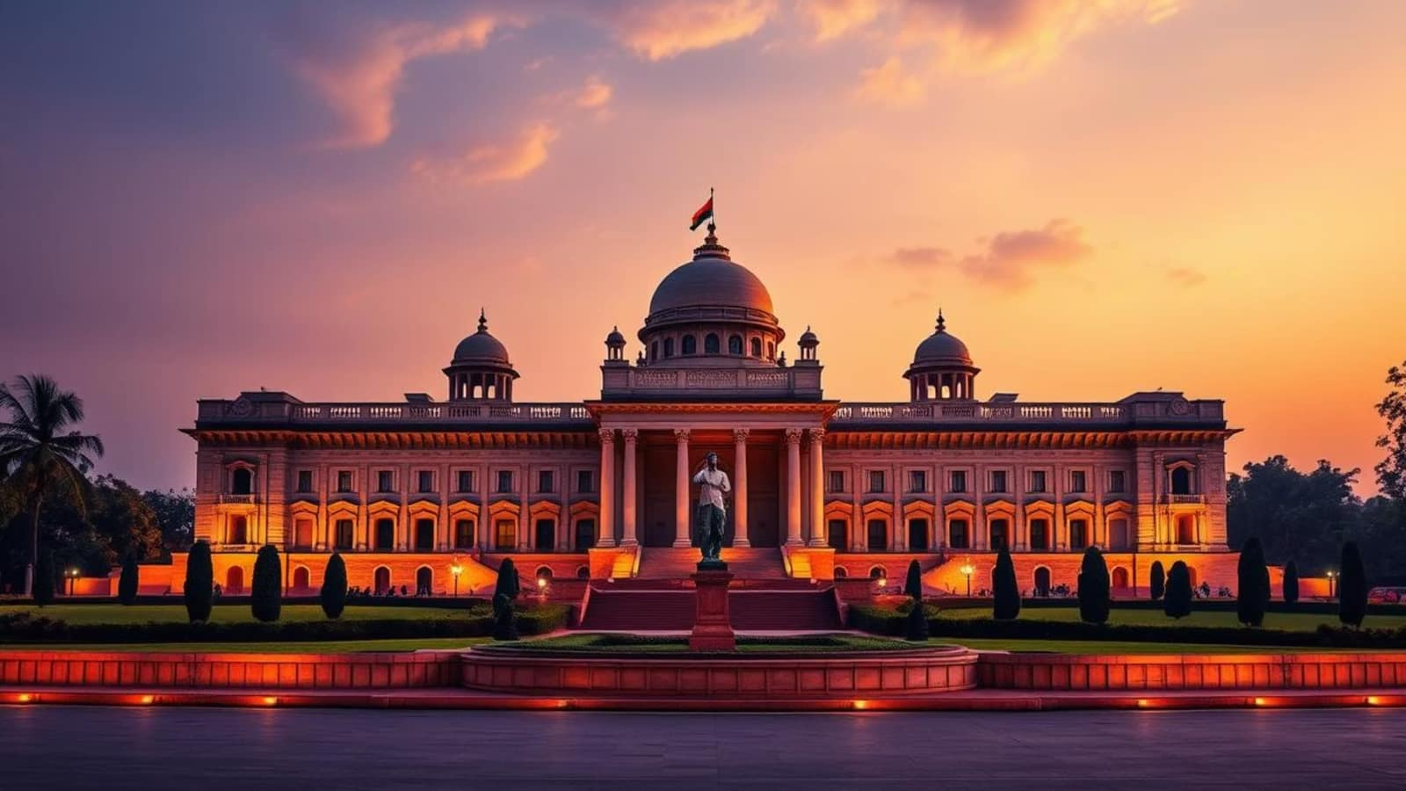
The President of India
Roles, Responsibilities, and Legacy
Prepared by Sarat Chandra Roy

Slide 2
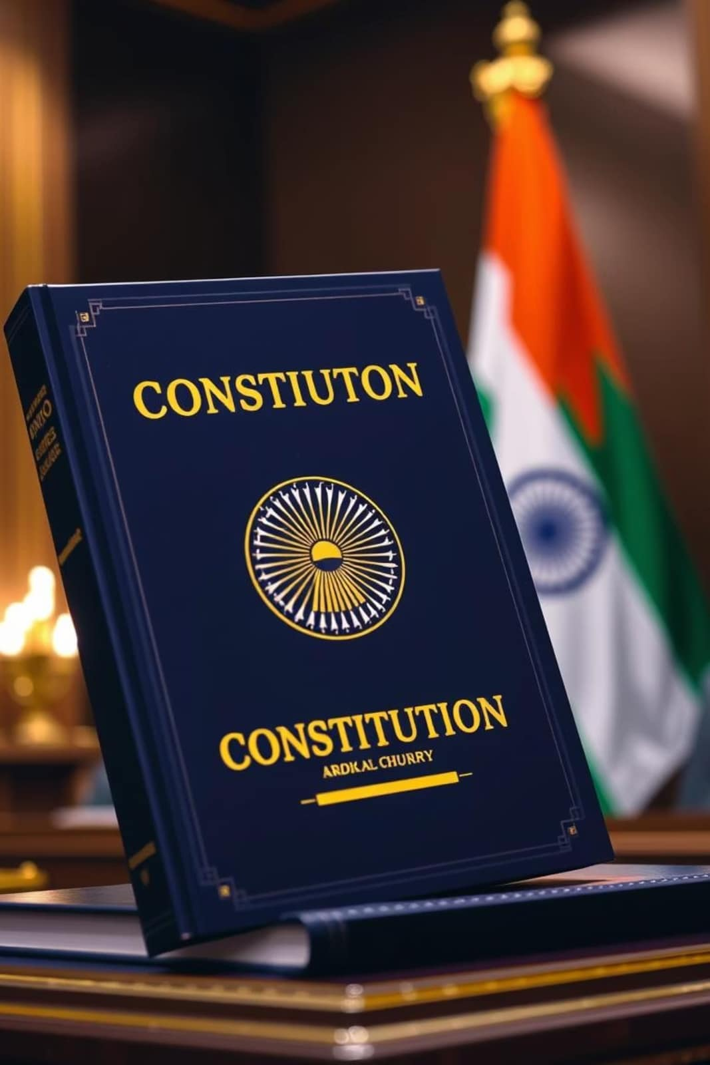
Journey to Understanding India's First Citizen
Constitutional Foundation
The President as the supreme executive authority under Articles 52-78
Democratic Symbol
Representing the unity and integrity of the Indian Republic
Guardian of Constitution
Upholding democratic values and constitutional principles

Slide 3
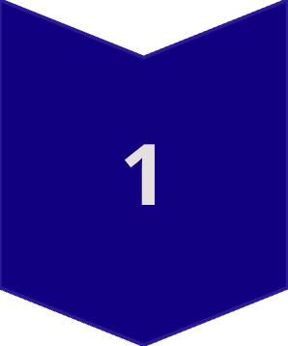

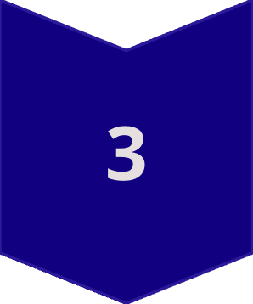
Presentation Overview
Constitutional Framework
Powers, provisions, and election process
Presidential Functions
Beyond ceremonial duties to nation building
Legacy and Evolution
Notable presidents and contemporary challenges

Slide 4
Constitutional Framework
Powers and Provisions

Slide 5
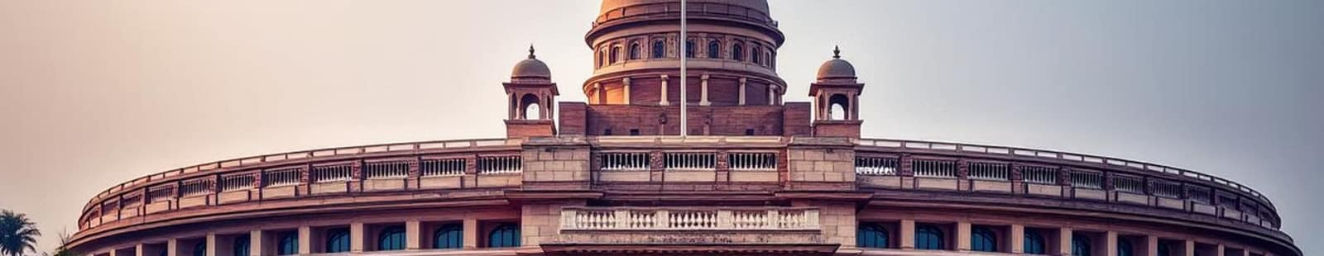
The Office of President
Art. 52
5 Years
15
Constitutional Provision
Term of Office
Presidents So Far
Executive power vested in the President of India
Eligible for re-election with no term limits
Including current President Droupadi Murmu

Slide 6
Presidential Powers Under the Constitution
Executive Powers
Legislative Powers
Appointment of Prime Minister and Council of Ministers
Summoning and proroguing Parliament
Assent to bills passed by Parliament
Appointment of governors, judges, and key officials
Promulgation of ordinances
Supreme commander of defence forces
Judicial Powers
Power to grant pardons and commute sentences
Appointment of Chief Justice and Supreme Court judges
Consultation on constitutional matters

Slide 7
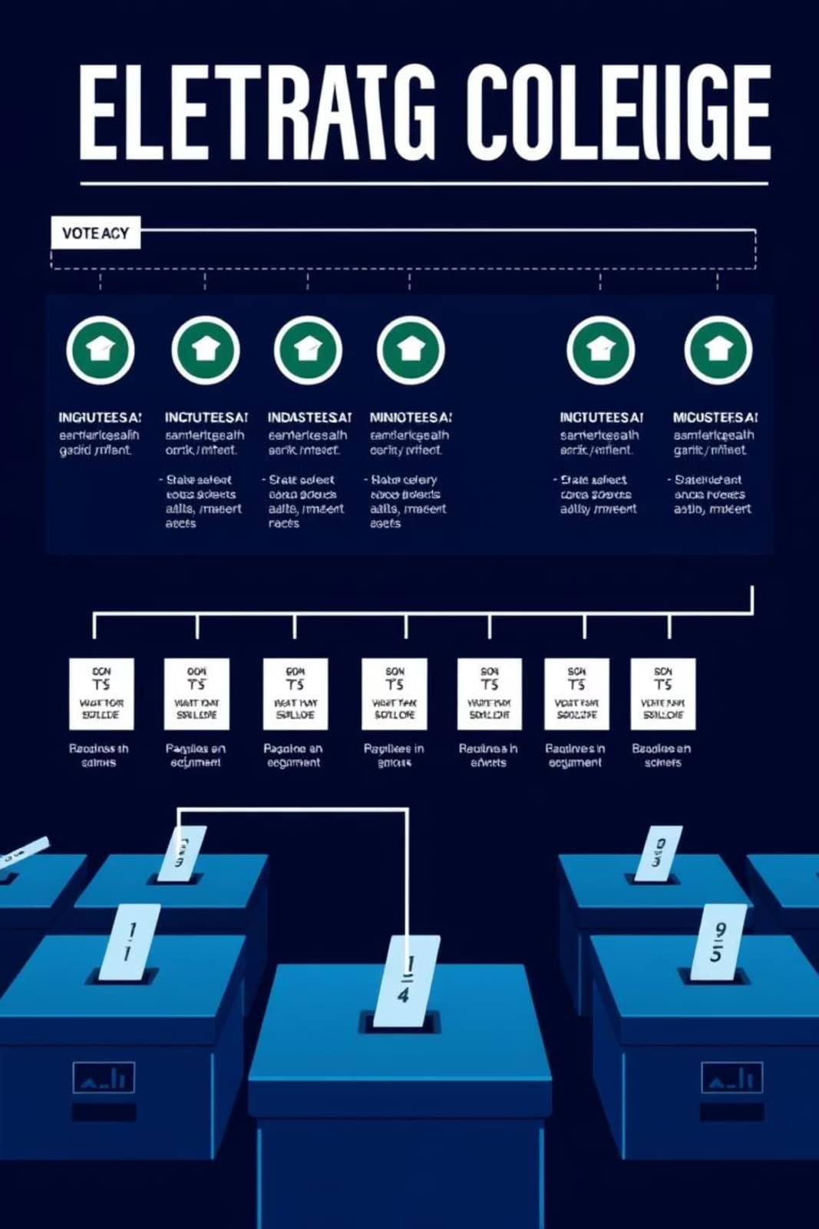
Election of the President
Electoral College System
Elected by MPs and MLAs through proportional representation
Value of Votes
Each MLA vote = State population/1000 × No. of MLAs
Nomination Process
Minimum 50 proposers and 50 seconders required

Slide 8
Presidential Functions
Beyond the Ceremonial

Slide 9






Realising Presidential Duties
Constitutional Guardian
Ensuring constitutional propriety and democratic governance
National Unity
Fostering harmony across diverse communities and regions
International Relations
Representing India on the global stage with dignity
National Honours
Conferring awards and recognising outstanding contributions

Slide 10
Key Presidential Responsibilities
Constitutional Duties
National Leadership
Protecting and preserving the Constitution
Addressing the nation during crises
Ensuring parliamentary democracy functions smoothly
Promoting national integration and secularism
Maintaining federal structure and state relations
Encouraging education, science, and culture
Upholding rule of law and democratic values
Supporting social justice and inclusive development

Slide 11
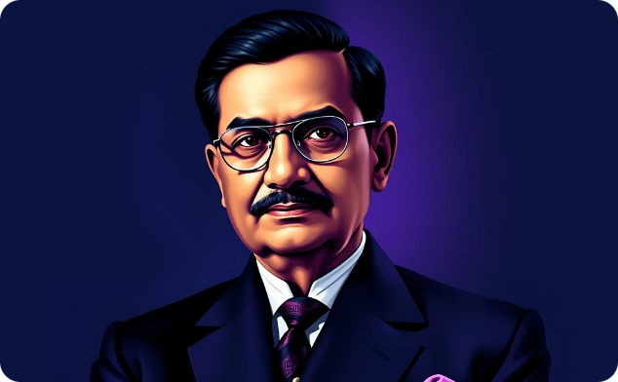
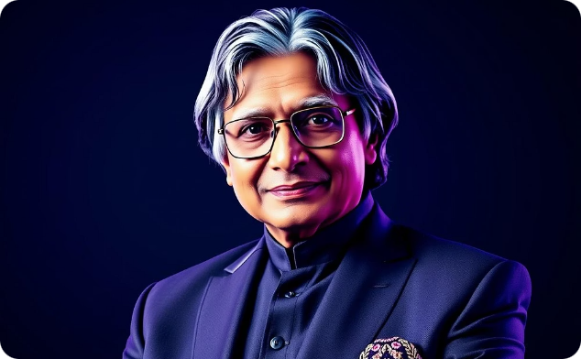
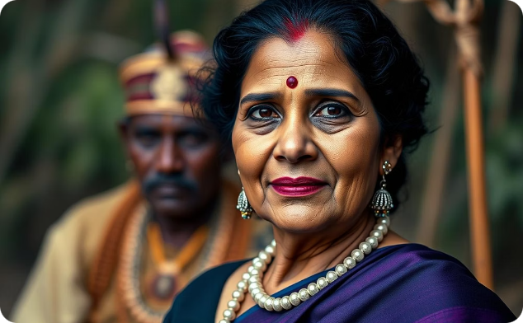
Notable Presidents and Their Contributions
Dr. Rajendra Prasad
Dr. A.P.J. Abdul Kalam
Droupadi Murmu
First President (1950-62), established presidential traditions and constitutional precedents
People's President (2002-07), connected with youth and promoted scientific temper
Current President (2022-present), first tribal woman to hold the office

Slide 12
Contemporary Challenges
Evolution of the Presidency

Slide 13
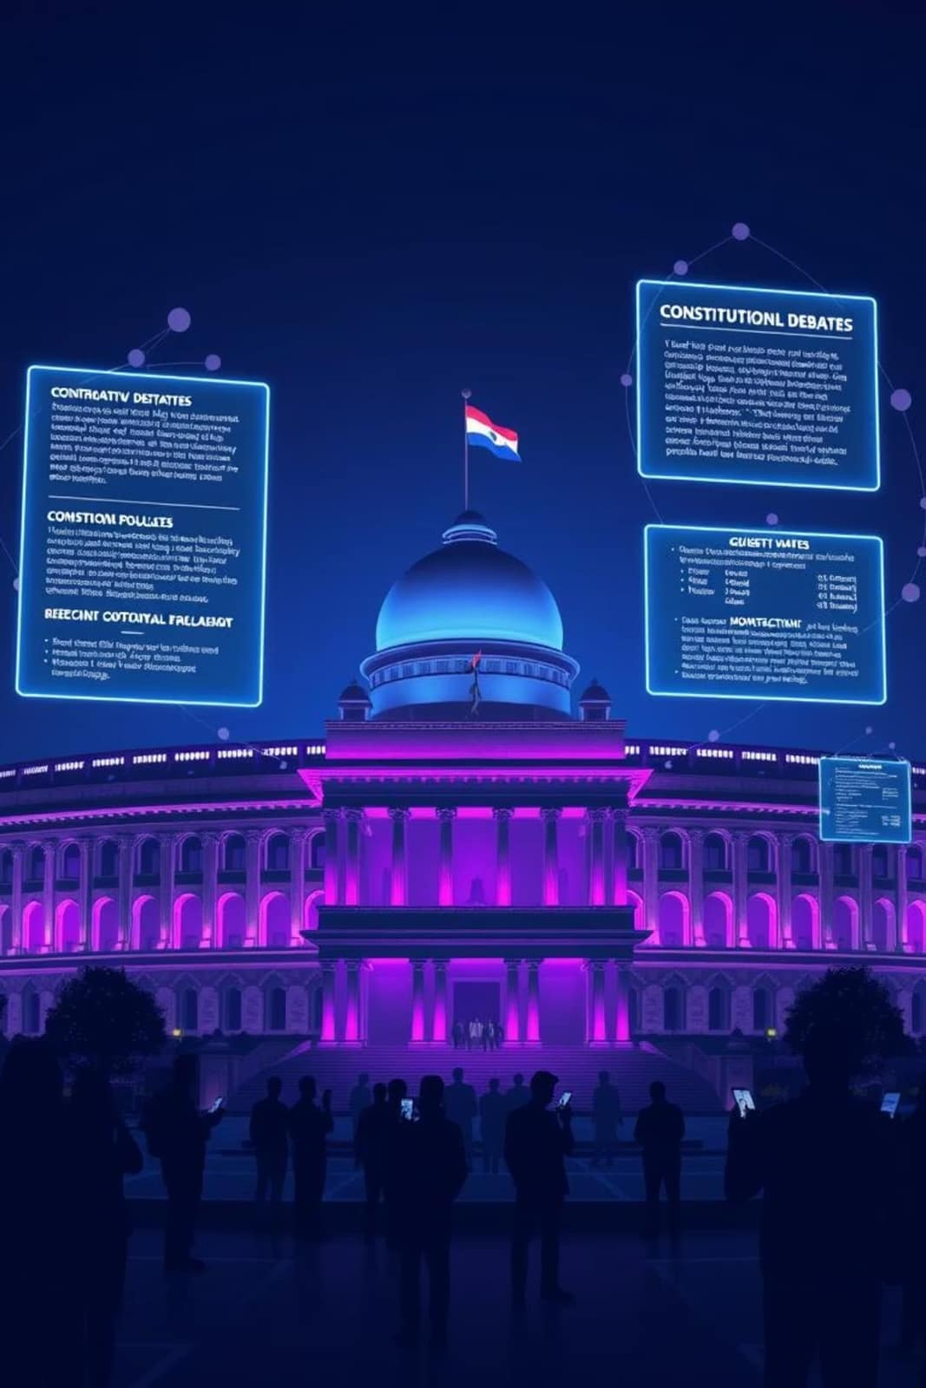
Navigating Modern Challenges
Coalition Politics
Managing hung parliaments and coalition governments effectively
Constitutional Interpretation
Balancing executive discretion with constitutional mandates
Federal Relations
Mediating centre-state disputes and maintaining federal harmony
Digital Age Governance
Adapting presidential functions to modern technological demands

Slide 14
Evolving Nature of the Presidency
1950s-60s
1990s-2000s
Establishing conventions and constitutional precedents
Facilitating coalition governments and democratic transitions
1
2
3
4
1970s-80s
2010s-Present
Active role during emergency and coalition politics
Promoting inclusivity and addressing contemporary challenges

Slide 15
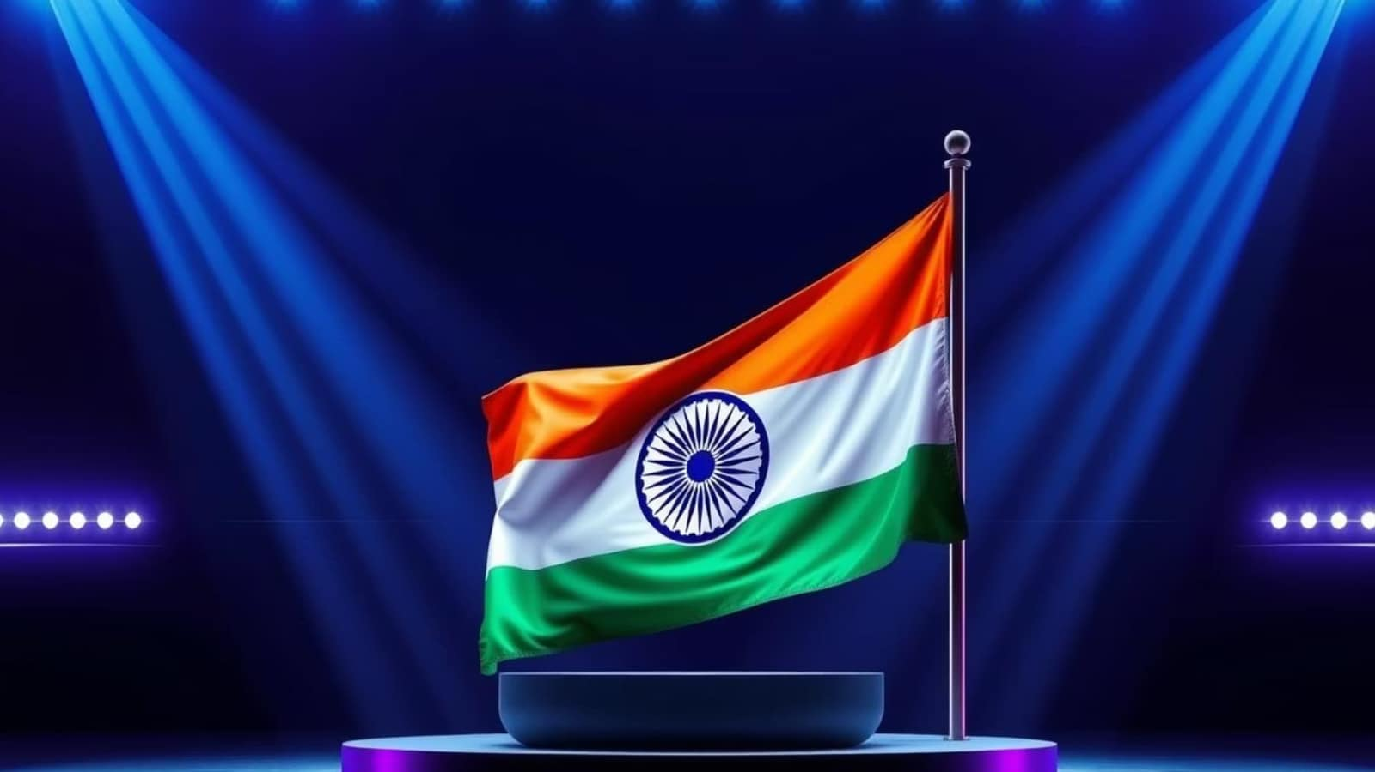
Future Vision
Upholding Constitutional Values

Slide 16
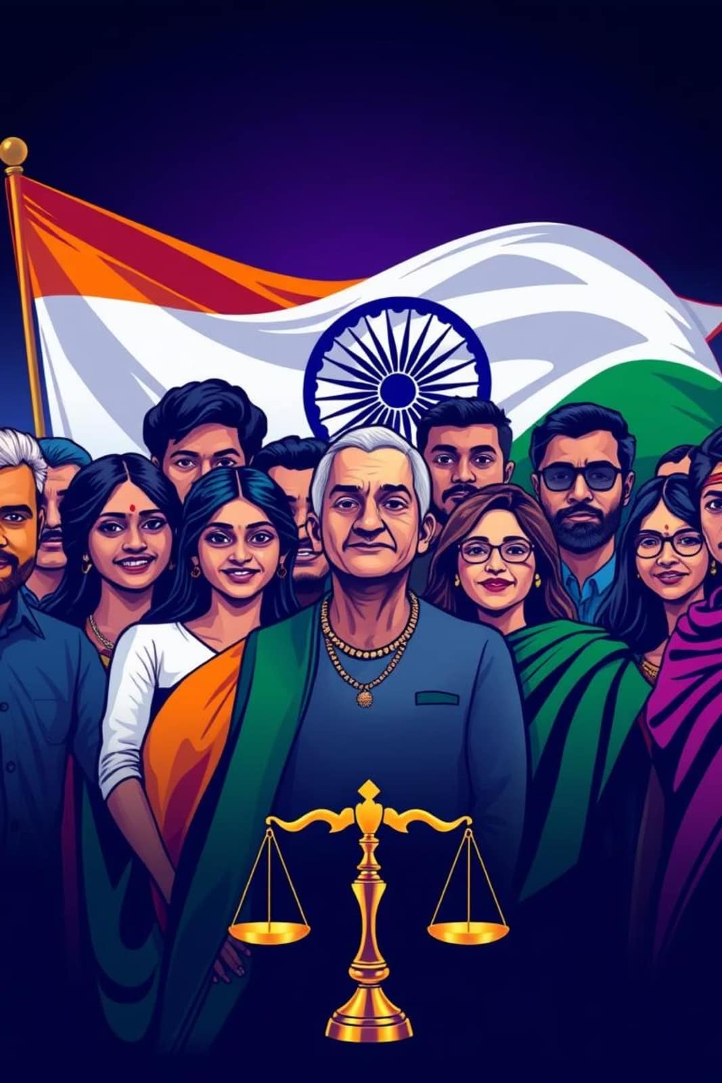




The President's Enduring Vision
Constitutional Supremacy
Ensuring the Constitution remains the supreme law of the land
Inclusive Democracy
Promoting equal participation of all sections of society
Innovation and Progress
Encouraging scientific research and technological advancement
National Unity
Fostering harmony and brotherhood among all Indians

