Slide 1

The Green Revolution and its consequences
Presented by Dr. Suraj Tamang

Slide 2
The Green Revolution and its consequences
Introduction.
The Green Revolution, a transformative agricultural movement of the mid-20th century, sought to eradicate global hunger and poverty through groundbreaking innovations. This presentation explores its profound impacts, both positive and negative, on our world.

Slide 3




Historical Context and Technological Foundations
Origin and Spread
Key Innovators
Initiated in the 1940s in Mexico, it rapidly expanded across Asia and Latin America.
Pioneers like Norman Borlaug developed high-yield wheat and the "miracle rice" from IRRI.
Technological Pillars
Efficiency Gains
Relied on High-Yield Varieties (HYVs), chemical fertilizers, pesticides, and modern irrigation.
Crop production tripled using only 30% more land, a testament to its efficiency.

Slide 4



Positive Impacts: Feeding a Growing World
Increased Food Security
Poverty Reduction
Lower Food Prices
Averted widespread famines, dramatically increasing cereal crop yields for wheat, rice, and maize.
Significantly reduced poverty in nations like India, transforming rural economies.
The increased supply led to more affordable food, improving access for vulnerable populations.

Slide 5
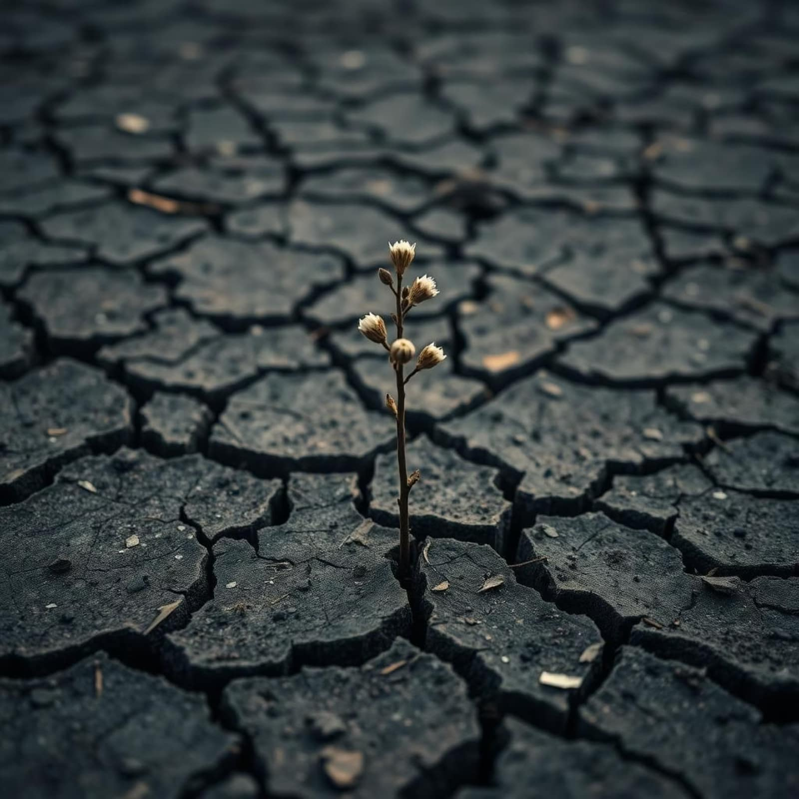
Environmental Consequences: A Hidden Cost
While the Green Revolution boosted food production, it came with significant environmental costs:
Soil Degradation: Over-reliance on chemical fertilizers and pesticides depleted soil health.
Water Scarcity: Intensive irrigation led to the rapid depletion of vital water resources.
Pollution: Agrochemical runoff contaminated water bodies, harming ecosystems.
Biodiversity Loss: Monoculture farming reduced crop diversity, making ecosystems more vulnerable.

Slide 6
Social and Economic Transformations
15%
25%
40%
Average increase in rural incomes in adopting regions.
Proportion of small farmers struggling with high input costs.
Estimated percentage of agricultural land benefiting from new irrigation.
The Green Revolution brought economic uplift for many, particularly through infrastructure development and new job opportunities. However, it also exacerbated economic inequality, as smaller farmers often couldn't afford the new technologies, and benefits disproportionately favored well-irrigated, wealthier areas.

Slide 7
Health Impacts: Mixed Outcomes
5%
20%
30%
Infant Mortality
Calorie Increase
Chronic Diseases
Reduction in infant mortality rates due to improved nutrition and food availability.
Average increase in daily calorie availability per person in many developing nations.
Estimated rise in chronic diseases linked to carbohydrate-heavy diets and reduced dietary diversity.
While the immediate impact was a reduction in infant mortality and increased calorie intake, concerns emerged over the long-term health effects of a less diverse, carbohydrate-heavy diet, contributing to the rise of obesity and diabetes in some populations.

Slide 8








Lessons Learned and Sustainability Challenges
Balance Productivity & Planet
Embrace Diversity
Reintroduce crop diversity and sustainable farming practices.
Future agriculture must prioritize both yield and ecological health.
Green Revolution 2.0
Invest in Resilience
Develop new strategies integrating social and environmental goals.
Fund research for climate-resilient, low-impact technologies.

Slide 9
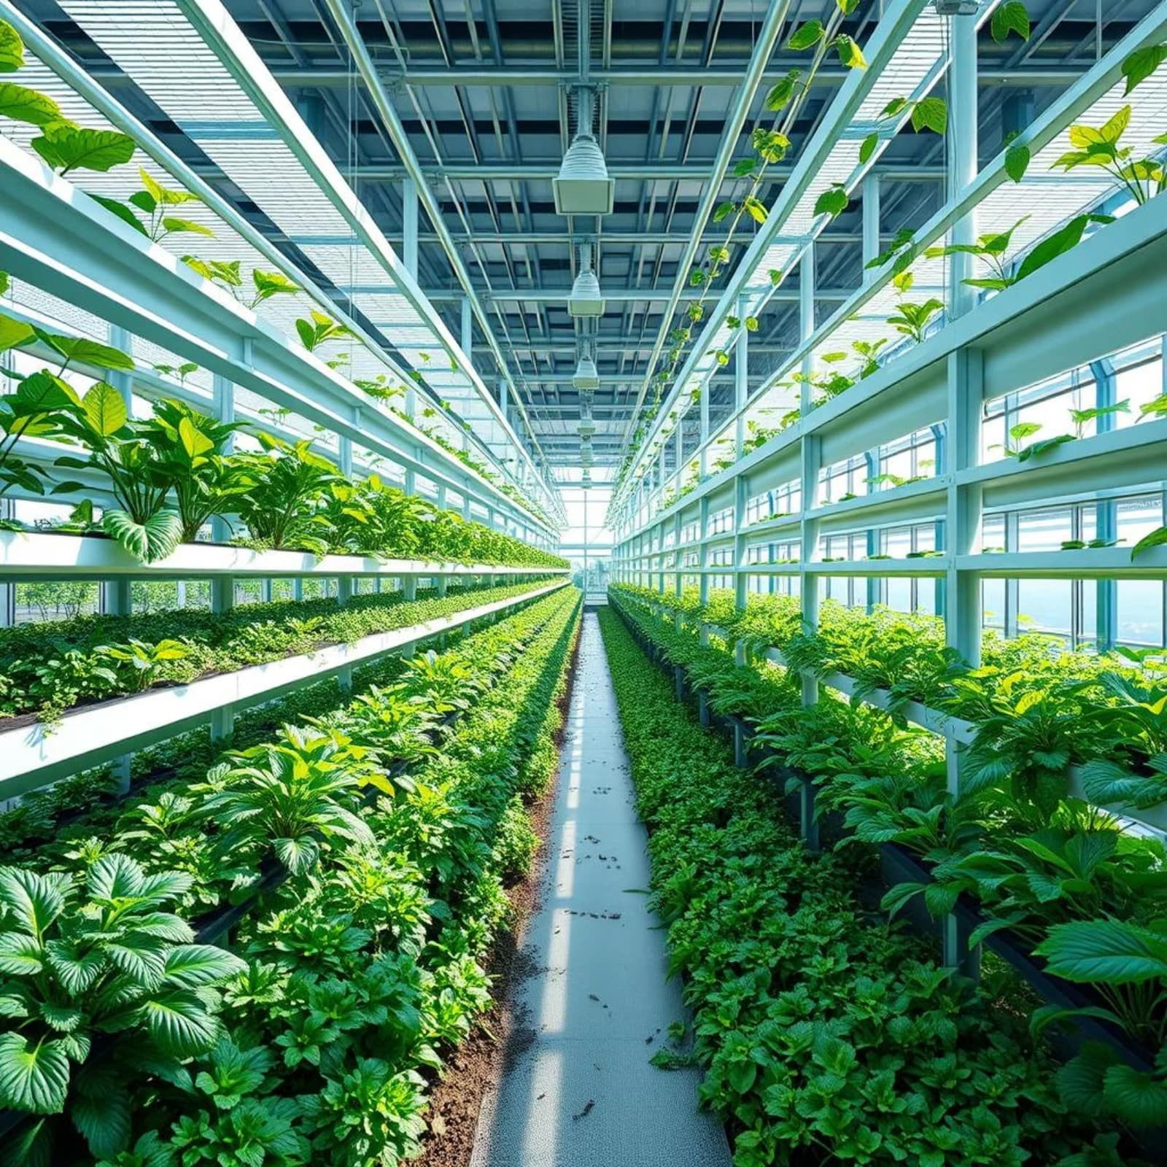
Conclusion: Shaping the Future of Food
The Green Revolution was a pivotal moment in human history, dramatically altering global food security.
Its undeniable successes in feeding millions are, however, tempered by significant environmental and social costs.
Moving forward, the focus must shift towards "sustainable intensification" and ensuring equitable access to agricultural innovations.
The resilience of our global food systems will ultimately depend on continuous innovation and responsible stewardship of our planet.

