Slide 1



Target Group Approach to Rural Development
DR RANJITA ROY SARKAR , ASSISTANT PROFESSOR, DEPARTMENT OF GEOGRAPHY, KGTM

Slide 2
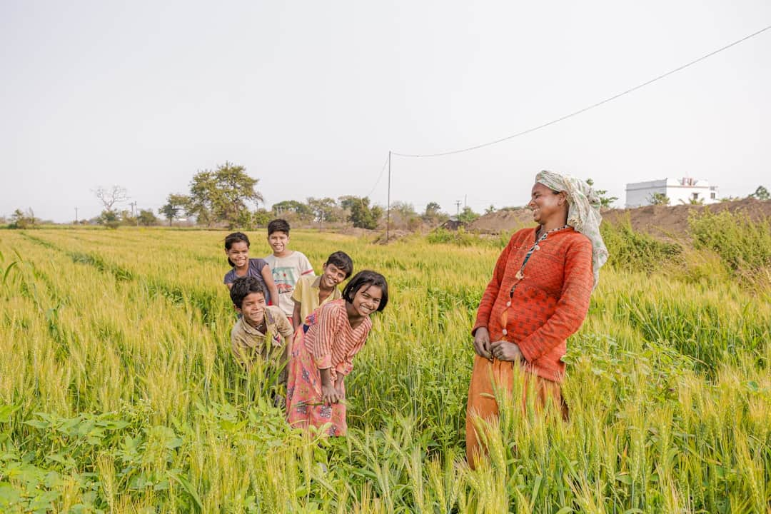
Target Group Approach to Rural Development
This presentation explores the Target Group Approach to Rural Development, focusing on key initiatives like SGSY, MNREGA, Jan Dhan Yojana, and the vital role of Self Help Groups. These programs aim to empower rural communities, enhance livelihoods, and improve infrastructure. By analyzing their impact, we can understand how these strategies contribute to sustainable development and poverty alleviation in rural India. Join us as we delve into these transformative initiatives.

Slide 3
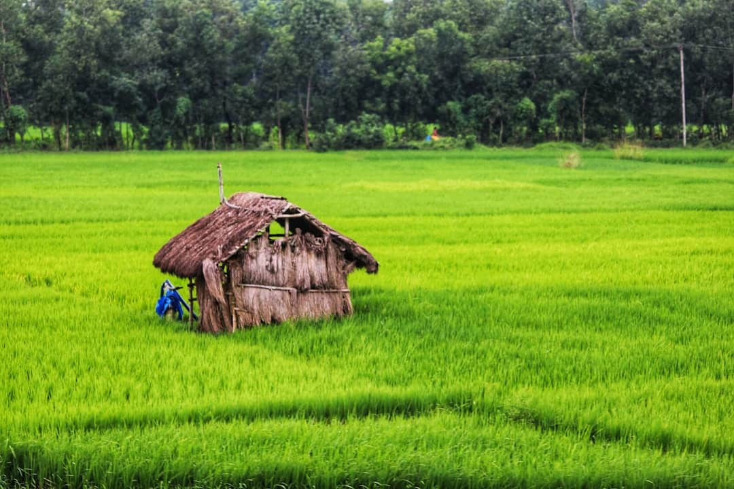



Introduction to Rural Development
Importance of Rural Development
Government Initiatives
Rural development enhances living standards, providing access to education, healthcare, and infrastructure, ultimately improving the quality of life for millions in rural areas.
Programs like SGSY, MNREGA, and Jan Dhan Yojana empower marginalized communities, ensuring sustainable livelihoods and financial inclusion for rural populations across India.
Role of Self Help Groups
Self Help Groups (SHGs) foster entrepreneurship and savings among rural women, contributing significantly to economic development and social empowerment in their communities.
Photo by Dibakar Roy

Slide 4

Swarnjayanti Gram Swarozgar Yojana (SGSY)
Promoting Self-Employment
SGSY aims to empower rural poor by promoting self-employment through various initiatives, targeting over 1.5 million families annually across India.
Skill Training & Financial Aid
The program provides essential skill training and financial assistance, with an average grant of ₹1 lakh per self-help group to enhance livelihood opportunities.
Focus on Group Formation
SGSY emphasizes the formation of self-help groups, fostering sustainable livelihoods and community support, which has led to a 30% increase in income for participants.
Success Stories
Notable success includes women-led poultry and dairy projects, which have significantly improved household incomes and empowered women in rural areas.

Slide 5
Mahatma Gandhi National Rural Employment Guarantee Act (MNREGA)
Key Features of MNREGA
Impact of MNREGA
Guarantees 100 days of wage employment per year for every rural household.
Significant reduction in rural poverty rates observed since implementation.
Aims to enhance livelihood security in rural areas.
Improvement in rural infrastructure and community assets.
Focuses on creating durable assets through public works.
Increased bargaining power of rural workers.
Promotes social inclusion by providing work to marginalized groups.
Boost to local economies through increased cash flow.
Encourages local self-governance through the involvement of Gram Panchayats.
Encouragement of sustainable practices through asset creation.

Slide 6





Jan Dhan Yojana: Financial Inclusion
Promoting Financial Inclusion
Jan Dhan Yojana aims to provide financial services to the disadvantaged, ensuring that everyone has access to banking facilities and financial products.
Bank Accounts Opened
Since its launch, over 40 million bank accounts have been opened, significantly increasing the financial participation of rural households across India.
Encouraging Savings
The initiative encourages savings and access to credit, empowering rural households to manage their finances and invest in their futures effectively.
Empowering Women
Jan Dhan Yojana empowers women through direct benefit transfers and financial literacy programs, enhancing their economic independence and decision-making power.
Photo by collier finance

Slide 7



Importance of Connectivity in Rural Development
Access to Markets
Improved roads and transport systems significantly enhance access to markets, allowing farmers to sell produce efficiently, thus increasing their income and economic stability.
Education and Health Services
Enhanced connectivity leads to better access to education and health services, resulting in improved literacy rates and health outcomes in rural communities.
Government Initiatives
Government initiatives like PMGSY focus on rural road construction, aiming to connect over 125,000 villages, thereby fostering economic growth and development.
Economic Activity Statistics
Statistics indicate that regions with improved connectivity experience a 30% increase in economic activity, showcasing the direct impact of infrastructure on rural economies.
Photo by Bradyn Shock

Slide 8
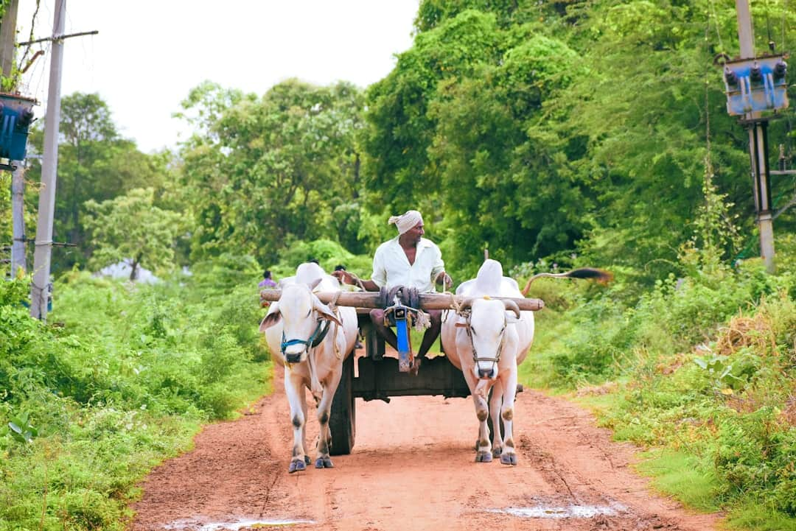
Impact of Self Help Groups
This visual illustrates the multifaceted impact of Self Help Groups (SHGs) on rural communities, highlighting economic growth, women's empowerment, and social cohesion. Key takeaway: SHGs significantly enhance livelihoods and community resilience.

Slide 9
Comparative Analysis of Rural Development Programs
SGSY (Self-Employment)
MNREGA (Wage Employment)
Focuses on promoting self-employment opportunities for rural individuals.
Guarantees 100 days of wage employment in a financial year to every rural household.
Provides skill development training to enhance employability.
Aims to create durable assets and improve rural infrastructure.
Encourages the formation of self-help groups for collective growth.
Empowers rural communities by providing a safety net during lean seasons.

Slide 10
Transformative Impact on Rural Development
10M+
2M+
Households Benefited
Self-Employment Opportunities
From MNREGA, enhancing livelihoods
Created through SGSY initiatives
300M+
20%
Bank Accounts Opened
Reduction in Rural Poverty
Under Jan Dhan Yojana, promoting financial inclusion
Achieved over the past decade

Slide 11
Key Takeaways
The Target Group Approach has significantly enhanced rural development through initiatives like SGSY, MNREGA, and Jan Dhan Yojana. Self Help Groups have empowered communities, fostering economic independence. Moving forward, it is crucial to strengthen these programs, ensuring better connectivity and access to resources. Continued collaboration among stakeholders will be vital for sustainable growth and improved livelihoods in rural areas. Together, we can build resilient communities that thrive.

