Slide 1
SOIL COLLOIDS
DR RANJITA ROY SARKAR , ASSISTANT PROFESSOR, DEPARTMENT OF GEOGRAPHY, KGTM

Slide 2
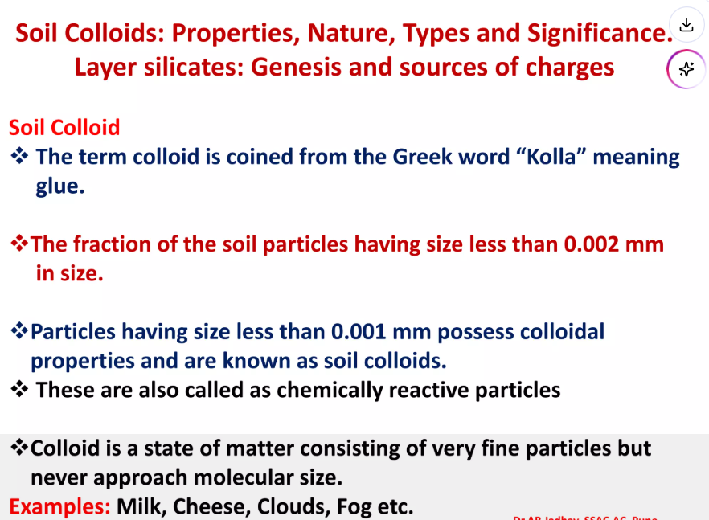

Slide 3
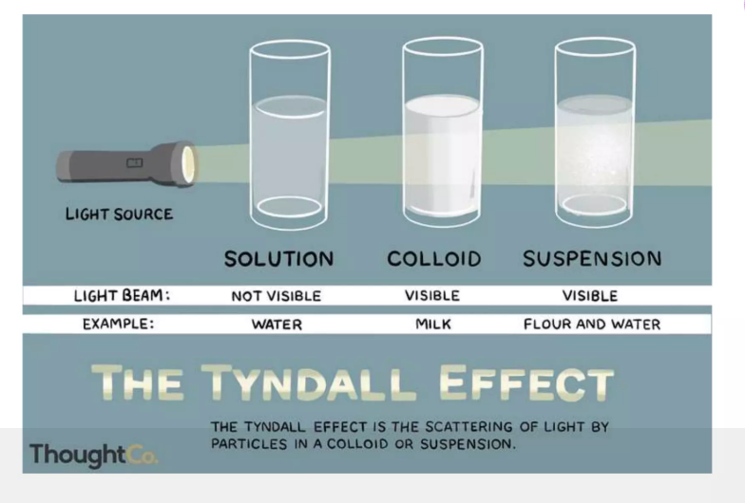

Slide 4
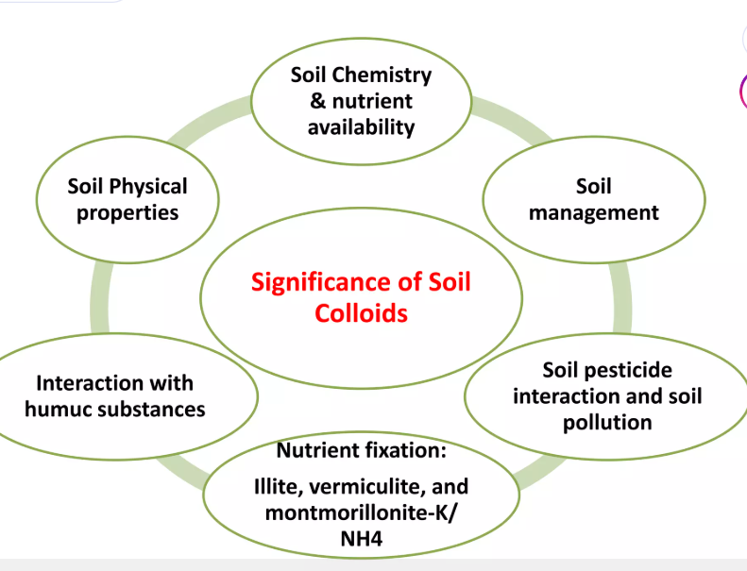

Slide 5
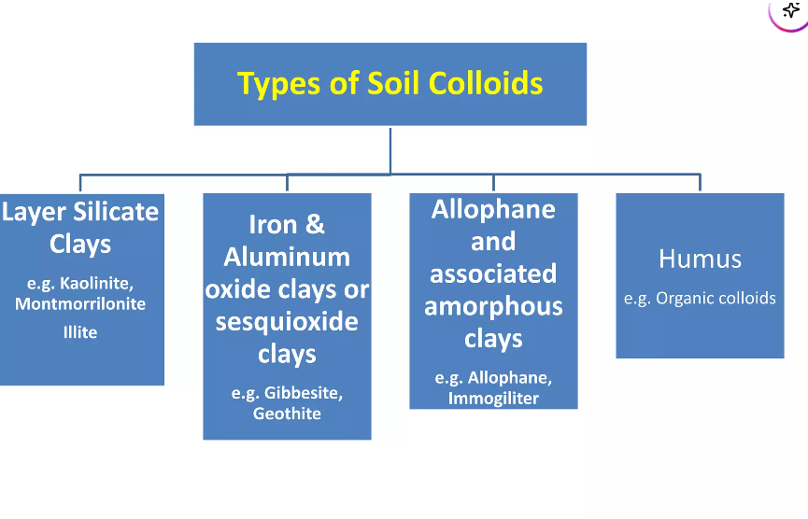

Slide 6
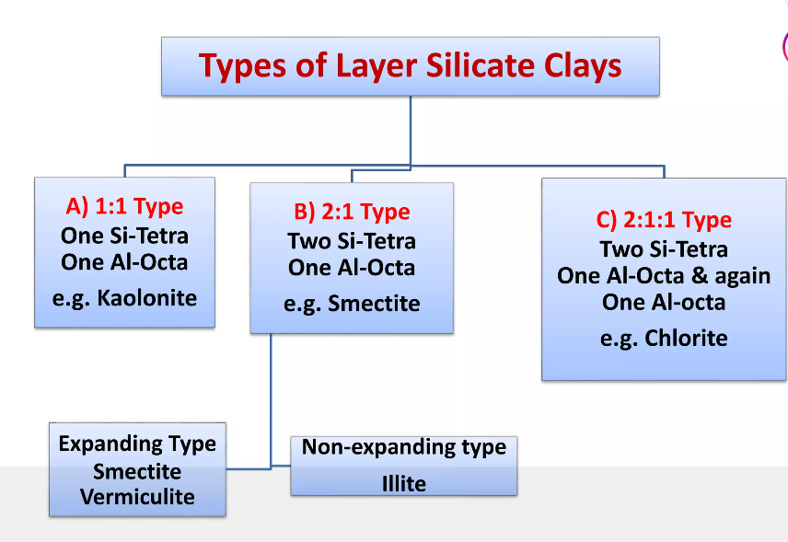

Slide 7
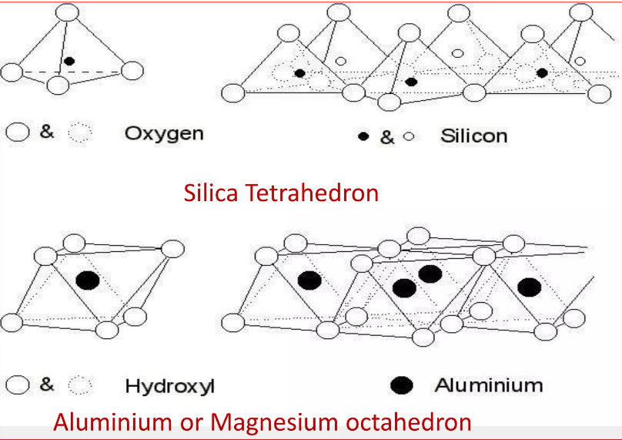

Slide 8
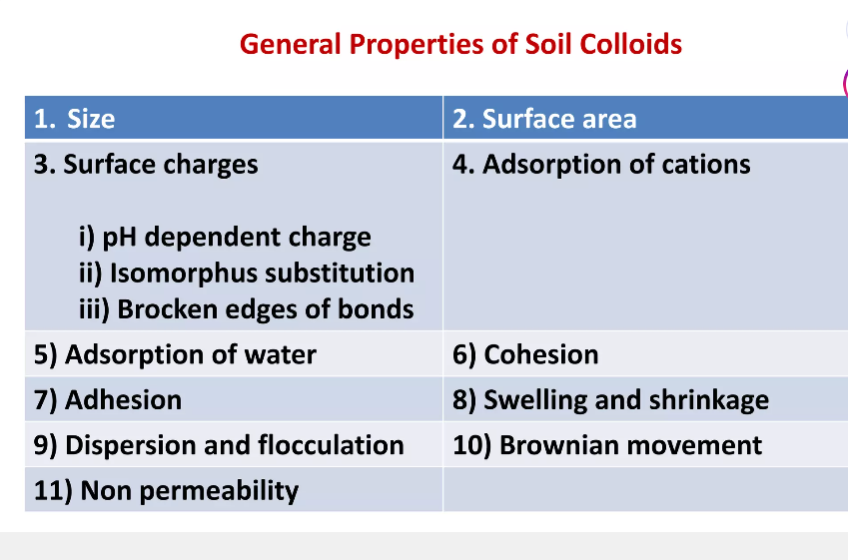

Slide 9
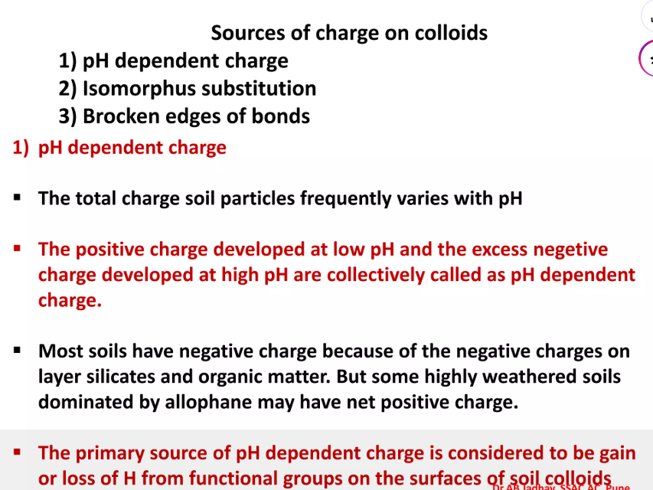

Slide 10
