Slide 1
Rural Economic Base: A Comprehensive Overview
DR RANJITA ROY SARKAR , ASSISTANT PROFESSOR, DEPARTMENT OF GEOGRAPHY, KGTM

Slide 2




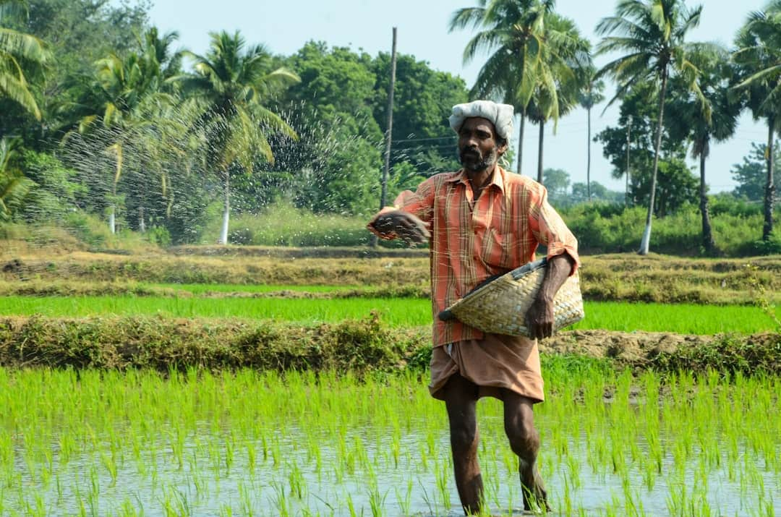




Rural Economic Base: A Comprehensive Overview
This presentation explores the intricate dynamics of the rural economic base, focusing on the Panchayat Raj system, agriculture, allied sectors, and co-operatives. We will analyze how these components interact to foster sustainable development in rural areas. Additionally, we will discuss the PURA initiative, which aims to enhance rural infrastructure and connectivity, ultimately improving the quality of life for rural populations. Join us as we delve into these critical aspects of rural economics.

Slide 3
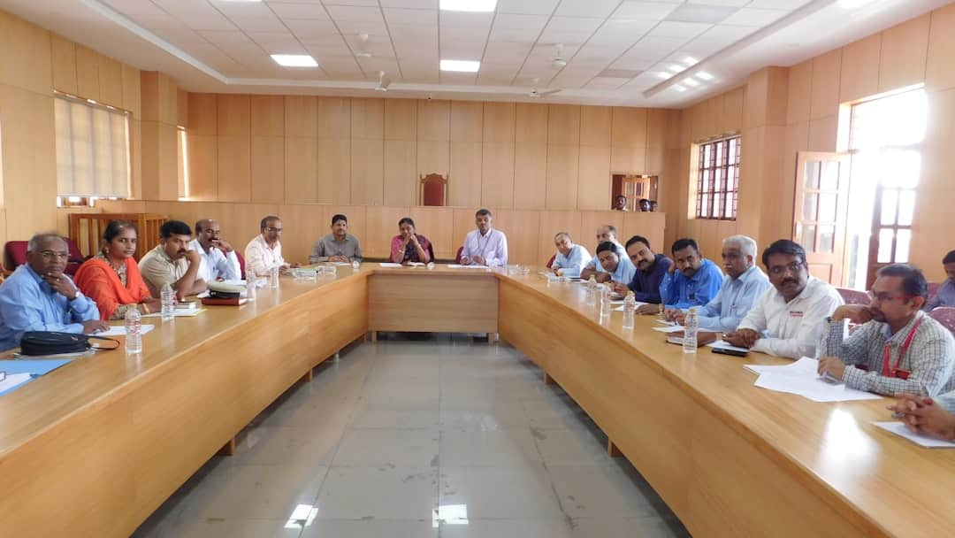




Panchayat Raj System Overview
Decentralized Governance Structure
Empowerment of Local Self-Governance
The Panchayat Raj System establishes a decentralized governance framework, allowing local bodies to manage resources and implement policies tailored to community needs.
Elected representatives in Panchayati Raj empower citizens, ensuring their voices are heard in local governance, enhancing accountability and transparency in decision-making.
Community Participation Enhancement
Contribution to Rural Development
Panchayat Raj plays a crucial role in rural development by facilitating local initiatives, improving infrastructure, and promoting sustainable agricultural practices.
The system fosters community engagement, encouraging residents to actively participate in local initiatives, which strengthens social cohesion and collective responsibility.
Photo by Chethana Muniswamygowda

Slide 4

Importance of Agriculture Sector
Backbone of Rural Economy
Agriculture is vital, contributing approximately 17% to India's GDP and serving as the primary economic activity in rural areas.
Employment Statistics
Around 58% of the rural workforce is engaged in agriculture, highlighting its role in providing livelihoods and reducing poverty.
Key Crop Contributions
Major crops like rice, wheat, and pulses are essential for food security, with rice alone accounting for 40% of total food grain production.
Sustainable Practices Needed
Adopting sustainable agricultural practices is crucial for ensuring long-term productivity and environmental health, addressing challenges like climate change.

Slide 5
Role of Allied Sectors in Rural Economy
Economic Contributions
Social Impact
Dairy, poultry, and fisheries provide diverse income streams for farmers.
Enhances food security and improves nutritional standards in rural areas.
Allied sectors contribute significantly to the overall rural GDP.
Creates job opportunities, reducing rural unemployment rates.
Increased production in these sectors leads to better market access.
Supports women's empowerment through involvement in allied activities.

Slide 6

Visual Impact of Agriculture
This slide showcases diverse agricultural practices, highlighting sustainable methods, crop rotation, and organic farming. Key takeaway: Visual representation emphasizes the importance of innovative techniques in enhancing productivity.

Slide 7

Co-operatives vs. Individual Farming
Co-operatives
Individual Farming
Enhance bargaining power for better prices and terms.
Greater autonomy in decision-making and management.
Shared resources lead to reduced operational costs.
Potential for personalized farming practices tailored to specific needs.
Stronger community support fosters collaboration and trust.
Flexibility in crop selection and market timing.
Isolation can lead to limited access to resources and support.
Access to collective marketing channels increases visibility.
Higher individual risk without shared safety nets.
Risk is distributed among members, reducing individual burden.

Slide 8
Agricultural Productivity Trends

Slide 9
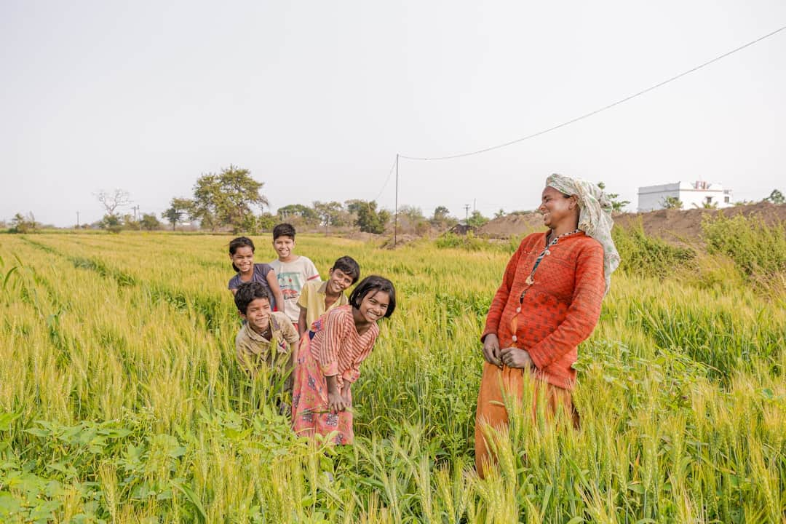






Understanding the PURA Initiative
Promoting Economic Development
Urban-like Amenities
PURA aims to enhance rural economies by creating job opportunities, with a target of increasing rural income by 30% over the next five years.
The initiative encourages the development of urban-like facilities in villages, including healthcare, education, and sanitation, improving overall quality of life.
Photo by EqualStock
Photo by Nathan Waters
Fostering Entrepreneurship
Infrastructure Improvement
PURA supports skill development programs, aiming to train 1 million rural youth in entrepreneurship and vocational skills by 2025, boosting local businesses.
Investment in rural infrastructure, such as roads and internet connectivity, is crucial for enhancing living standards and attracting investments in rural areas.
Photo by Prateek Katyal

Slide 10

Frequently Asked Questions
?
What is the role of Panchayat Raj in development?
Panchayat Raj serves as a decentralized governance system that empowers local self-governments, facilitating community participation in decision-making and resource allocation for rural development.
?
How can co-operatives improve rural income?
Co-operatives enhance rural income by pooling resources, providing better access to markets, and enabling members to benefit from collective bargaining and shared services.
?
What are the benefits of allied sectors?
Allied sectors, such as dairy and poultry, diversify income sources for farmers, reduce dependency on traditional crops, and contribute to food security and nutrition.
?
How does PURA impact rural living?
PURA (Providing Urban Amenities in Rural Areas) aims to bridge the urban-rural divide by improving infrastructure and services, thereby enhancing the quality of life and economic opportunities in rural areas.

Slide 11
Transformative Impact of Rural Development
17%
60M+
GDP Contribution
Farmers Benefited
Agriculture's share in the national economy
Empowered through co-operative initiatives
5M
30%
Improved Lives
Rural Employment Growth
PURA's impact on rural living standards
Increase over the last decade

Slide 12
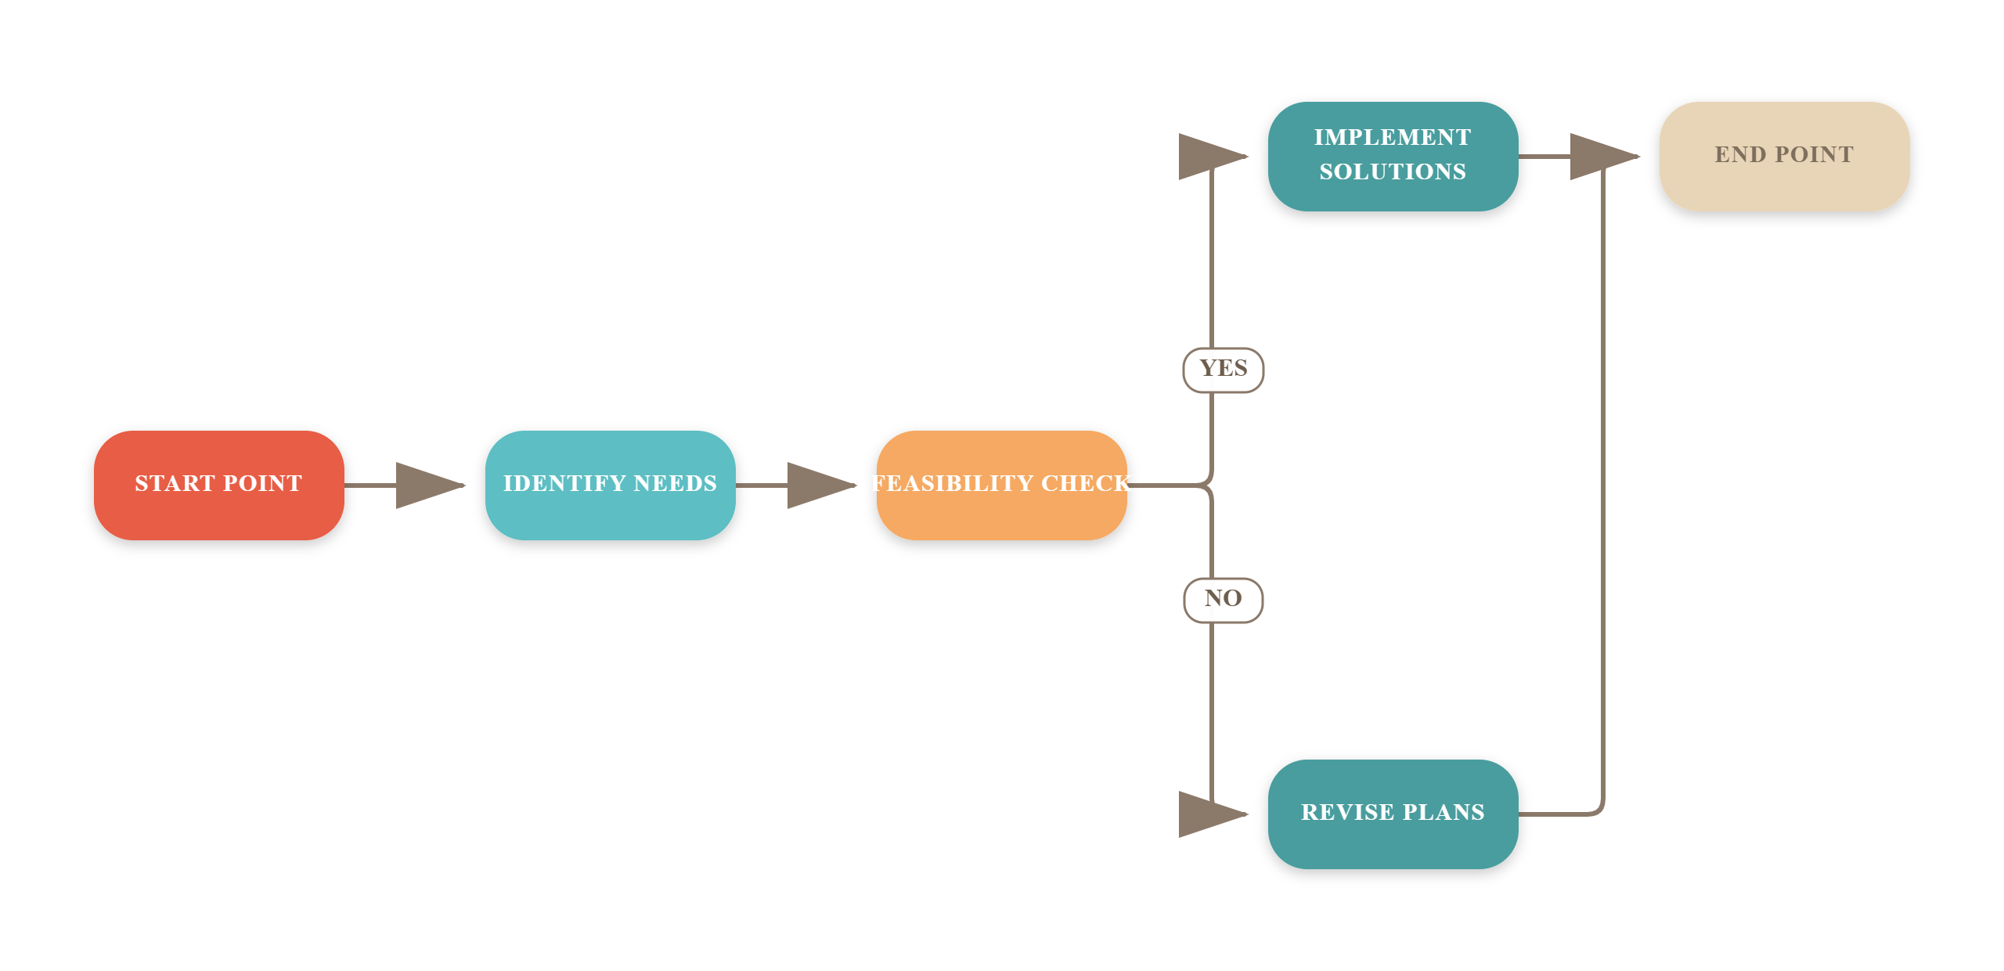
Steps for Sustainable Rural Development

Slide 13



Key Takeaways
This presentation highlighted the integral role of the Panchayat Raj system in enhancing rural economic development through agriculture, co-operatives, and PURA initiatives. Key insights include the need for improved infrastructure, community engagement, and sustainable practices. Moving forward, it is essential to foster collaboration among stakeholders to implement these strategies effectively. By prioritizing these areas, we can significantly uplift rural economies and ensure sustainable growth for future generations.

