Slide 1

Regional Planning and Development
DR RANJITA ROY SARKAR, ASSISTANT PROFESSOR, DEPT OF GEOGRAPHY, KGTM

Slide 2



Regional Planning and Development
This presentation explores the multifaceted domain of regional planning, encompassing its definitions, evolution, and various types. We will delve into the necessity of regional planning, the selection of ideal planning regions, and the theoretical frameworks that guide these processes. Additionally, we will examine key indicators for measuring development, including the Human Development Index, to understand regional disparities and promote balanced growth. Join us as we navigate the complexities of regional planning in India.

Slide 3

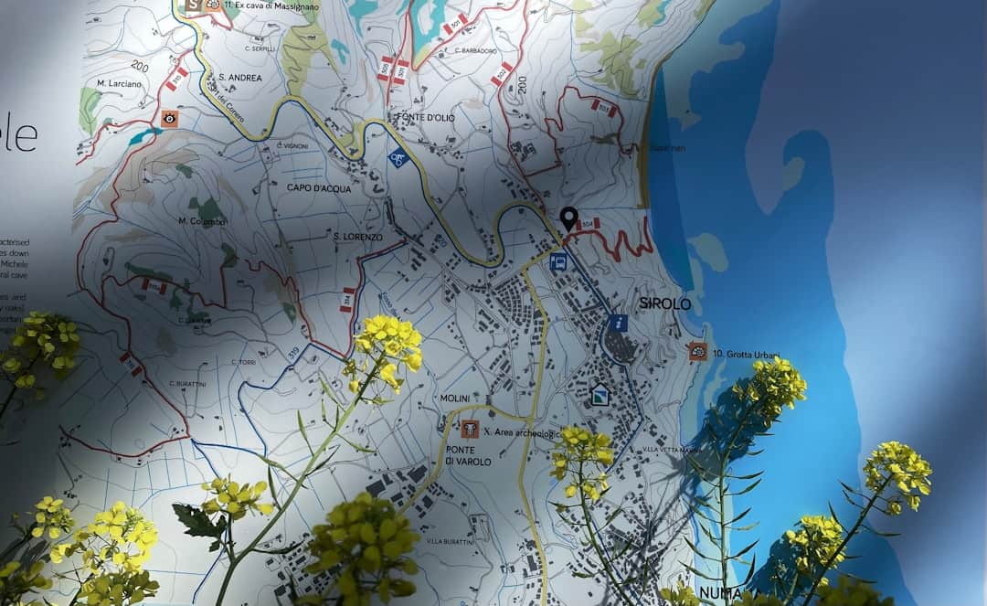






Definition and Types of Regional Planning
Regions Defined
Formal Regions
Regions can be categorized as formal, functional, and planning based on governance, economic interactions, and developmental strategies, respectively, impacting regional planning effectiveness.
Formal regions are defined by official boundaries, such as states or districts, which facilitate governance and resource allocation, ensuring structured regional planning.
Functional Regions
Planning Regions
Functional regions focus on economic interactions, such as metropolitan areas, where the flow of goods and services shapes planning priorities and regional development.
Planning regions are delineated based on developmental needs, allowing for targeted strategies that address specific socio-economic challenges within those areas.
Photo by Paolo Chiabrando

Slide 4



Need for Regional Planning
Addressing Regional Imbalances
Resource Allocation Efficiency
Promoting Sustainable Development
Effective regional planning facilitates optimal resource allocation tailored to specific regional needs, enhancing productivity and addressing local challenges, such as infrastructure deficits.
Regional planning tackles disparities in development, ensuring equitable resource distribution. For instance, India's rural areas lag behind urban centers, necessitating targeted interventions.
Regional planning fosters sustainable practices by integrating environmental considerations, ensuring that development meets current needs without compromising future generations' resources.

Slide 5
How to Define an Ideal Planning Region
1
Identify Homogeneous Characteristics
Assess the socio-economic and cultural traits of the region to ensure they are similar and conducive for planning.
2
Establish Defined Boundaries
Determine clear geographical boundaries that facilitate effective governance and management of the planning region.
3
Evaluate Accessibility to Resources
Analyze the availability of resources and infrastructure to support development initiatives within the region.
4
Engage Stakeholders
Involve local stakeholders in the planning process to ensure their needs and perspectives are considered.

Slide 6





Overview of India's Agro-Ecological Zones
Delineation of Regions
India's agro-ecological zones categorize regions based on climate, soil, and agricultural practices, enhancing targeted planning and resource allocation.
Tailored Planning Strategies
These zones support customized planning strategies, ensuring that agricultural policies align with the unique ecological and economic characteristics of each region.
Targeted Interventions
Agro-ecological zones facilitate focused interventions in agriculture, promoting sustainable practices that cater to the specific needs of diverse regions.
Sustainable Practices
Encouraging sustainable agricultural practices based on regional characteristics helps in conserving resources and enhancing productivity across various agro-ecological zones.
Photo by Scott Goodwill

Slide 7





Theories of Regional Planning
Growth Pole Model
Perroux's Growth Pole Model emphasizes the importance of economic hubs, suggesting that investment in specific areas can stimulate broader regional development and growth.
Cumulative Causation
Myrdal's theory of cumulative causation highlights how initial advantages can lead to further development, creating a cycle that exacerbates regional disparities over time.
Stages of Growth
Rostow's Stages of Growth provide a linear framework for development, outlining five stages that countries typically progress through as they industrialize and grow economically.
Growth Foci Model
R. P. Mishra's Growth Foci Model identifies critical areas for investment, suggesting that targeted development in specific sectors can lead to overall regional improvement.
Photo by Heeren Darji

Slide 8







Key Features
Economic Indicators
Social Indicators
Environmental Indicators
Utilizes GDP and employment rates to assess economic health and growth potential.
Evaluates education, health, and equity to measure societal well-being and quality of life.
Measures sustainability and resource use to ensure ecological balance and conservation.
Human Development Index
Regional Imbalances
Combines health, education, and income metrics to provide a comprehensive view of development.
Identifies and addresses disparities in development across different regions for balanced growth.

Slide 9


Development Indicators Comparison

Slide 10



“
Planning is bringing the future into the present.
Alan Lakein, Author and Time Management Expert
This quote emphasizes the critical role of foresight in regional planning, encouraging proactive strategies to address development challenges and inspiring stakeholders to actively shape their regions.

Slide 11




Challenges in Regional Planning
Local Resistance to Change
Limited Financial Resources
Communities often resist proposed changes due to fear of disruption. For instance, 60% of local populations oppose new infrastructure projects, impacting planning effectiveness.
Funding constraints hinder project implementation. Reports indicate that 70% of regional plans face budget shortfalls, limiting development opportunities and project scope.
Data Scarcity Issues
Coordination Among Stakeholders
Inadequate data availability complicates decision-making. Approximately 50% of regions lack comprehensive data, leading to poorly informed planning strategies and outcomes.
Effective regional planning requires collaboration. However, 65% of projects experience coordination challenges among stakeholders, delaying progress and complicating implementation.
Photo by John Cameron

Slide 12


Regional Planning vs. Traditional Planning
Regional Planning
Traditional Planning
Focuses on holistic development efforts.
Often emphasizes sectoral strategies.
Addresses regional imbalances and disparities.
May overlook inter-regional dynamics.
Incorporates local contexts and needs.
Typically follows a top-down approach.
Encourages collaboration among various sectors.
Focuses on isolated projects rather than integrated solutions.
Utilizes adaptive strategies for sustainable growth.
Can lead to uneven development across regions.

Slide 13




Key Takeaways
In summary, regional planning is essential for addressing imbalances and fostering sustainable development. Key theories, such as the Growth Pole Model, provide frameworks for effective planning. Moving forward, prioritizing the delineation of ideal planning regions and utilizing comprehensive indicators will enhance regional strategies. Collaboration among stakeholders is crucial for implementing these insights effectively. Together, we can create resilient regions that thrive economically, socially, and environmentally.

