Slide 1
Regional Development
Presented by Dr. Suraj Tamang

Slide 2




What is Regional Development?
Targeted Efforts
Key Metrics
Focused initiatives to develop specific geographic areas within a country.
Measured by improvements in income, job creation, innovation, and overall creativity.
Core Aim
To reduce uneven development and promote balanced prosperity across all regions.

Slide 3
Key Theories of Regional Development
Cumulative Causation
1
Myrdal (1957): Growth in one area attracts resources, reinforcing further growth.
Polarization & Trickle-down
2
Hirschman (1958): Growth in core regions eventually benefits periphery through spread effects.
Economic Geography
3
Focuses on firm networks, innovation clusters, and spatial organization driving regional growth.

Slide 4
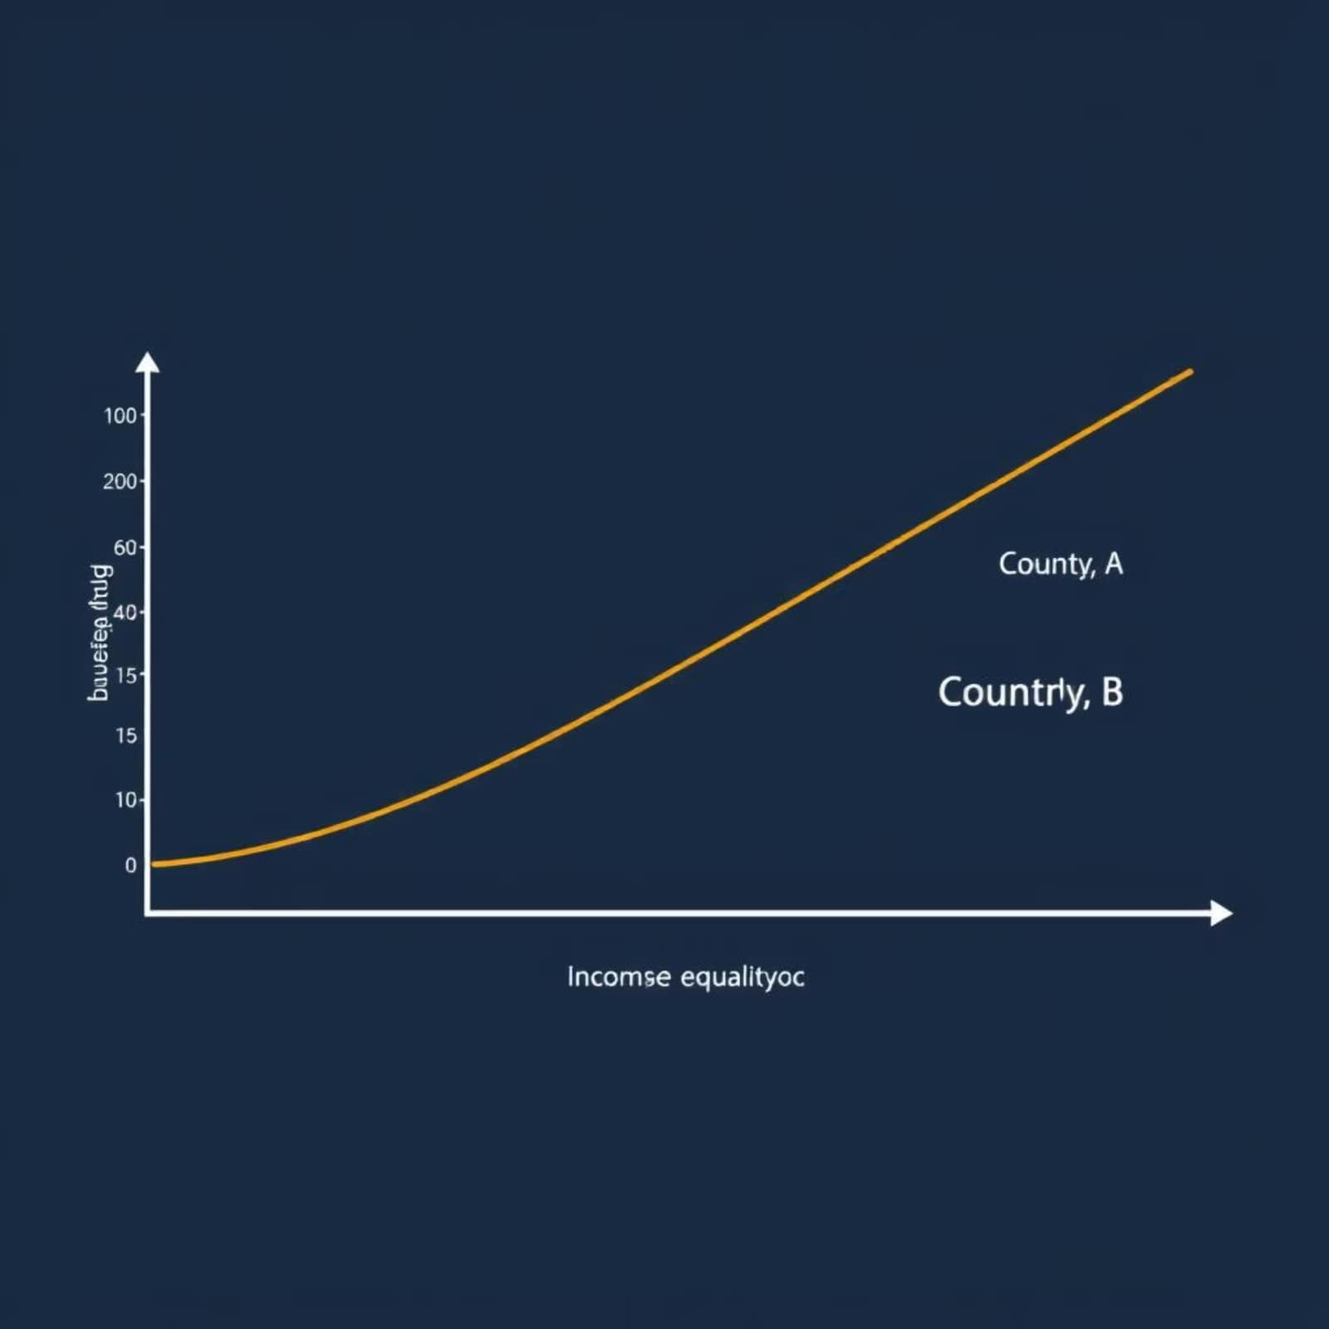
Measuring Regional Disparities
Regional disparities are often measured using key economic indicators. These tools help policymakers understand the extent of inequality and target interventions effectively.
0-1
Gini Coefficient
A measure of statistical dispersion intended to represent the income or wealth distribution of a nation's residents.
The Lorenz Curve visually depicts income distribution, showing the proportion of total income earned by any given percentage of the population. Combined with the Gini Coefficient, it clearly highlights income inequality within and between regions, guiding efforts towards more balanced economic landscapes.

Slide 5




Policy Approaches and Regional Strategies
Policy Interventions
Regional policies aim to correct imbalances and stimulate growth in underdeveloped areas.
CEDS
Comprehensive Economic Development Strategies (CEDS) provide strategic frameworks for regional growth in the US.
Opportunity Zones
Tax incentives attract private investments to distressed communities, fostering economic revitalization.

Slide 6
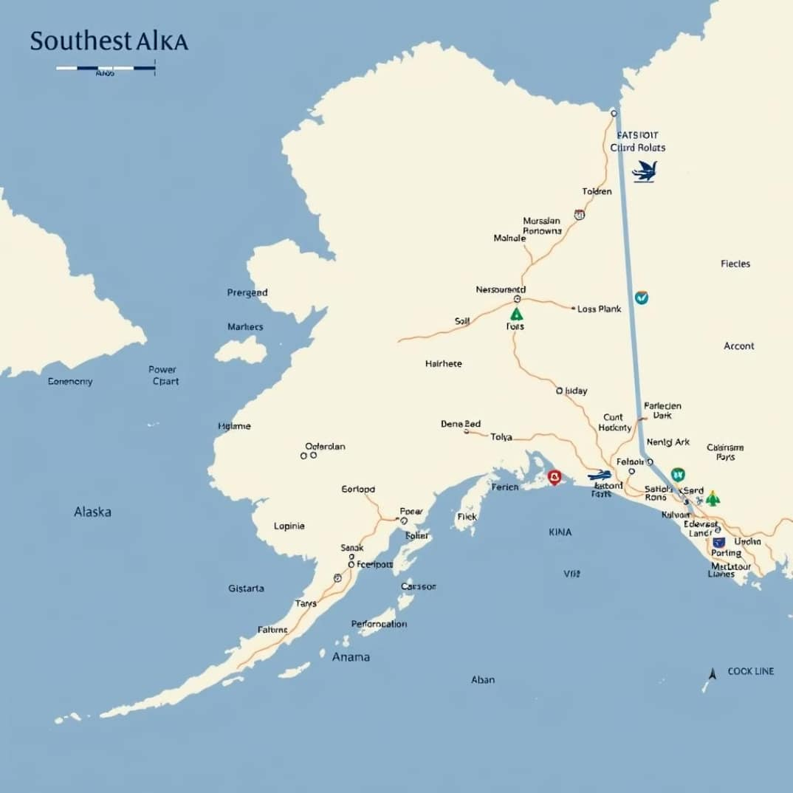


Case Examples & Current Trends
Southeast Alaska
Innovation & Entrepreneurship
Sustainability & Clean Tech
Its regional plan focuses on enhancing transportation, energy independence, and sustainable tourism, leveraging natural resources.
Increasingly recognized as primary drivers for regional growth, fostering new businesses and job creation.
Global emphasis on policies promoting environmentally friendly technologies and sustainable development practices.

Slide 7

Challenges in Regional Development
Persistent Disparities: Ongoing income and employment gaps remain significant hurdles.
Social Inequalities: Ethnic and social divides continue to limit equitable opportunities.
Balancing Growth: Achieving economic progress without compromising environmental or cultural heritage is a delicate act.

Slide 8
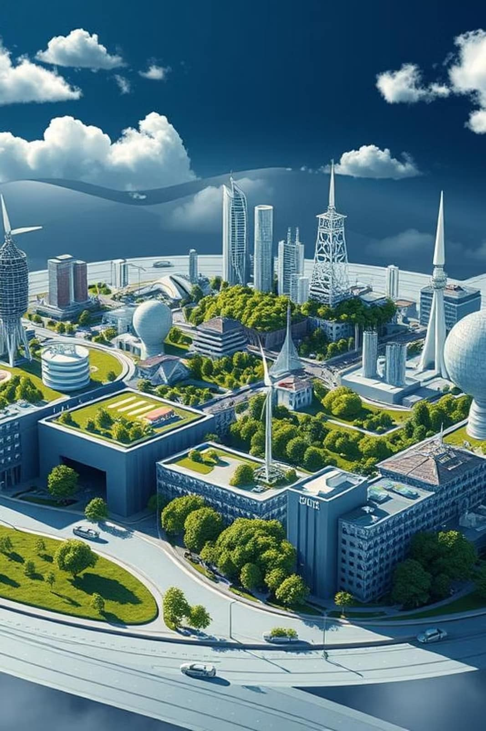
Conclusion
Regional development is paramount for balanced national progress. Future success hinges on fostering innovation, embracing sustainability, and implementing inclusive policies. Effective collaboration among government, businesses, and local communities will be essential to navigate challenges and build prosperous, equitable regions.

