Slide 1
Perfect Competition
Presented By
DR. Shyam Charan Barma
Assistant Professor , KGT Mahavidyalaya

Slide 2
Perfect competition
What Is Perfect Competition?
In economic theory, perfect competition occurs when all companies sell identical products, market share does not influence price, companies are able to enter or exit without barriers, buyers have perfect or full information, and companies cannot determine prices.
What are the 5 characteristics of perfect competition?
Following are the characteristics of perfect competition:
Large numbers of buyers and sellers in the market.
Free entry and exit of firms in the market.
Each firm should be selling a homogeneous product.
Buyers and sellers should possess complete knowledge of the market.
No price control.

Slide 3
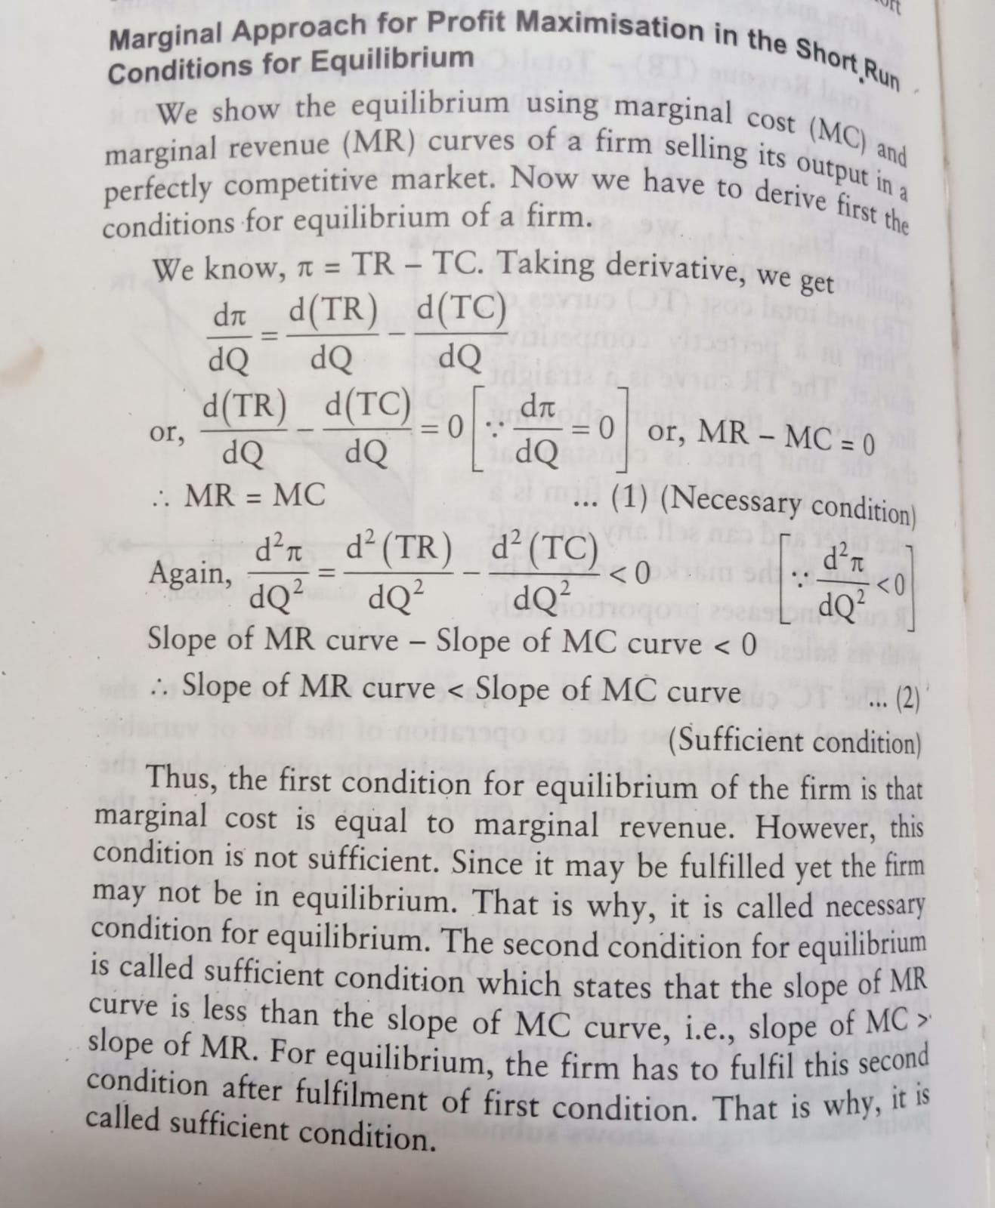

Slide 4
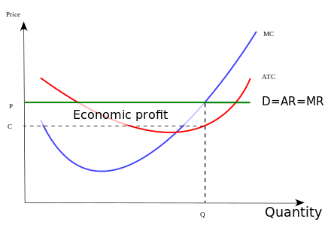

Slide 5
Thank You for Attention

