Slide 1
Natural Disasters and Biological Hazards
DR RANJITA ROY SARKAR , ASSISTANT PROFESSOR, DEPARTMENT OF GEOGRAPHY, KGTM

Slide 2
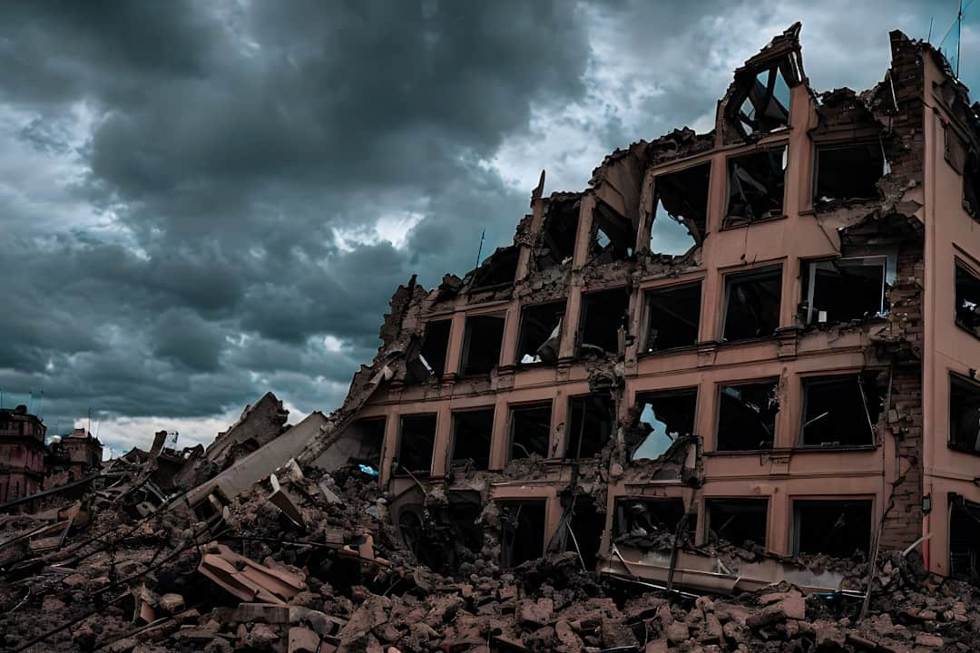
Natural Disasters and Biological Hazards
This presentation explores critical factors, consequences, and management strategies for natural disasters such as earthquakes, floods, cloud bursts, and landslides. Additionally, we will examine pandemics as significant biological hazards. Understanding these phenomena is essential for effective risk management and disaster preparedness. By analyzing real-world examples and data, we aim to provide insights that can enhance resilience in vulnerable communities. Join us as we delve into these pressing issues.

Slide 3






Overview of Natural Hazards
Definition of Natural Hazards
Types of Natural Hazards
Natural hazards are extreme events that disrupt human activities, causing damage to life and property. They include earthquakes, floods, landslides, and cloud bursts.
Natural hazards can be categorized into geological (earthquakes, landslides) and hydrometeorological (floods, cloud bursts). Each type poses unique risks to communities.
Impact on Human Life
Infrastructure Damage
Natural hazards significantly affect human life, leading to loss of lives, injuries, and displacement. For instance, the 2010 Haiti earthquake resulted in over 230,000 deaths.
Natural hazards can devastate infrastructure, causing economic losses. The 2011 Japan earthquake caused an estimated $360 billion in damages, highlighting the need for effective management.
Importance of Management
Studying natural hazards is crucial for developing effective management strategies. Preparedness and response plans can mitigate impacts and enhance community resilience.
Photo by ostudio

Slide 4

Earthquake Dynamics
Causes of Earthquakes
Earthquakes primarily result from tectonic plate movements and volcanic activity, with approximately 90% occurring along plate boundaries, significantly impacting global seismic activity.
Consequences of Earthquakes
Ground shaking can lead to severe structural damage, with estimates suggesting that a magnitude 7.0 quake can cause losses exceeding $100 billion in urban areas.
Management Strategies
Implementing strict building codes and early warning systems can reduce earthquake damage by up to 50%, enhancing community resilience and safety during seismic events.
Case Study: Haiti 2010
The 2010 Haiti earthquake resulted in over 230,000 deaths and widespread devastation, highlighting the need for improved disaster preparedness and response strategies in vulnerable regions.

Slide 5
Flooding Events: Causes and Management
Causes of Flooding
Management Strategies
Heavy rainfall leading to excessive runoff
Implementing floodplain zoning to restrict development
Snowmelt during spring contributing to river flow
Constructing levees to protect against rising waters
Dam failure resulting in uncontrolled water release
Developing efficient drainage systems to manage excess water

Slide 6





Characteristics and Management of Cloud Bursts
Definition of Cloud Bursts
Cloud bursts are sudden, intense rainfall events occurring over small areas, often leading to severe weather phenomena. They can produce over 100 mm of rain in minutes.
Consequences of Cloud Bursts
The aftermath includes flash floods, landslides, and significant infrastructure damage. For instance, the Leh cloud burst in 2010 caused over 200 fatalities and extensive property loss.
Management Strategies
Effective management includes early warning systems and community preparedness initiatives. Training local populations can significantly reduce risks and enhance response capabilities during such events.
Case Study: Leh 2010
The Leh cloud burst of 2010 highlighted the need for better infrastructure and emergency response. Lessons learned emphasize the importance of community engagement and timely alerts.
Photo by C Dustin

Slide 7
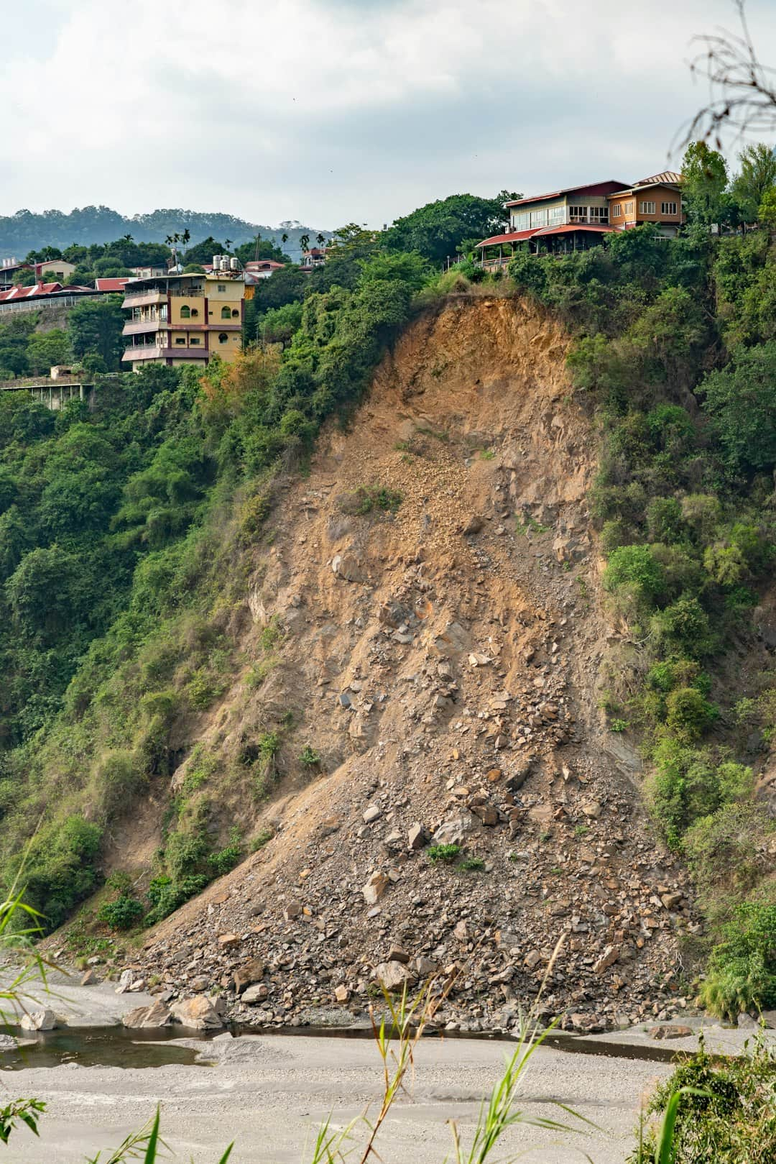




Understanding Landslides and Their Impacts
Causes of Landslides
Heavy rainfall, earthquakes, and human activities like deforestation significantly contribute to landslides, destabilizing slopes and increasing the risk of disasters.
Consequences of Landslides
Landslides can cause extensive property damage, loss of life, and disruption of ecosystems, affecting both human and wildlife habitats in the impacted areas.
Management Strategies
Effective management includes slope stabilization techniques, land-use planning, and community awareness programs to mitigate risks associated with landslides.
2014 Uttarakhand Disaster
The 2014 Uttarakhand landslide resulted in over 5,000 homes destroyed and significant loss of life, highlighting the urgent need for improved disaster management strategies.
Photo by Timo Volz

Slide 8





Key Features
Global Impact
Health Crises
Economic Disruptions
Pandemics affect populations worldwide, highlighting the interconnectedness of health systems.
Pandemics lead to significant health challenges, overwhelming healthcare systems and resources.
Widespread illness can cause severe economic downturns, affecting businesses and employment.
Societal Changes
Public Health Measures
Pandemics can alter social behaviors, impacting daily life and community interactions.
Effective response strategies, including vaccination and health guidelines, are crucial in managing outbreaks.

Slide 9
Statistical Comparison of Damages

Slide 10
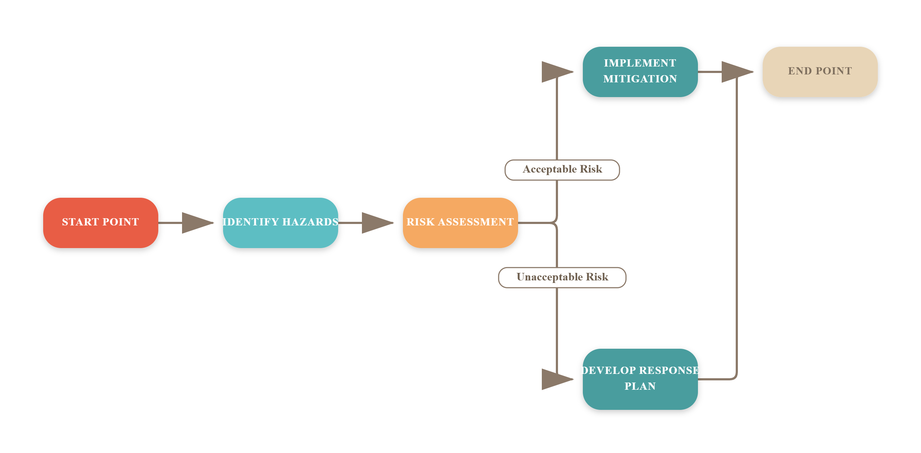
Disaster Management Cycle

Slide 11
The Impact of Disasters: Key Statistics
200M+
$300B+
10%
People Affected
Economic Losses
GDP Loss
By disasters annually worldwide
Global losses due to disasters each year
Potential economic impact of pandemics on affected countries

Slide 12
“
Preparedness today leads to resilience tomorrow.
Unknown
This quote emphasizes the importance of proactive measures in disaster management, encouraging communities to be ready for potential hazards.

Slide 13
Key Takeaways
This presentation highlighted the critical factors, consequences, and management strategies for natural disasters like earthquakes, floods, cloud bursts, and landslides, alongside the pandemic as a biological hazard. Key recommendations include enhancing early warning systems, improving community preparedness, and fostering interdisciplinary collaboration. Moving forward, it is essential to prioritize sustainable practices and invest in research to mitigate these hazards effectively, ensuring resilience in vulnerable communities.

