Slide 1



National Disaster Management in India
DR RANJITA ROY SARKAR , ASSISTANT PROFESSOR, DEPARTMENT OF GEOGRAPHY, KGTM

Slide 2

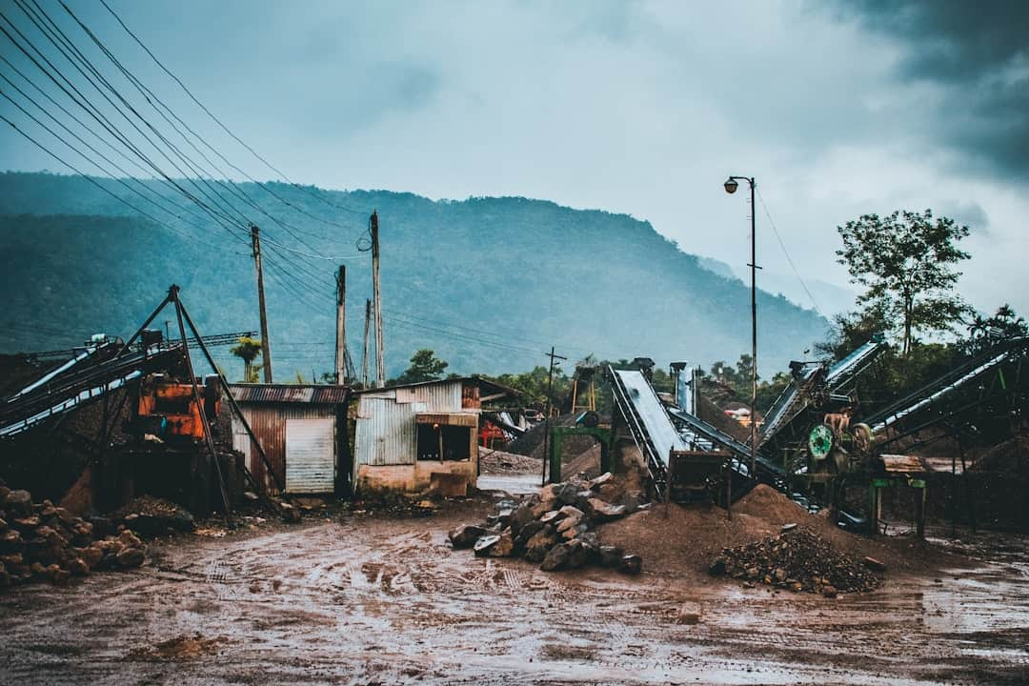



National Disaster Management in India
This presentation explores the National Disaster Management Act of 2005, highlighting its significance in enhancing disaster preparedness and response in India. We will also examine the pivotal role of the National Institute of Disaster Management (NIDM) in implementing these strategies. By analyzing key metrics and case studies, we aim to provide a comprehensive understanding of disaster management frameworks and their impact on communities across the nation.

Slide 3








Introduction to Disaster Management
Phases of Disaster Management
Key Stakeholders Involved
Disaster management encompasses three critical phases: preparedness, response, and recovery, ensuring communities are equipped to handle emergencies effectively.
Effective disaster management involves collaboration among government agencies, NGOs, and local communities, each playing a vital role in mitigating disaster impacts.
Minimizing Societal Impacts
Comprehensive Approach Required
Proper disaster management strategies can reduce economic losses by up to 30%, highlighting the importance of proactive measures in safeguarding communities.
A successful disaster management framework requires coordinated efforts across various sectors, integrating technology and community engagement for optimal results.
Photo by Jason Leung

Slide 4

Overview of the National Disaster Management Act, 2005
Establishment of NDMA
The Act establishes the National Disaster Management Authority (NDMA) to coordinate disaster management efforts at the national level, enhancing response efficiency.
State and District Roles
It outlines specific roles for state and district disaster management authorities, ensuring localized and effective disaster response and recovery strategies.
Focus on Risk Reduction
The Act emphasizes disaster risk reduction and preparedness strategies, aiming to minimize vulnerabilities and enhance community resilience against disasters.
Community Participation
Promotes community participation in disaster management efforts, recognizing local knowledge and resources as vital for effective disaster response and recovery.

Slide 5



Key Features of the NDMA
Policy Formulation and Coordination
Capacity Building and Research
Formulates comprehensive policies for disaster management in India.
Conducts training programs for disaster management professionals.
Coordinates national response efforts during disasters.
Promotes research and development in disaster management practices.
Establishes guidelines for disaster risk reduction.
Facilitates knowledge sharing and best practices among stakeholders.

Slide 6



Disaster Response Framework Analysis

Slide 7
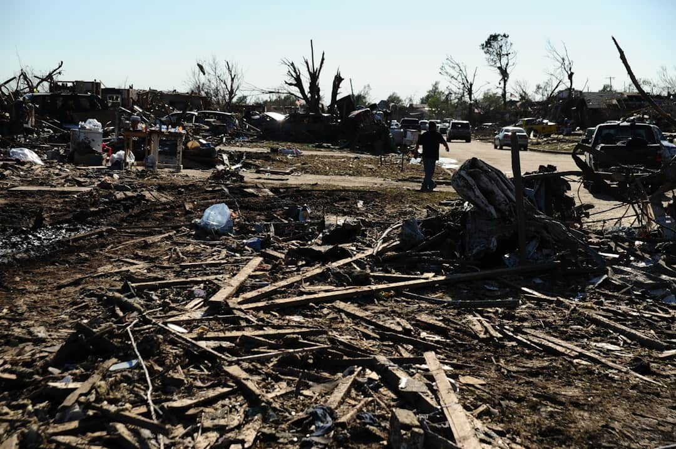




Role of State and District Authorities
State Disaster Management Plans
State authorities are responsible for developing comprehensive disaster management plans, ensuring alignment with national guidelines and addressing local vulnerabilities effectively.
Localized Strategies Implementation
District authorities implement tailored disaster management strategies, focusing on community-specific risks and enhancing local resilience through targeted interventions.
Coordination with NDMA
Regular coordination with the National Disaster Management Authority (NDMA) ensures access to training, resources, and best practices for effective disaster response.
Regular Drills and Exercises
Conducting regular drills and exercises enhances preparedness, allowing authorities to test response plans and improve coordination among various stakeholders.
Photo by Greg Johnson

Slide 8




Community Engagement in Disaster Management
This visual illustrates the critical role of local participation in disaster management. Engaging communities enhances resilience, ensuring effective response and recovery during disasters. Key takeaway: Local involvement is essential for sustainable disaster preparedness.

Slide 9



Impact of the National Disaster Management Act, 2005
Before
After
Casualties in disasters: 10,000+ annually
Casualties in disasters: Reduced to 3,000 annually
Funding for disaster management: $50 million/year
Funding for disaster management: Increased to $200 million/year
Response time to disasters: 72 hours average
Response time to disasters: Improved to 24 hours average
Coordination among agencies: 30% effective
Coordination among agencies: 85% effective
The NDMA has significantly improved disaster management efficiency and effectiveness, leading to reduced casualties and enhanced resource allocation.

Slide 10
Challenges and Future Directions
01
Continuous Training Needs
Ongoing training is essential for disaster management personnel, with studies showing that 70% of responders feel unprepared without regular updates and skill enhancement.
02
Inter-Agency Coordination
Effective disaster response requires seamless coordination among agencies. Research indicates that improved collaboration can reduce response times by up to 30% during emergencies.
03
Climate Change Impacts
Climate change is increasing disaster frequency, with a 40% rise in extreme weather events over the last decade, necessitating adaptive strategies in disaster management.
04
Technology Integration
Incorporating technology, such as GIS and real-time data analytics, can enhance decision-making processes, improving disaster response efficiency by 25% according to recent studies.

Slide 11



Key Takeaways
In conclusion, the National Disaster Management Act, 2005, has significantly enhanced disaster preparedness in India. Key takeaways include the importance of community involvement, the role of the National Institute of Disaster Management in training, and the need for continuous policy evaluation. Moving forward, it is crucial to strengthen local capacities and integrate technology for effective disaster response. By fostering collaboration among stakeholders, we can build a resilient future against disasters.

