Slide 1
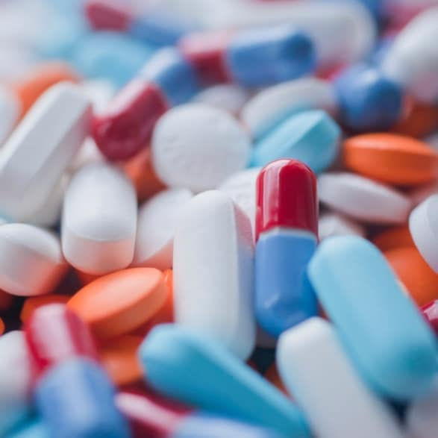
Drugs and Pharmaceuticals
Lecture module -01
Dr. Abir B. Majumder

Slide 2
What are Drugs ?
The molecules /compounds which exert various physiological effects of therapeutic value.
Ideally on administration a drug should be localized in its action and specifically should hit the areas where it is needed on our body.
In reality, the drug molecules are distributed through out anywhere in the tissues of the host.

Slide 3
Are all biologically active agents drugs?
There are compounds which are are biologically active ( as drugs)
These have the potential to destroy the microorganism and the host tissue cell at large
These are not considered as therapeutic agents or drugs
These compounds are applied externally
These are termed as antiseptic or disinfectants . Examples are: Formaldehyde, Phenol, Iodine

Slide 4
Antiseptics and Disinfectants
Antiseptics
Disinfectants
These are chemicals applied externally
Prevents or kills the growth of micro organisms
Directly applied on living tissues for wounds, cuts, ulcers
Example: Dettol; widely used antiseptic composed of Chloroxylenol and alpha terpeneol
These are chemicals , more toxic in nature
Prevents or kills the growth of micro organisms
Directly applied on non living objects viz. on floor, drainage, instruments
Example: Halazone used for water purification

Slide 5
Antiseptics
Disinfectants
Chloroxylenol: Used in Dettol
Alpha terpeneol: Used in Dettol
Halazone: Used for disinfecting water
Bithiol: Used as antiseptic in soaps
Dichloramine T: Used for disinfecting instruments

Slide 6
How drugs are invented?
Trial and Error method: This involves the trial of all kinds of compounds, natural and synthetic. This is the most primitive one.
By synthesizing bioactive mimic: The method with a complete knowledge of cell system and the compounds that interfere with it, and thereby synthesizing similar compounds.
By synthesizing a compound of required activity: The method in which one starts with a compound known to have some required activity (information gained from previous methods: 1 and 2) and then the structural changes are done systematically. Each small change can bring enormous gain in curative activity of the drug. This method is the most fruitful in drug designing.

Slide 7
Drugs Classification
Anesthetics
Neurologically active drugs
Analgesic
Anti Fertility drugs
Non Steroidal Anti-Inflammatory drug
Cardiovascular drug
Antibiotics
Vitamins

Slide 8
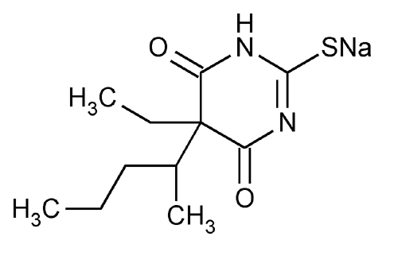
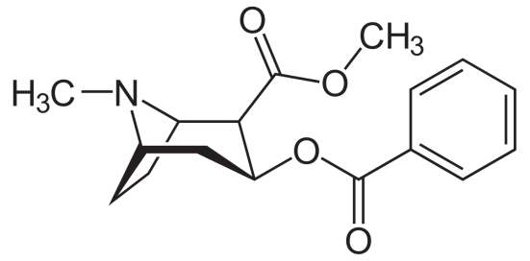
Anesthetic
These are chemical substances which produce insensibility to pain and other sensations.
Classifications:
General anesthetic: These are mostly volatile in nature. and are used in minor surgeries. These are mostly muscle relaxants. Example: Ether, chloroform, trichloroethylene, ethyl chloride.
Non volatile anesthetic: These are liquid at room temperature. One very good example of this class is sodium thiopental “Fatal Plus” used in veterinary Euthanasia (a process to allow a suffering pet to death).
Local anesthetic: These anesthetics act locally, for example Cocaine.

Slide 9
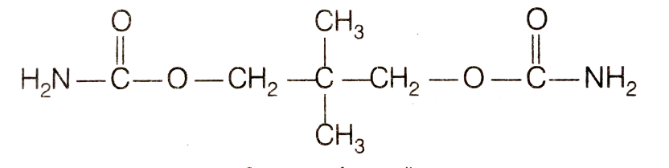
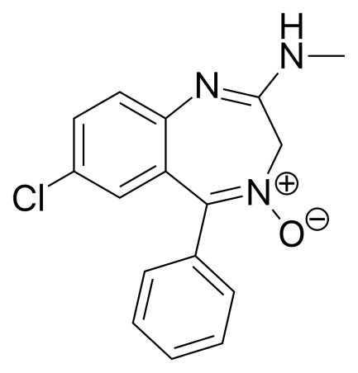
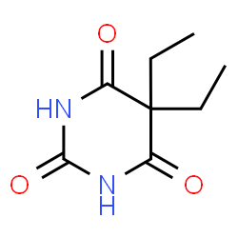
Neurologically active drugs
These affect the message transfer mechanism from nerves to the receptor. There are two major classes:
A) Tranquilizers B) Analgesics
Tranquilizers
These are used for the treatment of stress, mild or severe mental disorder.
Chlorodiazepoxide is a mild drug used to relieve tension. Equanil is used to control depression.
Derivatives of barbituric acid viz. veronal , nembutal are important class of tranquilizers which are used to produce sleep and are termed as hypnotic drugs.
Equanil
Chlorodiazepoxide
Veronal

Slide 10
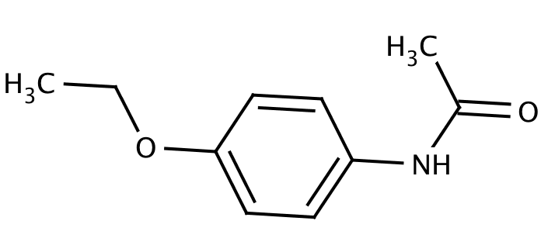

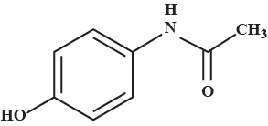
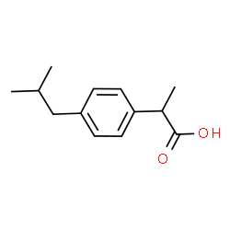
Neurologically active drugs
Analgesics
These reduce or abolish pain without causing unconsciousness or paralysis or other disturbances of the nervous systems. These are classified as non-narcotic and narcotic analgesic.
Non narcotic analgesic: These are non addictive drugs. These are further divided into following classes:
Anti -Rheumatic : To treat pains associated with rheumatism
Examples are Salicylic acid derivatives: Aspirin, Salicin
Anti-Pyretic : To combat fever
Examples are 4-aminophenol derivatives:
Paracetamol, Phenacetin
Anti-Inflammatory: To reduce inflammation
Examples are Aryl acetic acid derivatives:
Ibuprofen (Brufen)
Aspirin
Phenacetin
Paracetamol
Ibuprofen

Slide 11
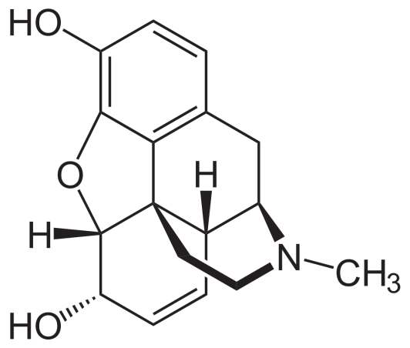

Analgesics
Narcotic analgesics: These are the analgesics when used in overdose, cause addiction. Morphine and its analogues (derivatives) fall in this class. Morphine once used before surgery during operation. Heroine, a derivative of morphine is infamous for its addictive power.
Morphine
Heroine

Slide 12
Aspirin
Aspirin falls in the class of non narcotic analgesic. It is anti-rheumatic.
Preparation
Ortho hydroxy benzoic acid (salicylic acid) is reacted with acetic anhydride in presence of catalytic amount of concentrated sulfuric acid.
The temperature is maintained at 50-60 º C for about half an hour.
The reaction medium is continuously stirred.
Aspirin is precipitated after pouring the medium in ice cold water.

Slide 13
Synthesis
Conc. H2SO4
Catalytic amount
Aspirin

Slide 14
Mode of action of Aspirin
Essentially helps to reduce fever with high temperature to bring it down to normal body temperature.
It falls in the group of antipyretic analgesics.
This NSAID inhibits the enzyme called cyclo oxygenase which is responsible for the formation of prostaglandins (PGs) that cause inflammation, swelling, pain and or fever.

Slide 15
Paracetamol mode of action
(Acetamenophen)
Paracetamol (acetaminophen) is generally not considered an NSAID.
It has only minor anti -inflammatory activity.
Acetaminophen treats pain mainly by blocking Cyclooxygenase-2 and inhibiting endocannabinoid reuptake almost exclusively within the brain, but not much in the rest of the body.

Slide 16
Synthesis of Paracetamol
Acetic anhydride
P-Aminophenol
P-Acataaminophenol or p-Hydroxy acetanilide
The widely used process of the synthesis of Paracetamol involves the acetylation of 4-amino phenol using equivalent amount of acetic anhydride and sodium acetate.

Slide 17
Mechanism

Slide 18
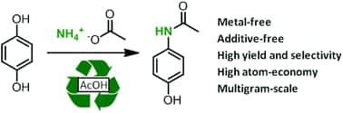
Synthesis of Paracetamol
Amidation of phenol derivatives: A direct synthesis from para quinol

Slide 19
Paracetamol mode of action
(Acetamenophen)
Paracetamol (acetaminophen) is generally not considered an NSAID.
It has only minor anti -inflammatory activity.
Acetaminophen treats pain mainly by blocking Cyclooxygenase-2 and inhibiting endocannabinoid reuptake almost exclusively within the brain, but not much in the rest of the body.

Slide 20
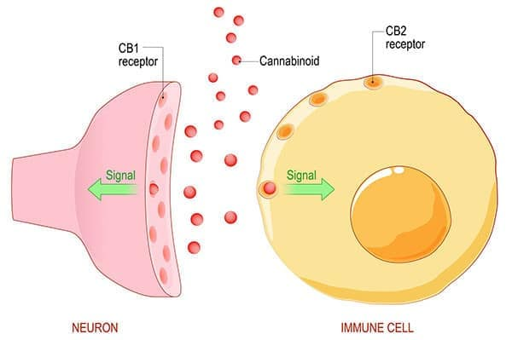
Endo Cannabinoid System (ECS): Responsible for Pain Feeling
Endo genous cannabinoids or endocannabinoids are naturally occuring lipid based neurotransmitters. The ECS regulates and controls many of our most critical bodily functions such as learning and memory, emotional processing, sleep, temperature control, pain control, inflammatory and immune responses, and eating.
Source: Harvard University Archive
(health.harvard.edu)

Slide 21
Synthesis of some drugs: Anti-Pyretic and analgesics
(NSAID)

Slide 22
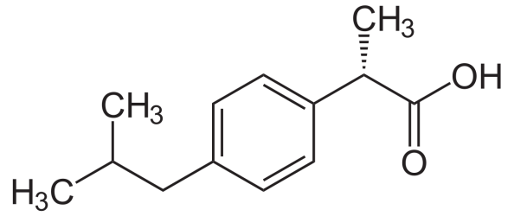
Ibuprofen
Ibuprofen, industrially known as Brufen, is a non steroidal anti-inflammatory drug (NSAID).
The racemic form is available in the market. However, the S-enantiomer is more biologically active.
The synthesis of ibuprofen and its advancement from the traditional chemical route, the advanced greener route and the most advanced and the greenest pathway giving S-ibuprofen.

Slide 23
The Boot’s synthesis
This was the most widely accepted process by industries till 1980. It involved six steps:

Slide 24
The Boot’s Synthesis (Cont..)

Slide 25
Mechanism

Slide 26
Disadvantage of Boot’s process
Large number of steps
Large number of side products in each step.
Poor Atom Economy
Product is a Racemic mixture of S-Ibuprofen and R-Ibuprofen. That means 50% of the product remains biologically less useful or active.

Slide 27
Greener synthesis than Boot:
The Boots-Hoechst-Celanese
No Waste
No Waste

Slide 28
The Synthesis of S-Ibuprofen
No Waste
+
No Waste
Candida rugosa
lipase

Slide 29
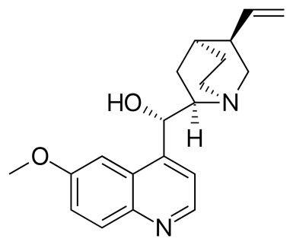
Cardiovascular drugs
Cardiovascular drugs are meant for better functioning of heart and or circulation of blood for oxygen transport. It consists of three subclasses
Anti arrhythmic drugs (Beta Blockers and ACE inhibitors) : These are used to suppress abnormal rhythm.
Quinidine (blocks sodium ion influx causing slower heart rate)

Slide 30
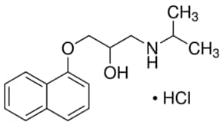
Beta Blocker
These block the function of hormones viz. adrenaline and nor adrenaline. These hormones are responsible for a very fast heart beat by forcing the heart muscle to pump with extreme rapidity
Propranolol: Beta Blocker

Slide 31
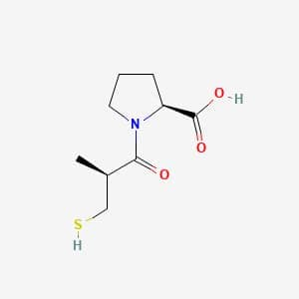
ACE (Angiotensin Converting Enzyme) Inhibitors
ACE inhibitors prevent an enzyme in the body from producing angiotensin II, a substance that narrows blood vessels
Captopril

Slide 32

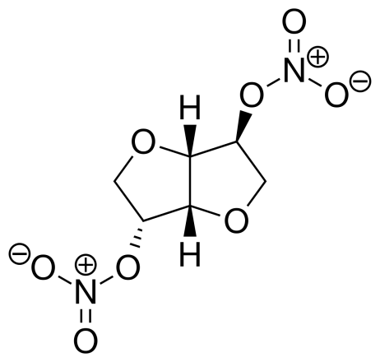
Cardiovascular drugs cont..
Anti-anginal drugs: These widen the blood vessels and help in better transport of oxygen.
Glyceryl nitrates fall in this category. Isosorbide dinitrate, marketed as Sorbitrate is a widely popular drug of this class.
Glyceryl trinitrate
Sorbitrate

Slide 33

Cardiovascular drugs: cont..
Anti hypertensive drugs: These are used to reduce the blood pressure. A well known natural drug for this purpose is reserpine. Calcium channel blockers fall in this class. Calcium influx into the heart muscle cells and help those to contract with force. This class of drugs block calcium ion influx. Calcium ion comes into the blood stream from bones.
Reserpine

Slide 34
Cardiovascular Drugs cont..
Anti anginal agents: These widen the blood vessels and help in better oxygen transport preventing heart attack (angina pectoris). Glyceryl nitrates fall in this class.
Glycerin or Glycerol
Glyceryl trinitrate
Sorbitrate
(isosorbid nitrate)

Slide 35
Anti Bacterial Drugs: The Sulphonamides
Sulphonamides were the first antibacterial drugs which were used systematically
The first sulphonamide was “ Prontosil” .
It was the first prodrug which could be used against a range of bacterial infections including streptococcus viz. blood infections , child bed fever and erysipelus

Slide 36
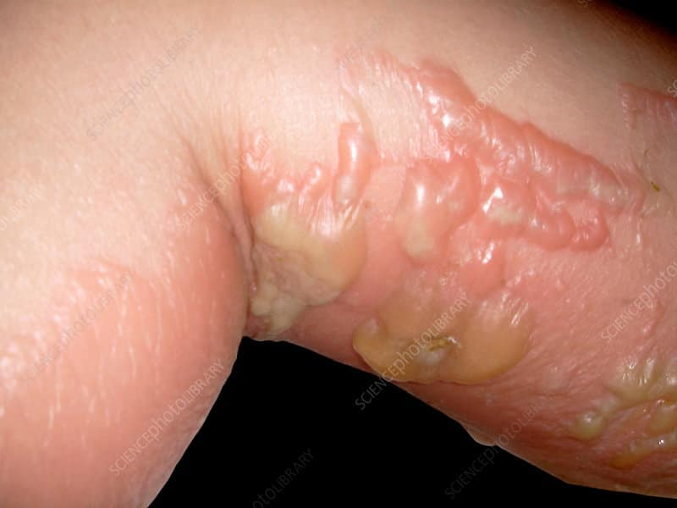
Prontosil is a pro drug
Inside the body the compound decomposes into sulphanilamide which is biologically most active.
Erysipelus
Cell
Sulphanilamide

Slide 37
Sulphonamides are structurally similar to p-amino benzoic acid
Thus sulphanilamides act as a mmic of PABA. Bacteria uses PABA to synthesise folic acid as a part of their metabolism. Sulphanilamides are taken up by bacteria and the process of folic acid synthesis by bacterial enzyme is inhibited.
Suphanilamide
PABA

Slide 38
Trimethoprim: Compound and use:
Trimethoprim is a not a sulpha drug.
It acts as a dihydrofolate reductase inhibitor.
It prevents bacteria to form folic acid.
Hence sulphonamides are given with it as a combination
Trimethoprim

Slide 39
Short acting sulphonamides
These are effective very soon after being administered.
For a long treatment these are repeated periodically.
Short acting suphonamides are used for urinarey tract infection as these are excreted in high concentration with urea.
Urea binds it via H-bonding.
Sulpha diazines

Slide 40
Intermediate acting sulphonamides
Sulphamethoxazole is the main representative of this group
Sulphamethoxazole with trimethoprim together produce a bacteriocidal effect against a wide range of gram positive and gram negative bacteria and protozoa. The combo is named as Co-trimoxazole (5:1) .
The combo is used to treat infections of urinary, respiratory and gastrointestinal tracts.

Slide 41
Intermediate acting sulphonamides
Synthesis of sulphamethoxazole
Pyridine
-HCl
NaOH

Slide 42
Sulphonamides For Topical Use
Sulphacetamide: Sulphacetamide sodium ( a water soluble form) is exclusively used for opthalmic use as ointment
Silver sulphadiazine and Mafenide acetate is used in burns as antibacterial agents
Silver sulpha diazine
Mafenide

Slide 43
Synthesis

Slide 44
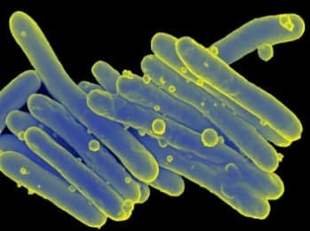
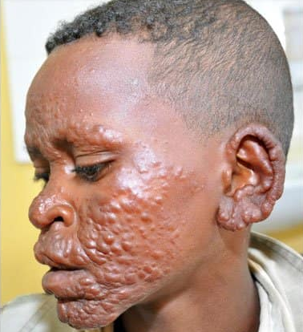
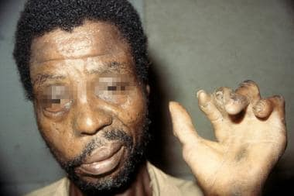
Anti Leprosy Drug
Micobacterium leprae (Leprosy bacillus or Hansen Bacillus) is the microorganism responsible for human leprosy and has been reported to be infectious. It damages the peripheral nerves and targets skin, eyes, nose and muscle.
Leprosy expression

Slide 45
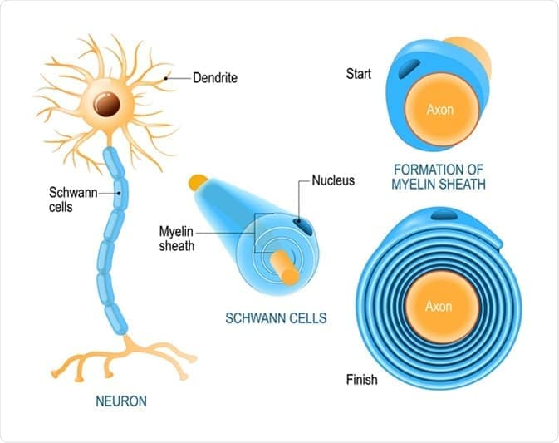
Action of Micobacterium leprae
Primarily invades Schwann cells (SCs) in the peripheral nerves leading to nerve damage and the development of disabilities.
It damages the nerve cells via releasing exotoxins or through immune mechanism

Slide 46
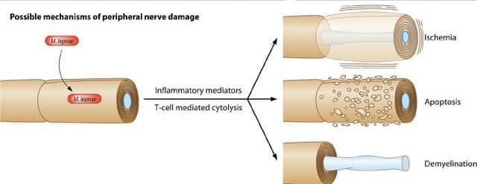
Action of M. leprae

Slide 47

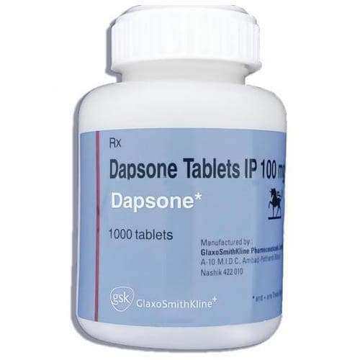
Use of sulpha-drug
Bis-(4 amino phenyl)sulphone, Dapsone became available since 1940 and has been used as the standard drug for the treatment of Leprosy.
Dapsone

Slide 48
Synthesis

Slide 49
Mechanism of Action
It s action is similar to sulphonamides
Bacteria use 4-amino benzoic acid (PABA) to form folic acid as a part of its metabolism
Dapsone mimics 4-amino benzoic acid (PABA)
Dapsone is absorbed by the bacteria and its enzyme action is inhibited.

Slide 50
Anti-HIV drug
The Human Immune Deficiency Virus infection causes AIDS (Acquired Immune Deficiency Syndrome)
The infection causes the depletion of CD4 lymphocytes
Lack of lymphocytes leads to immune deficiency

Slide 51
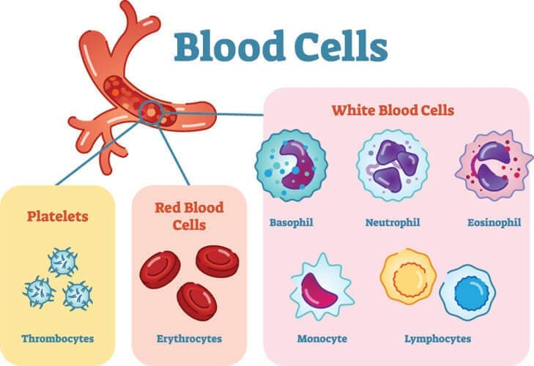

Slide 52
Antigen and Antibody
Antigen (Ag) is a molecule or molecular structure or any foreign particulate matter that can bind to a specific antibody or T-cell receptor.
The term antigen originally referred to a substance that is an antibody generator.
Antigens can be proteins, peptides (amino acid chains), polysaccharides (chains of monosaccharides/simple sugars), lipids, or nucleic acids, microorganisms including Virus, Bacteria.

Slide 53
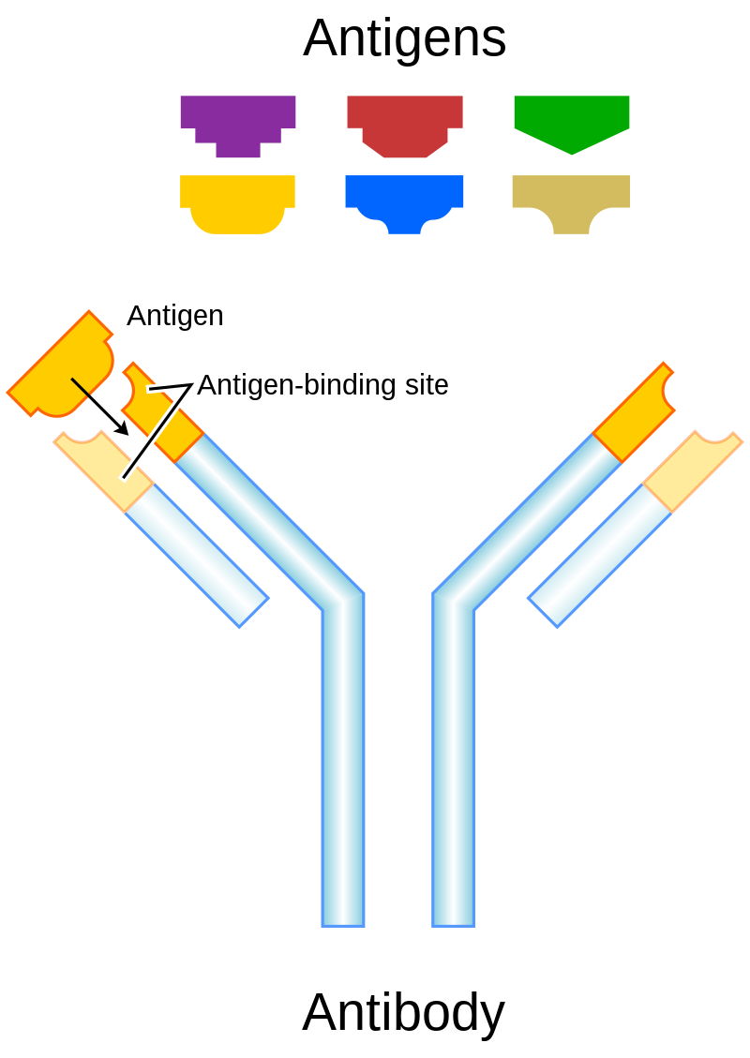
Immunity: Antigen and Antibody
Antigen-presenting cells present antigens in the form of peptides on histocompatibility molecules.
The T cells selectively recognize the antigens; depending on the antigen and the type of the histocompatibility molecule.
An antibody (Ab), also known as an immunoglobulin (Ig),^{[1]} is a large, Y-shaped protein used by the immune system to identify and neutralize foreign objects such as pathogenic bacteria and viruses.

Slide 54
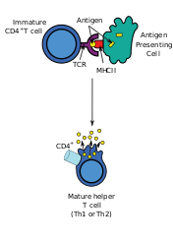
Immunity
CD4 (cluster of differentiation 4) is a glycoprotein that serves as a co-receptor for the T-cell receptor (TCR).
CD4 is a co-receptor of the T cell receptor (TCR) and assists the latter in communicating with antigen-presenting cells (APC).
APCs process antigens and present them to T-cells.

Slide 55
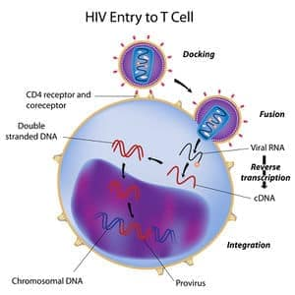
Types of HIV drugs
Reverse Transcriptase Inhibitors
HIV Protease Inhibitors

Slide 56
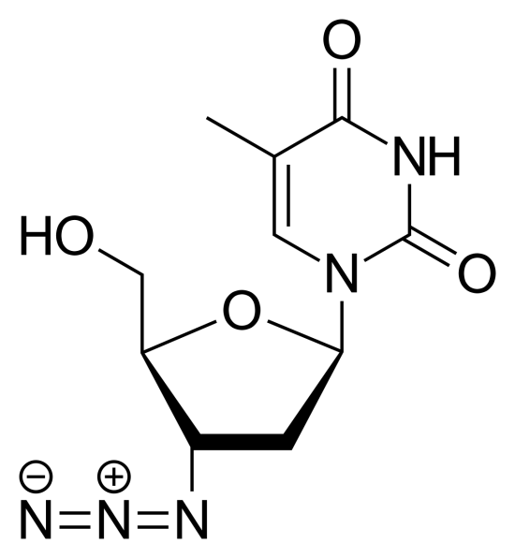
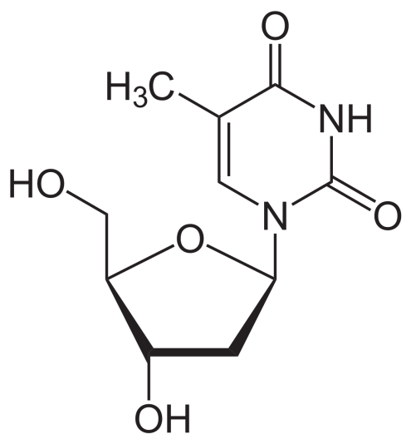
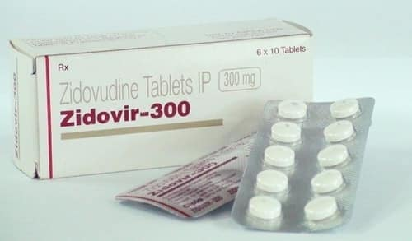
Anti HIV Drug: Zidovudine
AZidoThymidine (AZT)
Zidovudine is structurally similar to Thymidine
Thymidine
Zidovudine

Slide 57
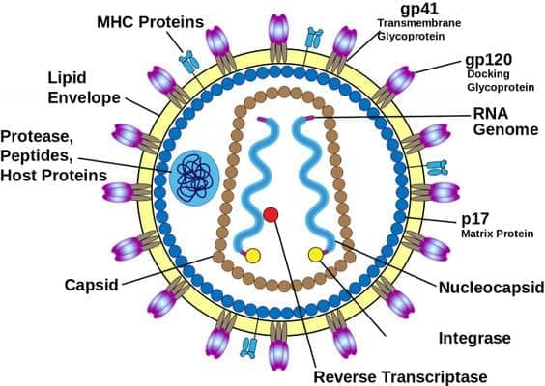
Retro virus and RNA Virus
Most RNA viruses reproduce by inserting RNA into the host cell. The RNA contains the instructions for making copies of the virus.
A retrovirus is an RNA virus, but instead of inserting the RNA directly into the cell, it first converts it into DNA.
The HIV genome consists of two identical single-stranded RNA molecules that are enclosed within the core of the virus particle.

Slide 58
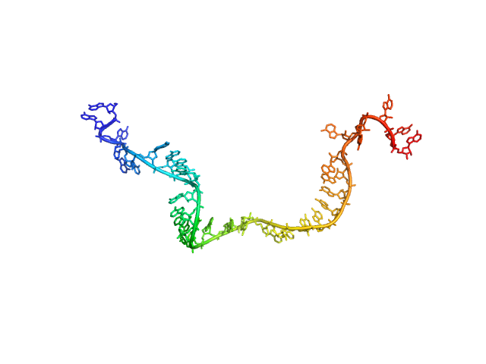
HIV virus structure

Slide 59
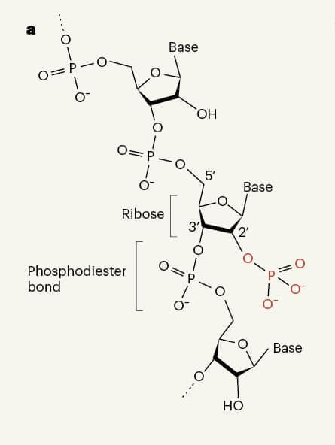
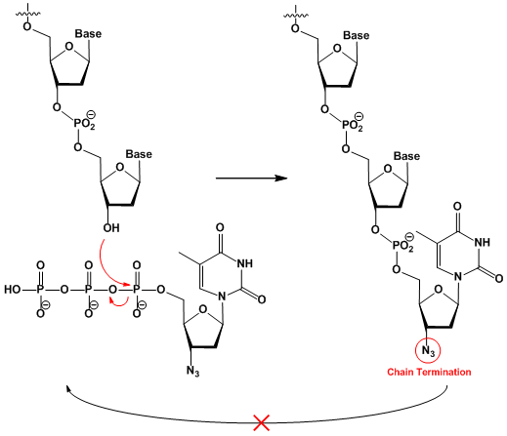
Chain growth of RNA

Slide 60
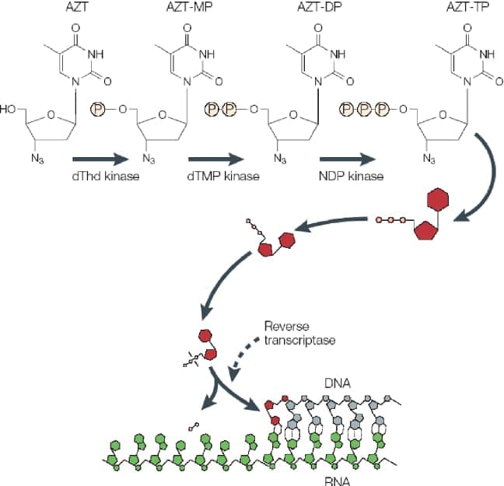
Mechanism of action of AZT Zidovudine
AZT is a thymidine analogue.
It is well absorbed by oral intake and is converted to triphosphate.
AZT works by selectively inhibiting HIV's reverse transcriptase, the enzyme that the virus uses to make a DNA copy of its RNA.
It halts the DNA synthesis

Slide 61
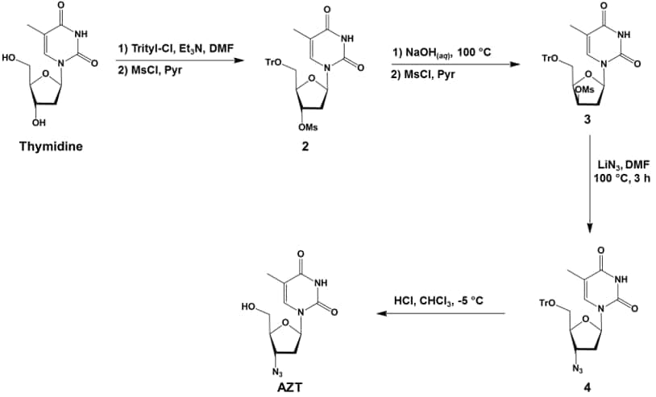
Synthesis

Slide 62
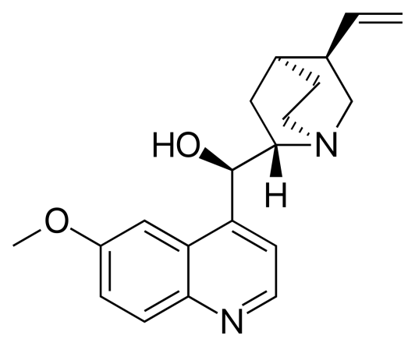
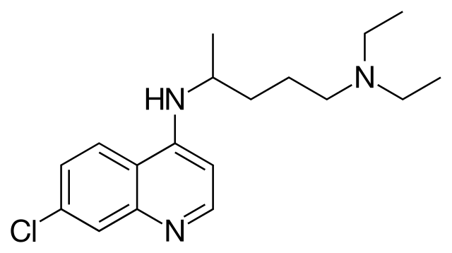
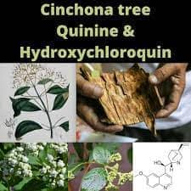
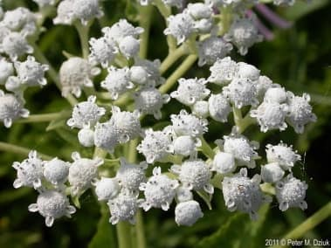
Anti Malarial Drug
Quinine is used to treat malaria caused by Plasmodium falciparum. It is the only natural drug that can treat malaria.
Plasmodium falciparum is a parasite that gets into the red blood cells in the body and causes malaria. Quinine works by killing the parasite or preventing it from growing.
Chloroquinine
Quinine
Parthenium integrifolium (wild quinine)

Slide 63
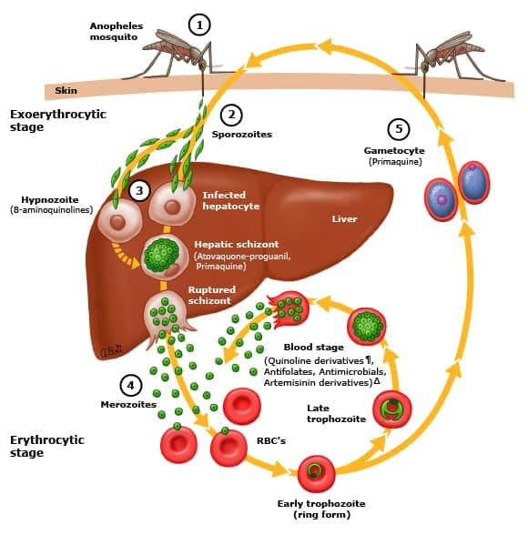
Malaria: How does it happen?

Slide 64
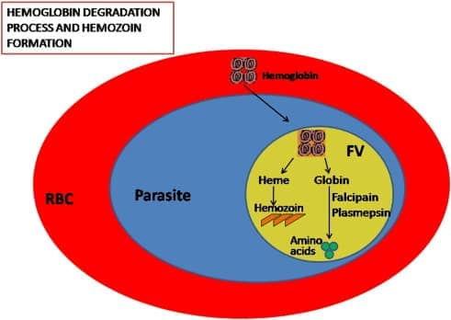
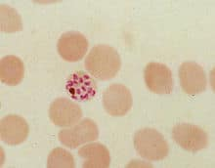
Degradation of Hemoglobin to Heme and Hemozoin formation

Slide 65
Quinine: Mechanism
It enters red blood cells and binds with heme through complex formation
This heme-quinine complex inhibits the metabolic process of the parasite.
Chloroquine accumulates in the food vacuole of the Plasmodia parasite
It prevents the conversion of Heme to Hemozoin
Accumulation of Heme is toxic to the parasite and kills it

Slide 66
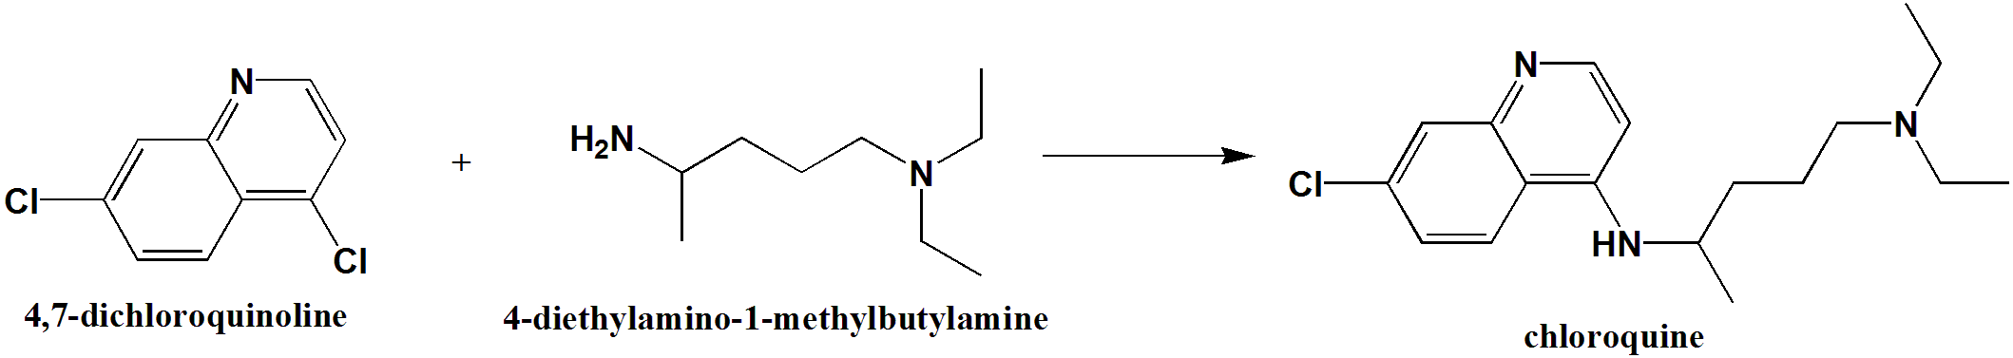
Chloroquine synthesis
N-C Coupling reaction
2-7 h heat

Slide 67
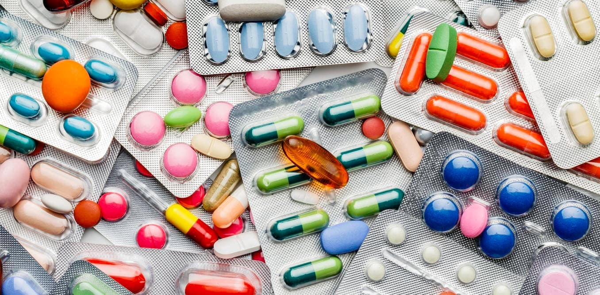
Antibiotics
Antimicrobial substance that can inhibit the growth or kill bacteria and in limited cases active against protozoa.

Slide 68
Antibiotics : Classification
Aminoglycosides
Fluoroquinolones
Lincosamides
Glycopeptides
Cephalosporins
Tetracyclins
Penicillins
Sulphonamides
Macrolides
Carbapenems

Slide 69
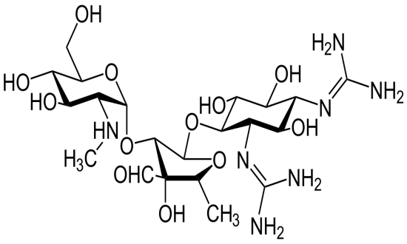
Aminoglycosides
The name ends with “mycin”: e.g. Streptomycin, Gentamycin.
Used for infection in blood streams and in severe abdominal infections: bacteremia
These inhibit the protein synthesis in gram negative bacteria.
It binds with the 30s subunit of the bacterial ribosome.

Slide 70
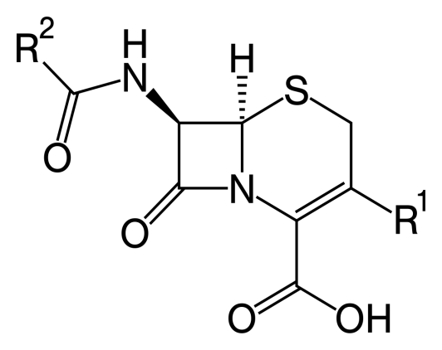
Cephalosporins
The name of drugs starts with “ ceph” of “Cef”
For example: Cefixime
Attacks both gram positive and gram negative bacteria.
It inhibits cell wall synthesis of bacteria.
Used for Skin, Urinary and respiratory infections.

Slide 71
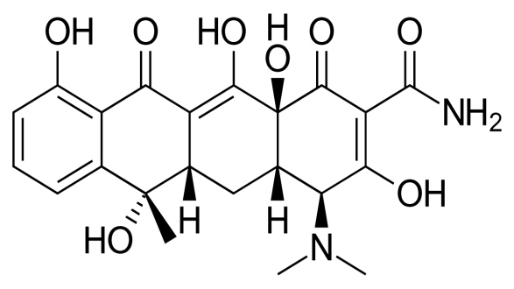
Tetracyclins
These drugs ends with the name “ cycline” For Example: Doxycycline, Methacycline
Attacks both gram negative and gram positive bacteria
Acts like amino glycosides by inhibiting the protein synthesis of bacterial ribosome
Used for Lyme Disease, Pulmonary inflammatory diseases and STDs (Sexually Transmitted Diseases)

Slide 72
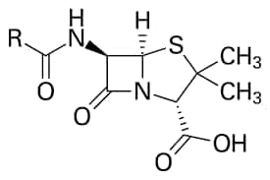
Penicillins
These ends with the name “ cillins” For example: Amoxycillin, Ampicillin
Attacks both Gram positive and Gram negative bacteria
Acts like Cephalosporins: inhibits cell wall synthesis of bacterial cell wall
Used for ENT infections, Urinary Track Infections, Skin infections

Slide 73

Sulphonamides
Starts with “Sulpho”
Examples: Sulphomethoxazole
Covers both gram positive and gram negative bacteria
Kills bacteria by inhibiting folate synthesis
Used for Urinary Tract Infection (UTI), Burns and Eye infections

Slide 74

Fluoroquinolones
Drug name ends with “floxacin”. For example: Ciprofloxacin, Levofloxacin
Covers both gram positive and gram negative bacteria
Inhibits bacterial DNA replication.
Used for respiratory and UTI

Slide 75

Macrolides
Ends with the name : “thromycin”. For example , Azethromycin, Erythromycin
Attacks only gram positive bacteria
Inhibits bacterial protein synthesis by binding with 50 s subunit of ribosome.
Used for pneumonia, sinucites, UTI, inner throat infection, STD.

Slide 76

Carbapenems
Name ends with “penems”. Examples are like Meropenem, Ertapenem
Covers both gram positive and gram negative bactera
Inhibits bacterial cell wall synthesis
Used for UTI and Abdomen infections

Slide 77

Lincosides
Ends with mycin
Only for gram positive bacteria
Attacks the 50 s subunit of ribosome inhibiting bacterial protein sunthesis
Used for skin, bone and lung infections

Slide 78

Glycopeptides
This also ends with mycin:
For example Vancomycin
Used for only gram positive bacteria
Inhibits bacterial cell wall synthesis
Used for skin and cardioinfections

