Slide 1
Pharmaceutical Chemistry
Dr. Abir B. Majumder (Ph.D., IIT Delhi)
Project Scientist IIT Delhi (2009-2010)
Lecturer IIIT Hyderabad(2010-2015)
Assistant Professor, KGT Mahavidyalaya
(2015 onwards)

Slide 2
Anti-HIV drug
The Human Immune Deficiency Virus infection causes AIDS (Acquired Immune Deficiency Syndrome)
The infection causes the depletion of CD4 lymphocytes
Lack of lymphocytes leads to immune deficiency

Slide 3
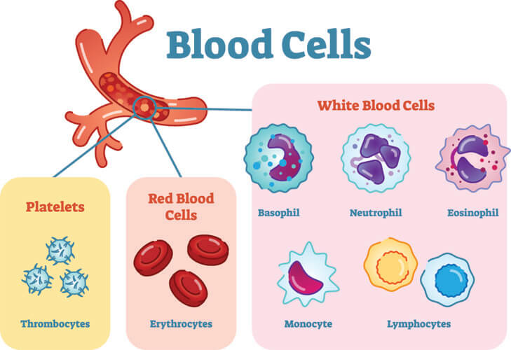

Slide 4
Antigen and Antibody
Antigen (Ag) is a molecule or molecular structure or any foreign particulate matter that can bind to a specific antibody or T-cell receptor.
The term antigen originally referred to a substance that is an antibody generator.
Antigens can be proteins, peptides (amino acid chains), polysaccharides (chains of monosaccharides/simple sugars), lipids, or nucleic acids, microorganisms including Virus, Bacteria.

Slide 5
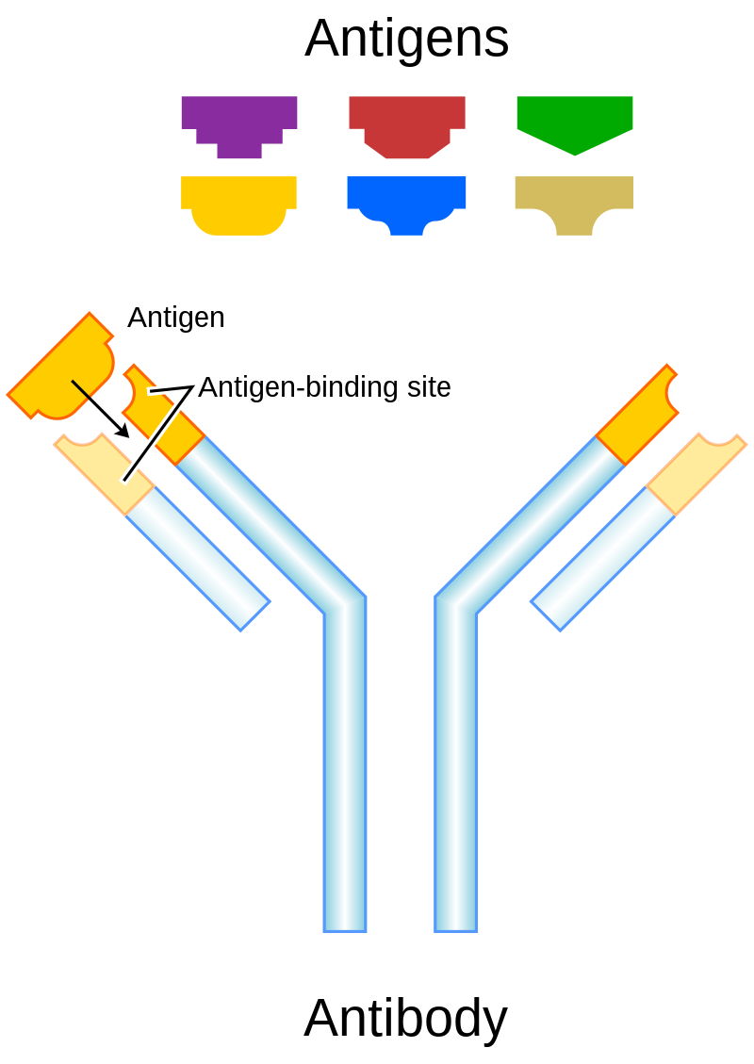
Immunity: Antigen and Antibody
Antigen-presenting cells present antigens in the form of peptides on histocompatibility molecules.
The T cells selectively recognize the antigens; depending on the antigen and the type of the histocompatibility molecule.
An antibody (Ab), also known as an immunoglobulin (Ig),^{[1]} is a large, Y-shaped protein used by the immune system to identify and neutralize foreign objects such as pathogenic bacteria and viruses.

Slide 6
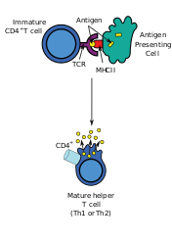
Immunity
CD4 (cluster of differentiation 4) is a glycoprotein that serves as a co-receptor for the T-cell receptor (TCR).
CD4 is a co-receptor of the T cell receptor (TCR) and assists the latter in communicating with antigen-presenting cells (APC).
APCs process antigens and present them to T-cells.

Slide 7
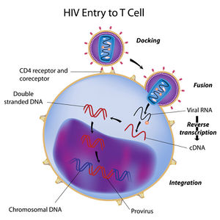
Types of HIV drugs
Reverse Transcriptase Inhibitors
HIV Protease Inhibitors

Slide 8
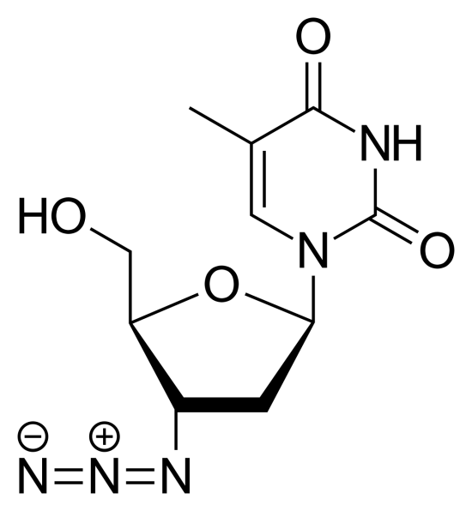
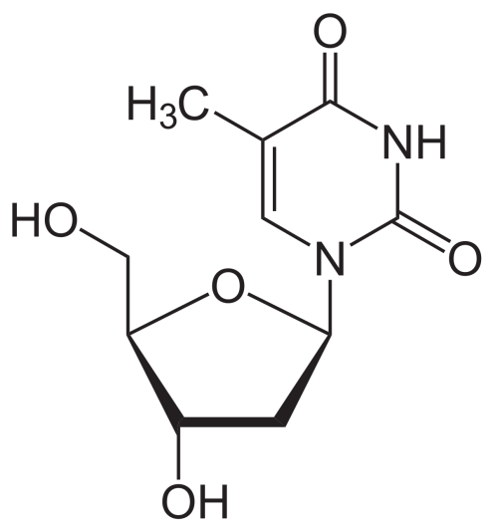
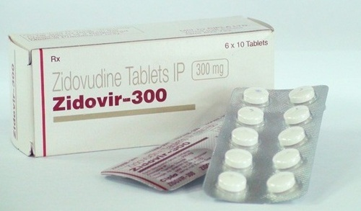
Anti HIV Drug: Zidovudine
AZidoThymidine (AZT)
Zidovudine is structurally similar to Thymidine
Thymidine
Zidovudine

Slide 9
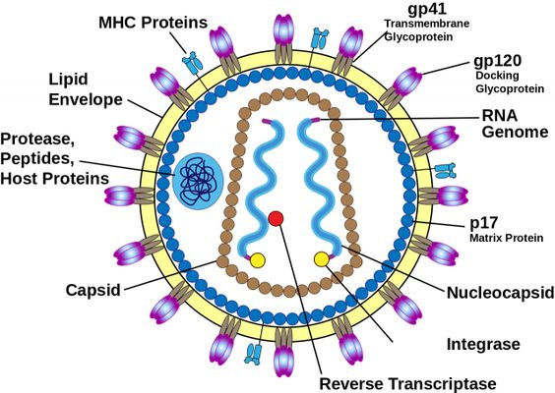
Retro virus and RNA Virus
Most RNA viruses reproduce by inserting RNA into the host cell. The RNA contains the instructions for making copies of the virus.
A retrovirus is an RNA virus, but instead of inserting the RNA directly into the cell, it first converts it into DNA.
The HIV genome consists of two identical single-stranded RNA molecules that are enclosed within the core of the virus particle.

Slide 10
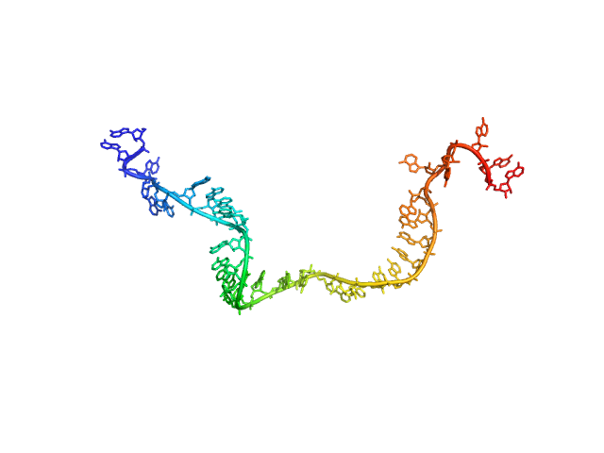
HIV virus structure

Slide 11
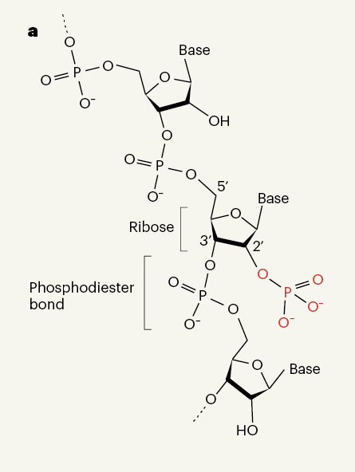
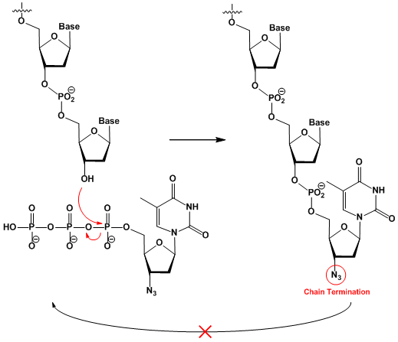
Chain growth of RNA

Slide 12
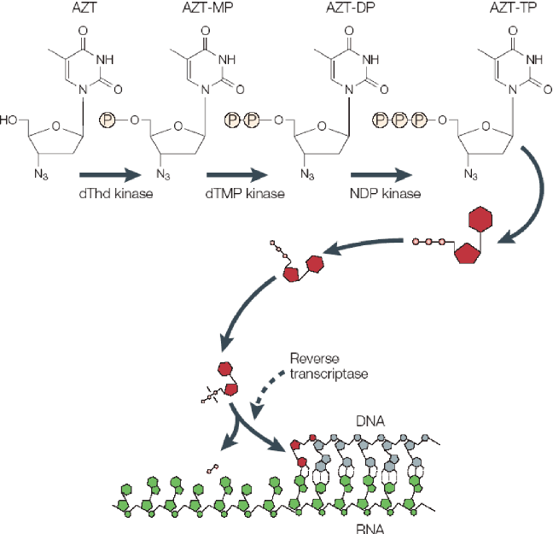
Mechanism of action of AZT Zidovudine
AZT is a thymidine analogue.
It is well absorbed by oral intake and is converted to triphosphate.
AZT works by selectively inhibiting HIV's reverse transcriptase, the enzyme that the virus uses to make a DNA copy of its RNA.
It halts the DNA synthesis

Slide 13
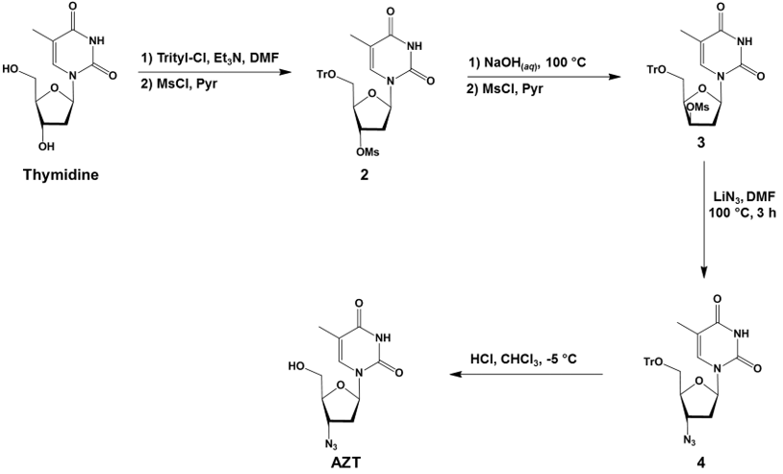
Synthesis

