Slide 1
Pharmaceutical Chemistry
Dr. Abir B. Majumder (Ph.D., IIT Delhi)
Project Scientist IIT Delhi (2009-2010)
Lecturer IIIT Hyderabad(2010-2015)
Assistant Professor, KGT Mahavidyalaya
(2015 onwards)

Slide 2
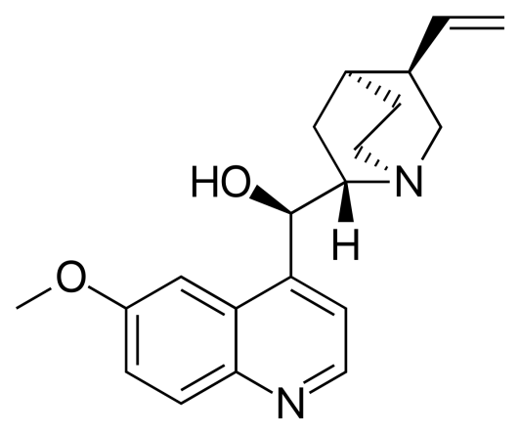
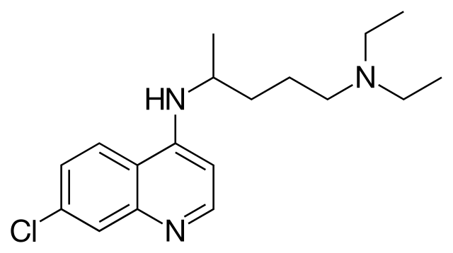
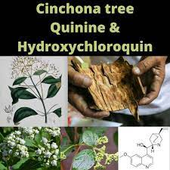
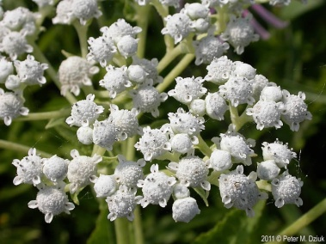
Anti Malarial Drug
Quinine is used to treat malaria caused by Plasmodium falciparum. It is the only natural drug that can treat malaria.
Plasmodium falciparum is a parasite that gets into the red blood cells in the body and causes malaria. Quinine works by killing the parasite or preventing it from growing.
Chloroquinine
Quinine
Parthenium integrifolium (wild quinine)

Slide 3
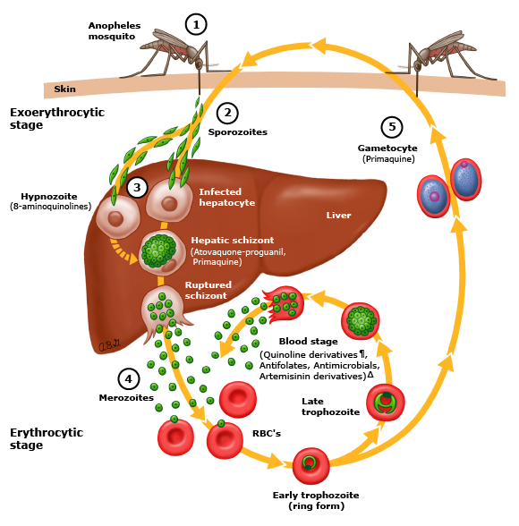
Malaria: How does it happen?

Slide 4
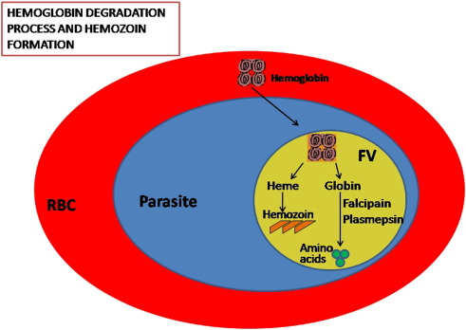
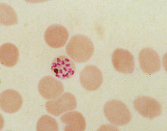
Degradation of Hemoglobin to Heme and Hemozoin formation

Slide 5
Quinine: Mechanism
It enters red blood cells and binds with heme through complex formation
This heme-quinine complex inhibits the metabolic process of the parasite.
Chloroquine accumulates in the food vacuole of the Plasmodia parasite
It prevents the conversion of Heme to Hemozoin
Accumulation of Heme is toxic to the parasite and kills it

Slide 6
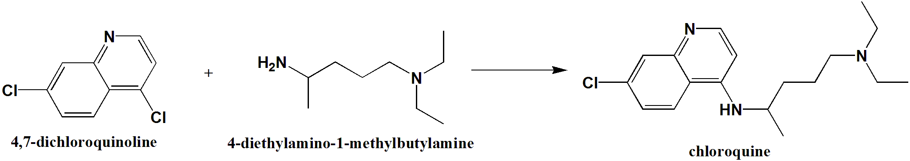
Chloroquine synthesis
N-C Coupling reaction
2-7 h heat

