Slide 1
Anti-Ulcer Drugs
Dr. Abir B. Majumder, Ph.D. , IIT Delhi

Slide 2
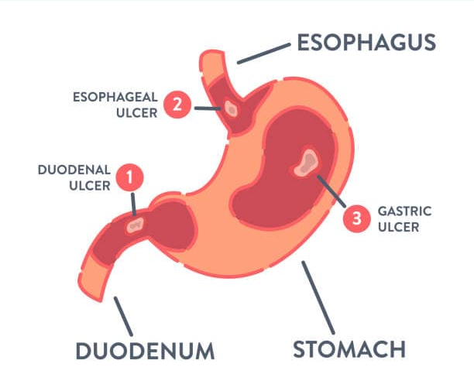
What is ulcer ?
A localized lesion of the mucous membrane of the stomach (gastric ulcer) or duodenum (duodenal ulcer), typically extending through the muscularis mucosa i.e the outermost layer of elastic fibers and smooth mucous cells.

Slide 3
Protection and de-protection of Mucus layer: Physiological factors
Hydrochloric acid and pepsin destroy gastric and duodenal mucosa.
Mucus and bicarbonate ion secretions protect mucosa
Prostaglandins protect mucosa by enhancing mucus and bicarbonate production and by enhancing mucosal blood flow
How ulcer is caused?
External/ Acquired factors :
Helicobacter pylori infection
Alcohol
Smoking
Caffeine
Genetic factors
Spicy and Hot diet
Hypersecretory states (Zollinger Ellison syndrome): Presence of Gastrin releasing tumors (Gastrinoma). Release of Gastrin hormone cause the stomach to release excessive HCl
Drugs (e.g.) NSAIDs over usage

Slide 4
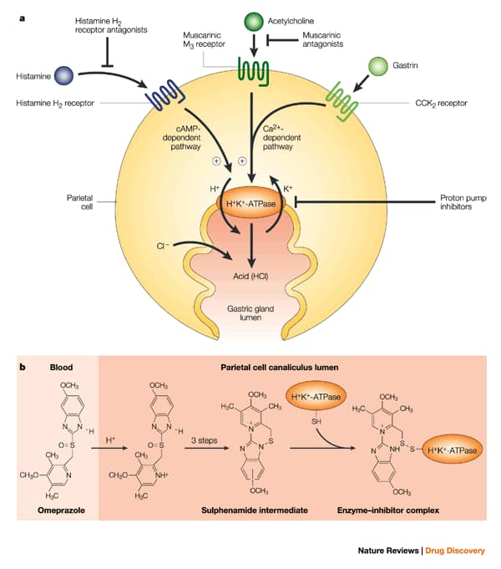
Parietal cells secrete acid in response to:
Histamine (local hormone): H₂ receptors
Gastrin (hormone): CCK₂ receptors
Ach (neurotransmitter): M₃ receptors
Proton pump (H⁺/ K⁺ ATPase)

Slide 5
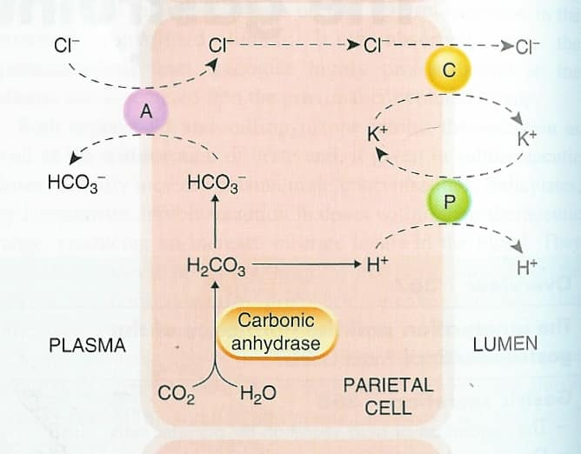
Proton Pump Mechanism

Slide 6
Treatment of Ulcer:
Recovery of of H. pylori infections.
Hyposecretory drugs: those prevents secretion of HCl from perietal cell
  H₂ receptor blockers
  Antimuscarinic drugs
  Proton pump inhibitors (PPI)
3. Mucosal protective agents.
  Prostaglandin analogues
  Sucralfate (Carafate^{R})
4. Neutralizing agents (antacids).

Slide 7
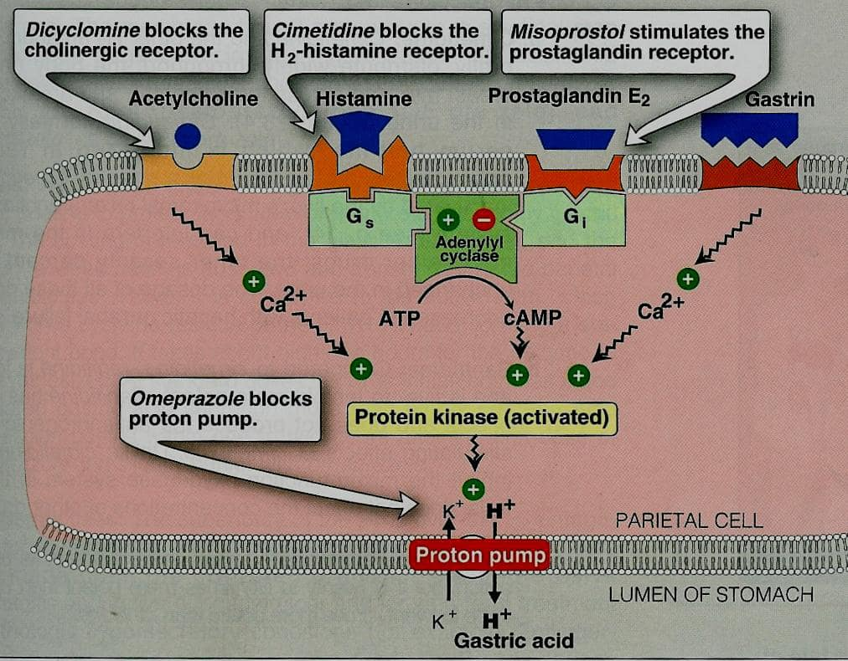

Slide 8
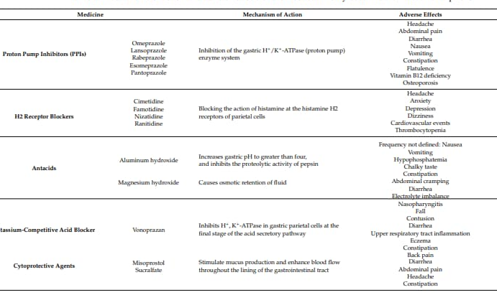
Anti-Ulcer Drugs : Summary

Slide 9
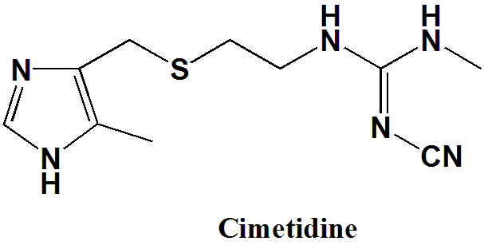
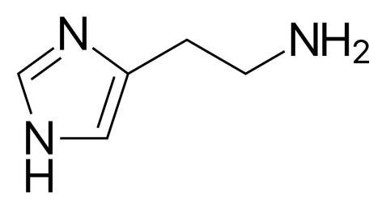
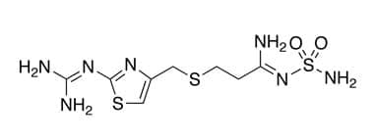
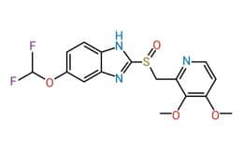
Histamine
Famotidine
Famotidine
Proton Pump Inhibitor (PPI)
Pantoprazole

Slide 10
Cimetidine
1-cyano-2-methyl-3-[2-[(5-methyl-1H-imidazol-4-yl)methylsulfanyl]ethyl]guanidine
The H2-receptor antagonist cimetidine competitively and reversibly blocks histamine from stimulating the H2-receptors located on the gastric parietal cells and as a result secretion of acid is controlled.

Slide 11
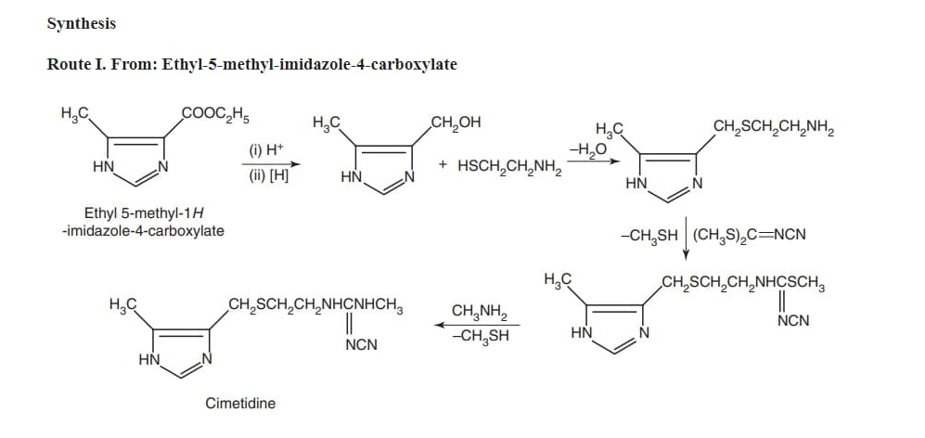

Slide 12
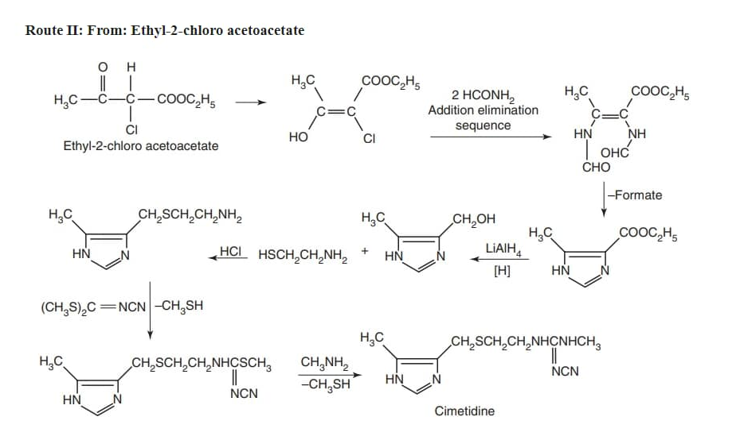

Slide 13
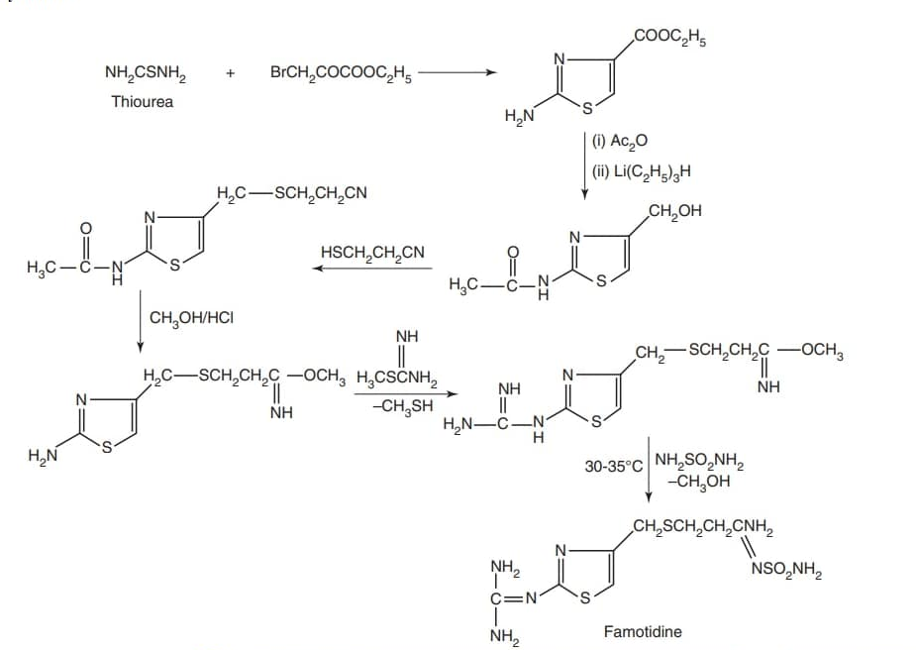
Synthesis of Famotidine :

Slide 14
