Slide 1

Drugs and Pharmaceuticals
Lecture module -02
Dr. Abir B. Majumder

Slide 2
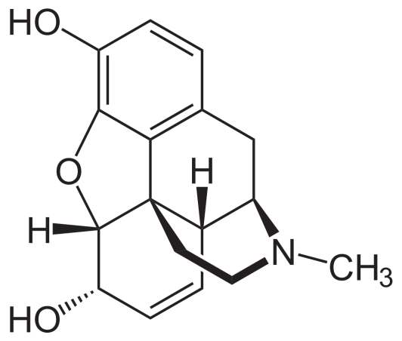
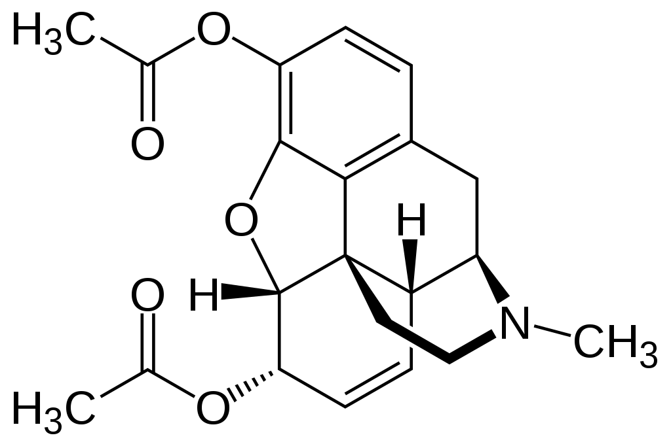
Analgesics
Narcotic analgesics: These are the analgesics when used in overdose, cause addiction. Morphine and its analogues (derivatives) fall in this class. Morphine once used before surgery during operation. Heroine, a derivative of morphine is infamous for its addictive power.
Morphine
Heroine

Slide 3
Aspirin
Aspirin falls in the class of non narcotic analgesic. It is anti-rheumatic.
Preparation
Ortho hydroxy benzoic acid (salicylic acid) is reacted with acetic anhydride in presence of catalytic amount of concentrated sulfuric acid.
The temperature is maintained at 50-60 º C for about half an hour.
The reaction medium is continuously stirred.
Aspirin is precipitated after pouring the medium in ice cold water.

Slide 4
Synthesis
Conc. H2SO4
Catalytic amount
Aspirin

Slide 5
Mode of action of Aspirin
Essentially helps to reduce fever with high temperature to bring it down to normal body temperature.
It falls in the group of antipyretic analgesics.
This NSAID inhibits the enzyme called cyclo oxygenase which is responsible for the formation of prostaglandins (PGs) that cause inflammation, swelling, pain and or fever.

Slide 6
Paracetamol mode of action
(Acetamenophen)
Paracetamol (acetaminophen) is generally not considered an NSAID.
It has only minor anti -inflammatory activity.
Acetaminophen treats pain mainly by blocking Cyclooxygenase-2 and inhibiting endocannabinoid reuptake almost exclusively within the brain, but not much in the rest of the body.

Slide 7
Synthesis of Paracetamol
Acetic anhydride
P-Aminophenol
P-Acataaminophenol or p-Hydroxy acetanilide
The widely used process of the synthesis of Paracetamol involves the acetylation of 4-amino phenol using equivalent amount of acetic anhydride and sodium acetate.

Slide 8
Mechanism

Slide 9
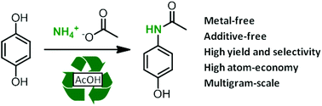
Synthesis of Paracetamol
Amidation of phenol derivatives: A direct synthesis from para quinol

Slide 10
Paracetamol mode of action
(Acetamenophen)
Paracetamol (acetaminophen) is generally not considered an NSAID.
It has only minor anti -inflammatory activity.
Acetaminophen treats pain mainly by blocking Cyclooxygenase-2 and inhibiting endocannabinoid reuptake almost exclusively within the brain, but not much in the rest of the body.

Slide 11
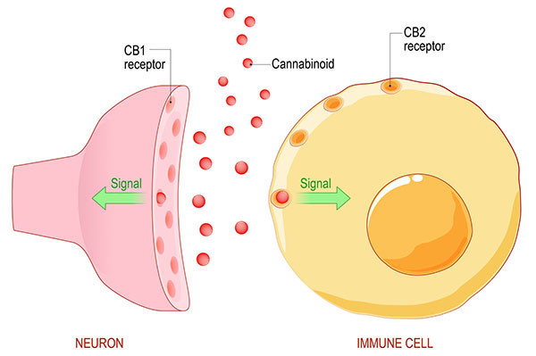
Endo Cannabinoid System (ECS): Responsible for Pain Feeling
Endo genous cannabinoids or endocannabinoids are naturally occuring lipid based neurotransmitters. The ECS regulates and controls many of our most critical bodily functions such as learning and memory, emotional processing, sleep, temperature control, pain control, inflammatory and immune responses, and eating.
Source: Harvard University Archive
(health.harvard.edu)

