Slide 1
Pharmaceutical Chemistry
Dr. Abir B. Majumder (Ph.D., IIT Delhi)
Project Scientist IIT Delhi (2009-2010)
Lecturer IIIT Hyderabad(2010-2015)
Assistant Professor, KGT Mahavidyalaya
(2015 onwards)

Slide 2

Antibiotics
Kills the microbial cells (Germs) by inhibiting its protein synthesis

Slide 3
Antibiotics : Classification
Aminoglycosides
Fluoroquinolones
Lincosamides
Glycopeptides
Cephalosporins
Tetracyclins
Penicillins
Sulphonamides
Macrolides
Carbapenems

Slide 4
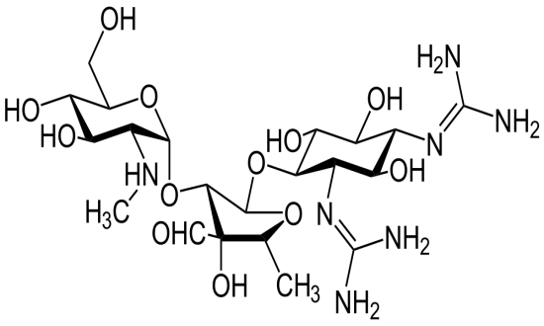
Aminoglycosides
The name ends with “mycin”: e.g. Streptomycin, Gentamycin.
Used for infection in blood streams and in severe abdominal infections: bacteremia
These inhibit the protein synthesis in gram negative bacteria.
It binds with the 30s subunit of the bacterial ribosome.

Slide 5
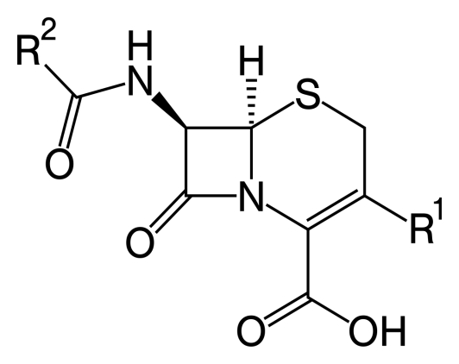
Cephalosporins
The name of drugs starts with “ ceph” of “Cef”
For example: Cefixime
Attacks both gram positive and gram negative bacteria.
It inhibits cell wall synthesis of bacteria.
Used for Skin, Urinary and respiratory infections.

Slide 6
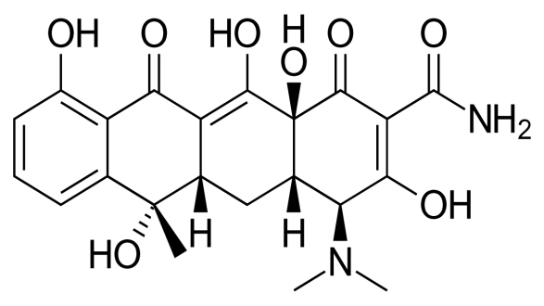
Tetracyclins
These drugs ends with the name “ cycline” For Example: Doxycycline, Methacycline
Attacks both gram negative and gram positive bacteria
Acts like amino glycosides by inhibiting the protein synthesis of bacterial ribosome
Used for Lyme Disease, Pulmonary inflammatory diseases and STDs (Sexually Transmitted Diseases)

Slide 7
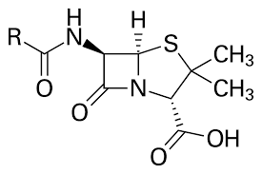
Penicillins
These ends with the name “ cillins” For example: Amoxycillin, Ampicillin
Attacks both Gram positive and Gram negative bacteria
Acts like Cephalosporins: inhibits cell wall synthesis of bacterial cell wall
Used for ENT infections, Urinary Track Infections, Skin infections

Slide 8
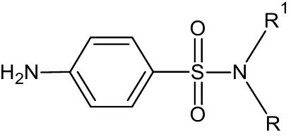
Sulphonamides
Starts with “Sulpho”
Examples: Sulphomethoxazole
Covers both gram positive and gram negative bacteria
Kills bacteria by inhibiting folate synthesis
Used for Urinary Tract Infection (UTI), Burns and Eye infections

Slide 9
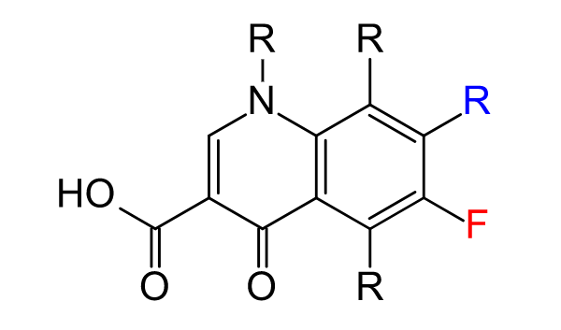
Fluoroquinolones
Drug name ends with “floxacin”. For example: Ciprofloxacin, Levofloxacin
Covers both gram positive and gram negative bacteria
Inhibits bacterial DNA replication.
Used for respiratory and UTI

Slide 10
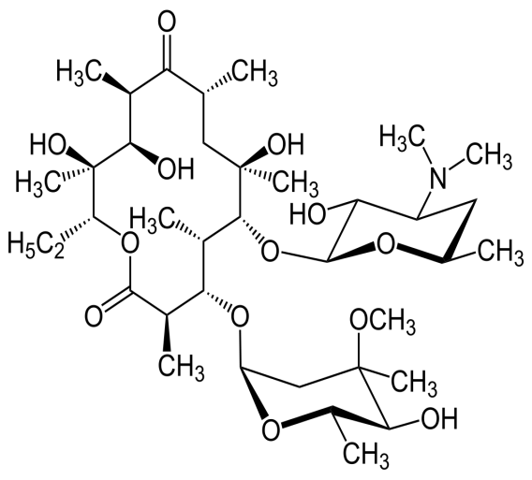
Macrolides
Ends with the name : “thromycin”. For example , Azethromycin, Erythromycin
Attacks only gram positive bacteria
Inhibits bacterial protein synthesis by binding with 50 s subunit of ribosome.
Used for pneumonia, sinucites, UTI, inner throat infection, STD.

Slide 11
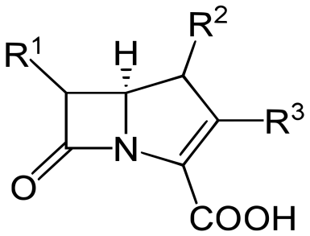
Carbapenems
Name ends with “penems”. Examples are like Meropenem, Ertapenem
Covers both gram positive and gram negative bactera
Inhibits bacterial cell wall synthesis
Used for UTI and Abdomen infections

Slide 12
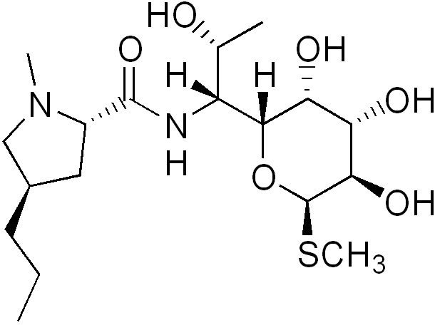
Lincosides
Ends with mycin
Only for gram positive bacteria
Attacks the 50 s subunit of ribosome inhibiting bacterial protein sunthesis
Used for skin, bone and lung infections

Slide 13
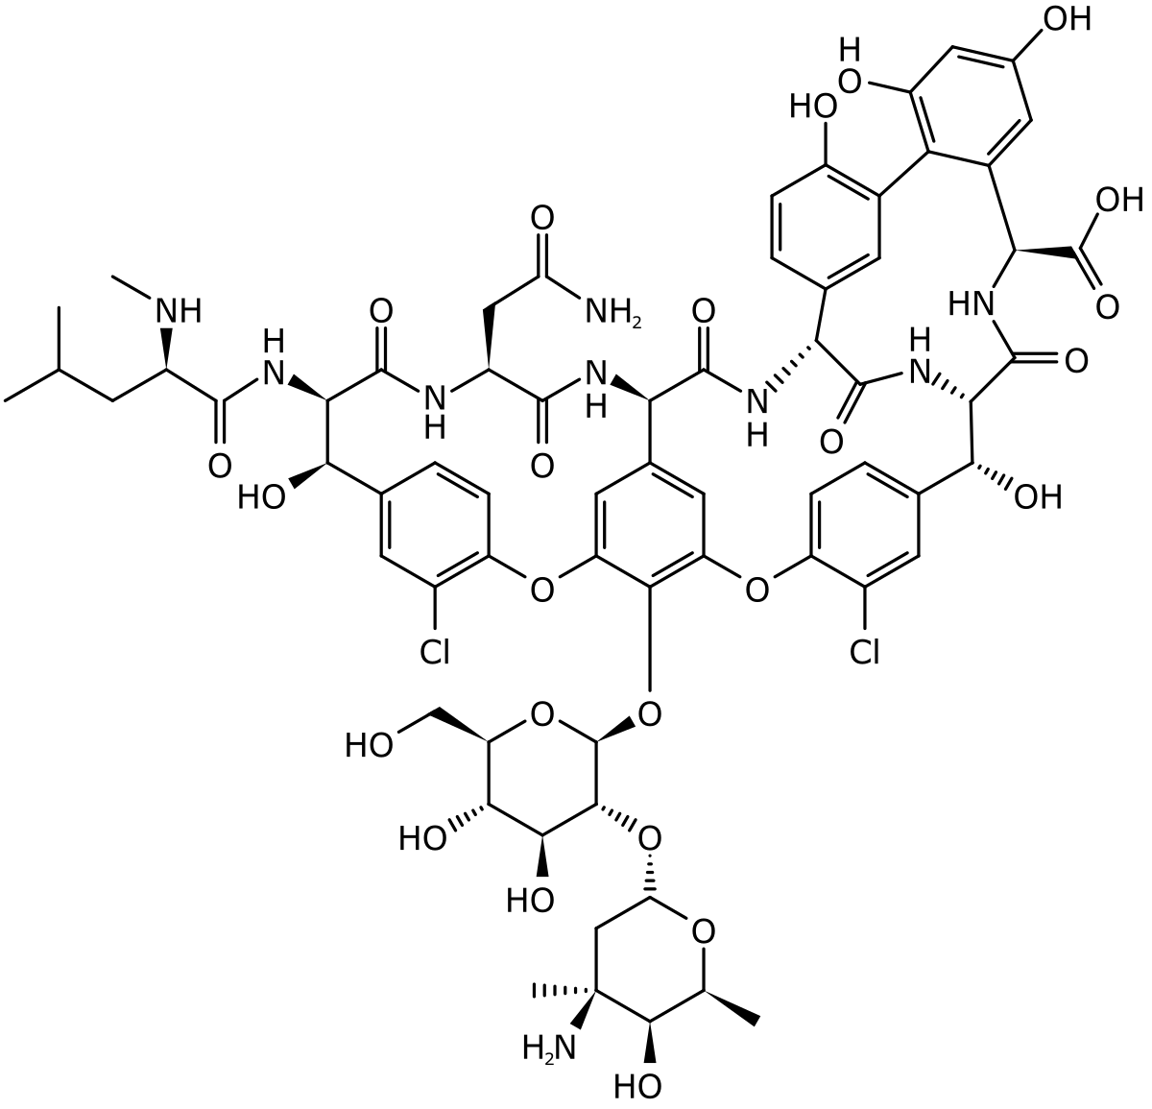
Glycopeptides
This also ends with mycin:
For example Vancomycin
Used for only gram positive bacteria
Inhibits bacterial cell wall synthesis
Used for skin and cardioinfections

