Slide 1
Pharmaceutical Chemistry
Dr. Abir B. Majumder (Ph.D., IIT Delhi)
Project Scientist IIT Delhi (2009-2010)
Lecturer IIIT Hyderabad(2010-2015)
Assistant Professor, KGT Mahavidyalaya
(2015 onwards)

Slide 2
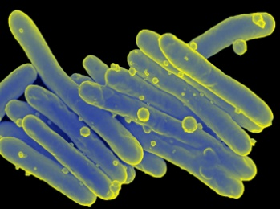
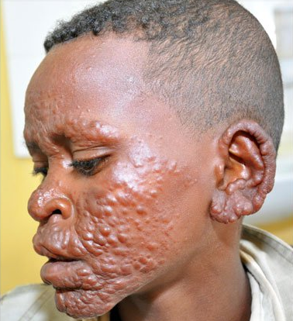

Anti Leprosy Drug
Micobacterium leprae (Leprosy bacillus or Hansen Bacillus) is the microorganism responsible for human leprosy and has been reported to be infectious. It damages the peripheral nerves and targets skin, eyes, nose and muscle.
Leprosy expression

Slide 3
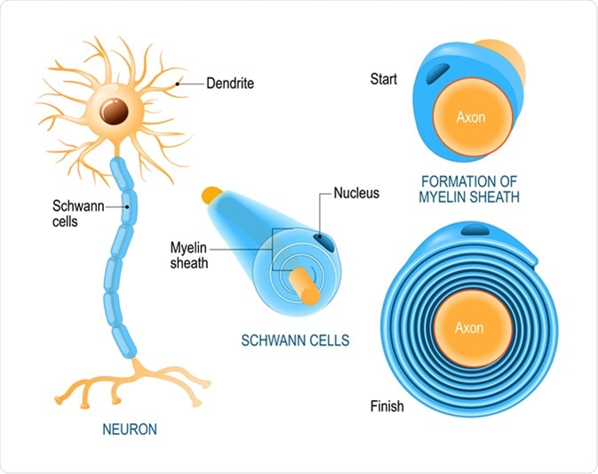
Action of Micobacterium leprae
Primarily invades Schwann cells (SCs) in the peripheral nerves leading to nerve damage and the development of disabilities.
It damages the nerve cells via releasing exotoxins or through immune mechanism

Slide 4
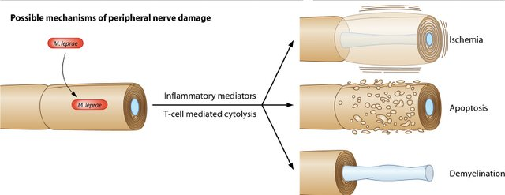
Action of M. leprae

Slide 5
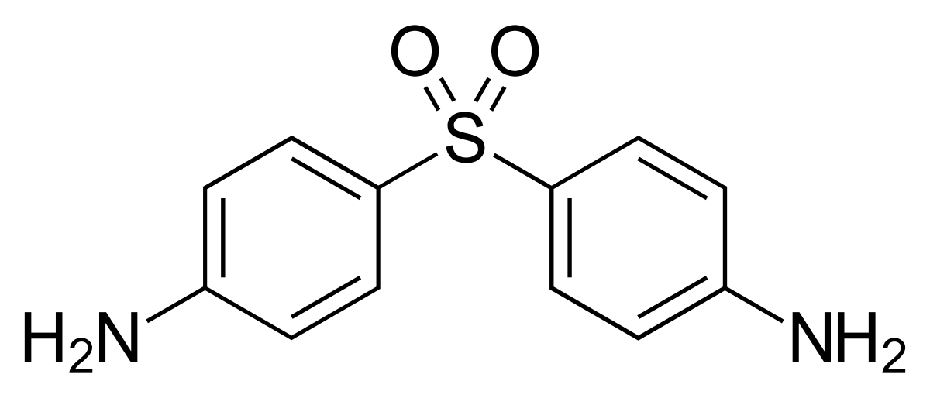
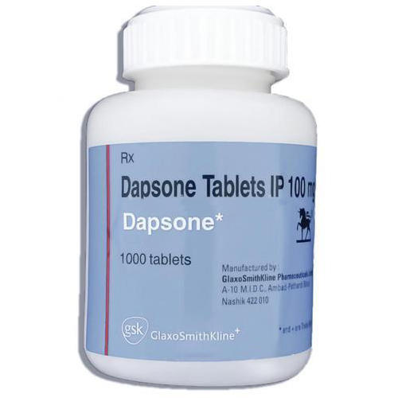
Use of sulpha-drug
Bis-(4 amino phenyl)sulphone, Dapsone became available since 1940 and has been used as the standard drug for the treatment of Leprosy.
Dapsone

Slide 6
Synthesis

Slide 7
Mechanism of Action
It s action is similar to sulphonamides
Bacteria use 4-amino benzoic acid (PABA) to form folic acid as a part of its metabolism
Dapsone mimics 4-amino benzoic acid (PABA)
Dapsone is absorbed by the bacteria and its enzyme action is inhibited.

