Slide 1
Pharmaceutical Chemistry
Dr. Abir B. Majumder (Ph.D., IIT Delhi)
Project Scientist IIT Delhi (2009-2010)
Lecturer IIIT Hyderabad(2010-2015)
Assistant Professor, KGT Mahavidyalaya
(2015 onwards)

Slide 2
Antiseptics and Disinfectants
Antiseptics
Disinfectants
These are chemicals applied externally
Prevents or kills the growth of micro organisms
Directly applied on living tissues for wounds, cuts, ulcers
Example: Dettol; widely used antiseptic composed of Chloroxylenol and alpha terpeneol
These are chemicals , more toxic in nature
Prevents or kills the growth of micro organisms
Directly applied on non living objects viz. on floor, drainage, instruments
Example: Halazone used for water purification

Slide 3
Antiseptics
Disinfectants
Chloroxylenol: Used in Dettol
Alpha terpeneol: Used in Dettol
Halazone: Used for disinfecting water
Bithiol: Used as antiseptic in soaps
Dichloramine T: Used for disinfecting instruments

Slide 4
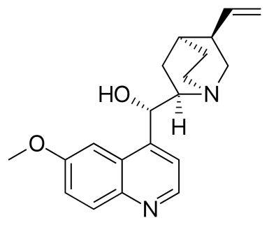
Cardiovascular drugs
Cardiovascular drugs are meant for better functioning of heart and or circulation of blood for oxygen transport. It consists of three subclasses
Anti arrhythmic drugs (Beta Blockers and ACE inhibitors) : These are used to suppress abnormal rhythm.
Quinidine (blocks sodium ion influx causing slower heart rate)

Slide 5
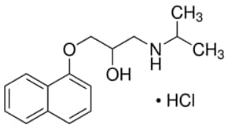
Beta Blocker
These block the function of hormones viz. adrenaline and nor adrenaline. These hormones are responsible for a very fast heart beat by forcing the heart muscle to pump with extreme rapidity
Propranolol: Beta Blocker

Slide 6
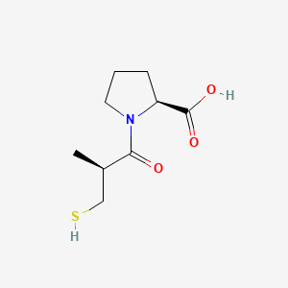
ACE (Angiotensin Converting Enzyme) Inhibitors
ACE inhibitors prevent an enzyme in the body from producing angiotensin II, a substance that narrows blood vessels
Captopril

Slide 7
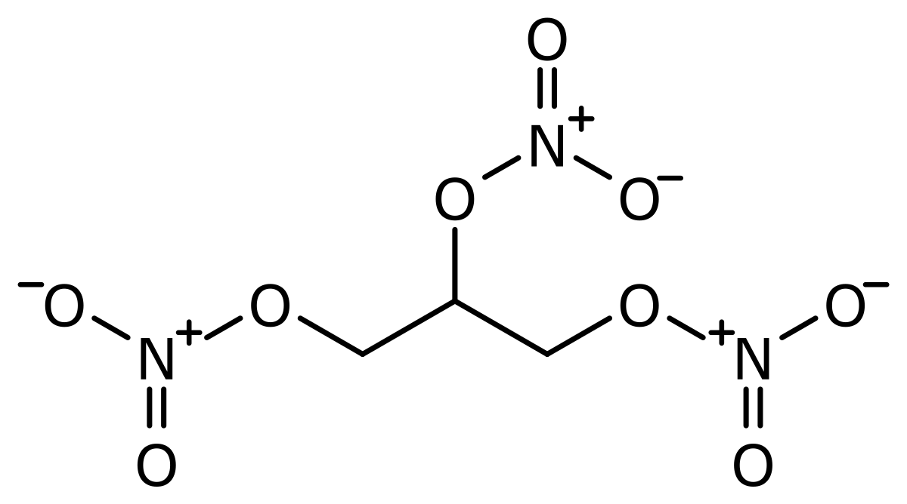
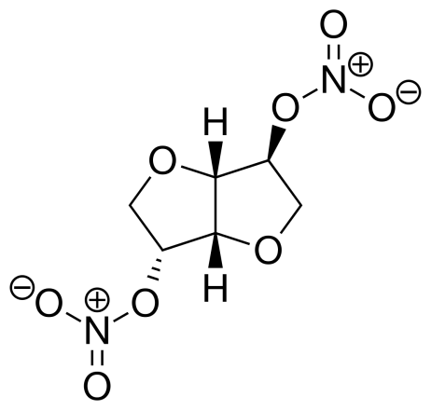
Cardiovascular drugs cont..
Anti-anginal drugs: These widen the blood vessels and help in better transport of oxygen.
Glyceryl nitrates fall in this category. Isosorbide dinitrate, marketed as Sorbitrate is a widely popular drug of this class.
Glyceryl trinitrate
Sorbitrate

Slide 8
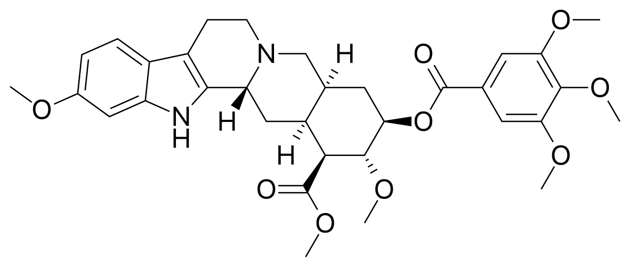
Cardiovascular drugs: cont..
Anti hypertensive drugs: These are used to reduce the blood pressure. A well known natural drug for this purpose is reserpine. Calcium channel blockers fall in this class. Calcium influx into the heart muscle cells and help those to contract with force. This class of drugs block calcium ion influx. Calcium ion comes into the blood stream from bones.
Reserpine

Slide 9
Cardiovascular Drugs cont..
Anti anginal agents: These widen the blood vessels and help in better oxygen transport preventing heart attack (angina pectoris). Glyceryl nitrates fall in this class.
Glycerin or Glycerol
Glyceryl trinitrate
Sorbitrate
(isosorbid nitrate)

Slide 10
Heart and drugs
https://youtu.be/-I-NN2PSAU8
https://youtu.be/OnLsLByuo0E

