Slide 1
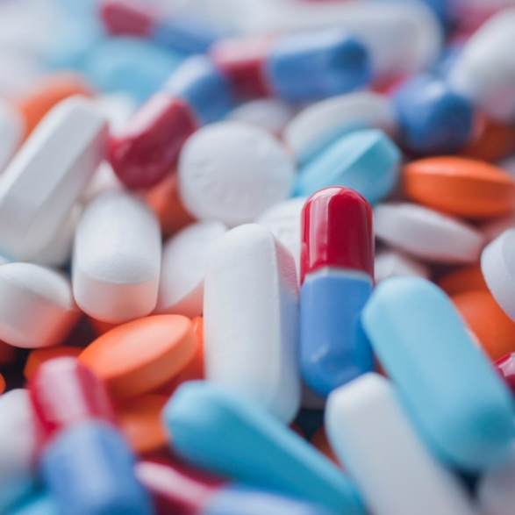
Drugs and Pharmaceuticals
Lecture module -01
Dr. Abir B. Majumder

Slide 2
What are Drugs ?
The molecules /compounds which exert various physiological effects of therapeutic value.
Ideally on administration a drug should be localized in its action and specifically should hit the areas where it is needed on our body.
In reality, the drug molecules are distributed through out anywhere in the tissues of the host.

Slide 3
Are all biologically active agents drugs? Drugs and Disinfectants
These compounds/ molecules are biologically active ( as drugs)
These have the potential to destroy the microorganism and the host tissue cell at large
These are not considered as therapeutic agents
These compounds are applied externally
These are termed as disinfectants . Examples are: Formaldehyde, Phenol, Iodine

Slide 4
How drugs are invented?
Trial and Error method: This involves the trial of all kinds of compounds, natural and synthetic. This is the most primitive one.
By synthesizing bioactive mimic: The method with a complete knowledge of cell system and the compounds that interfere with it, and thereby synthesizing similar compounds.
By synthesizing a compound of required activity: The method in which one starts with a compound known to have some required activity (information gained from previous methods: 1 and 2) and then the structural changes are done systematically. Each small change can bring enormous gain in curative activity of the drug. This method is the most fruitful in drug designing.

Slide 5
Drugs Classification
Anesthetics
Neurologically active drugs
Analgesic
Anti Fertility drugs
Non Steroidal Anti-Inflammatory drug
Cardiovascular drug
Antibiotics
Vitamins

Slide 6
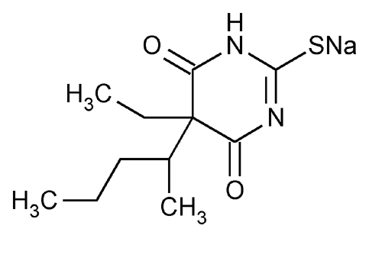
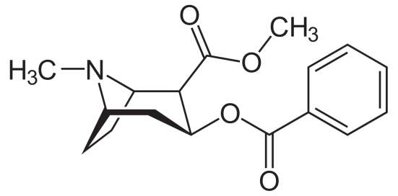
Anesthetic
These are chemical substances which produce insensibility to pain and other sensations.
Classifications:
General anesthetic: These are mostly volatile in nature. and are used in minor surgeries. These are mostly muscle relaxants. Example: Ether, chloroform, trichloroethylene, ethyl chloride.
Non volatile anesthetic: These are liquid at room temperature. One very good example of this class is sodium thiopental “Fatal Plus” used in veterinary Euthanasia (a process to allow a suffering pet to death).
Local anesthetic: These anesthetics act locally, for example Cocaine.

Slide 7
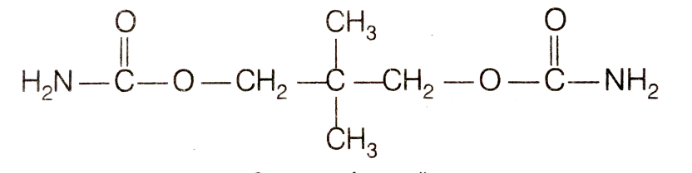
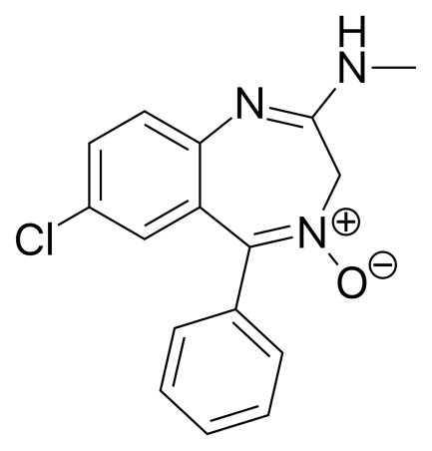
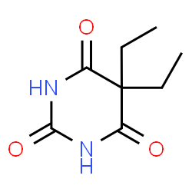
Neurologically active drugs
These affect the message transfer mechanism from nerves to the receptor. There are two major classes:
A) Tranquilizers B) Analgesics
Tranquilizers
These are used for the treatment of stress, mild or severe mental disorder.
Chlorodiazepoxide is a mild drug used to relieve tension. Equanil is used to control depression.
Derivatives of barbituric acid viz. veronal , nembutal are important class of tranquilizers which are used to produce sleep and are termed as hypnotic drugs.
Equanil
Chlorodiazepoxide
Veronal

Slide 8
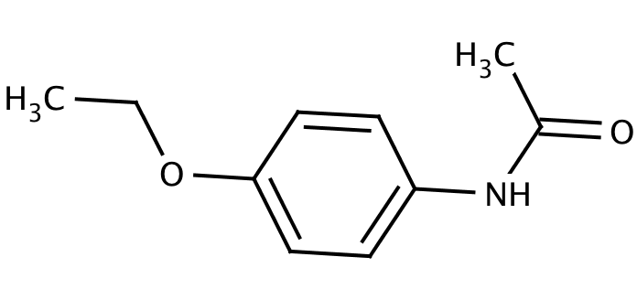
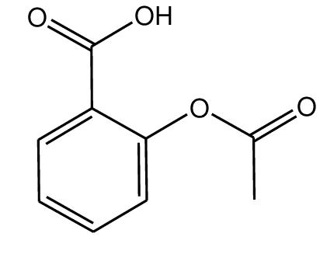
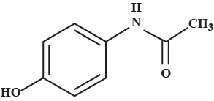
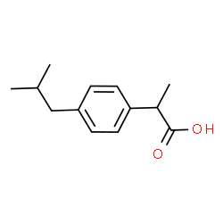
Neurologically active drugs
Analgesics
These reduce or abolish pain without causing unconsciousness or paralysis or other disturbances of the nervous systems. These are classified as non-narcotic and narcotic analgesic.
Non narcotic analgesic: These are non addictive drugs. These are further divided into following classes:
Anti -Rheumatic : To treat pains associated with rheumatism
Examples are Salicylic acid derivatives: Aspirin, Salicin
Anti-Pyretic : To combat fever
Examples are 4-aminophenol derivatives:
Paracetamol, Phenacetin
Anti-Inflammatory: To reduce inflammation
Examples are Aryl acetic acid derivatives:
Ibuprofen (Brufen)
Aspirin
Phenacetin
Paracetamol
Ibuprofen

