Slide 1
Synthesis of some drugs: Anti-Pyretic and analgesics
(NSAID)
Dr. Abir B. Majumder (Ph.D., IIT Delhi)
Project Scientist IIT Delhi (2009-2010)
Lecturer IIIT Hyderabad(2010-2015)
Assistant Professor, KGT Mahavidyalaya (2015 onwards)

Slide 2
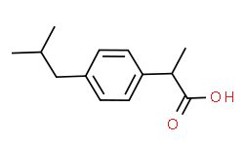
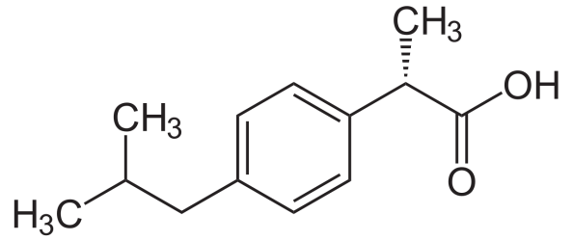
Ibuprofen
Ibuprofen, industrially known as Brufen, is a non steroidal anti-inflammatory drug (NSAID).
The racemic form is available in the market. However, the S-enantiomer is more biologically active.
The synthesis of ibuprofen and its advancement from the traditional chemical route, the advanced greener route and the most advanced and the greenest pathway giving S-ibuprofen.

Slide 3
The Boot’s synthesis
This was the most widely accepted process by industries till 1980. It involved six steps:

Slide 4
The Boot’s Synthesis (Cont..)

Slide 5
Mechanism

Slide 6
Disadvantage of Boot’s process
Large number of steps
Large number of side products in each step.
Poor Atom Economy
Product is a Racemic mixture of S-Ibuprofen and R-Ibuprofen. That means 50% of the product remains biologically less useful or active.

Slide 7
Greener synthesis than Boot:
The Boots-Hoechst-Celanese
No Waste
No Waste

Slide 8
The Synthesis of S-Ibuprofen
No Waste
+
No Waste
Candida rugosa
lipase

