Slide 1
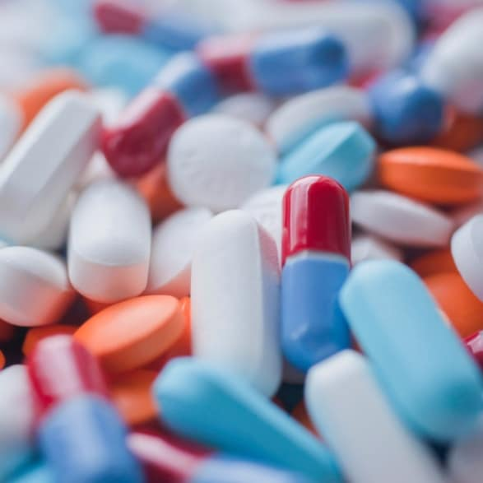
Drugs and Pharmaceuticals
Dr. Abir B. Majumder (Ph.D., IIT Delhi)
Project Scientist IIT Delhi (2009-2010)
Lecturer IIIT Hyderabad(2010-2015)
Assistant Professor, KGT Mahavidyalaya (2015 onwards)

Slide 2
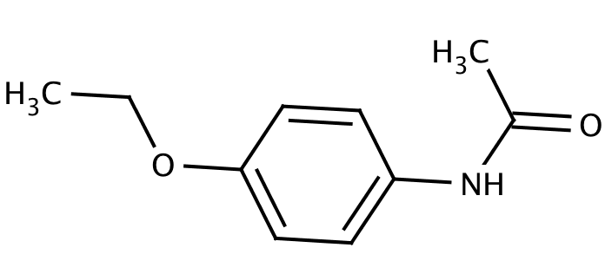

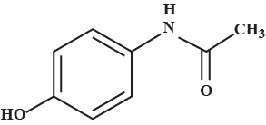
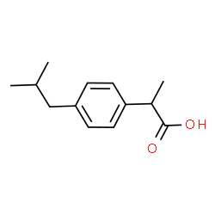
Neurologically active drugs
Analgesics
These reduce or abolish pain without causing unconsciousness or paralysis or other disturbances of the nervous systems. These are classified as non-narcotic and narcotic analgesic.
Non narcotic analgesic: These are non addictive drugs. These are further divided into following classes:
Anti -Rheumatic : To treat pains associated with rheumatism
Examples are Salicylic acid derivatives: Aspirin, Salicin
Anti-Pyretic : To combat fever
Examples are 4-aminophenol derivatives:
Paracetamol, Phenacetin
Anti-Inflammatory: To reduce inflammation
Examples are Aryl acetic acid derivatives:
Ibuprofen (Brufen)
Aspirin
Phenacetin
Paracetamol
Ibuprofen

Slide 3
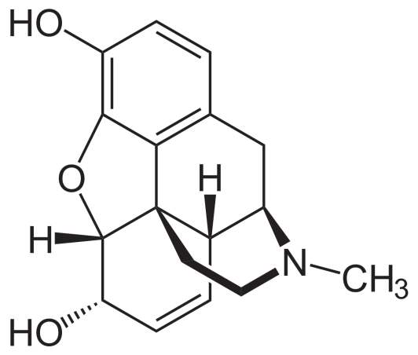

Analgesics
Narcotic analgesics: These are the analgesics when used in overdose, cause addiction. Morphine and its analogues (derivatives) fall in this class. Morphine once used before surgery during operation. Heroine, a derivative of morphine is infamous for its addictive power.
Morphine
Heroine

Slide 4
Aspirin
Aspirin falls in the class of non narcotic analgesic. It is anti-rheumatic.
Preparation
Ortho hydroxy benzoic acid (salicylic acid) is reacted with acetic anhydride in presence of catalytic amount of concentrated sulfuric acid.
The temperature is maintained at 50-60 º C for about half an hour.
The reaction medium is continuously stirred.
Aspirin is precipitated after pouring the medium in ice cold water.

Slide 5
Synthesis
Conc. H2SO4
Catalytic amount
Aspirin

Slide 6
Mode of action of Aspirin
Essentially helps to reduce fever with high temperature to bring it down to normal body temperature.
It falls in the group of antipyretic analgesics.
This NSAID inhibits the enzyme called cyclo oxygenase which is responsible for the formation of prostaglandins (PGs) that cause inflammation, swelling, pain and or fever.

Slide 7
Paracetamol mode of action
(Acetamenophen)
Paracetamol (acetaminophen) is generally not considered an NSAID.
It has only minor anti -inflammatory activity.
Acetaminophen treats pain mainly by blocking Cyclooxygenase-2 and inhibiting endocannabinoid reuptake almost exclusively within the brain, but not much in the rest of the body.

Slide 8
Synthesis of Paracetamol
Acetic anhydride
P-Aminophenol
P-Acataaminophenol or p-Hydroxy acetanilide
The widely used process of the synthesis of Paracetamol involves the acetylation of 4-amino phenol using equivalent amount of acetic anhydride and sodium acetate.

Slide 9
Mechanism

Slide 10
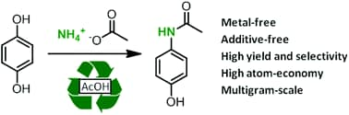
Synthesis of Paracetamol
Amidation of phenol derivatives: A direct synthesis from para quinol

Slide 11
Paracetamol mode of action
(Acetamenophen)
Paracetamol (acetaminophen) is generally not considered an NSAID.
It has only minor anti -inflammatory activity.
Acetaminophen treats pain mainly by blocking Cyclooxygenase-2 and inhibiting endocannabinoid reuptake almost exclusively within the brain, but not much in the rest of the body.

Slide 12
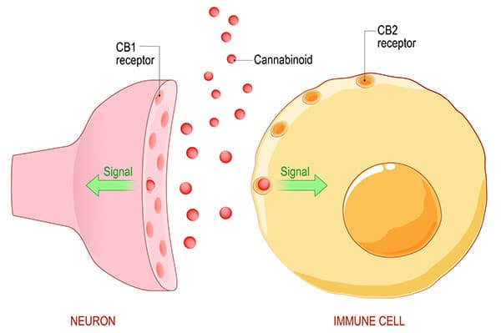
Endo Cannabinoid System (ECS): Responsible for Pain Feeling
Endo genous cannabinoids or endocannabinoids are naturally occuring lipid based neurotransmitters. The ECS regulates and controls many of our most critical bodily functions such as learning and memory, emotional processing, sleep, temperature control, pain control, inflammatory and immune responses, and eating.
Source: Harvard University Archive
(health.harvard.edu)

Slide 13
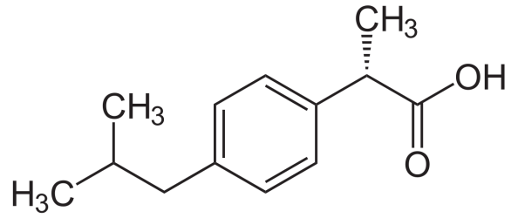
Ibuprofen
Ibuprofen, industrially known as Brufen, is a non steroidal anti-inflammatory drug (NSAID).
The racemic form is available in the market. However, the S-enantiomer is more biologically active.
The synthesis of ibuprofen and its advancement from the traditional chemical route, the advanced greener route and the most advanced and the greenest pathway giving S-ibuprofen.

Slide 14
The Boot’s synthesis
This was the most widely accepted process by industries till 1980. It involved six steps:

Slide 15
The Boot’s Synthesis (Cont..)

Slide 16
Mechanism

Slide 17
Disadvantage of Boot’s process
Large number of steps
Large number of side products in each step.
Poor Atom Economy
Product is a Racemic mixture of S-Ibuprofen and R-Ibuprofen. That means 50% of the product remains biologically less useful or active.

Slide 18
Greener synthesis than Boot:
The Boots-Hoechst-Celanese
No Waste
No Waste

Slide 19
The Synthesis of S-Ibuprofen
No Waste
+
No Waste
Candida rugosa
lipase

