Slide 1
Introduction to Soil Profile
DR RANJITA ROY SARKAR
ASSISTANT PROFESSOR, DEPARTMENT OF GEOGRAPHY, KGTM

Slide 2




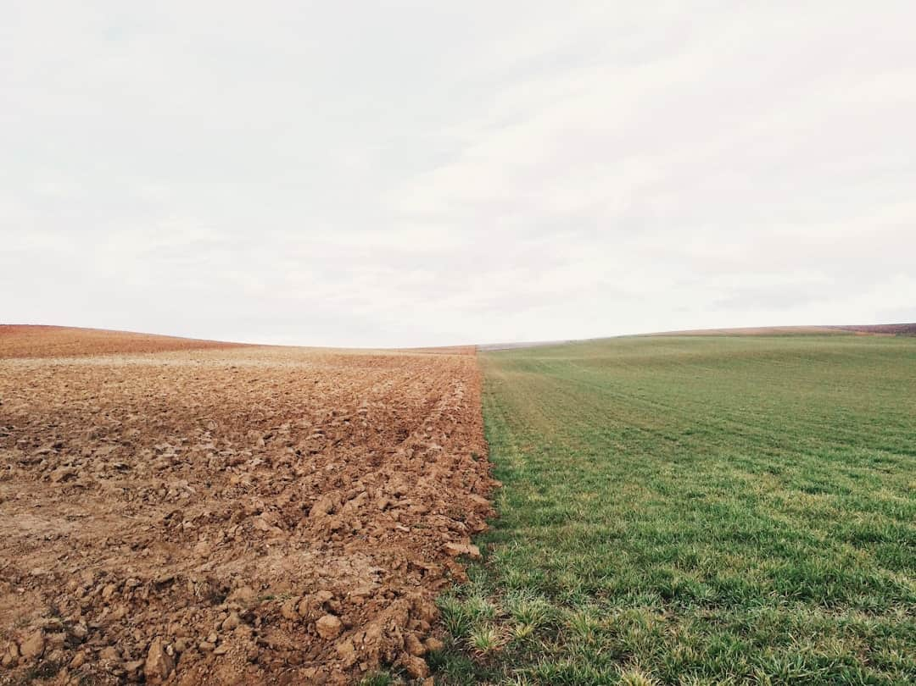

Introduction to Soil Profile
Understanding soil profiles is essential for agriculture, ecology, and environmental science. This presentation explores the layers of soil, their composition, and their significance in supporting plant life and ecosystems. We will delve into soil formation processes, types of soil horizons, and the impact of human activities on soil health. Join us as we uncover the intricate world beneath our feet.

Slide 3

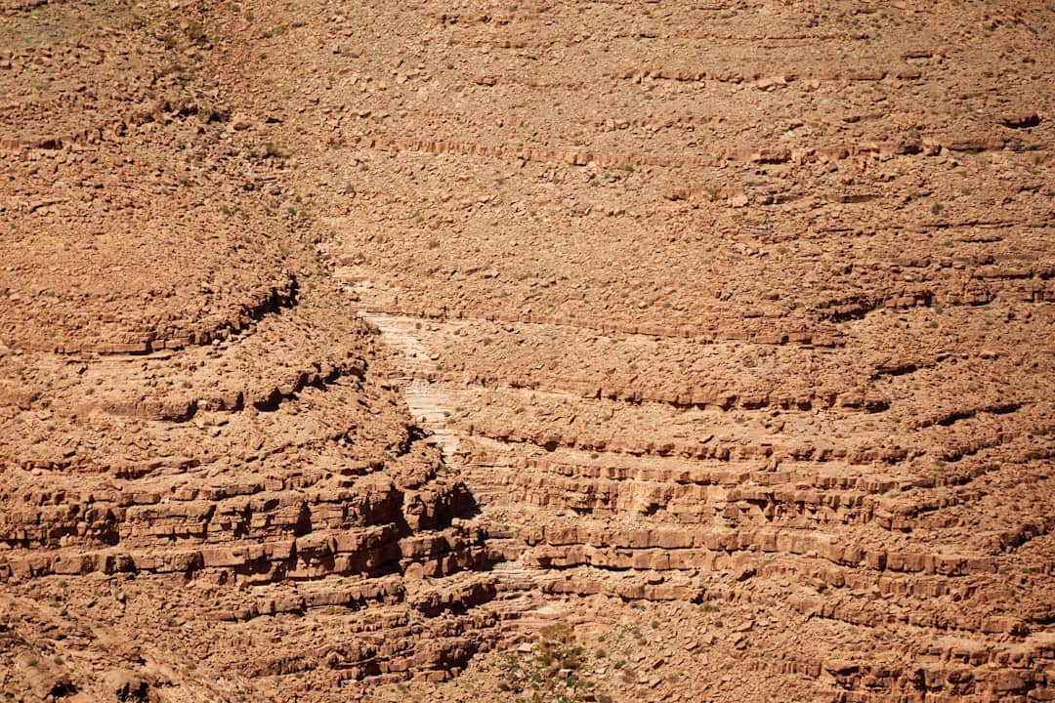






What is Soil Profile?
Definition of Soil Profile
Horizon Variability
Soil profile is the vertical section showing different soil layers and horizons.
Each horizon has unique properties affecting water retention and nutrient availability.
Impact on Plant Growth
Sustainable Land Management
Soil layers significantly influence plant health and agricultural productivity.
Understanding soil profiles aids in effective and sustainable land use practices.
Photo by Wolfgang Hasselmann

Slide 4
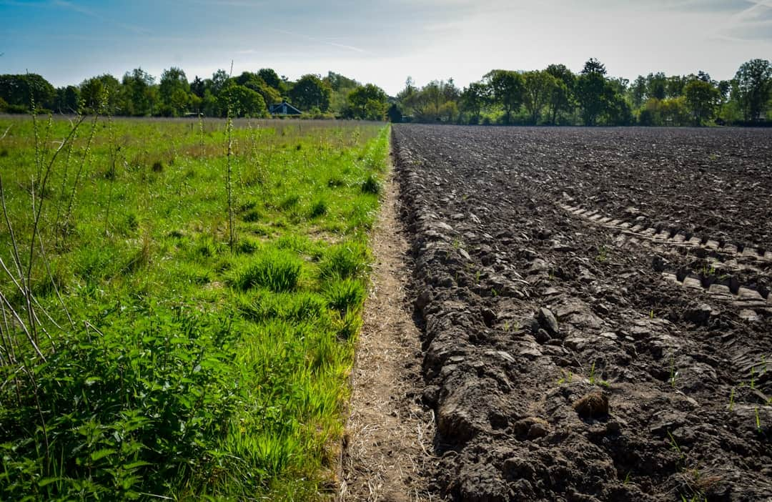



Soil Horizons Overview
Topsoil Rich in Organic Matter
O and A horizons contain 5% to 10% organic matter, crucial for plant growth.
Subsoil Mineral Composition
B horizon accumulates minerals leached from topsoil, enhancing soil fertility.
Parent Material's Role
C horizon serves as the foundational material, influencing soil characteristics.
Photo by Rick van der Haar

Slide 5


Soil Composition Analysis

Slide 6
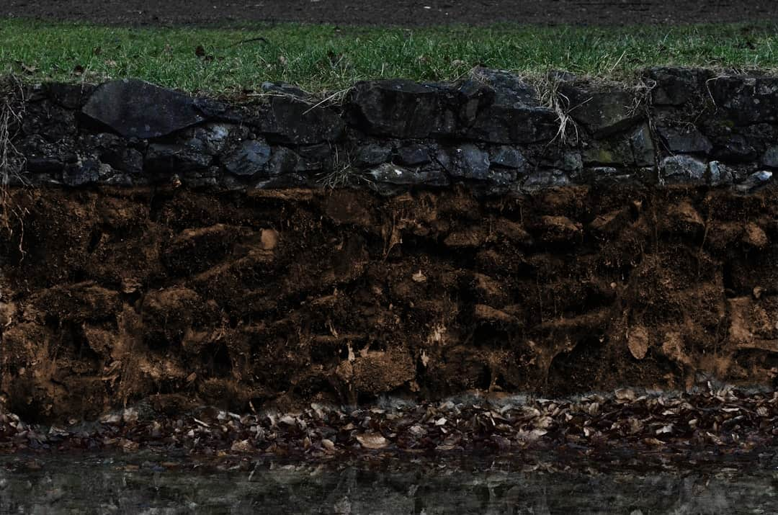





Importance of Soil Profile
Water Retention Capacity
Soil profiles determine water retention, impacting agricultural productivity significantly.
Root Development
Profiles influence root growth, enhancing plant stability and nutrient uptake efficiency.
Soil Fertility Assessment
Understanding profiles helps assess soil fertility, crucial for sustainable farming practices.
Biodiversity Support
Diverse soil profiles promote various organisms, enhancing ecosystem resilience and health.
Environmental Conservation
Knowledge of soil profiles aids in effective land management and conservation strategies.
Photo by Viktor Talashuk

Slide 7

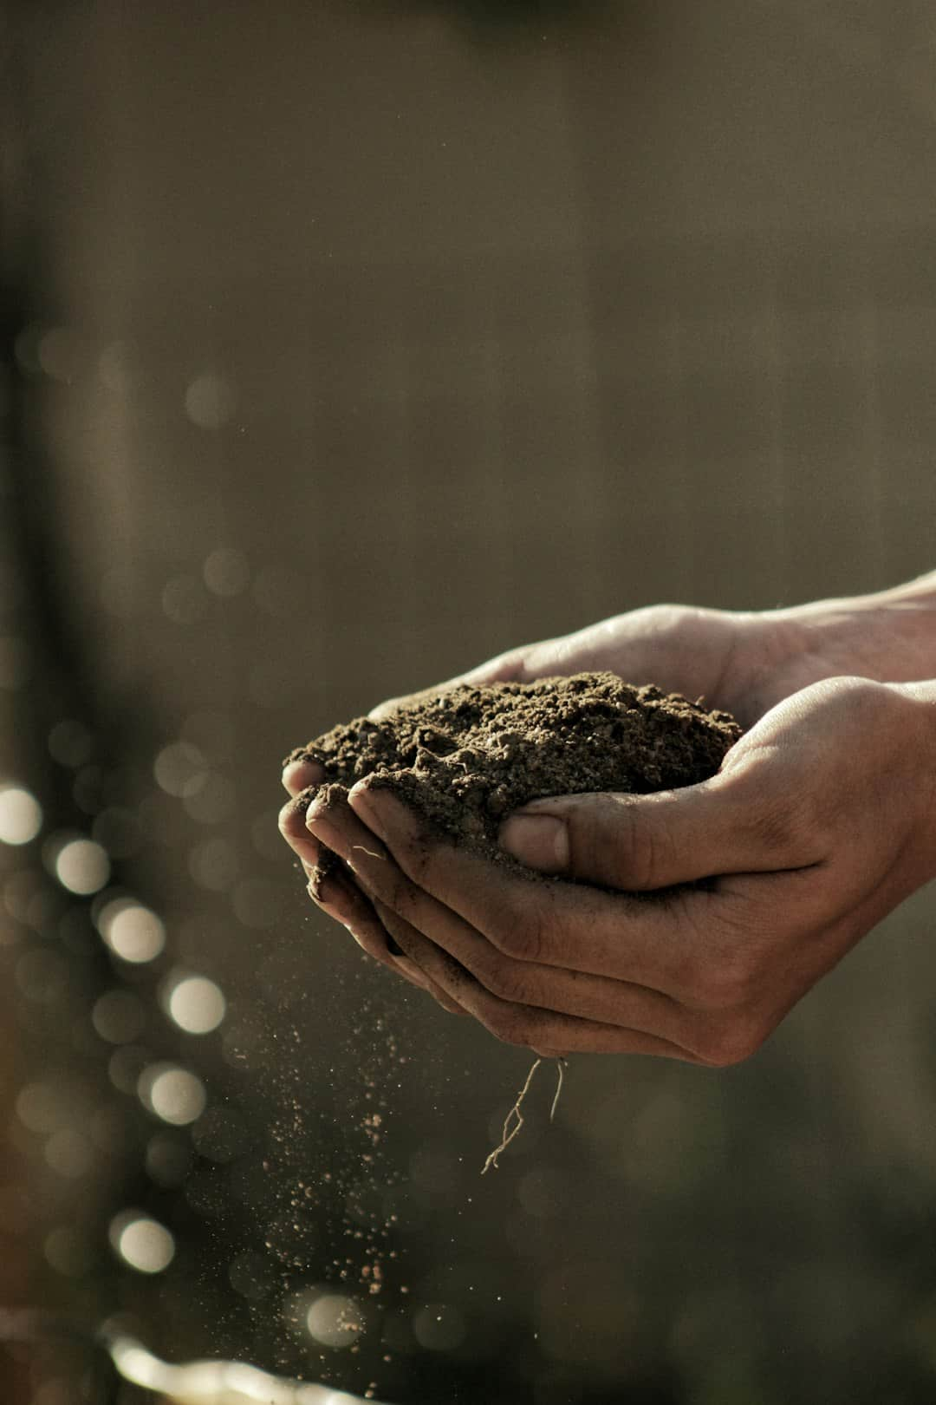


Illustrating a Typical Soil Profile
This visual represents the layers of soil, showcasing horizons from topsoil to bedrock. Key takeaway: Understanding soil layers is crucial for agriculture and ecology.

Slide 8

Factors Affecting Soil Profile
Impact of Climate
Role of Parent Material
Climate influences soil moisture and temperature, affecting organic matter decomposition.
Parent material determines soil mineral composition, influencing fertility and structure.
Influence of Topography
Topography affects soil erosion and drainage, impacting soil depth and nutrient availability.
Photo by Glen Carrie

Slide 9



Impact of Soil Management Practices
Before
After
Nutrient Retention: 30%
Nutrient Retention: 70%
Soil Erosion Rate: 15 tons/ha/year
Soil Erosion Rate: 5 tons/ha/year
Organic Matter Content: 2%
Organic Matter Content: 5%
Soil management practices significantly improved nutrient retention and reduced erosion, enhancing overall soil health.

Slide 10
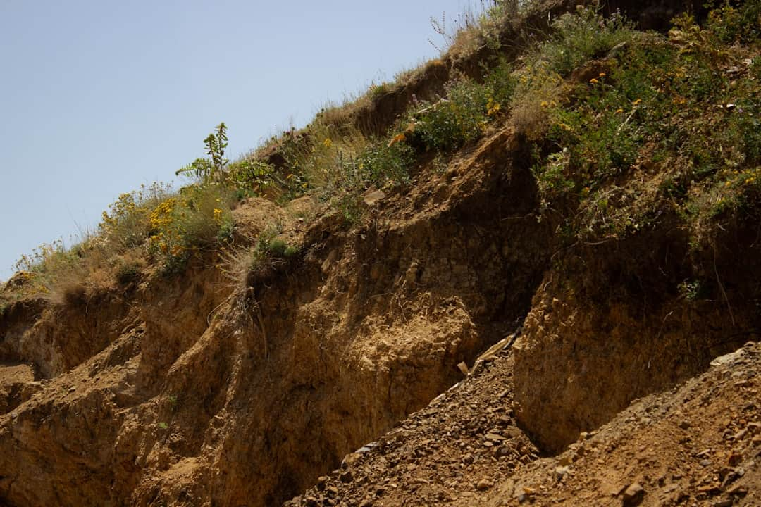


Soil Profile and Agriculture
Crops and Soil Types
Crop Rotation Benefits
Different crops thrive in sandy, clay, or loamy soils, impacting yield significantly.
Understanding soil profiles enhances effective crop rotation, improving soil health and productivity.
Soil Testing Importance
Pest Management Strategies
Regular soil testing informs precise fertilization strategies, optimizing nutrient availability for crops.
Knowledge of soil profiles aids in targeted pest management, reducing crop damage and losses.
Water Retention Insights
Soil profiles influence water retention, crucial for irrigation planning and drought resilience.
Photo by Elham Abdi

Slide 11
Frequently Asked Questions
?
What is the best soil for gardening?
The best soil for gardening is loamy soil, which is a balanced mixture of sand, silt, and clay, providing good drainage and nutrient retention.
?
How do soil profiles vary regionally?
Soil profiles vary regionally due to differences in climate, vegetation, and parent material, leading to distinct layers and characteristics in different areas.
?
What tests can assess soil health?
Soil health can be assessed through tests for pH, nutrient levels, organic matter content, and microbial activity, which help determine its fertility and structure.
?
How does erosion affect soil profile?
Erosion can strip away the topsoil layer, reducing soil fertility and altering the soil profile, which can negatively impact plant growth and ecosystem health.

Slide 12
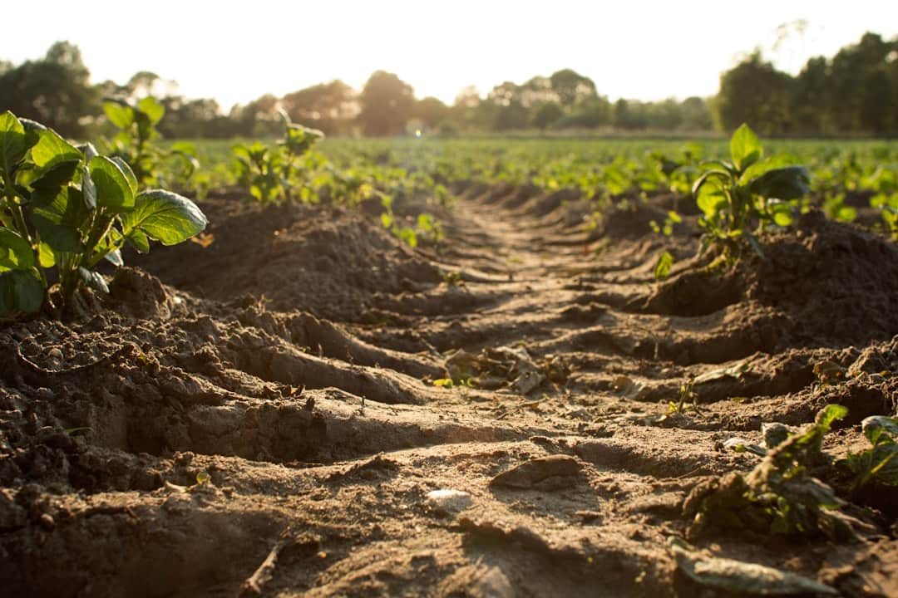


Future of Soil Management
Advancements in Soil Mapping
AI in Soil Analysis
Drones and sensors enhance soil mapping accuracy by 40% in agricultural fields.
AI algorithms predict soil health trends, improving crop yields by 20% annually.
Sustainable Practices Focus
Integrating cover crops boosts soil organic matter, enhancing fertility sustainably.
Photo by Dylan de Jonge

Slide 13






Key Takeaways
This presentation highlighted the importance of soil profiles in understanding ecosystem health, agricultural productivity, and environmental sustainability. Key factors include soil composition, moisture retention, and nutrient availability. Moving forward, integrating soil profile analysis into land management practices can enhance crop yields and promote sustainable development. Emphasizing education on soil health will empower communities to make informed decisions.

