Slide 1
High Court and Supreme Court of India: An Overview
Presented by Sarat Chandra ray

Slide 2
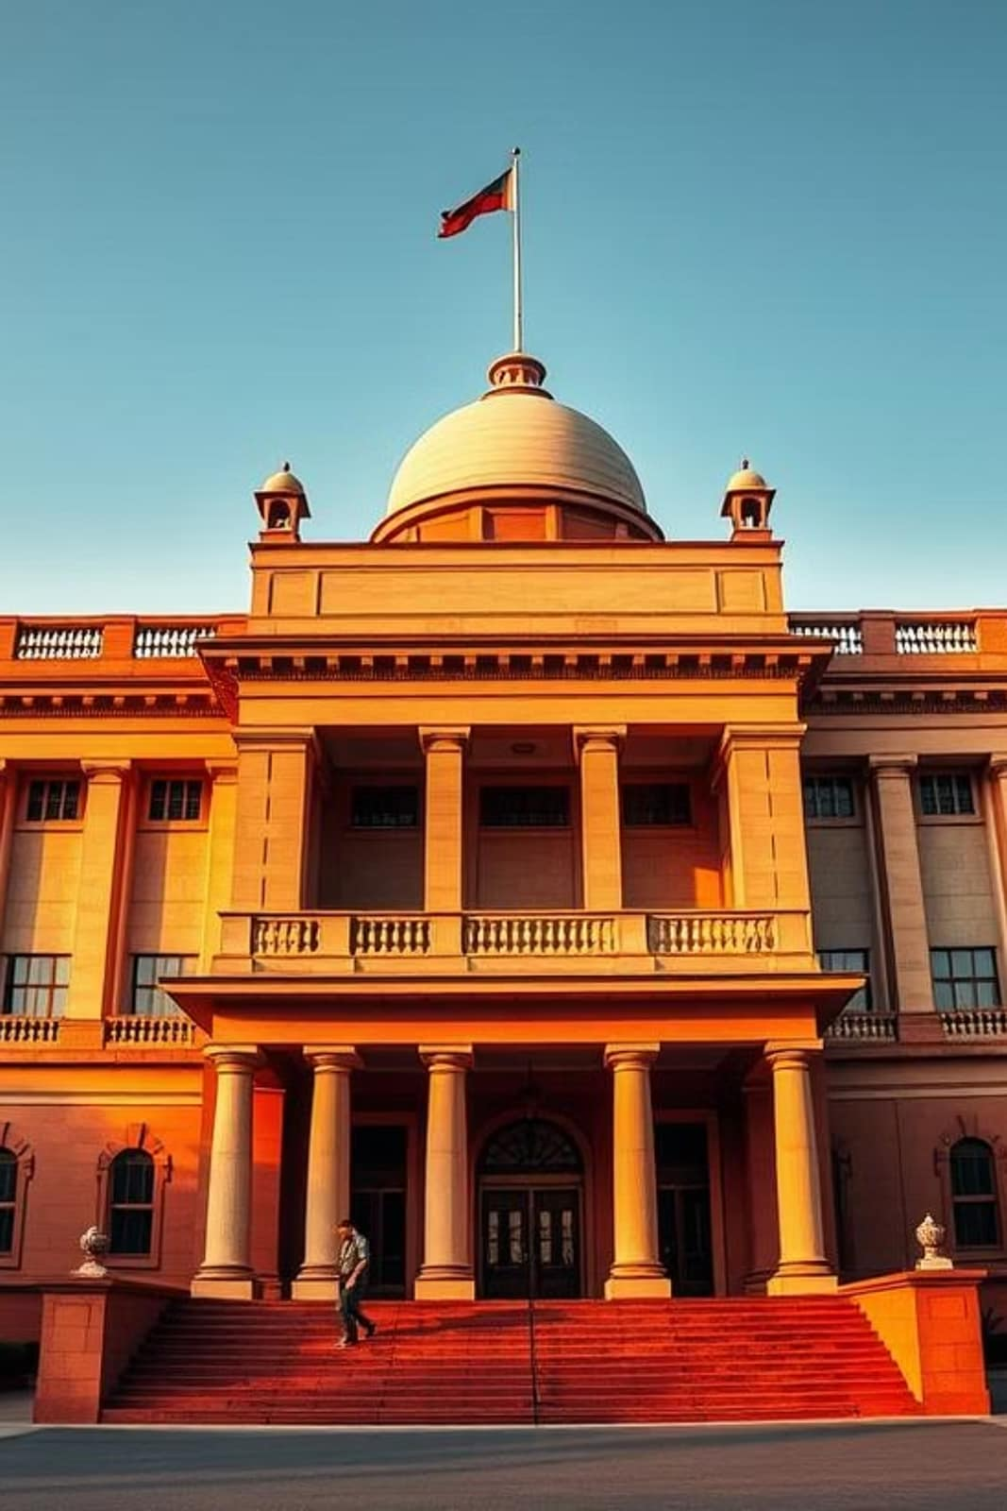
High Court and Supreme Court of India: An Overview
The Indian Judiciary stands as an independent pillar of the Indian government, safeguarding the Constitution and the rights of its citizens. This presentation provides an essential overview of the Supreme Court and High Courts, their roles, and their significance within India's legal framework.

Slide 3
Structure and Composition
Supreme Court of India
High Courts
Comprises the Chief Justice of India and up to 33 other judges, totaling a maximum of 34.
Each state and Union Territory has a High Court, with a Chief Justice and a variable number of other judges.
Judges are appointed by the President of India.
Supreme Court judges retire at the age of 65.
High Court judges are also appointed by the President of India.
High Court judges retire at the age of 62.
The number of High Court judges is determined by the President, considering the workload and population of each state, ensuring efficient judicial administration.

Slide 4
Jurisdiction and Powers
1
2
3
Supreme Court
High Courts
Final Authority
Possesses extensive jurisdiction across India, handling appellate cases, original disputes between states, and matters involving fundamental rights.
Exercise jurisdiction within their respective state or Union Territory, reviewing decisions of lower courts and certifying cases for Supreme Court appeal.
Decisions rendered by the Supreme Court are final and binding on all other courts within India, establishing legal precedents.
Both courts play a critical role in upholding justice, with their powers clearly delineated to ensure a balanced and effective judicial system.

Slide 5



Appointment and Eligibility of Judges
Supreme Court
High Courts
Eligibility
Appointed by the President following consultation with judges of the Supreme Court and High Courts, a process known as the collegium system.
Appointed by the President in consultation with the Chief Justice of India, the Governor of the concerned state, and the Chief Justice of that High Court.
Candidates must have at least 10 years of experience as an advocate of a High Court or as a judicial officer in India. Enrollment with the Bar Council of India is mandatory.
The appointment process emphasizes judicial experience and legal expertise to ensure the integrity and competence of the judiciary.

Slide 6
Important Terminology
Writ Jurisdiction
The power of the Supreme Court and High Courts to issue specific orders (writs) like Habeas Corpus, Mandamus, Prohibition, Quo Warranto, and Certiorari to protect fundamental rights.
Judicial Review
The power of the judiciary to examine the constitutionality of legislative enactments and executive orders, striking down those found to violate the Constitution.
Original Jurisdiction
The authority of a court to hear a case for the first time, rather than on appeal. For the Supreme Court, this includes disputes between the Union and states, or between states.
Appellate Jurisdiction
The power of a higher court to review decisions and change outcomes of decisions of lower courts. Both the Supreme Court and High Courts possess this power.

Slide 7
Landmark Supreme Court Judgments
Kesavananda Bharati (1973)
Vishaka (1997)
Established the 'Basic Structure Doctrine,' asserting that certain fundamental features of the Constitution cannot be altered by parliamentary amendment.
Laid down comprehensive guidelines to prevent sexual harassment of women in the workplace, filling a legislative vacuum and prompting future laws.
1
2
3
4
Maneka Gandhi (1978)
S.R. Bommai (1994)
Significantly expanded the interpretation of Article 21 (right to life and personal liberty) to include a fair and just procedure, not merely arbitrary executive action.
Reinforced the principles of federalism and placed strict limits on the arbitrary imposition of President's Rule (Article 356) in states.
These judgments have profoundly shaped Indian jurisprudence, strengthening constitutional democracy and protecting individual rights.

Slide 8

Role of High Courts
Act as the apex judicial authority within their respective states and Union Territories, overseeing all subordinate courts.
Possess the vital power of judicial review, enabling them to examine the validity of laws and executive actions at the state level.
Exercise supervisory control over all lower courts and tribunals within their jurisdiction, ensuring adherence to legal procedures and justice.
Can certify cases as fit for appeal to the Supreme Court, especially those involving substantial questions of law or constitutional interpretation.
High Courts are pivotal in providing access to justice at the regional level and ensuring the proper functioning of the legal system.

Slide 9
Summary and Importance for Students
1
2
Supreme Court
High Courts
The ultimate guardian of the Indian Constitution and the highest court of appeal, ensuring uniform interpretation of laws across the nation.
Safeguard state laws and fundamental rights regionally, playing a crucial role in the administration of justice at the grassroots level.
3
4
Essential Understanding
Foundation for Study
Grasping the functions of these courts is fundamental to comprehending the Indian legal system, its checks and balances, and the protection of citizens' rights.
This knowledge forms a strong basis for further exploration in Indian polity, constitutional law, and governance, crucial for BA Honours students.

