Slide 1
Functions of Spatial Information Systems
DR RANJITA ROY SARKAR
ASSISTANT PROFESSOR, DEPARTMENT OF GEOGRAPHY, KGTM

Slide 2




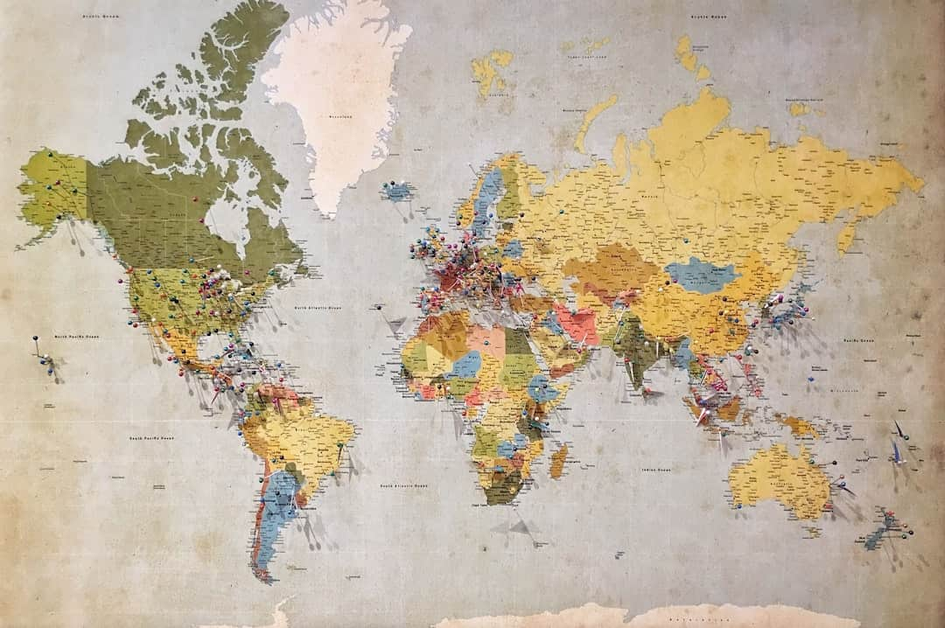

Functions of Spatial Information Systems
Spatial Information Systems (SIS) play a crucial role in managing, analyzing, and visualizing geographic data. They enable informed decision-making across various sectors, including urban planning, environmental management, and transportation. By integrating spatial data with analytical tools, SIS enhances our understanding of complex spatial relationships, ultimately leading to more effective solutions for real-world problems. This presentation explores the diverse functions and applications of SIS.

Slide 3








Definition of Spatial Information Systems
Manage Geographic Data
Integrate Hardware and Software
Spatial Information Systems efficiently manage and store vast geographic datasets.
They combine hardware, software, and data for comprehensive geographic analysis.
Mapping and Analysis
Applications in Various Fields
SIS is essential for accurate mapping, spatial analysis, and informed decision-making.
Used in urban planning, environmental science, and disaster management for effective solutions.
Photo by Insaanu Studio

Slide 4




Importance of Data in SIS
Diverse Data Collection Methods
SIS gathers data via surveys, remote sensing, and GPS technologies.
Types of Data Collected
Data can be spatial, indicating location, or attribute, providing descriptive details.
Enhancing Decision-Making
Real-time data collection significantly improves decision-making processes in various sectors.
Photo by Leandro Barreto

Slide 5
How to Organize and Store Data in a Spatial Information System
1
Identify Data Requirements
Determine the types of spatial data needed for your analysis, including geographic features, attributes, and formats.
2
Select a Spatial Database
Choose an appropriate spatial database system that supports efficient querying and retrieval of spatial data, such as PostGIS or Oracle Spatial.
3
Implement Data Cleaning Procedures
Conduct data cleaning and preprocessing to remove inaccuracies and ensure consistency in the dataset, preparing it for analysis.
4
Ensure Data Integrity
Establish protocols for maintaining data integrity, including validation checks and regular updates to ensure accurate analysis.
5
Document Data Management Practices
Create comprehensive documentation of data management practices, including data sources, cleaning methods, and database structure for future reference.

Slide 6
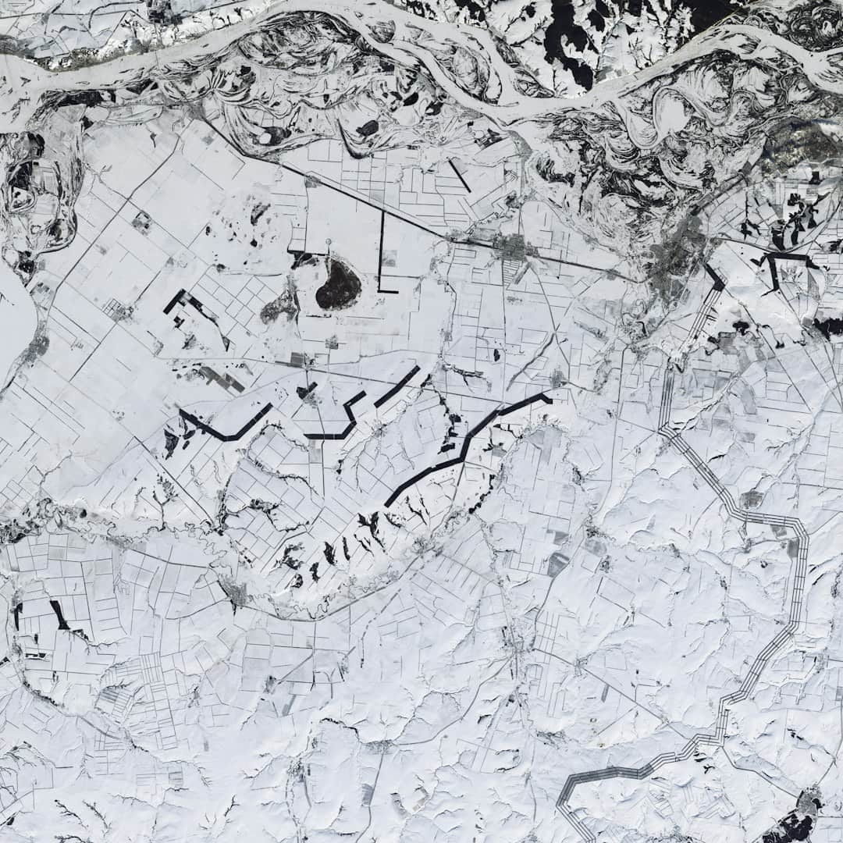





Functions of Spatial Information Systems
Complex Spatial Analysis
SIS enables advanced techniques like overlay and buffering for detailed insights.
Pattern Identification
It helps in recognizing spatial patterns and relationships in diverse datasets.
Environmental Modeling
SIS is crucial for modeling environmental changes and impacts effectively.
Urban Studies Support
Facilitates urban planning by analyzing spatial data for better decision-making.
Predictive Analytics
Supports predictive analytics, enhancing planning accuracy and resource allocation.
Photo by USGS

Slide 7


Applications of Spatial Information Systems

Slide 8




Visualization Techniques
Diverse Visualization Methods
Enhanced Data Understanding
SIS provides maps and 3D models for effective spatial data representation.
Effective visualizations significantly improve comprehension of complex spatial data.
User Engagement with Maps
Impactful Presentations
Interactive maps foster user exploration and deeper engagement with the data.
Visualization techniques enhance the delivery and impact of presentations significantly.
Photo by Hans

Slide 9
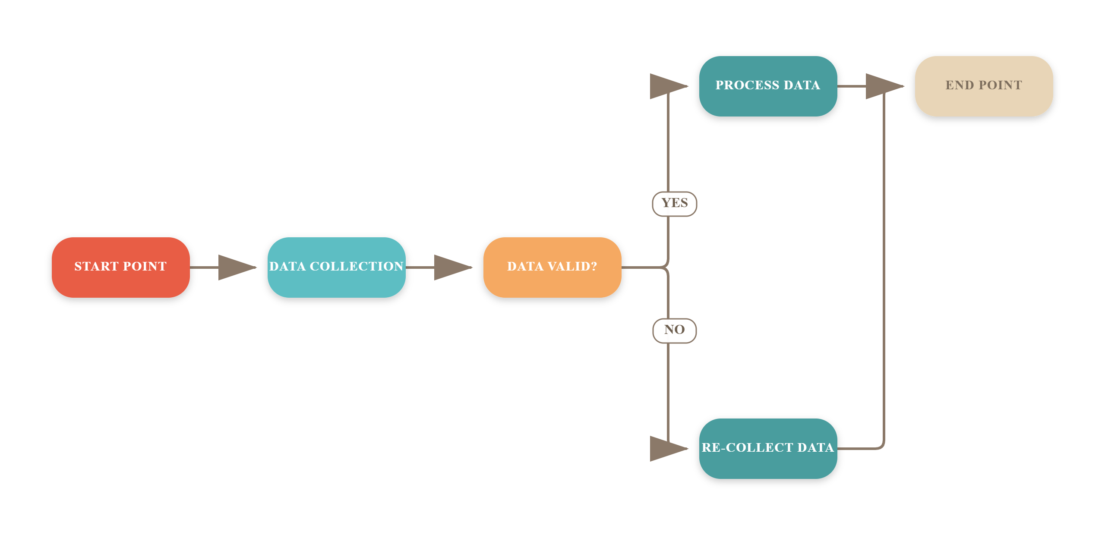
Workflow of Spatial Information Systems

Slide 10



Challenges in SIS
Data Privacy Concerns
Integration Issues
Data sharing is often limited due to strict privacy regulations and compliance issues.
Combining diverse data types from various sources complicates analysis and system functionality.
High Tool Costs
Advanced SIS tools can incur significant costs, limiting access for smaller organizations.
Photo by Claudio Schwarz

Slide 11
Frequently Asked Questions
?
What is the primary function of a Spatial Information System (SIS)?
The primary function of an SIS is to capture, store, analyze, and manage spatial data to support decision-making and problem-solving in various fields.
?
How is spatial data collected?
Spatial data is collected through various methods, including satellite imagery, GPS technology, surveys, and remote sensing techniques.
?
What industries benefit from SIS?
Industries such as urban planning, environmental management, transportation, and agriculture benefit significantly from SIS by improving efficiency and accuracy in their operations.
?
What are the future trends in SIS?
Future trends in SIS include the integration of artificial intelligence, real-time data processing, and enhanced user interfaces to improve accessibility and functionality.

Slide 12



Transformative Impact of Spatial Information Systems
80%
30%
$100B
Data with Spatial Component
Improved Decision-Making Efficiency
Global SIS Market Value
Over 80% of global data includes a spatial element, driving insights.
Utilizing SIS can enhance decision-making processes by up to 30%.
Projected to reach $100 billion by 2025, showcasing rapid growth.

Slide 13






Key Takeaways
This presentation highlighted the essential functions of Spatial Information Systems, including data management, analysis, and visualization. Key recommendations include investing in training and technology to enhance GIS capabilities. As we move forward, embracing innovative spatial solutions will be crucial for informed decision-making and sustainable development in geography and related fields.

