Slide 1
Field Work and Research Methodology
DR RANJITA ROY SARKAR , ASSISTANT PROFESSOR, DEPARTMENT OF GEOGRAPHY, KGTM

Slide 2




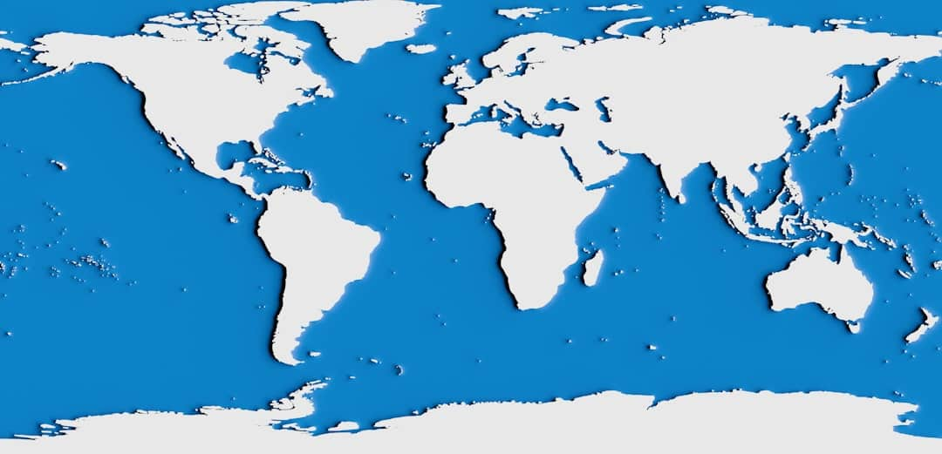

Field Work and Research Methodology
This presentation explores the critical aspects of research in geography, focusing on its components, objectives, types, and stages. Additionally, we will delve into the significance of fieldwork, examining its role, value, and ethical considerations in geographical studies. By understanding these elements, we can enhance our research methodologies and contribute to the field's advancement. Join us as we navigate through these essential topics, providing insights and practical examples to enrich our understanding.

Slide 3








Overview of Research in Geography
Theory and Practice Integration
Understanding Spatial Patterns
Research in geography merges theoretical frameworks with practical applications, enhancing our understanding of spatial dynamics and human-environment interactions.
The primary objective is to analyze spatial relationships, revealing patterns that inform urban planning, environmental management, and resource allocation.
Qualitative and Quantitative Methods
Research Stages Defined
The research process includes distinct stages: planning, fieldwork, data analysis, and reporting, ensuring systematic exploration and documentation of findings.
Geographical research employs both qualitative and quantitative approaches, utilizing surveys, interviews, and statistical analysis to gather comprehensive data.
Photo by Leandro Barreto

Slide 4

Components of Geographic Research
Data Collection Methods
Geographic research employs surveys, interviews, and observations to gather data, ensuring comprehensive insights into spatial patterns and human interactions.
Analytical Techniques
Techniques such as statistical analysis and Geographic Information Systems (GIS) are crucial for interpreting data and visualizing geographic phenomena effectively.
Guiding Research Questions
Research questions are essential as they direct the study's focus, helping to clarify objectives and determine the methodology employed in geographic research.
Field Observations
Field observations play a vital role in validating theoretical frameworks and hypotheses, providing real-world context to academic research findings.

Slide 5


Objectives of Geographic Research
Goals of Geographic Research
Aims of Conducting Research
To understand human-environment interactions.
To enhance geographical education and awareness.
To identify spatial distributions of phenomena.
To develop critical thinking and analytical skills.
To inform policy-making and resource management.
To contribute to sustainable development practices.

Slide 6




Types of Geographic Research
Descriptive Research
Descriptive research focuses on identifying 'what' and 'where' phenomena occur, utilizing surveys and observational studies to gather data effectively.
Analytical Research
Analytical research delves into 'why' and 'how' geographic patterns exist, employing statistical methods to interpret data and draw meaningful conclusions.
Applied Research
Applied research addresses real-world problems, such as urban planning and environmental management, providing practical solutions based on geographic data.
Theoretical Research
Theoretical research develops models and frameworks to explain geographic phenomena, contributing to the academic understanding of spatial relationships.
Photo by Insaanu Studio

Slide 7






Stages of Research Process
Problem Identification
Identifying the research problem sets the agenda, guiding the focus of the study. This crucial step ensures relevance and clarity in geographical research.
Literature Review
Conducting a literature review provides essential context and background, helping to frame the research question and identify gaps in existing knowledge.
Fieldwork Data Collection
Fieldwork involves collecting data in real-world settings, utilizing surveys and observations to gather firsthand information critical for analysis.
Data Analysis
Analyzing collected data is vital for drawing conclusions. This stage involves statistical methods and qualitative analysis to interpret findings effectively.
Reporting Findings
The final stage involves reporting results, presenting insights through reports or presentations, ensuring findings contribute to the broader geographical discourse.
Photo by Daniel Brady

Slide 8








Key Features
Firsthand Data Collection
Contextual Understanding
Insightful Observations
Fieldwork allows researchers to gather data directly from the environment, ensuring accuracy and relevance.
Field experiences provide a real-world context that enhances theoretical knowledge and understanding.
Direct observations during fieldwork can uncover insights and patterns that literature may overlook.
Enhanced Learning Engagement
Ethical Considerations
Fieldwork fosters active learning, encouraging students to engage deeply with the subject matter.
Fieldwork emphasizes the importance of ethical practices in research, promoting respect for communities and environments.

Slide 9
Value of Field Work
Critical Thinking Development
Fieldwork fosters critical thinking and problem-solving skills, enabling researchers to analyze complex geographical issues effectively and develop innovative solutions.
Enhanced Collaboration
Fieldwork enhances collaboration among researchers and local participants, promoting knowledge exchange and fostering community engagement in geographical studies.
Real-World Applications
Conducting fieldwork provides real-world applications that enrich academic learning, allowing students to connect theoretical knowledge with practical experiences.
Innovative Solutions
Field data collection can lead to innovative solutions for pressing geographical issues, such as urban planning and environmental conservation, benefiting communities.

Slide 10
Ethics in Field Work
01
Informed Consent Importance
Obtaining informed consent ensures participants understand their involvement, fostering trust and transparency in research, which is crucial for ethical integrity.
02
Respect for Cultures
Researchers must respect local communities and cultures, acknowledging their values and traditions, which enhances collaboration and enriches the research experience.
03
Data Privacy Safeguards
Safeguarding data privacy is essential to protect participant information, ensuring confidentiality and compliance with ethical standards throughout the research process.
04
Guidelines for Integrity
Adhering to ethical guidelines promotes integrity and trust in research, ensuring that findings are credible and that participants are treated fairly.

Slide 11



Key Takeaways
This presentation highlighted the essential components of geographical research, emphasizing the importance of fieldwork in understanding real-world contexts. Key takeaways include the need for ethical considerations in field studies and the diverse methodologies available. Moving forward, researchers should prioritize integrating innovative technologies and community engagement in their work to enhance data accuracy and relevance. Embracing these strategies will lead to more impactful geographical research and informed decision-making.

