Slide 1



Exploring the Dynamics of Tourism Management
DR RANJITA ROY SARKAR , ASSISTANT PROFESSOR, DEPARTMENT OF GEOGRAPHY, KGTM

Slide 2
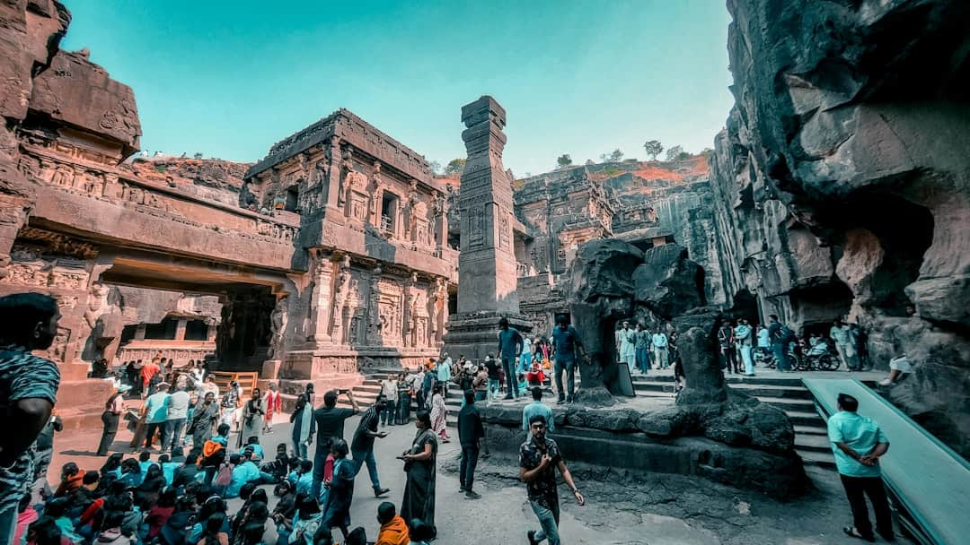
Exploring the Dynamics of Tourism Management
This presentation delves into the multifaceted world of tourism management, highlighting key concepts, geographical elements, and various types of tourism. We will explore Robinson's insights, Peter's Inventory, and examine diverse tourism forms such as heritage, cultural, medical, home stay, and ecotourism. By understanding these components, we can better appreciate the industry's impact on global economies and local cultures. Join us as we navigate through these essential topics in tourism management.

Slide 3
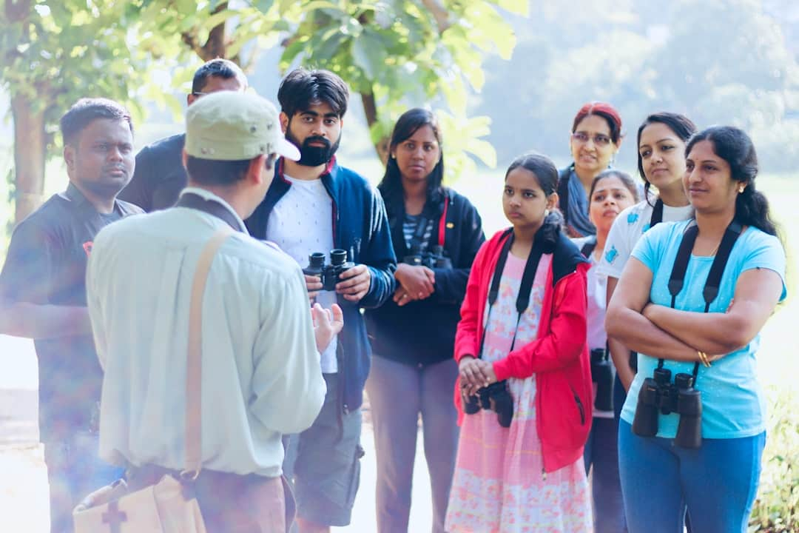





Understanding Tourism
Definition of Tourism
Significance of Tourism
Tourism encompasses travel for leisure, business, or other purposes, contributing significantly to global economies, with the sector generating over $9 trillion in 2019.
Tourism fosters cultural exchanges and social interactions, enhancing mutual understanding among diverse populations, which is crucial in today’s interconnected world.
Economic Impact
Environmental Considerations
The tourism industry supports 1 in 10 jobs globally, highlighting its importance in economic development and job creation across various sectors.
Tourism can lead to environmental degradation; thus, sustainable practices are essential to mitigate negative impacts and preserve natural resources.
Management Dynamics
Understanding tourism dynamics is vital for effective management, ensuring that economic benefits are maximized while minimizing social and environmental costs.
Photo by Ravi N Jha

Slide 4

Geographical Elements of Tourism
Impact of Geography
Geographical features like mountains and beaches can significantly enhance tourism development, attracting millions of visitors annually to scenic locations.
Robinson's Model
Robinson's model highlights the importance of location and accessibility, showing how these factors can dictate tourism success in various regions.
Peter’s Inventory
Peter’s Inventory categorizes tourism resources, identifying key attractions that drive visitor interest and regional economic growth.
Regional Characteristics
Unique regional characteristics, such as culture and climate, influence tourist preferences, shaping their experiences and satisfaction levels.

Slide 5
Types of Tourism Overview
Heritage and Cultural Tourism
Medical and Ecotourism
Focus on historical sites and traditions.
Involves travel for health-related services.
Promotes understanding of diverse cultures.
Supports sustainable travel practices.
Encourages preservation of cultural heritage.
Promotes conservation of natural resources.

Slide 6
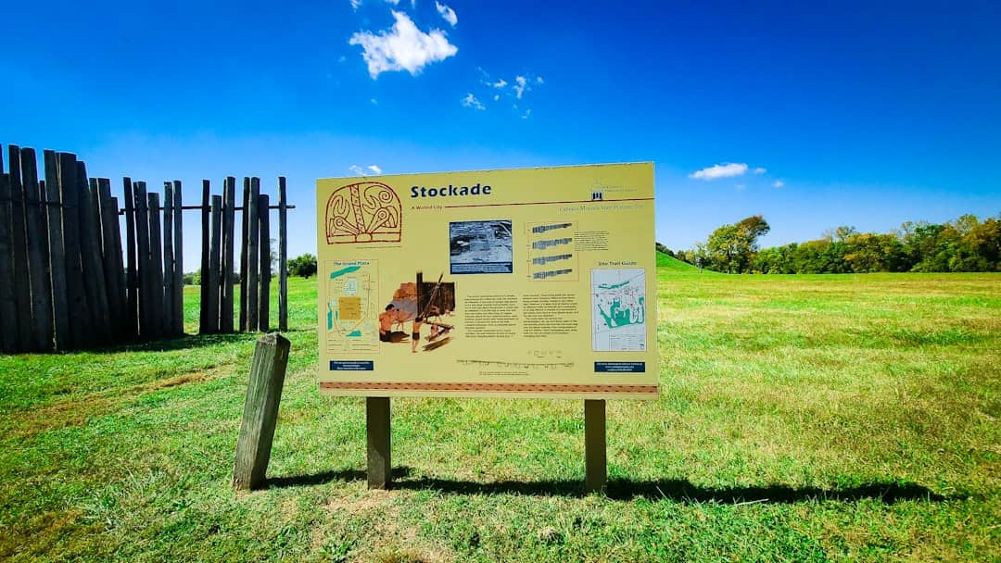




Heritage Tourism Overview
Cultural Connections
Heritage tourism connects travelers with historical sites and cultures, fostering a deeper understanding of local traditions and lifestyles.
Site Visits
This tourism type encompasses visits to monuments, museums, and heritage sites, enriching the travel experience through education and exploration.
Global Examples
UNESCO World Heritage Sites, such as the Great Wall of China and Machu Picchu, exemplify significant cultural heritage attracting millions of visitors annually.
Cultural Preservation
Heritage tourism promotes cultural preservation and education, ensuring that future generations appreciate and understand their historical roots.
Photo by pcrm Dorego

Slide 7
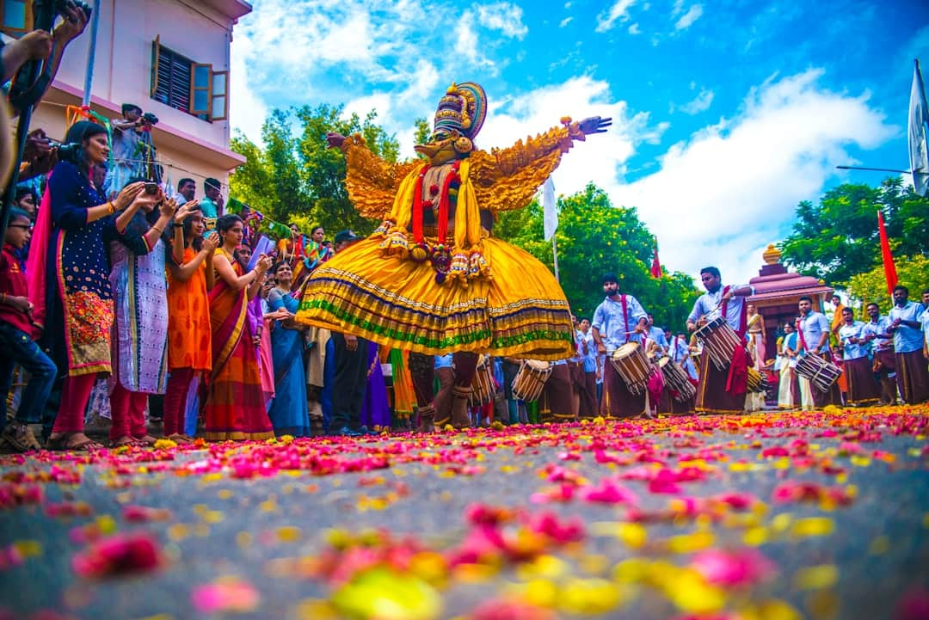




Cultural Tourism
Immersion in Local Customs
Cultural tourism immerses visitors in local customs and traditions, enhancing their travel experience and fostering deeper connections with the destination's heritage.
Engaging Activities Offered
Activities may include local festivals, culinary experiences, and arts workshops, providing tourists with authentic insights into the culture and lifestyle of the area.
Community Interaction
Cultural tourism encourages interaction with local communities, allowing visitors to engage with residents and learn about their daily lives and traditions.
Fostering Diversity Appreciation
This form of tourism fosters appreciation and understanding of cultural diversity, promoting respect and tolerance among different communities and enhancing global awareness.
Photo by Nandu Menon

Slide 8






Key Features of Medical Tourism
Global Access
Quality Healthcare
Cost-Effective Treatments
Patients can access a wide range of medical services across various countries.
Many destinations offer high-quality healthcare services at competitive prices.
Medical procedures abroad can be significantly cheaper than in home countries.
Personalized Care
Safety and Standards
Wellness and Recovery
Patients often receive tailored treatment plans and personalized attention.
Reputable medical tourism providers ensure compliance with international healthcare standards.
Many medical tourism destinations offer wellness programs and recovery options in serene environments.

Slide 9
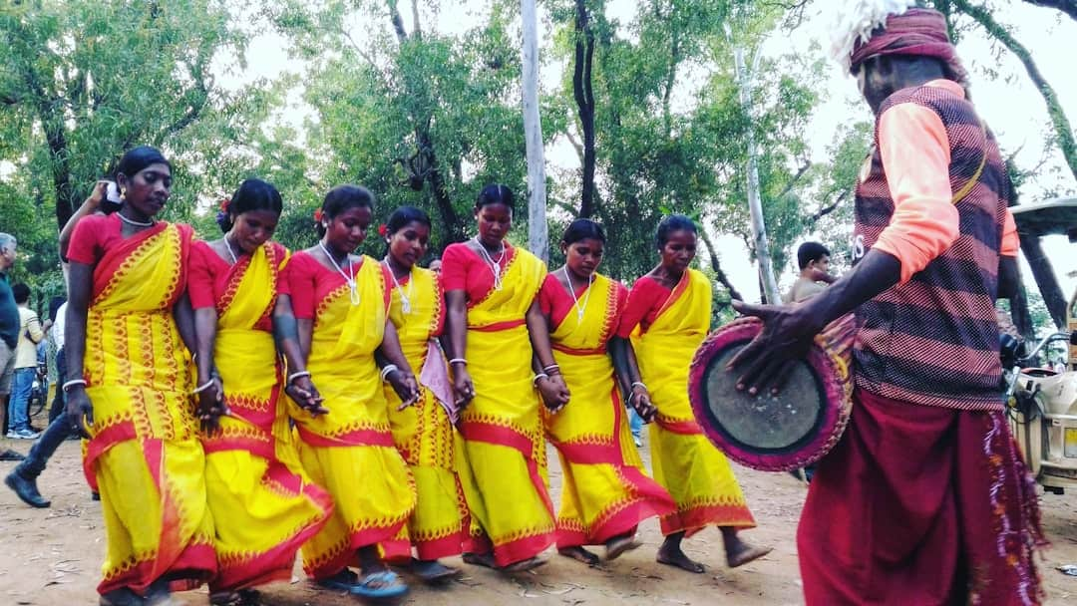



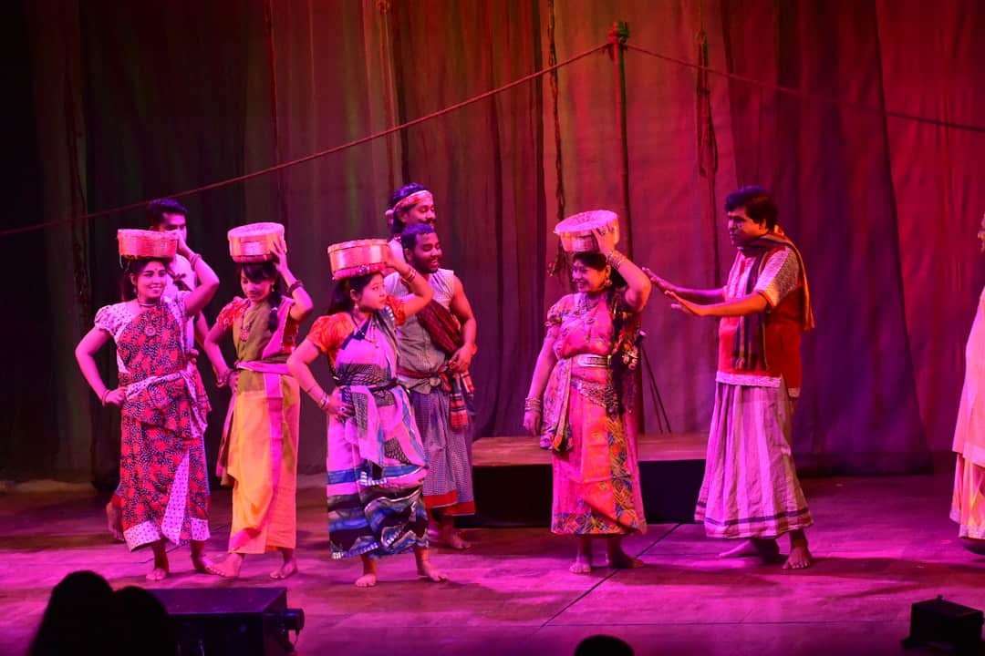
Home Stay Tourism
Authentic Local Experiences
Cultural Insights
Home stay tourism allows tourists to live with local families, providing an immersive experience that showcases authentic cultural practices and daily life.
Tourists gain valuable insights into local customs and traditions, enhancing their understanding of the culture through direct interaction with hosts and community members.
Photo by SHATABDI ROY
Photo by Sandy Millar
Participation in Activities
Visitors often engage in local activities, such as cooking traditional meals or participating in festivals, fostering deeper connections with the community.
Photo by Samiul Haque Bhuyan

Slide 10





Ecotourism: Sustainable Travel
Responsible Travel Practices
Conservation and Livelihoods
Ecotourism emphasizes responsible travel to natural areas, ensuring minimal impact on the environment while promoting conservation and sustainable practices among travelers.
The aim of ecotourism is to conserve the environment and improve local livelihoods, often providing economic benefits to communities through sustainable tourism initiatives.
Wildlife and Conservation Activities
Awareness of Ecological Issues
Activities in ecotourism often include wildlife watching and participation in conservation projects, fostering a deeper connection between tourists and nature.
Ecotourism promotes awareness of ecological issues and sustainability, educating travelers about the importance of preserving natural habitats and biodiversity.
Photo by Road Ahead

Slide 11
Tourism's Economic Power: A Global Perspective
$8T
1.4B
10%
Global Economic Contribution
International Arrivals
Share of Global GDP
Tourism contributes over $8 trillion to the global economy.
Tourism accounts for 10% of the world's GDP.
Reaching 1.4 billion international tourist arrivals in 2019.

Slide 12
“
Travel is the only thing you buy that makes you richer.
Unknown
This quote emphasizes the value of experiences over material goods, highlighting the transformative power of travel and encouraging exploration and cultural appreciation.

Slide 13
Key Takeaways
This presentation highlighted the multifaceted nature of tourism, emphasizing its geographical elements and diverse types, including heritage, cultural, medical, homestay, and ecotourism. Understanding these concepts is crucial for effective tourism management. Recommendations include promoting sustainable practices and enhancing local community involvement. As we move forward, embracing innovation and adaptability will be essential for the growth and resilience of the tourism sector in a rapidly changing world.

