Slide 1
Exploring Geographic Paradigms
DR RANJITA ROY SARKAR , ASSISTANT PROFESSOR, DEPARTMENT OF GEOGRAPHY, KGTM

Slide 2









Exploring Geographic Paradigms
This presentation delves into key geographic theories, including Environmental Determinism and Possibilism, as well as the evolution of thought through Systematic and Regional approaches. We will also examine the impact of the Quantitative Revolution, alongside contemporary perspectives such as Feminism and Post Modernism. Each paradigm offers unique insights into human-environment interactions and spatial analysis, shaping our understanding of geography today. Join me, Dr. Ranjita Roy Sarkar, as we navigate these critical concepts.

Slide 3





Environmental Determinism
Shaping Human Behavior
Cultural Distribution
Environmental determinism posits that the physical environment significantly influences human behavior and societal development, shaping cultural practices and social structures.
This theory explains how geographical factors, such as climate and terrain, affect the distribution of cultures and societies across different regions of the world.
Agricultural Practices
Criticism of Oversimplification
For instance, regions with fertile soil and favorable climates tend to have more intensive agricultural practices, demonstrating the environment's role in shaping economic activities.
Critics argue that environmental determinism oversimplifies the complex interactions between humans and their environments, neglecting cultural, social, and technological factors.
Photo by Marija Zaric

Slide 4

Possibilism: A Contrasting Perspective
Human Adaptation
Possibilism asserts that humans can adapt to their environment, utilizing available resources creatively to overcome geographical limitations and thrive in diverse settings.
Cultural Influence
This perspective emphasizes the role of cultural and technological factors in shaping societies, highlighting how innovation can transform environmental challenges into opportunities.
Urban Development Examples
Examples include urban development in arid regions, such as Dubai, where advanced technology and planning have enabled thriving cities in challenging environments.
Human Agency
Possibilism recognizes human agency in modifying environmental conditions, showcasing how societies can alter landscapes through infrastructure and sustainable practices.

Slide 5
Comparative Analysis of Systematic and Regional Geography
Systematic Geography
Regional Geography
Focuses on specific themes such as climate, landforms, or human activities.
Studies specific locations and their unique characteristics.
Utilizes a thematic approach to analyze geographical phenomena.
Emphasizes the spatial distribution of phenomena within a region.
Emphasizes the interrelationships between different geographical elements.
Incorporates qualitative methods to understand local contexts.
Often employs quantitative methods for data analysis.
Focuses on the cultural, economic, and physical aspects of regions.
Case studies highlight systematic themes across various regions.
Case studies illustrate how systematic themes manifest in different regions.

Slide 6

Quantitative Revolution vs. Qualitative Approaches
Quantitative Revolution
Qualitative Approaches
Emphasizes statistical and mathematical techniques for data analysis.
Focuses on subjective interpretation and understanding of context.
Utilizes large datasets to identify patterns and trends.
Utilizes interviews, observations, and case studies for data collection.
Focuses on objectivity and replicability in research findings.
Emphasizes the richness of human experience and cultural factors.

Slide 7




Feminism in Geography
Gender and Spatial Relations
Feminist geography explores how gender shapes spatial dynamics, influencing access to resources and opportunities, thereby redefining traditional geographical frameworks.
Challenging Geographical Narratives
This field critiques conventional geographical narratives, exposing biases that often marginalize women's experiences and contributions in spatial analysis and planning.
Highlighting Women's Contributions
Feminist geography emphasizes the importance of women's roles in shaping environments, advocating for their recognition in both historical and contemporary geographical contexts.
Photo by Markus Winkler

Slide 8
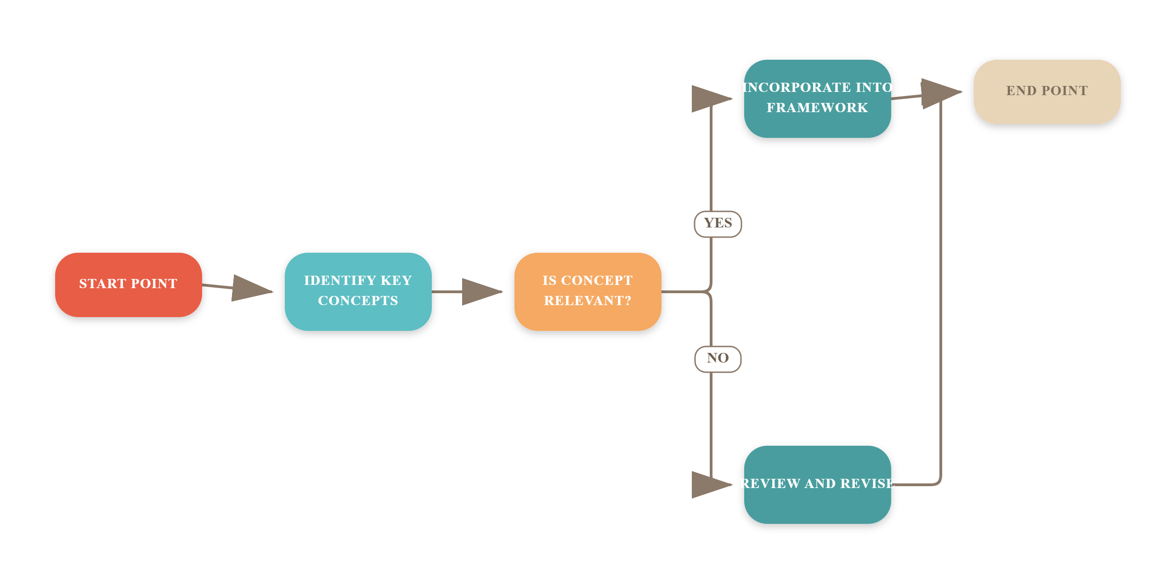
Postmodernism in Geography

Slide 9
Geography's Profound Impact on Society
60%+
75%
1B+
Urban Population
Economic Activities
Affected by Climate Change
Over 60% of the global population now resides in urban areas (UN, 2022).
Geographical factors influence 75% of economic activities worldwide.
Climate change impacts over 1 billion people globally.

Slide 10


Visual Representation of Key Concepts
This slide illustrates the interplay between Environmental Determinism and Possibilism, highlighting their impact on geographical thought. Key takeaway: understanding these frameworks enhances our grasp of spatial analysis.

Slide 11

Frequently Asked Questions
?
What is the difference between determinism and possibilism?
Determinism suggests that the environment shapes human behavior and societal development, while possibilism argues that humans have the agency to adapt and modify their environment.
?
How has feminism influenced geographical research?
Feminism has introduced critical perspectives that challenge traditional male-centric narratives, emphasizing the importance of gender in spatial analysis and the experiences of marginalized groups.
?
What are key examples of systematic vs. regional geography?
Systematic geography focuses on specific themes like climate or urban development, while regional geography examines the unique characteristics and interactions of specific areas, such as cultural landscapes or economic systems.
?
How does postmodernism challenge traditional geographical thought?
Postmodernism critiques the objective claims of traditional geography, advocating for a more subjective understanding of space and place that considers diverse perspectives and experiences.

Slide 12




Future Directions in Geography
Interdisciplinary Approaches
Geography increasingly integrates with fields like sociology and environmental science, enhancing research depth. For instance, urban studies now incorporate social equity metrics.
Technological Advancements
Innovations like GIS and remote sensing are revolutionizing data collection and analysis, allowing geographers to visualize complex spatial relationships effectively.
Focus on Sustainability
Environmental sustainability is paramount, with studies emphasizing climate change impacts. Research shows that 70% of urban areas face significant climate risks by 2050.
Impact of Globalization
Globalization reshapes geographical perspectives, influencing migration patterns and economic landscapes. For example, 1.5 billion people are now living outside their birth countries.

Slide 13



Key Takeaways
This presentation highlighted the evolution of geographical thought, emphasizing Environmental Determinism, Possibilism, and the impact of Feminism and Post Modernism. Key takeaways include the importance of integrating diverse perspectives in geography and recognizing the quantitative revolution's role in shaping modern methodologies. Moving forward, we should prioritize interdisciplinary approaches and foster collaboration among scholars to address contemporary geographical challenges effectively. Together, we can enhance our understanding of spatial dynamics and their implications for society.

