Slide 1




Exploring GIS Data Structures and Applications
DR RANJITA ROY SARKAR , ASSISTANT PROFESSOR, DEPARTMENT OF GEOGRAPHY, KGTM

Slide 2

Exploring GIS Data Structures and Applications
This presentation delves into the essential components of Geographic Information Systems (GIS), focusing on data structures, analysis techniques, and practical applications. We will explore both spatial and non-spatial data types, including raster and vector formats. Additionally, we will discuss the processes of geo-referencing, editing, and output generation. Finally, we will highlight the significance of GIS in land use mapping, urban sprawl analysis, and forest monitoring, showcasing its impact on decision-making and resource management.

Slide 3





Types of GIS Data Structures
Spatial Data Structures
Non-Spatial Data Structures
Spatial data structures represent geographical locations using coordinates, enabling precise mapping and analysis of features like roads, rivers, and boundaries.
Non-spatial data structures store attribute information related to spatial features, such as names, types, and classifications, essential for comprehensive GIS analysis.
Common Data Types
Importance in GIS
Common types of GIS data structures include points, lines, and polygons, each serving distinct purposes in representing real-world entities and their relationships.
Understanding these data types is crucial for effective GIS analysis, as they influence data processing, visualization, and decision-making in various applications.
Photo by Shubham Dhage

Slide 4



Raster vs Vector Data Structures
Raster Data Overview
Vector Data Overview
Best Use Cases
Raster data consists of grid cells, each representing a value, making it suitable for continuous data like temperature or elevation across a landscape.
Vector data utilizes points, lines, and polygons to represent discrete features, such as roads, boundaries, and land parcels, providing precise location information.
Raster is ideal for continuous phenomena like satellite imagery, while vector excels in mapping distinct features, such as administrative boundaries or transportation networks.

Slide 5
Understanding GIS Data Input
Data Collection Methods
Ensuring Data Quality
Collecting spatial data through surveys and field measurements.
Data accuracy is crucial for reliable GIS analysis.
Utilizing satellite imagery for comprehensive geographic coverage.
Implementing validation techniques to assess data integrity.
Employing GPS technology for precise location data.
Regular updates and maintenance of data sources to enhance quality.

Slide 6





Importance of Geo-referencing
Aligning Spatial Data
Geo-referencing aligns spatial data with real-world coordinates, ensuring that maps accurately represent physical locations, which is crucial for effective GIS applications.
Ensuring Mapping Accuracy
Accurate geo-referencing is vital for reliable outputs in GIS analysis, as it directly impacts the precision of land use and environmental assessments.
Methods of Geo-referencing
Common methods include using control points and transformation techniques, which help in correcting distortions and aligning data with geographic reality.
Critical for Reliable Outputs
Without accurate geo-referencing, GIS outputs can lead to misinterpretations, affecting decision-making in urban planning and resource management.
Photo by jasper guy

Slide 7





Editing GIS Data Processes
Ensuring Data Integrity
Editing processes are crucial for maintaining data integrity and accuracy, which are essential for reliable GIS analysis and decision-making.
Common Editing Tasks
Typical editing tasks include modifying existing data, deleting inaccuracies, and adding new information to ensure comprehensive datasets for analysis.
Error Prevention Strategies
Regular data reviews and validation checks help prevent errors, ensuring that GIS projects are based on accurate and up-to-date information.
Software Tools for Editing
Various GIS software tools, such as ArcGIS and QGIS, provide functionalities that facilitate effective data editing, enhancing user efficiency and accuracy.
Photo by Deng Xiang

Slide 8
How to Effectively Present GIS Analysis Outputs
1
Identify User Needs
Engage with stakeholders to understand their specific requirements for GIS outputs, ensuring that the final products are relevant and useful.
2
Select Appropriate Output Formats
Choose the most effective formats for presenting GIS data, such as maps, reports, or visualizations, based on the identified user needs.
3
Create Visual Representations
Develop clear and informative visualizations that highlight key findings from the GIS analysis, making complex data easily understandable.
4
Tailor Communication of Results
Customize the presentation of results to suit the audience, ensuring that technical jargon is minimized and insights are clearly articulated.
5
Gather Feedback
After presenting the outputs, solicit feedback from users to assess the effectiveness of the communication and make necessary adjustments for future presentations.

Slide 9
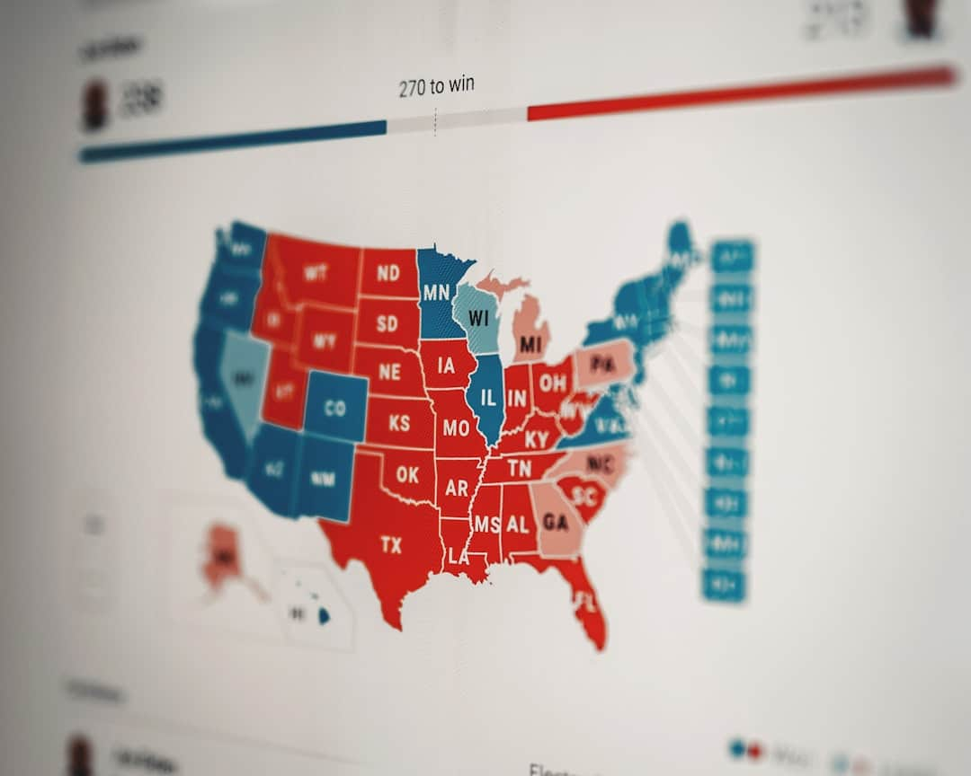




Land Use Mapping Applications
Identifying Land Types
Supporting Urban Planning
Land use mapping categorizes areas into types such as residential, commercial, and agricultural, aiding in effective resource allocation and planning.
GIS facilitates urban planning by providing data on land use patterns, enabling better decision-making for sustainable development and infrastructure.
Photo by Clay Banks
Photo by Chris Slupski
Visualizing Changes Over Time
Case Studies of Effectiveness
GIS technology allows for the visualization of land use changes over time, helping stakeholders understand trends and impacts on the environment.
Numerous case studies, such as in California and New York, demonstrate GIS's effectiveness in land use mapping for urban sprawl and resource management.
Photo by Planet Volumes

Slide 10
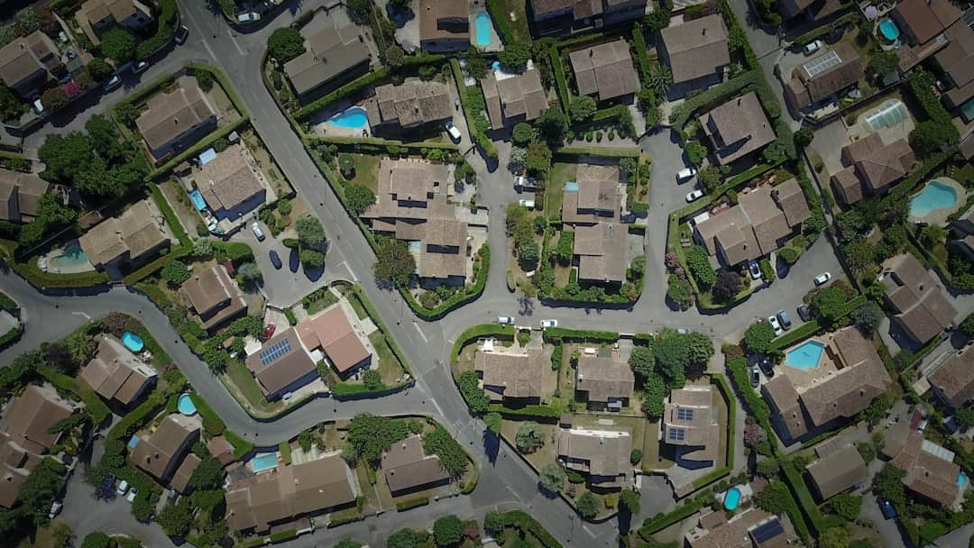



Analyzing Urban Sprawl
Definition of Urban Sprawl
GIS Tracking Capabilities
Urban sprawl refers to the uncontrolled expansion of urban areas, often leading to increased traffic congestion and loss of green spaces, affecting community sustainability.
GIS technology enables the tracking of sprawl patterns and impacts through spatial analysis, providing critical insights into land use changes over time.
Supporting Sustainable Development
Data-Driven Planning
Analyzing urban sprawl with GIS supports sustainable urban development strategies, helping planners make informed decisions to balance growth and environmental preservation.
Data-driven approaches enhance planning efficacy by utilizing GIS data to forecast urban growth trends, ensuring resources are allocated efficiently for future needs.
Photo by Raphaël Biscaldi

Slide 11
GIS Applications in Forest Monitoring
Role of GIS in Forest Management
Technologies and Case Studies
GIS plays a crucial role in forest management.
Remote sensing technologies enhance data collection.
It aids in monitoring deforestation and biodiversity.
Case studies demonstrate successful forest conservation efforts.
Facilitates effective planning and resource allocation.
Integration of GIS with other technologies for improved outcomes.

Slide 12




Trends and Innovations in GIS
Emerging Technologies
Technologies like drones and 3D mapping are revolutionizing GIS, enabling more accurate data collection and visualization, enhancing decision-making processes in various sectors.
IoT Integration
Integrating GIS with IoT allows for real-time data collection, improving urban planning and environmental monitoring, with a projected market growth of 25% by 2025.
AI and Machine Learning
AI and machine learning enhance GIS data analysis, enabling predictive modeling and trend analysis, which can lead to more informed policy-making and resource management.
Focus on Sustainability
Future GIS applications will prioritize sustainability, aiding in climate change mitigation and resource conservation, aligning with global goals for sustainable development.

Slide 13
Key Takeaways
This presentation highlighted the critical aspects of GIS, including the distinction between spatial and non-spatial data structures, and the importance of raster and vector formats. Key applications such as land use mapping and urban sprawl analysis demonstrate GIS's value in decision-making. Moving forward, organizations should prioritize integrating GIS into their workflows to enhance data-driven strategies and improve resource management. Embracing these technologies will lead to more sustainable and informed urban planning.

