Slide 1




Evolution of Geographical Thoughts
during the ancient period in Western world and India
during the ancient period in Western world and India
DR RANJITA ROY SARKAR , ASSISTANT PROFESSOR, DEPARTMENT OF GEOGRAPHY, KGTM

Slide 2
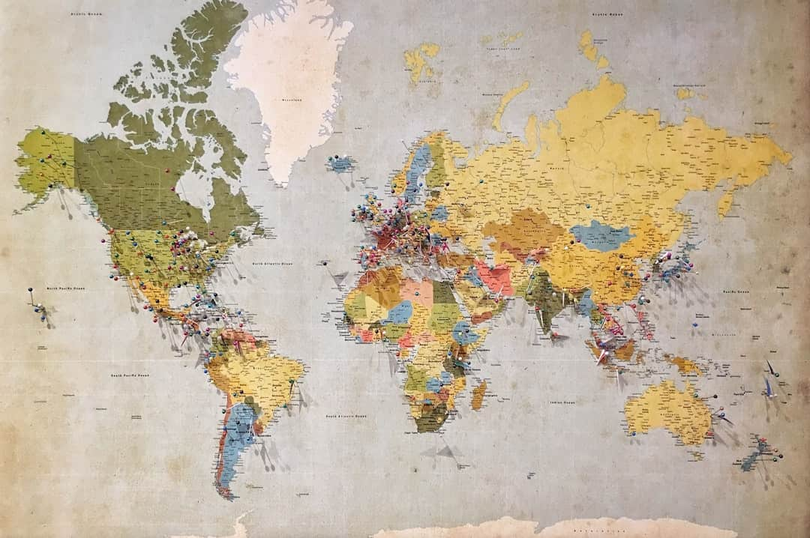
Evolution of Geographical Ideas
This presentation explores the evolution of geographical ideas from ancient to modern times, focusing on significant developments in the Western world and India. We will examine key thinkers, methodologies, and the impact of cultural contexts on geographical thought. By analyzing trends such as environmental determinism and post-modernism, we aim to provide a comprehensive understanding of how geography has shaped human understanding of the world. Join us as we delve into this fascinating journey through time.

Slide 3
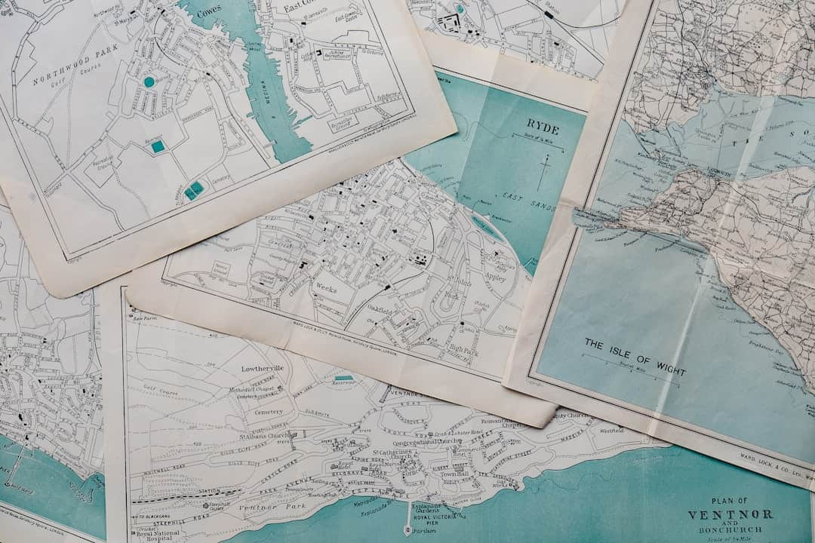



Ancient Period Overview
Geographical Understanding in Greece
Indian Contributions to Geography
Ancient Greece laid the foundation for geography, with thinkers like Aristotle emphasizing empirical observation and Ptolemy's maps influencing navigation for centuries.
Aryabhata's astronomical insights, including the concept of Earth's rotation, significantly advanced geographical understanding in ancient India, influencing later scholars and navigators.
Cultural Significance of Geography
Geography in ancient texts, such as the Mahabharata and Herodotus' Histories, reflects the cultural and philosophical contexts, shaping societal views on land and environment.
Photo by Annie Spratt

Slide 4

Medieval Period Developments
Rise of Islamic Scholars
Islamic scholars like Al-Idrisi and Ibn Battuta advanced geographical thought, integrating knowledge from ancient civilizations and expanding the understanding of the world.
Integration of Ancient Texts
Islamic thinkers preserved and translated ancient Greek and Roman texts, enriching their geographical knowledge and influencing European Renaissance thought significantly.
Medieval Maps Comparison
Ptolemaic maps emphasized mathematical precision, while Islamic cartography focused on practical navigation, showcasing diverse approaches to geographical representation.
Geographical Ideas in India
The Rajatarangini, written by Kalhana, provided insights into the geography of Kashmir, blending historical narrative with geographical observations and cultural context.

Slide 5
Modern Geographical Thinking
Geographical Evolution in Germany and Britain
Geographical Evolution in the USA
Influence of environmentalism on American geography, focusing on the relationship between humans and their environment.
Impact of Enlightenment on geographical ideas, emphasizing rational thought and empirical evidence.
Development of regional geography, emphasizing the unique characteristics of different areas.
Humboldt's biogeography: integration of physical geography and ecology, highlighting the interdependence of nature and culture.
Emergence of quantitative methods in geography, leading to a more scientific approach to spatial analysis.
British advancements in cartography: innovations in map-making techniques and exploration that expanded geographical knowledge.

Slide 6
Comparative Analysis of Geographical Schools

Slide 7





Understanding Environmental Determinism
Definition and Historical Context
Environmental determinism posits that human behaviors and cultures are shaped by environmental factors. This idea gained traction in the late 19th century.
Key Proponents: Huntington and Semple
Ellsworth Huntington and William Morris Davis were pivotal in promoting determinism, arguing that climate influences societal development and human capabilities.
Criticism of Determinism
Modern geography critiques determinism for oversimplifying human-environment interactions, emphasizing cultural and social factors that also shape human behavior.
Case Studies of Influence
Examples include how climate affects agricultural practices in India and urban development in the U.S., illustrating the complex interplay of environment and society.
Photo by Ricardo Santanna

Slide 8




Possibilism in Geography
Definition and Contrast
Prominent Figures
Possibilism posits that human agency shapes outcomes, contrasting with determinism, which suggests environment solely dictates human actions. This shift emphasizes cultural influence.
Vidal de la Blache, a key proponent of possibilism, argued that humans adapt to their environments, showcasing diverse cultural responses to geographical challenges.
Cultural Adaptations
Contemporary Relevance
Communities worldwide demonstrate possibilism through innovations like terrace farming in hilly regions, illustrating how culture adapts to environmental constraints.
Possibilism remains vital in discussions on sustainability, emphasizing human creativity in addressing environmental issues, such as climate change and resource management.

Slide 9

Visual Representation of Quantitative Revolution
This visual illustrates the Quantitative Revolution's impact on geography, showcasing statistical methods and data analysis. Key takeaway: It transformed geographical research into a more empirical and scientific discipline, emphasizing measurable data.

Slide 10





Feminism and Postmodernism in Geography
Feminist Geography Themes
Postmodern Critiques
Feminist geography emphasizes gendered spaces, power dynamics, and representation. Key scholars include Doreen Massey and Linda McDowell, who challenge traditional geographical narratives.
Postmodernism questions the objectivity of traditional geography, advocating for diverse perspectives. Scholars like Edward Soja argue for the importance of subjective experiences in spatial analysis.
Intersectionality in Geography
Contemporary Debates
Intersectionality examines how overlapping identities, such as race and gender, shape spatial experiences. This approach enriches geographical analysis by highlighting marginalized voices.
Current geographical discussions are influenced by feminist and postmodern ideas, focusing on social justice, environmental issues, and the role of identity in spatial practices.
Photo by Lindsey LaMont

Slide 11
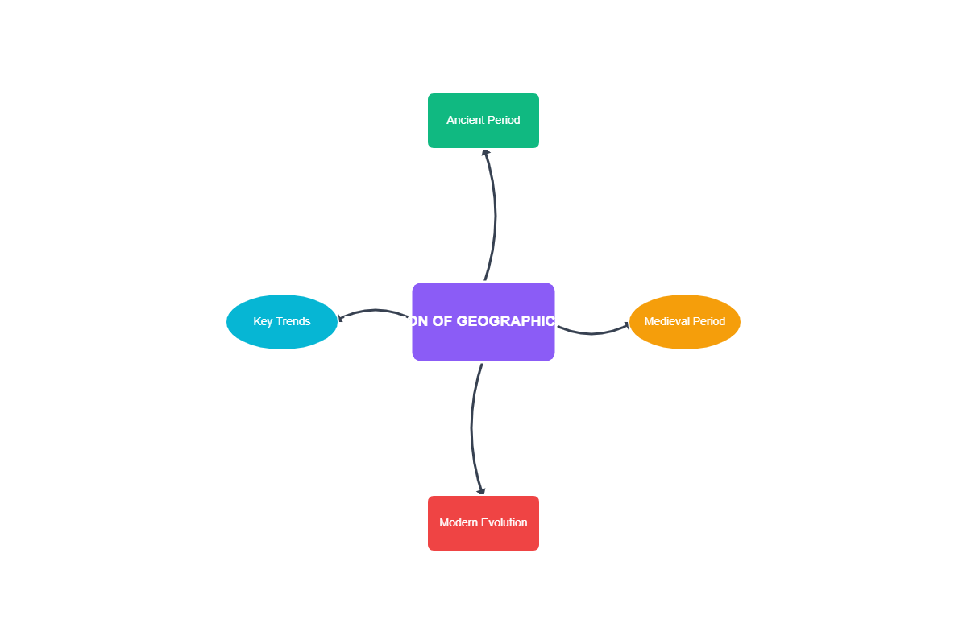
Trends in Geographical Thought

Slide 12




Conclusion
Evolution of Geographical Ideas
Geographical ideas have transformed significantly, reflecting societal changes and advancements in knowledge, from ancient philosophies to modern scientific approaches.
Historical Context Matters
The historical context of geographical thought shapes contemporary perspectives, influencing how we understand and address current global challenges.
Relevance in Today's Issues
Geography remains crucial in tackling contemporary issues like climate change, urbanization, and resource management, emphasizing its ongoing importance in society.
Engage in Discussions
Encouraging active participation in geographical discussions can foster a deeper understanding of our world and inspire innovative solutions to pressing problems.

Slide 13
Key Takeaways
In conclusion, the evolution of geographical ideas reveals a rich tapestry of thought from ancient to modern times. Key takeaways include the transition from environmental determinism to post-modern perspectives. Understanding these shifts is crucial for contemporary geographical analysis. As we move forward, embracing diverse methodologies will enhance our comprehension of spatial dynamics and human-environment interactions. Let us continue to explore and innovate in geographical thought, fostering a more inclusive and comprehensive understanding of our world.

