Slide 1




Evolution of Geographical Ideas in medieval period
DR RANJITA ROY SARKAR , ASSISTANT PROFESSOR, DEPARTMENT OF GEOGRAPHY, KGTM
ranjita roysarkar

Slide 2
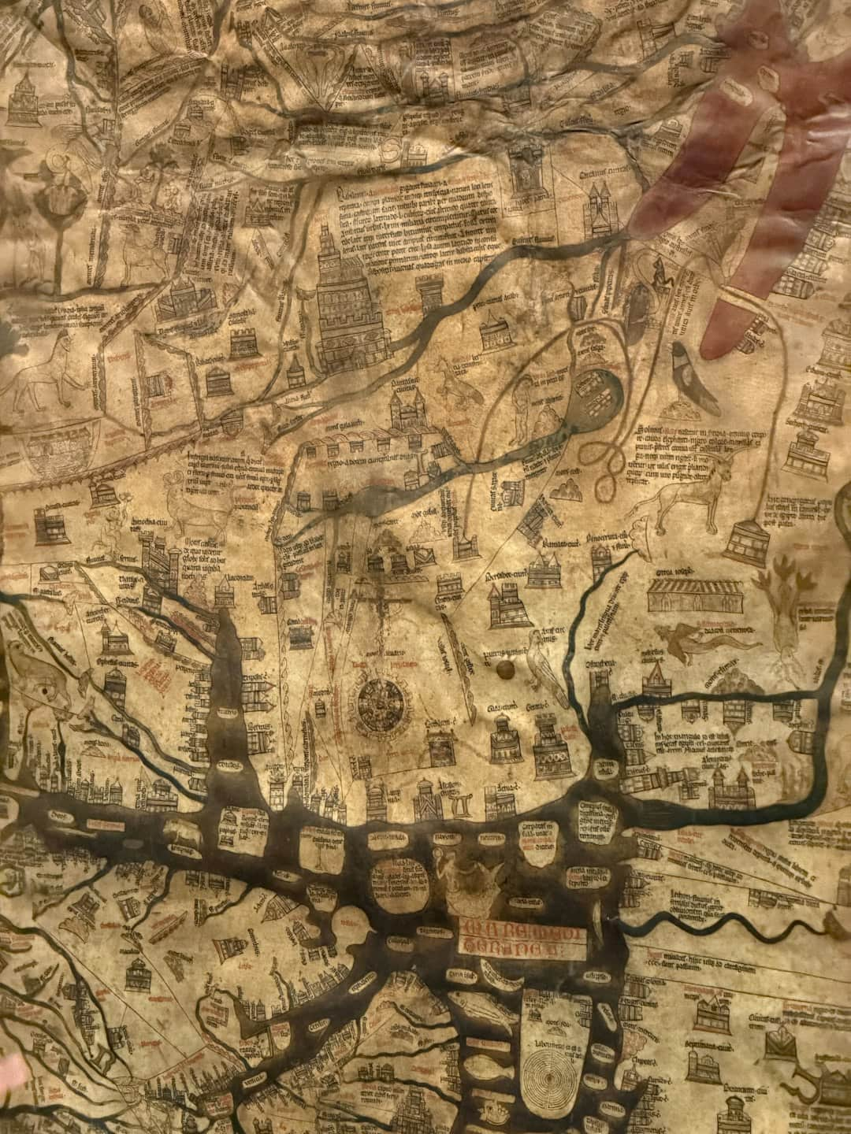
Evolution of Geographical Ideas
This presentation explores the evolution of geographical thought from the medieval period to modern times, focusing on key developments in Western and Indian contexts. We will examine significant trends such as Environmental Determinism, Feminism, and Post Modernism, alongside the contributions of Germany, Britain, and the USA. By understanding these shifts, we can appreciate how geography has shaped human understanding of the world and its complexities. Join us as we delve into this fascinating journey through time.

Slide 3
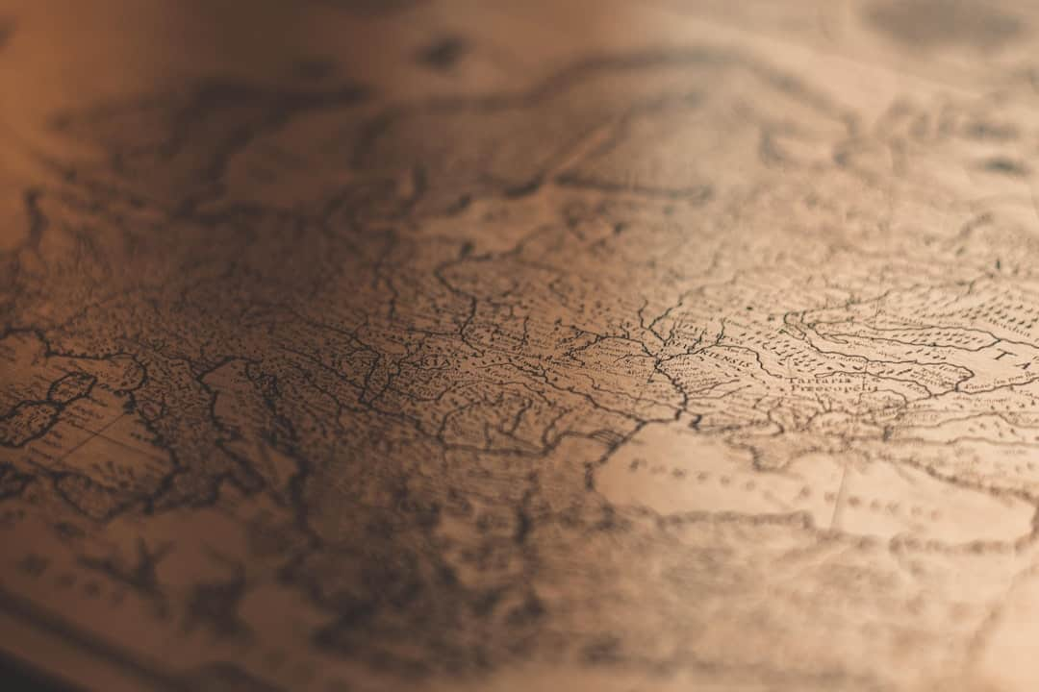




Medieval Period Overview
Religious Influence on Geography
Symbolic Maps
Geographical thought was heavily influenced by religious beliefs, with maps often depicting spiritual realms rather than physical landscapes, reflecting the era's worldview.
Maps during the medieval period were largely symbolic, emphasizing spiritual significance over physical accuracy, which limited the understanding of actual geography.
Notable Geographical Figures
Indian Geographical Concepts
Key figures like Al-Idrisi and the revival of Ptolemy's works contributed significantly to geographical knowledge, blending ancient wisdom with contemporary thought.
In India, the concept of 'Siddhanta' played a crucial role in shaping geographical understanding, integrating astronomy and geography in a unique cultural context.
Photo by Jakob Braun

Slide 4

Geographical Ideas in Western World
Renaissance Exploration Revival
The Renaissance ignited a renewed interest in exploration, leading to significant advancements in cartography and geographical knowledge across Europe.
Influential Explorers
Explorers like Columbus and Magellan expanded the geographical horizon, discovering new lands and enhancing the understanding of global geography.
Scientific Methods Integration
Geographical ideas began incorporating scientific methods and empirical research, marking a shift towards more systematic approaches in the study of geography.
Advancements in Mapping
Maps became increasingly accurate during this period, reflecting real-world locations and distances, which facilitated navigation and exploration.

Slide 5
Cultural Influences on Geography in India
Historical Texts and Concepts
Trade and Cultural Exchange
Indian astronomy and geography were intertwined, with notable texts like 'Surya Siddhanta'.
Trade routes influenced geographical knowledge and cultural exchange.
Interactions with other cultures enriched Indian geographical perspectives.
The concept of 'Jambudvipa' influenced geographic understanding.
Geographical knowledge was disseminated through trade, impacting local and regional understanding.
Geographical thought was often linked to religious and cultural narratives.

Slide 6
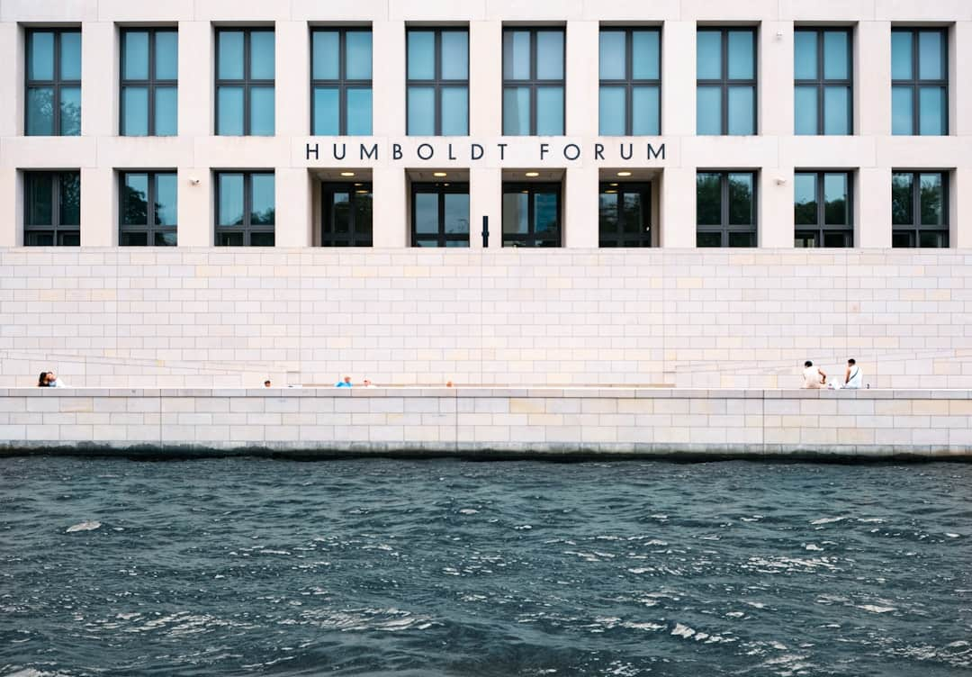




Modern Evolution in Germany
Systematic Geography Emphasis
In the 19th century, German geographers like Carl Ritter emphasized systematic geography, integrating various disciplines to enhance geographical understanding and education.
Humboldt's Foundational Work
Alexander von Humboldt's research, particularly in physical geography, established a scientific approach, influencing future geographical methodologies and promoting interdisciplinary studies.
Geography as a Science
Geography evolved into a recognized science, merging physical and human geography, which allowed for a comprehensive analysis of spatial relationships and environmental interactions.
Influence of German Idealism
German Idealism significantly shaped geographical thought, emphasizing the importance of perception and cultural context in understanding geographical phenomena and human-environment interactions.
Photo by Burak Arslan

Slide 7
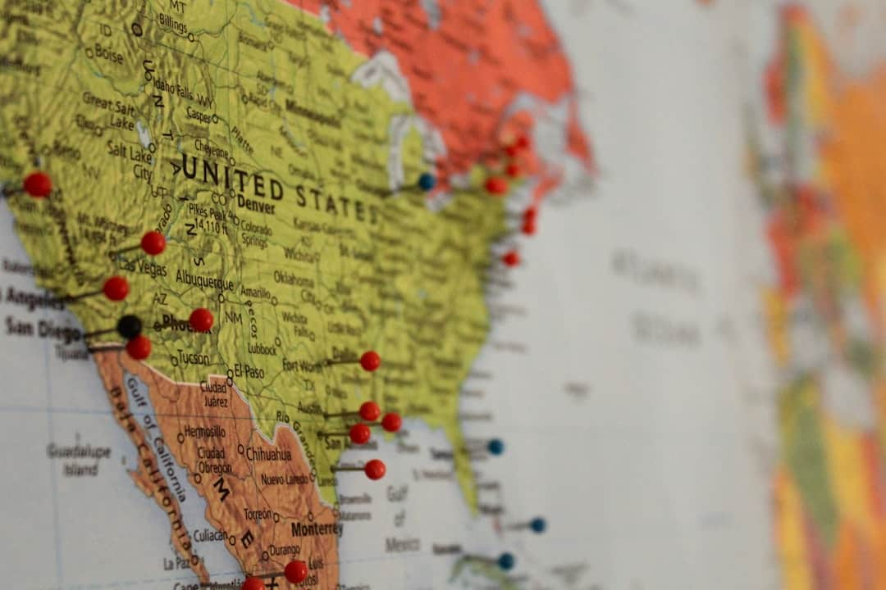


The British Approach to Geography
Emphasis on Regional Studies
British geography focused on regional studies and fieldwork, allowing for a deeper understanding of local environments and cultures, enhancing geographical knowledge significantly.
Influence of Halford Mackinder
Halford Mackinder's geopolitical theories, particularly the Heartland Theory, shaped British geographical thought, emphasizing strategic global positioning during the imperial era.
Impact of the British Empire
The British Empire's vast reach showcased global geographical dynamics, influencing trade routes, cultural exchanges, and the spread of geographical knowledge worldwide.
Educational Reforms in Geography
Educational reforms in the 19th century led to geography's recognition as an academic discipline, establishing geography departments in universities across Britain.
Photo by Morgan Lane

Slide 8




Key Features
Practical Geography
Cultural Geography
Influential Geographers
Focus on applying geographical knowledge for effective planning and development in urban and rural settings.
Explores the relationship between culture and landscapes, emphasizing how cultural practices shape geographical spaces.
Geographers like Carl Sauer played a pivotal role in advancing landscape studies and regional geography.
Technological Advancements
Interdisciplinary Approaches
Innovations in technology have revolutionized geographic research methods, enhancing data collection and analysis.
Integration of various disciplines within geography to address complex spatial issues and enhance understanding.

Slide 9
Trends: Environmental Determinism
Physical Environment's Impact
Environmental determinism posits that physical environments significantly shape human behaviors, influencing societal development and cultural practices across various regions.
Critique of Determinism
Critics argue that environmental determinism neglects cultural and social factors, suggesting that human agency and innovation also play crucial roles in shaping societies.
Historical Influence
This trend profoundly influenced early 20th-century geographic thought, guiding research on how climate and geography affect agriculture and settlement patterns.
Examples in Geography
Notable examples include how climate variations dictate agricultural practices, such as rice cultivation in monsoon regions versus wheat in temperate zones.

Slide 10


Trends: Possibilism
Cultural Influence on Outcomes
Origins of Possibilism
Possibilism posits that while the environment sets limits, human culture and choices significantly shape geographical outcomes, highlighting the role of agency in development.
Developed by Paul Vidal de la Blache, possibilism emerged as a counterpoint to environmental determinism, emphasizing the importance of human decision-making in geography.
Diverse Cultural Adaptations
Possibilism illustrates how different cultures adapt uniquely to similar environmental conditions, showcasing the variability of human responses to geographical challenges.
Photo by Ian Macharia

Slide 11
Overall challenge being addressed
The Problem
Our Solution
Postmodernism in geography presents significant challenges to traditional geographical thought, questioning the objectivity and universality of geographical knowledge.
Embracing postmodernism allows for a more inclusive and multifaceted understanding of geography, accommodating diverse perspectives and methodologies.
Encourages the incorporation of marginalized voices and narratives, enriching geographical discourse.
Difficulty in establishing a common framework for geographical analysis due to subjective interpretations.
Promotes innovative methodologies that can address complex geographical issues from multiple angles.
Challenges in integrating diverse methodologies, leading to fragmentation in geographical research.
Fosters a more dynamic and adaptable geographical practice that can respond to changing societal needs.
Resistance from traditionalists who favor objective and quantitative approaches, creating a divide in the discipline.

Slide 12



Conclusion
Evolution of Geographical Ideas
Geographical ideas have evolved significantly across cultures and time periods, reflecting diverse perspectives and methodologies in both Western and Indian contexts.
Interdisciplinary Modern Geography
Modern geography integrates multiple disciplines, including sociology, economics, and environmental science, enhancing our understanding of complex spatial dynamics.
Trends in Geographical Thought
Understanding trends like Environmental Determinism and Feminism enriches our comprehension of geographical thought and its adaptation to global changes.

Slide 13
Key Takeaways
This presentation highlighted the evolution of geographical ideas from medieval times to modern trends, emphasizing the significance of Environmental Determinism and Feminism. Understanding these concepts is crucial for future geographical research and education. As we move forward, integrating diverse perspectives and methodologies will enhance our comprehension of spatial dynamics. Embracing these evolving ideas will empower us to address contemporary geographical challenges effectively.

