Slide 1
Elasticity of Demand
Presented By
DR. Shyam Charan Barma
Assistant Professor , KGT Mahavidyalaya

Slide 2
What is Elasticity of Demand ?
Price elasticity of demand is the ratio of the percentage change in quantity demanded of a product to the percentage change in price
What Is Price Elasticity of Demand?
Price elasticity of demand is a measurement of the change in the consumption of a product in relation to a change in its price. Expressed mathematically, it is:
Price Elasticity of Demand = Percentage Change in Quantity Demanded ÷ Percentage Change in Price.

Slide 3
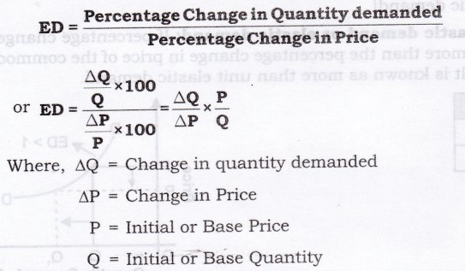

Slide 4
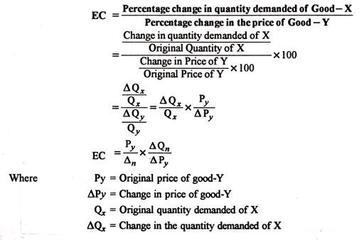
Cross Price Elasticity of Demand
The cross elasticity of demand is an economic concept that measures the responsiveness in the quantity demanded of one good when the price for another good changes.

Slide 5

Income Elasticity of Demand
Income elasticity of demand shows the way in which a consumer’s purchase of any good changes as a result of change in his income”.
It shows the responsiveness of a consumer’s purchase of a particular commodity to a change in his income. Income elasticity of demand means the ratio of percentage change in the quantity demanded to the percentage change in income.

Slide 6
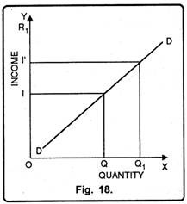
Positive Income Elasticity of Demand:
Positive income elasticity of demand is said to occur when with the increase in the income of the consumer, his demand for goods and services also increases and vice-versa. Income elasticity of demand is positive in case of normal goods.
In fig. 18, quantity of commodity ‘I’ has been measured on X-axis and income of the consumer on Y- axis. DD is the positive income elasticity of demand curve. It slopes upward from left to right indicating that increase in income is accompanied by increase in demand of goods and services and vice-versa.

